Slide 1
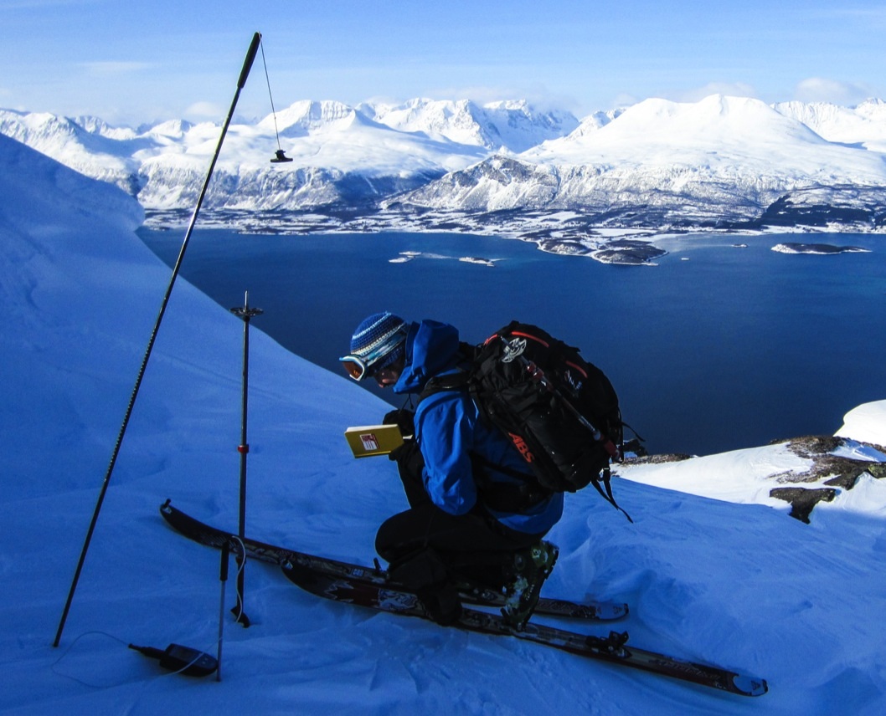
SeFaS -Monitoring avalanches in Northern Norway
using SAR and UAV borne sensors
Eirik Malnes, Markus Eckerstorfer, Rune Storvold, Norut
Regula Frauenfelder, Árni Jónsson, Christian Jaedicke, NGI
Earsel LISSIG, February 2014

Slide 2
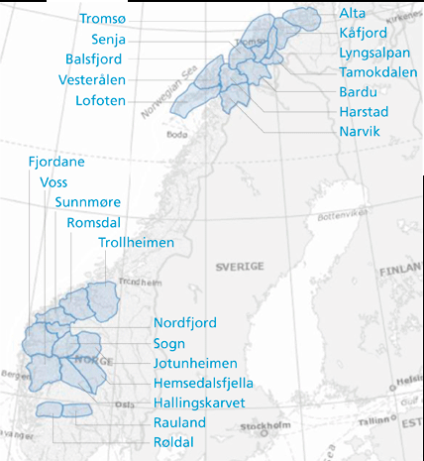
Background
Increasing number of avalanche related accidents in the Tromsø region the last 10 years as a result of increased out-door activity
Snow mobile accidents
Back-country skiing
Road accidents
Since 2000 the number of death accidents in Norway has been around 10 per year. - 50% of these were in the Tromsø-region
SeFaS = Centre for remote sensing of avalanches
Partners: Norut and NGI
Financed regional government in Troms county, Northern Norway and partly by the Norwegian Science Council.
The centre will develop innovative methods for applying sensors in satellites and unmanned aerial vehicles (UAV) for monitoring avalanches.

Slide 3
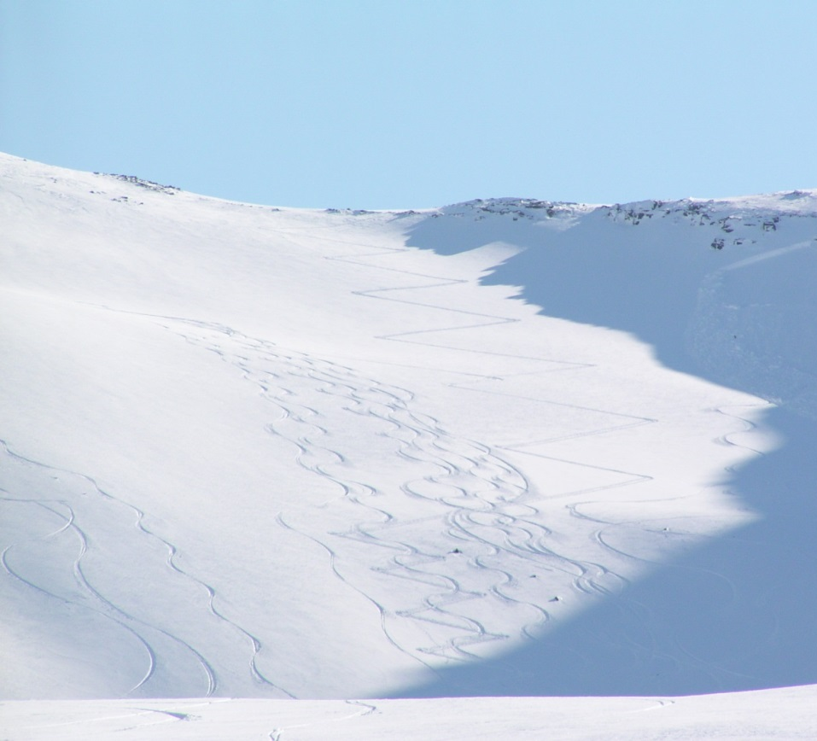
SeFaS
Satellite remote sensing
C-band SAR for detecting melting snow
High-resolution C-band SAR for detecting avalanche paths
Studies with X-band SAR, sensitivity to SWE?
UAV borne sensors
Ortho-photo
Ground penetrating radar
Recco/ cell phone detection
Validation
In situ measurements (stations and sampling
GPR
Outreach
Contact with national and regional avalanche authorities

Slide 4
Wet snow detection
We use C-band SAR (currently Radarsat-2, under the Norwegian RS-2 agreement) to monitor wet snow
Wet snow events during the winter may have both a stabilizing and destabilizing effect, depending on the following development of the snow pack
In 2013 the Tromsø-area experienced an severe winter
Little snow in the early winter
Rain on snow event in late February
March-April a long period with large amounts of snow
The crust developed in late February, formed an unstable layer upon which many avalanches were released

Slide 5
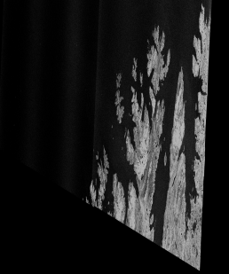
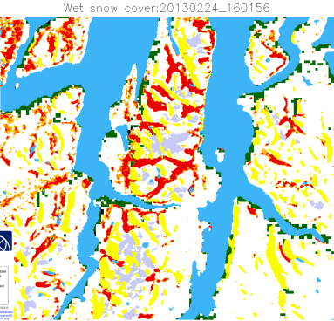
Processing chain
Wet snow detection using C-band SAR
RS-2
MODIS
σº-σ^{ref} <-3dB
Wet snow detection
Snow cover
MODIS
RS-2 ref. archive
MODIS multi-temporal aggregated

Slide 6
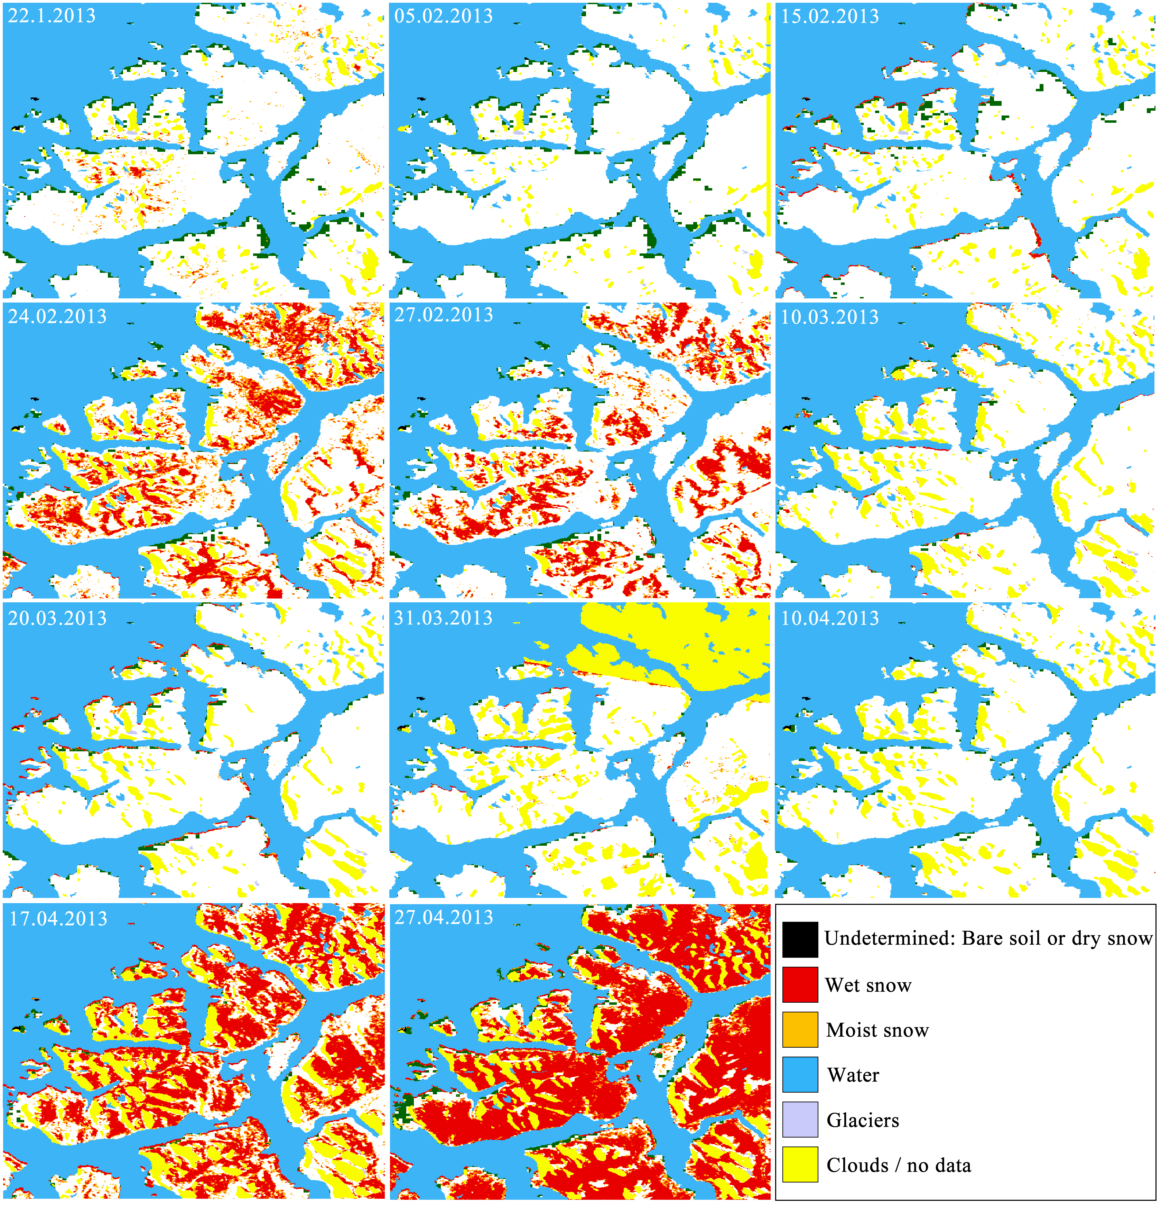
Kattfjordeidet 2013

Slide 7
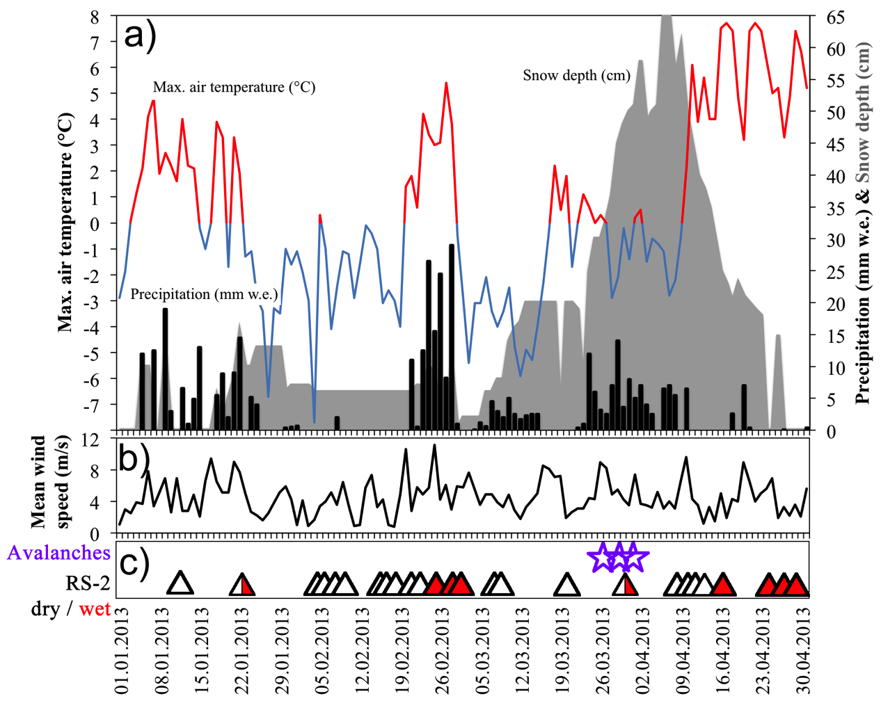
Meteorology Winter 2013–Tromsø area

Slide 8
Wet snow detection – value?
C-band SAR can be used to detect snow melt in steep terrain
In the current case we saw that the snow were wet up to ca 600 m altitude.
This altitude coincides with the release zone for many of the avalanches
Wet snow products could be used together with other data types to improve avalanche warning

Slide 9
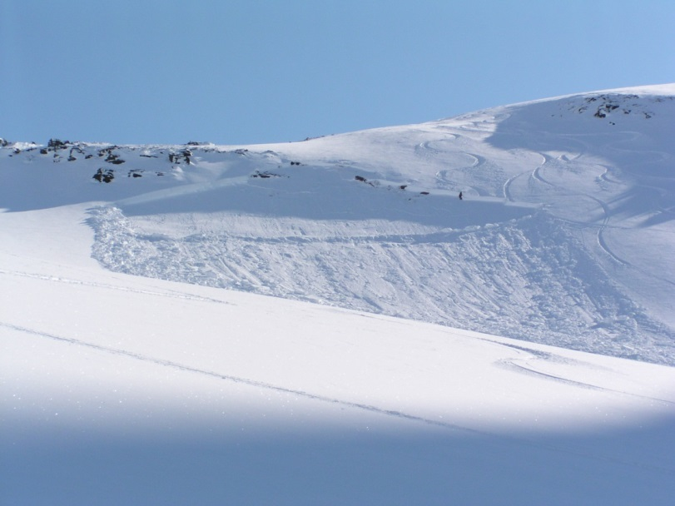
Detection of avalanche paths
Previous experiments with high-res optical sensors showed that it is feasible to detect avlanches, but cloud cover is often a problem
Last year we also tested out the use of high-resolution SAR for detection of avalanche paths
We chose to use Radarsat-2 Ultrafine mode
Images were multi-looked and geocoded to 3 m
We were able to detect the avalanches we targeted, and additionally a few others.

Slide 10
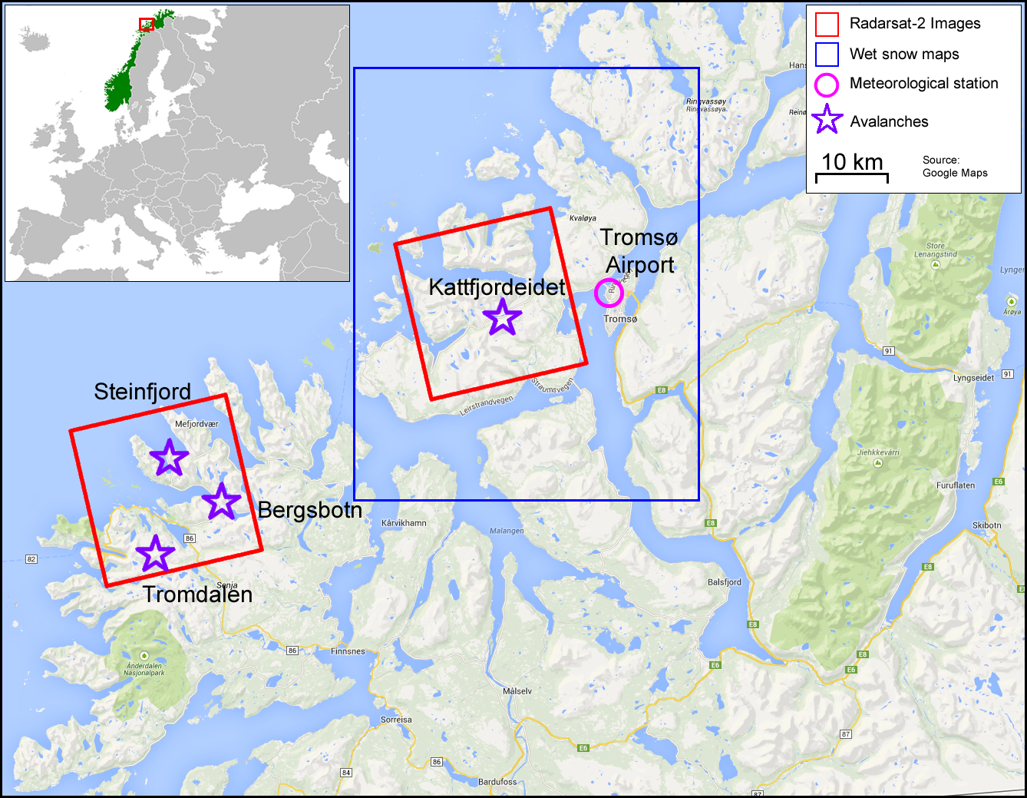
Avalanche path detection
April 9, 2013
April 5, 2013

Slide 11
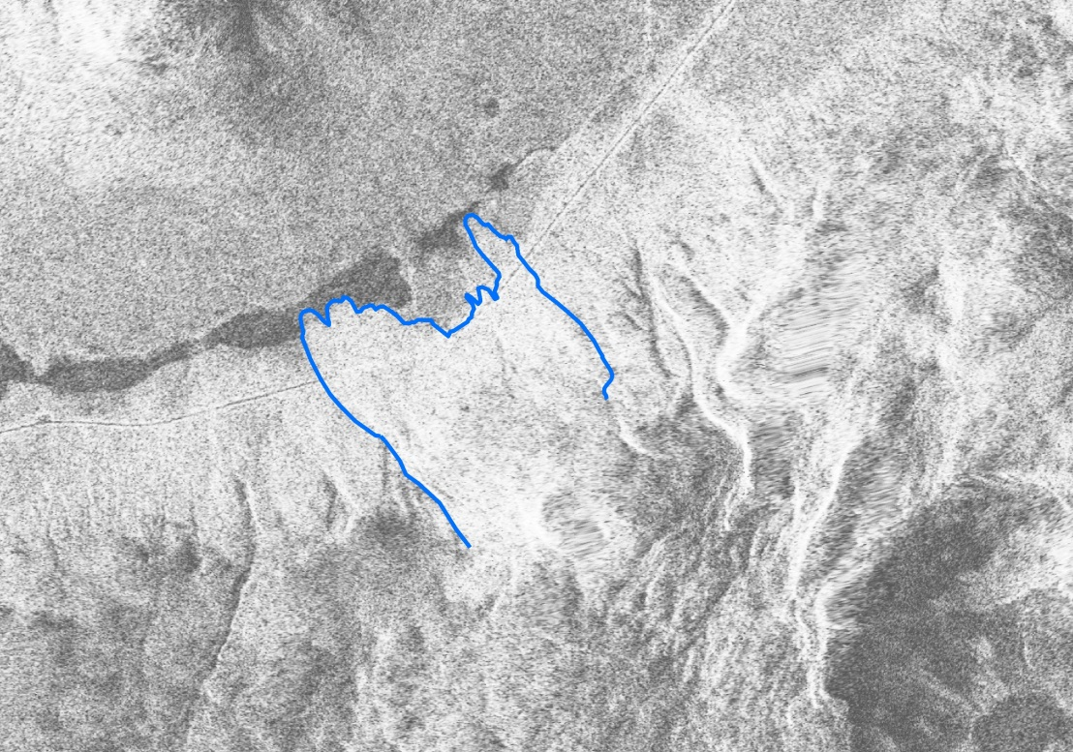
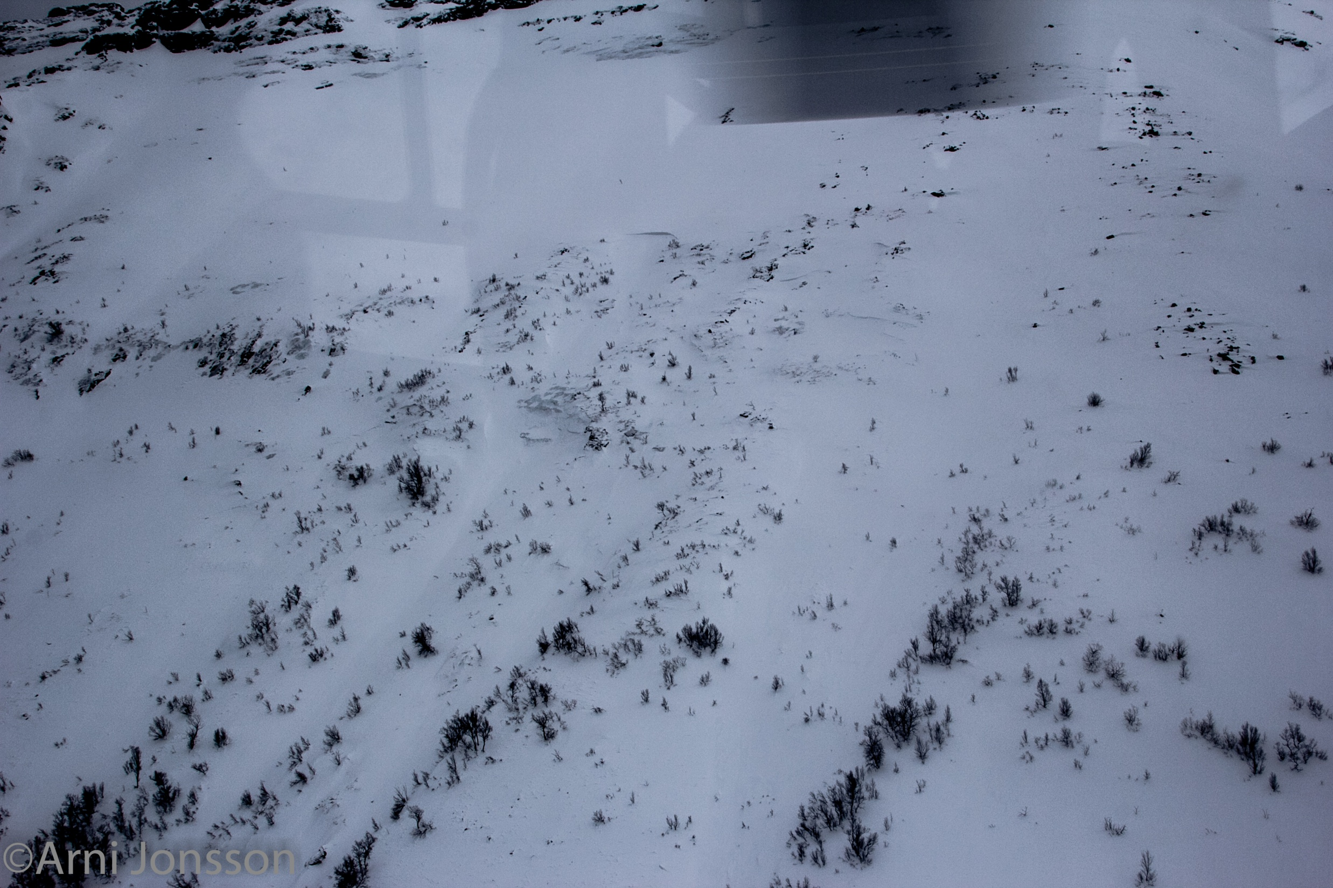
Steinfjord, April 5, 2013
Kattfjord, April 9, 2013
UAV cam

Slide 12
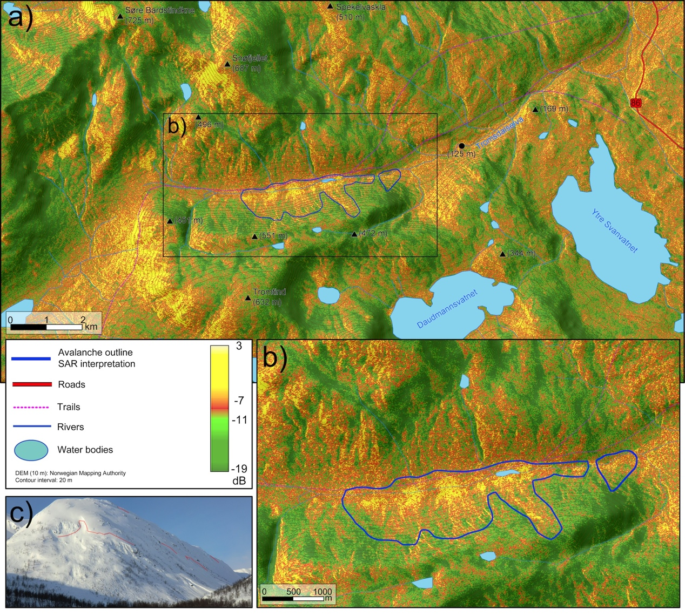
Tromdalen

Slide 13
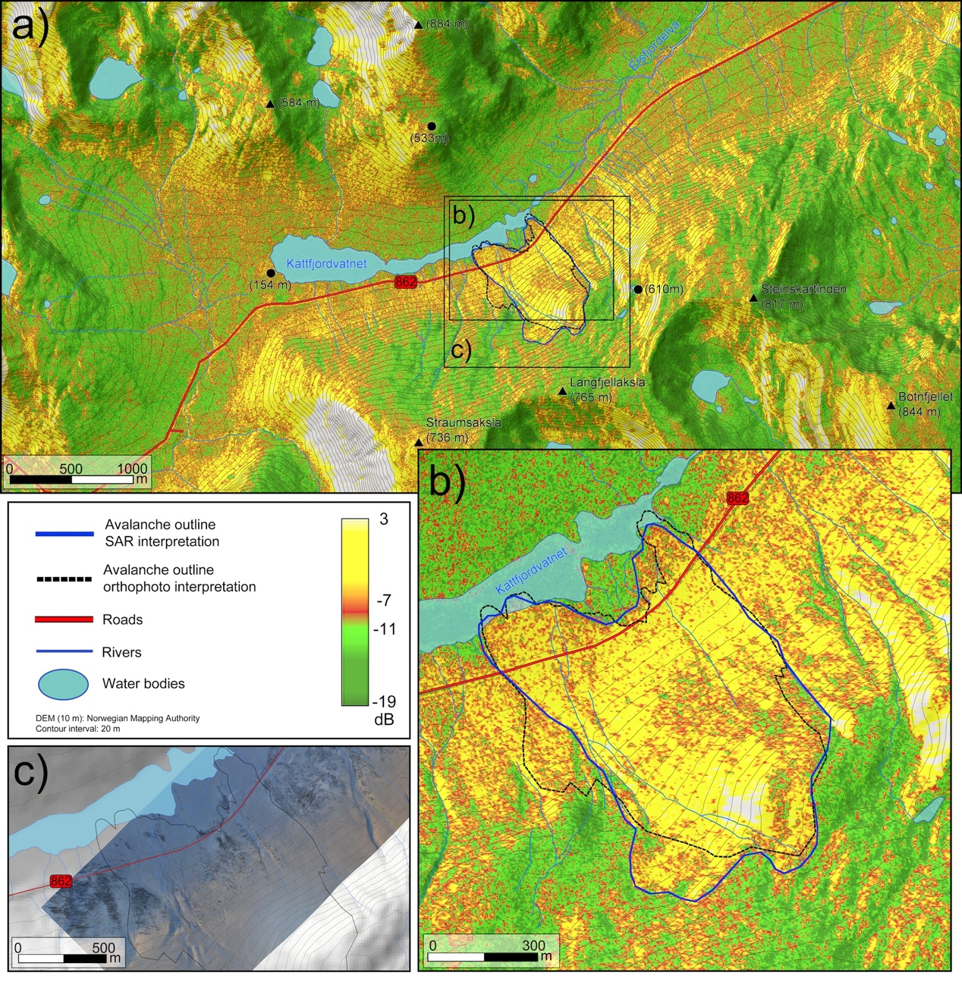
Kattfjordeidet

Slide 14
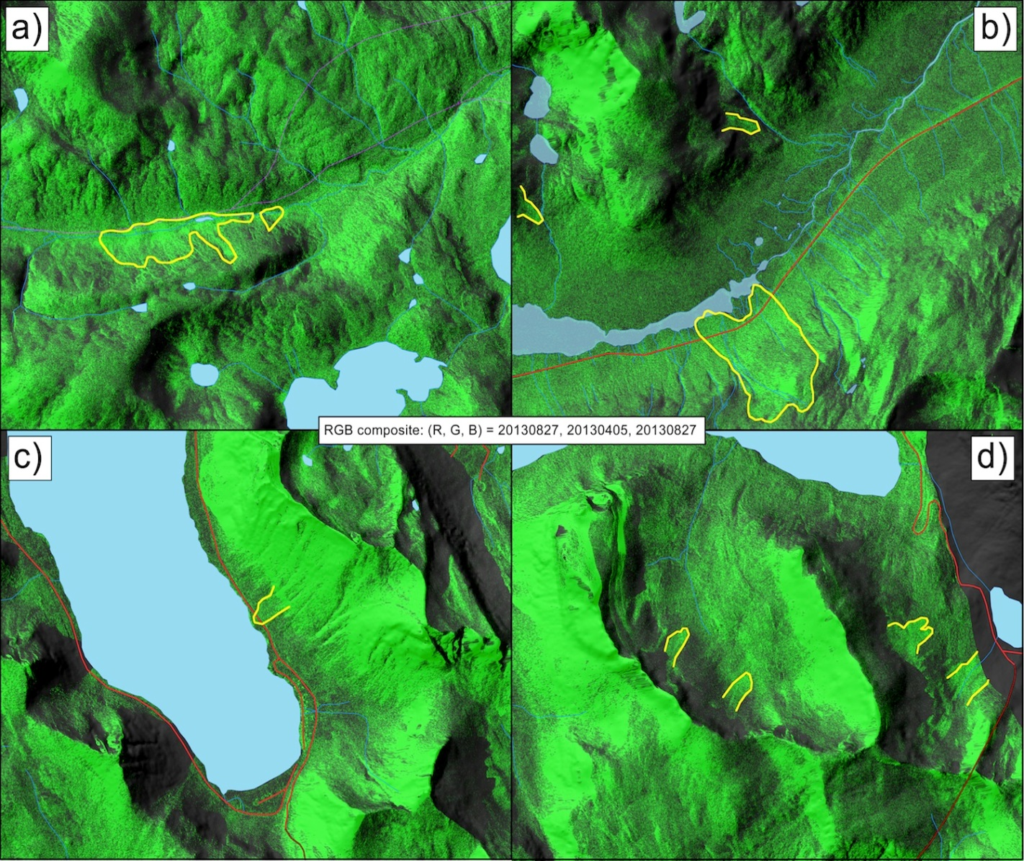
Signal processing (change vs. summer image)

Slide 15
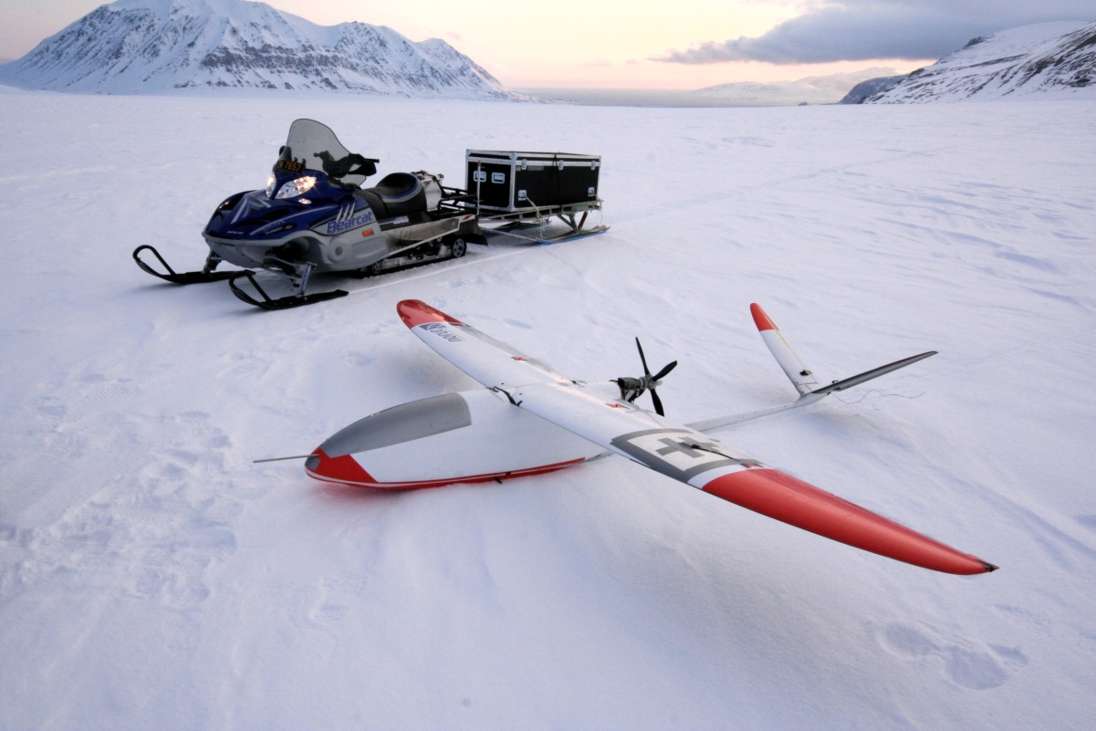
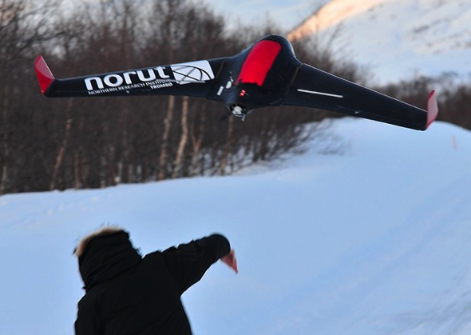
UAV
Norut has a fleet of UAV’s developed to carry various payloads under different conditions
Long range
Short range
Also helicopters

Slide 16
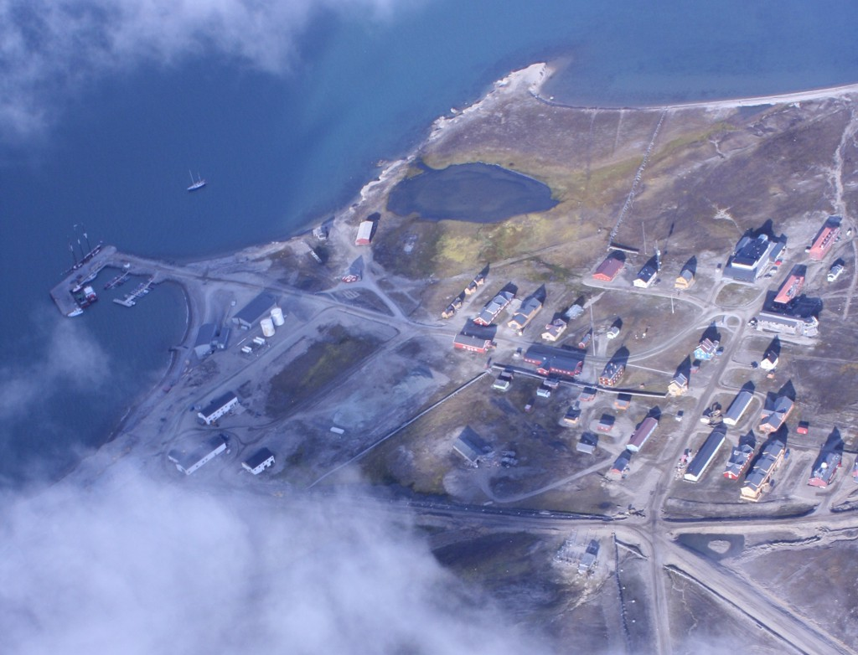
Ny-Ålesund

Slide 17
UAV Camera
Standard cameras are used to take high-resolution images of avalanches
Images are geocoded using GPS information to ortho-photos
Mapping of avalanche paths has a high value in it self, but also valuable as validation data for other sensors (SAR)
Avalanche, nearby Tromsø, April 2013

Slide 18
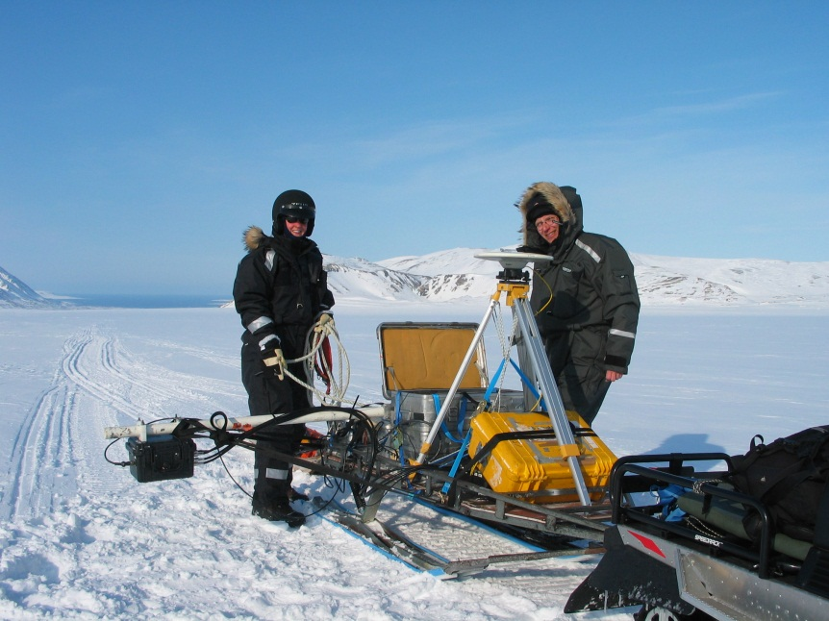
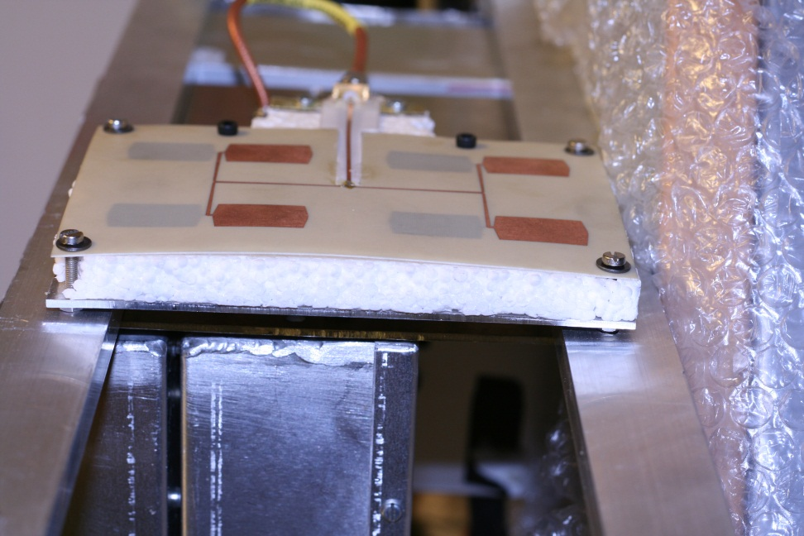
GPR development
We collaborate with the Norwegian Defence research institute
A new C-band sounder in GPR configuration will be tested out this week in Tromsø
As soon as we feel confident, we will also try it out mounted on a UAV-helicopter
A main objective in SeFaS is to test out if this sensor can provide valuable information about depth and layer structure in steep terrain

Slide 19
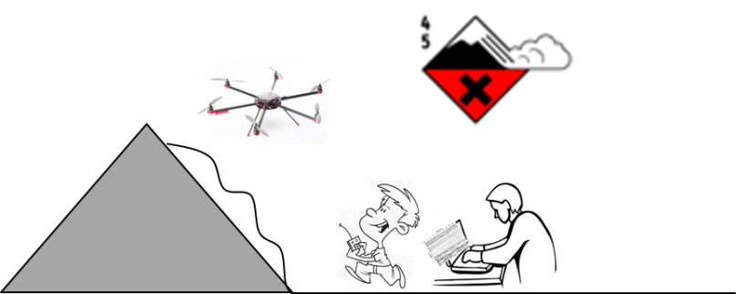
Sensor conscept for GPR mounted in unmanned helicopter
GPR

Slide 20
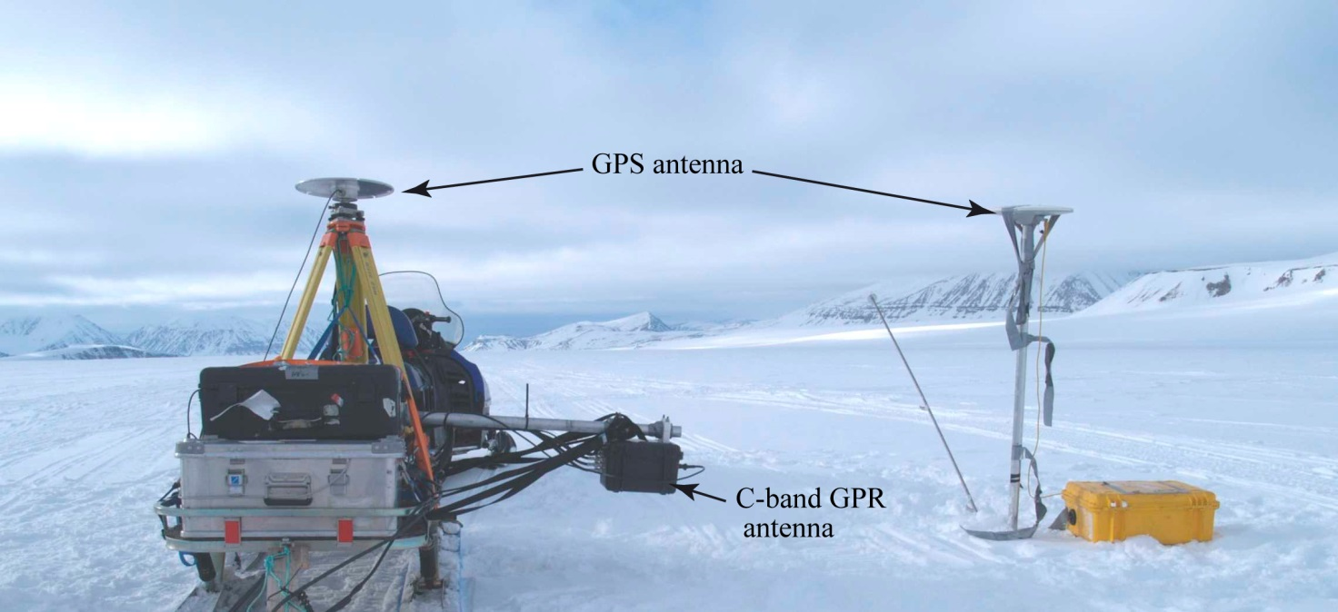
Snow profiling with GPR Glacier, Svalbard

Slide 21
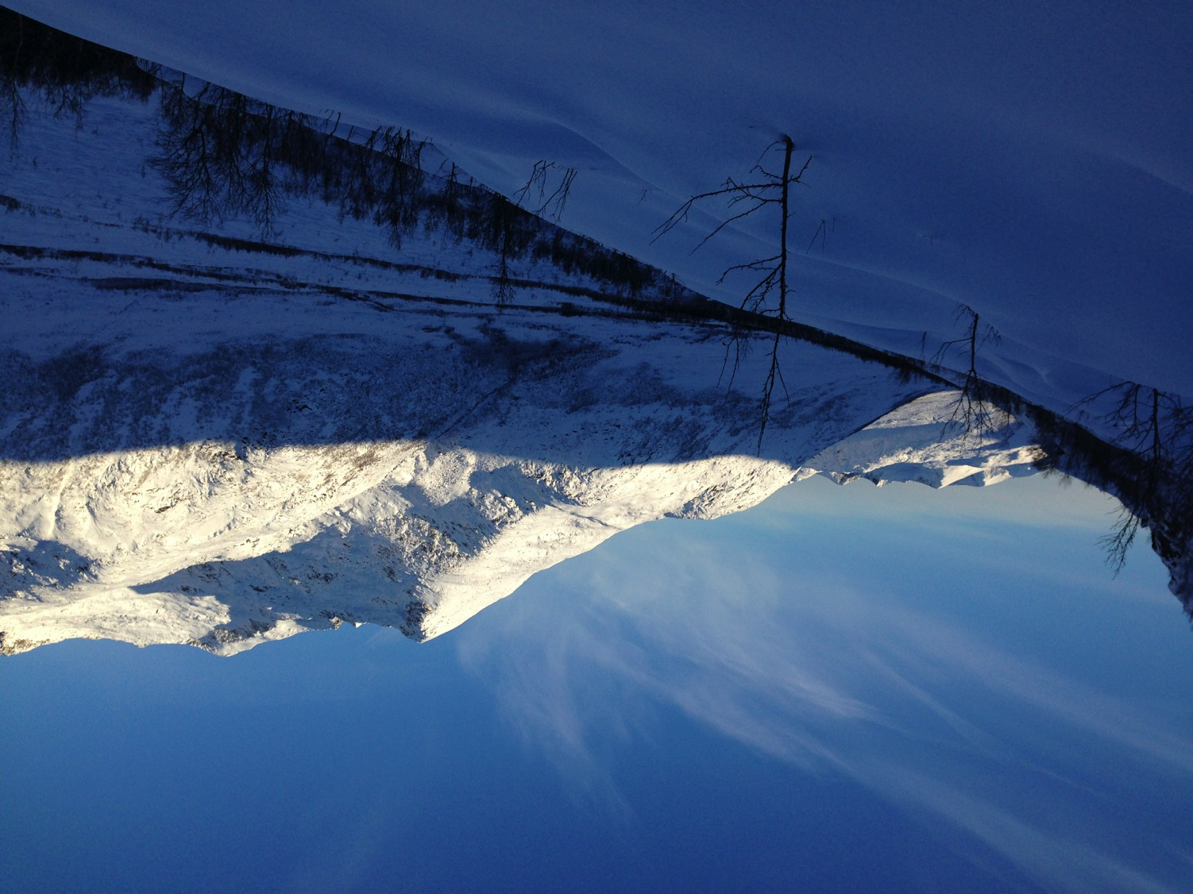
Field measurements
Validation
Collection of in situ data for validation of results from remote sensing
Field verification of radar backscatter (snow depth, SWE, wetness)
Field verification of UAV-GPR campaigns (snow depth, snow layering)
Understanding of seasonal snowpack development (skredvarsling, time series)

Slide 22
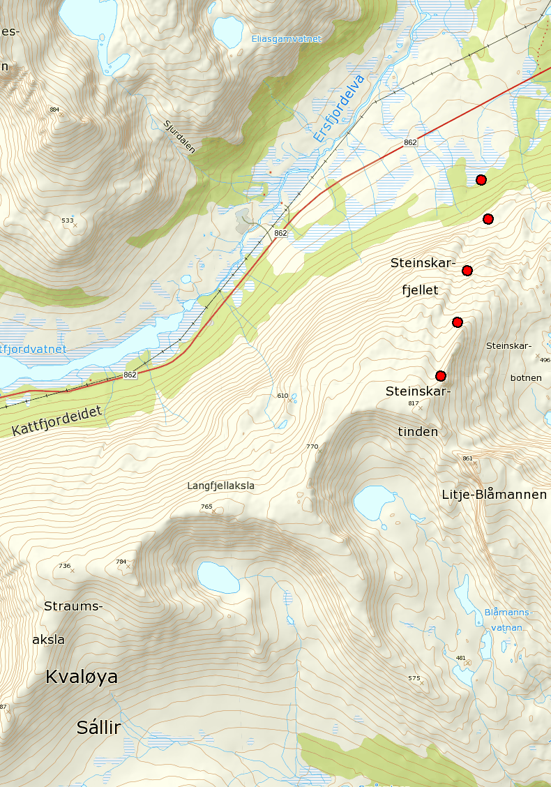
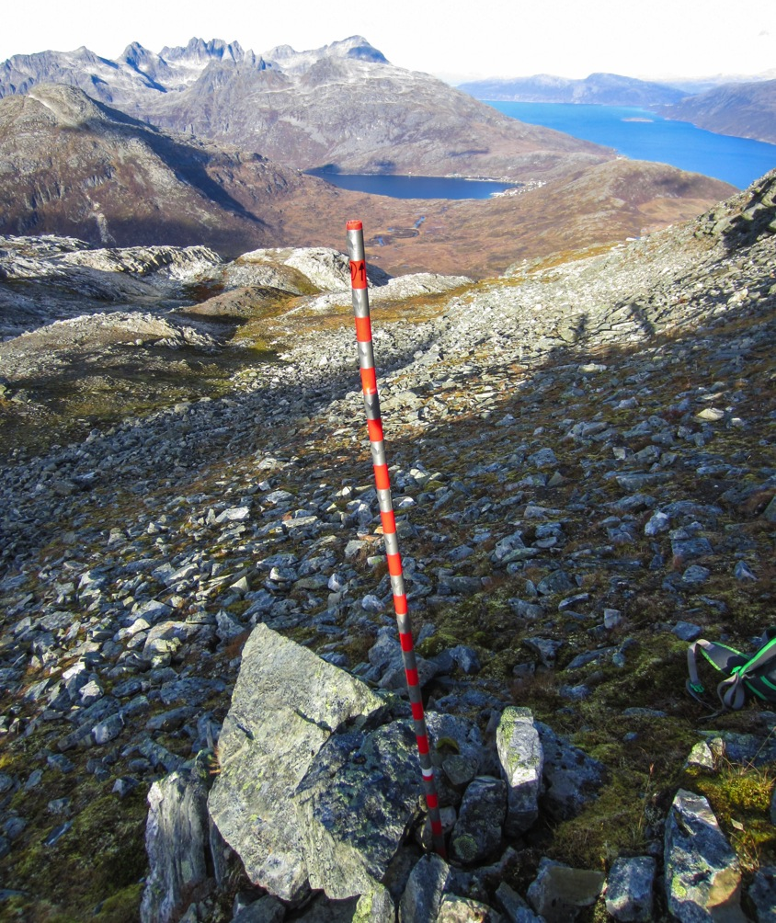
Sampling through the winter

Slide 23
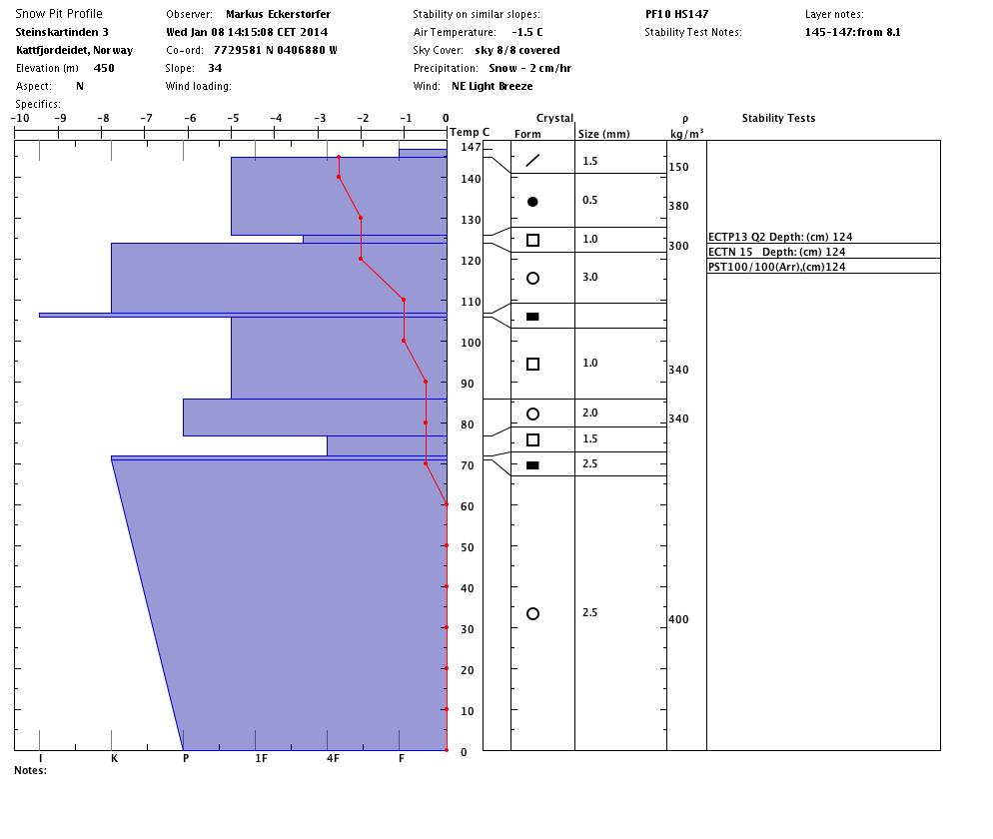
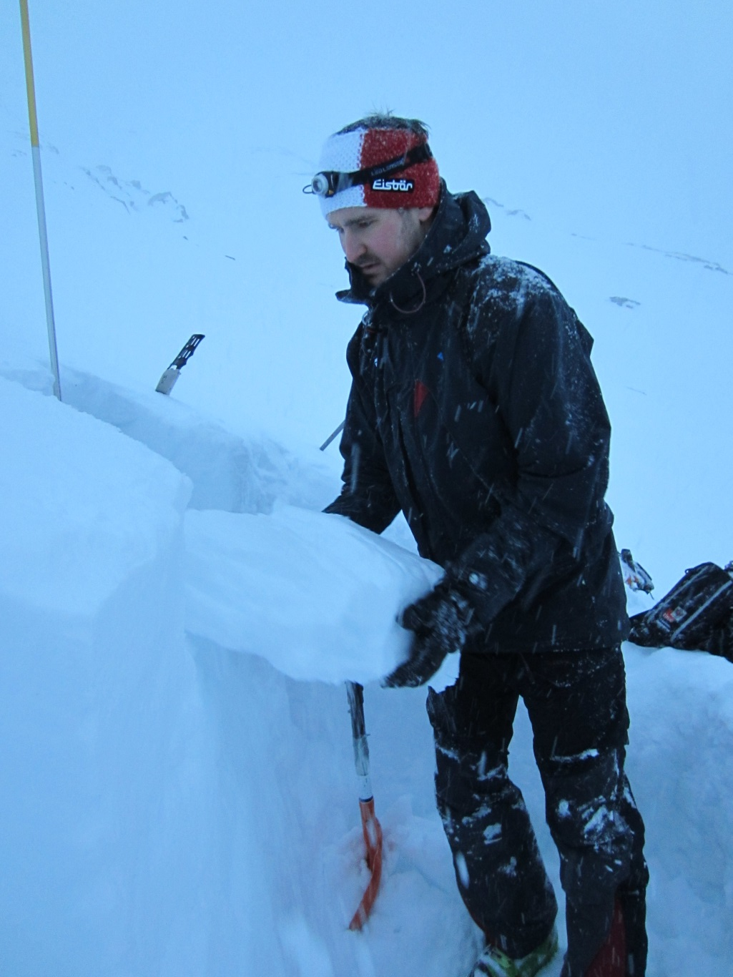
Campaings every 14 days + during airborne campaigns

Slide 24
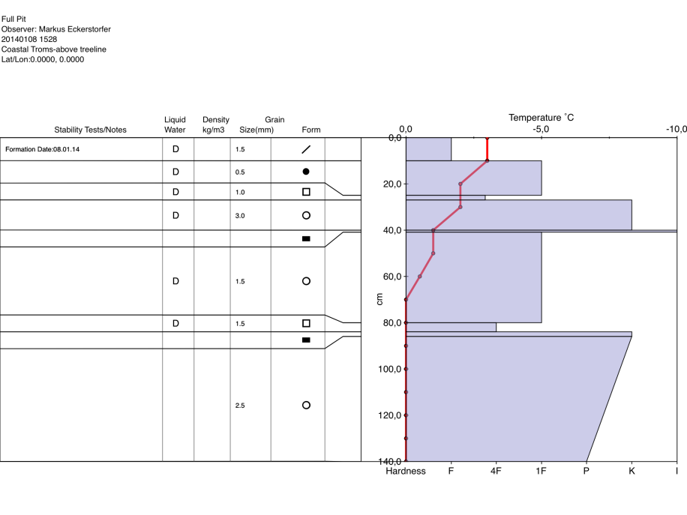
Field data is also reported to the national avalanche service varsom.no

Slide 25
Conclusion
SeFas started January 1, 2014
Many activities are started to test out remote sensing technology that can improve the monitoring of avalanches
We experience great interest in the community and hope that the results will be good!

Slide 26
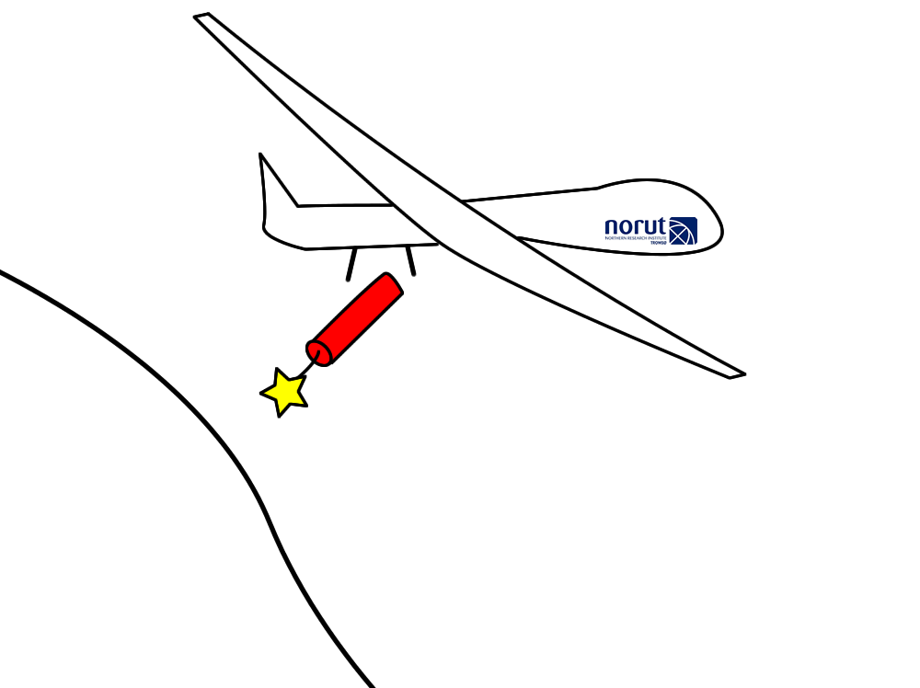
UAV’s offers many new
opportunities for avalanche studies

Slide 27
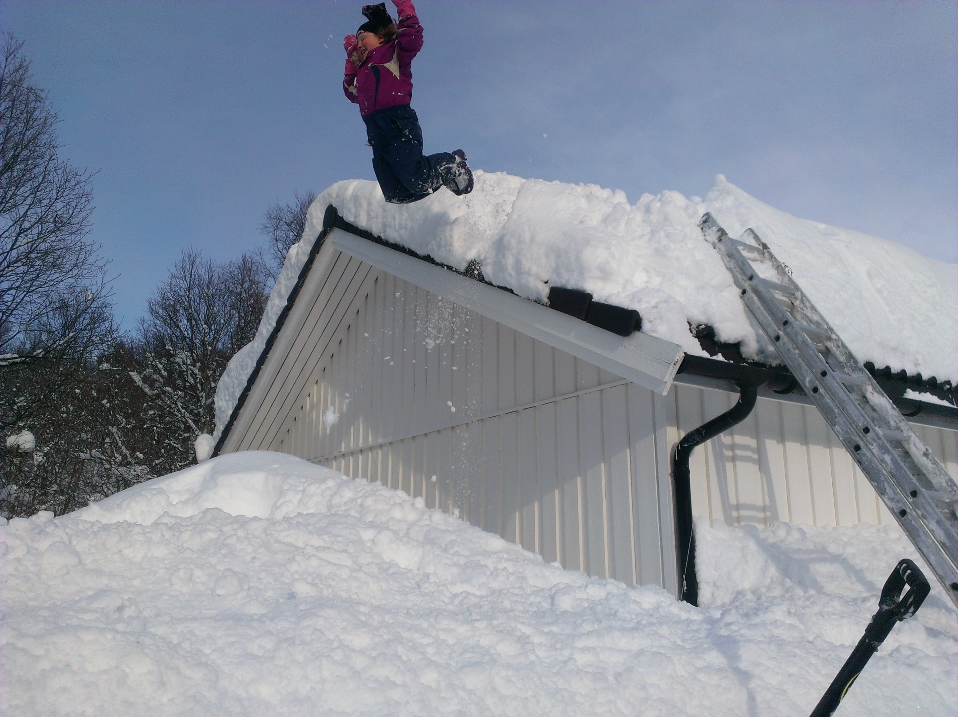
Thank you !

