Slide 1
Global Land Service- Cryosphere & Water LAKE ICE EXTENT FOR NORTHERN HEMISPHERE
EARSeL 3Feb 2020
Heinilä K., Mattila O.-P., Metsämäki S., Väkevä S., Luojus K., Schwaizer, G and Nagler T.

Slide 2
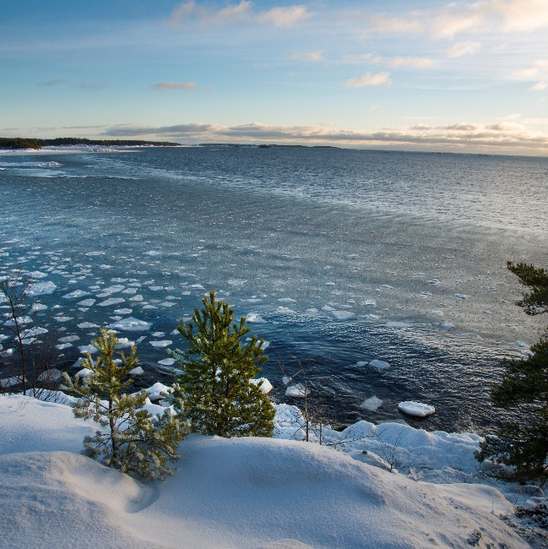
Introduction - Lake Ice Extent (LIE)
LIE product offers near real-time information on the ice conditions
In-situ stations are located sparsely – EO data are valuable
Due to the polar darkness obstructing the use of optical data, the LIE product is intended to monitor lake ice conditions from February until the end of lake ice season at high latitudes
Fields of application:
Numerical weather prediction
Climate modelling
Water quality research
Transportation
Recreation

Slide 3
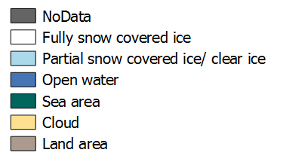
Lake Ice Extent for Northern Europe
Lake Ice Extent: 16.4.2019
Online in Global Land Service since 03/2017
250m resolution MODIS based product

Slide 4
Lake Ice Extent for Northern Hemisphere
Sentinel-3 SLSTR based 500m product
NoData
Ice
The main advantages of the algorithm developed at SYKE
Utilization of several spectral bands and indices
Inclusion of simultaneous cloud detection
Definition of statistical probability for each pixel
Simplicity of processing
Water
Sea area
Cloud
Land
Easy transition between different satellite sensors
1 April 2019

Slide 5
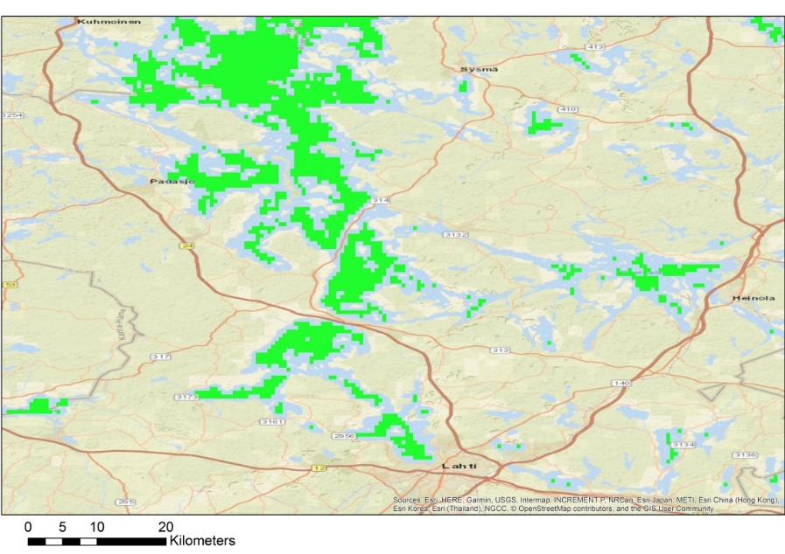
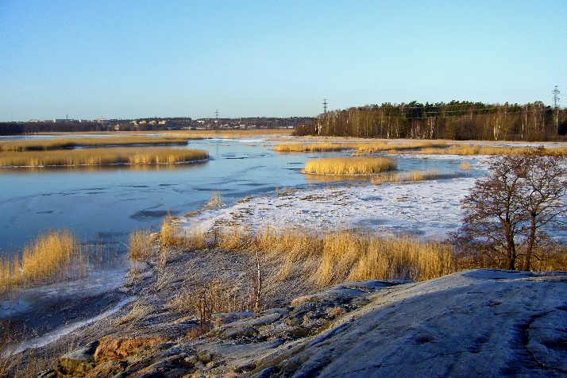
LIE-NH Watermask
25m resolution water occurrance data were reclassified
0 – 80 % Land
80 – 100 % Water
Water bodies were shrinked and resampled from 25m to 500 meters (nearest neighbor)
Without shrinking the 500m resolution retrieval suffers from mixed pixel effects (land and water), as well as from effects from shallow water

Slide 6
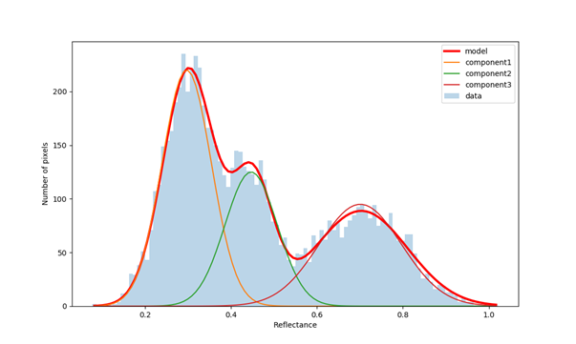
LIE-NH algorithm
LIE-NH algorithm is based on Gaussian Mixture Model (GMM) distributions of several reflectance/thermal bands and indices derived from S3-SLSTR data
Features of the new algorithm:
Calculation only on watermask pixels
Reduces calculation time
Additionally, areas where lakes will never freeze are excluded
Use of several bands and band relations
Increased separation ability
Reduced effect of varying illumination
Use of fitted probability distributions
Determine statistical probability for the estimate
Use of thermal bands
Diminate effects of water properties (algae, turbidity)
2000
1500
Number of pixels
1000
500
0
0.2
0.4
0.6
0.8
1.0
Reflectance
For clarity only three components are used in figure. In LIE-NH algorithm the initial number of classes (fitted distributions) is 21 and the number of dimensions is 8: SLSTR channels 1, 2, 5, 6, 8 and 9 and two indices NDSI and NDWI.

Slide 7
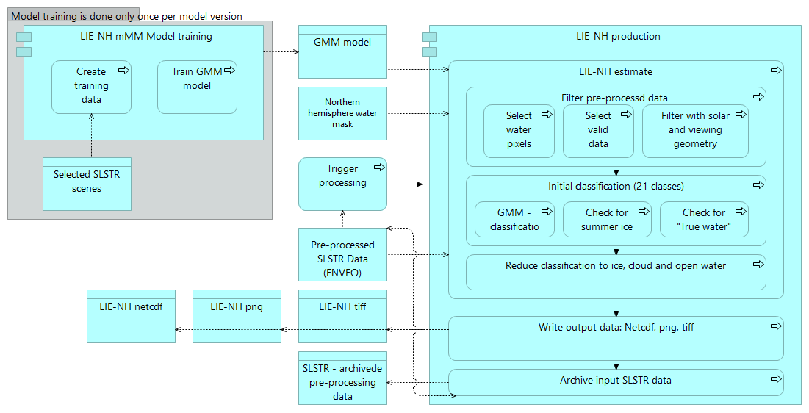
LIE-NH processing

Slide 8
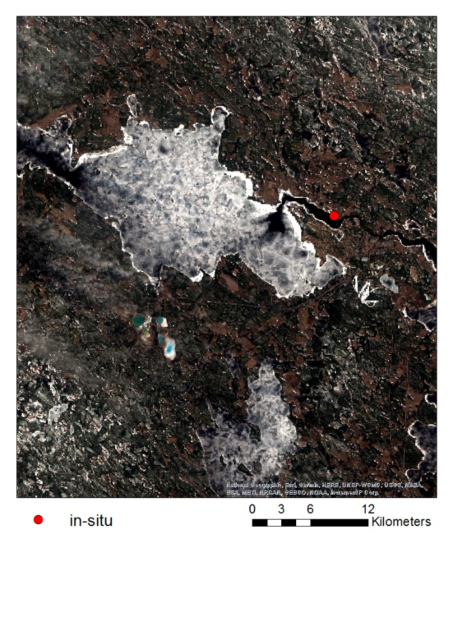
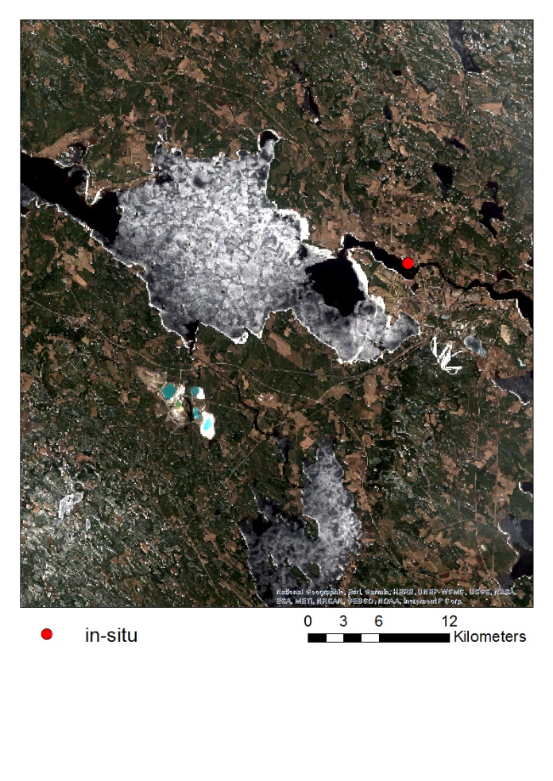
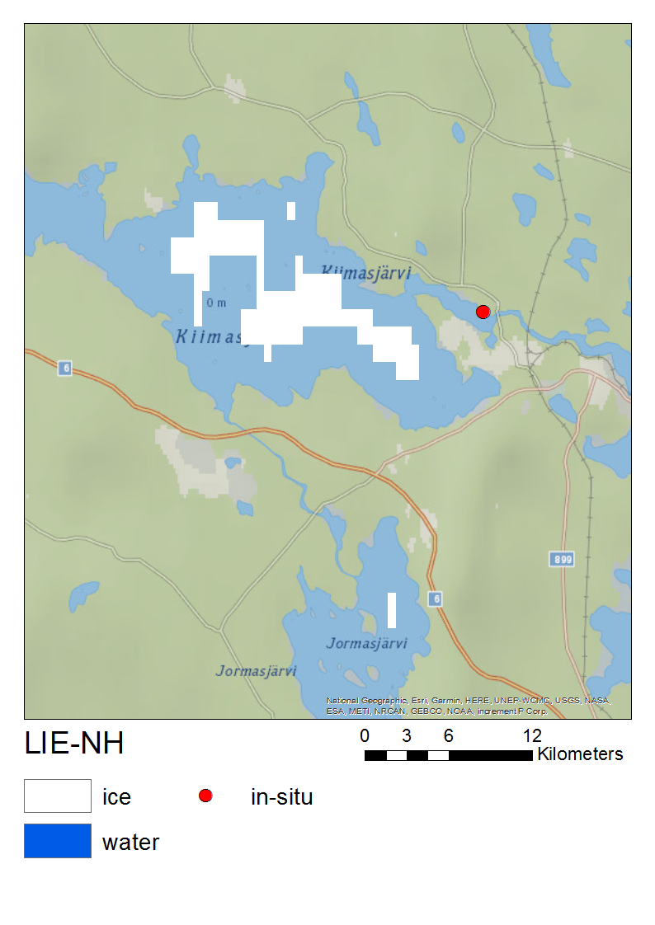
Validation: In-situ data
In-situ observation ” The whole horizon is ice-free” in Nuasjärvi, Finland, on 26 April 2019
S2 MSI image on 25 April 2019
S2 MSI image on 28 April 2019

Slide 9
Validation: Sentinel-2 MSI data
Over all 77 images between 7 March and 28 May 2019
Most lakes are under melting stage, presenting partial ice cover
23.9% of images includes only ice pixels (including different ice types)
8.6% of images includes only open water pixels
67.6.% of images includes lakes with both ice covered and open water pixels
From Lokka, Finland, and Tjaktjajaure, Sweden, several images during the spring

Slide 10
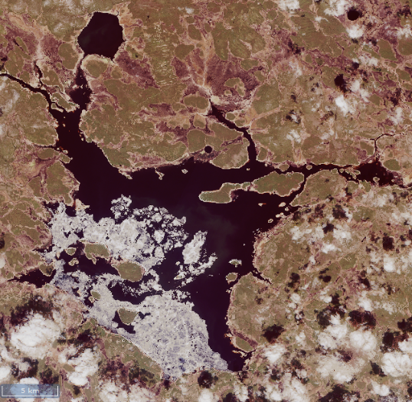
Example of validation: Time series from Lake Lokka
Lake Lokka in Finland on 24 May 2019

Slide 11
Challenges in validation – preparation of S2-based reference data
How to create high resolution lake ice extent maps – ice or open water?
Resampled high resolution data was classified as open water if <50% of the pixels were ice covered
This shows up as “false” ice commissions in the validation results
Lake Hyargas Nuur in Mongolia on 23 April 2019

Slide 12
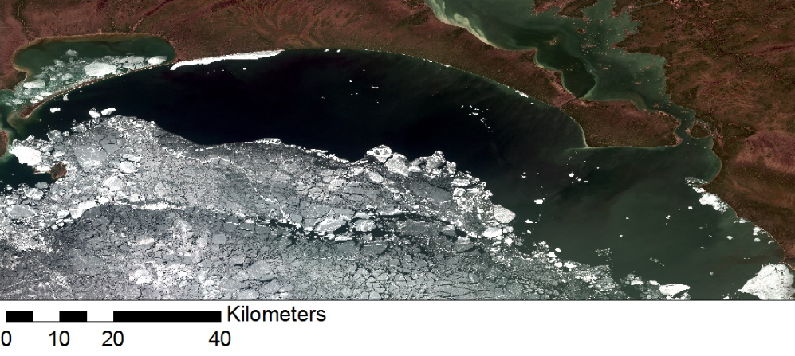
Pros and cons
Flathead Lake in USA on 21 April 2019
Recognizes even turbid open water
Very turbid water may be interpreted as cloud
Temperature limitation aids
North part of Lake Winnipeg on 19 May 2019
Recognizes ice even when it is fragmented
Even small pieces of ice within 500m resolution pixel may increase the reflectance -> the pixel is classified as ice - temperature data does not help

Slide 13
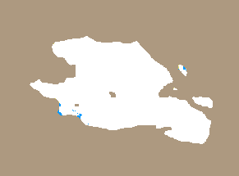
Pros and cons
Qinghai Lake in China 6 April 2019
Recognizes dark ice well
Glan in Sweden 26 February 2019
When the ice is very dark with water on it, ice is not identified
Temperature doesn’t help

Slide 14
Validation results
Results would seemingly improve if more totally ice-covered and ice-free lakes would be included!
-focus was on complex cases
Total number of 500 m resolution pixels 188 626
Recall 92.1%
Percentage of correctly classified ice out of all true ice pixels
False alarm rate 24.9%
Falsely classified as ice out of all open water pixels
Precision 73.8%
Percentage of correctly classified ice out of all classified ice pixels
F-Score 82.0%
The weighted harmonic mean of the precision and recall
 | LIE-NH 500m
S2-LIE | No ice | Ice | N cases
No Ice | 80487 (TN) | 26662 (FP) | 107149
Ice | 6413 (FN) | 75064 (TP) | 79818
N cases | 86900 | 101726 | 188626

Slide 15
Summary - Northern Hemisphere Lake Ice Extent product in 500 m
Review in March 2020
The main advantages of the algorithm
Utilization of several spectral bands and indices
Inclusion of simultaneous cloud detection
Definition of statistical probability for each pixel
Simplicity of processing
Validation results
Recall 92.1% (Percentage of correctly classified ice out of all true ice pixels)
Detect different kind of ice covers well
Water on ice: method cannot always detect if the water is on ice or is it open water
False alarm rate 24.9% (Falsely classified as ice out of all open water pixels)
Detect open water well (validation dataset includes mostly complicated cases where both ice and water is presented)
Fracmented ice cover causes challenges
In our case resampled high resolution data was classified as open water if <50% of the pixels were ice covered

Slide 16
Thank you!

