Slide 1
EARSeL, Bern, 3-5 February 2020
Impact of snow cover data assimilation over the Tibetan Plateau on medium-range Numerical Weather Prediction
Patricia de Rosnay, Gianpaolo Balsamo,Yvan Orsolini, Emanuel Dutra, Boqi Liu, Retish Senan, Wenli Wang,
Martin Wegmann, Kun Yang, Congwen Zhu
Thanks to the International Space Science Institute in Beijing (ISSI-BJ)
Team “Snow reanalyses over the Himalaya-Tibetan Plateau region and the monsoons”
European Centre for Medium-Range Weather Forecasts
Thank to the International Space Science Institute in Beijing (ISSI-BJ), through the working
team “Snow reanalyses over the Himalaya-Tibetan Plateau region and the monsoons”

Slide 2

Earth System approach
Integrated Forecasting System (IFS)
4D-Var
Atmosphere
Sea Ice
3D-Var
Land
OI/SEKF
Ocean
3D-Var
Waves
OI
Importance of interface observations (snow, soil moisture, sst, sea ice, …)
European Centre for Medium-Range Weather Forecasts

Slide 3
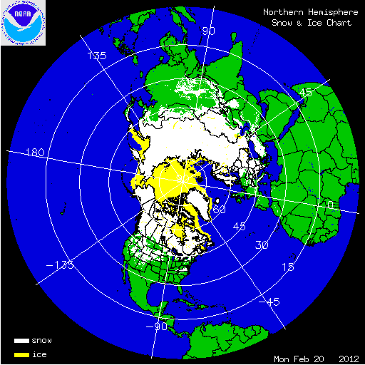
Snow assimilation at ECMWF
Snow Model: Component of H-TESSEL
Dutra et al., JHM 2010, Balsamo et al JHM 2009
Single layer snowpack
Snow water equivalent SWE (m)
Snow Density ρ_{s}
Observations:
de Rosnay et al ECMWF Newsletter 2015
- In situ snow depth data: SYNOP and National networks
- Snow cover extent: IMS daily product (4km)
Data Assimilation:
de Rosnay et al SG 2014
Optimal Interpolation (OI) → optimally combines the model first guess, in situ snow depth and IMS snow cover (data used only below 1500m altitude)
3

Slide 4
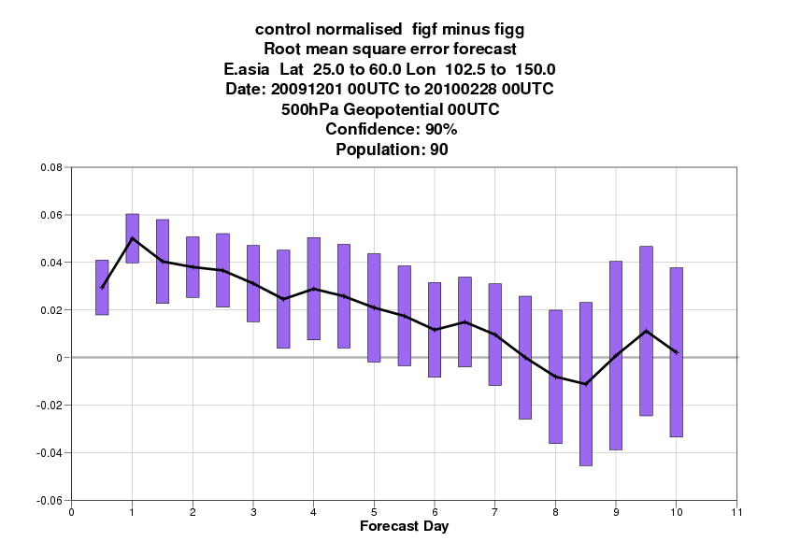
10 years ago: IMS data assimilation impact study in the IFS
Impact of blacklisting IMS above 1500m
DJF 2009-2010, NH
500 hPa Geopot RMSE
[with IMS]-[without IMS] in mountains above 1500m
IMS DA over the Himalayas degrades NWP performances
Unknown quality of IMS over in this region
Stopped using IMS for NWP at high altitude from IFS cycle 36r4 (2010)
- ERA-Interim: IFS cycle 31r1 (2006) → assimilates IMS (24km) including mountains
- ERA5: IFS cycle 41r2 (2016)→ assimilate IMS (4km) only below 1500m altitude
- Current oper NWP: IFS cycle 46r1 (2019) → assimilate IMS (4km) only below 1500m altitude
4

Slide 5
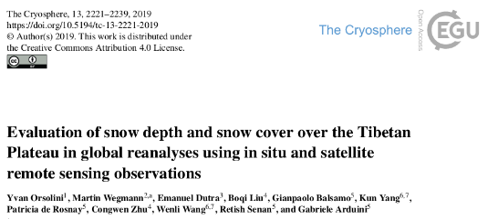
Comparison of reanalysis products over the Tibetan Plateau
Snow depth (cm)
In situ stations, orography
Observations:
In-situ
2009-2013
ERA-Interim
ECMWF
ERA5
ECMWF
ERA5: overestimates SD over the Tibetan Plateau (TP)
ERA-Interim: SD in better agreement with in situ stations
(Orsolini et al. The Cryosphere, 2019)

Slide 6
Numerical weather prediction experiments
NWP experiments, Sept 2011 – Dec 2012
Two 10-day FC per day (976 forecasts)
Resolution: Tco399 (~25 km)
IFS cycle: 43r3
CTRL : blacklist IMS above1500m altitude (like in NWP and ERA5)
TEST : no blacklist for IMS (use IMS everywhere)
6

Slide 7
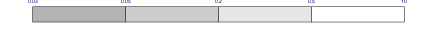
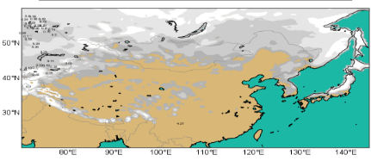
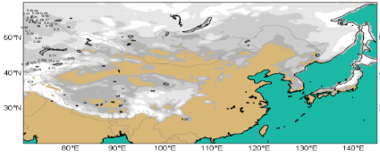
Snow depth (m)
0.05 0.2 0.5 SD (m)
CTRL
TEST
2012 02 01
CTRL (no IMS DA over the TP)
TEST (IMS DA over the TP)
7

Slide 8
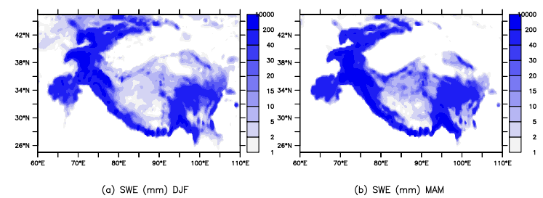
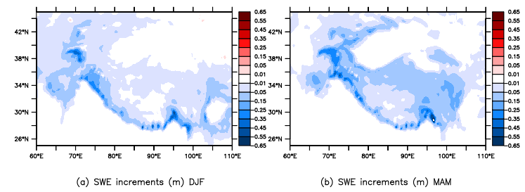
Snow Water Equivalent (mm)
(CTRL)
Increments (m)
Due to IMS DA
(TEST)
8

Slide 9
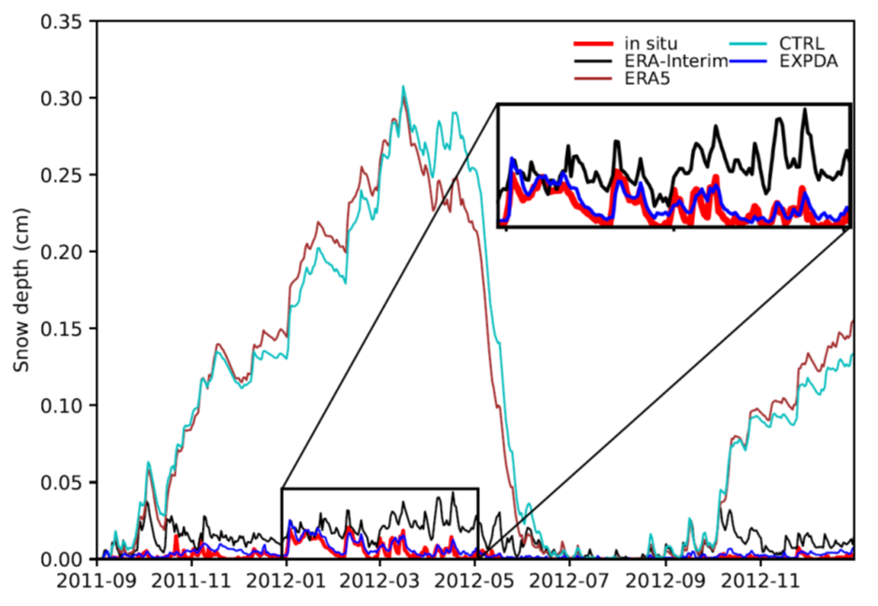
Evaluation against in situ snow depth stations
ERA-I
CTRL(no IMS DA)
ERA5 (no IMS DA)
TEST with IMS DA
In situ data
SNOW DEPH (m)
9

Slide 10
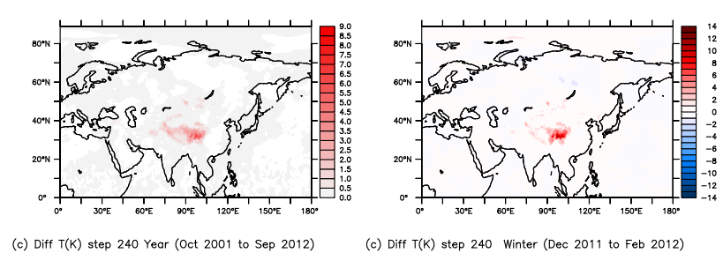
Snow cover data assimilation over the Tibetan Plateau
Impact on air temperature
IMS removes snow
Warmer surface conditions
T2m impact 10-day forecasts
Oct 2011-Sept 2012
T2m impact 10-day forecasts
Dec 2011-Feb 2012
10

Slide 11
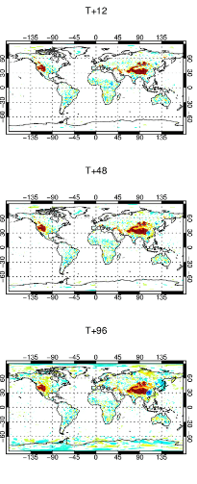
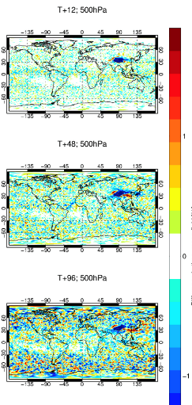
Snow cover data assimilation in mountainous areas
T2m
R 500hPa
12h
48h
96h
1 Year
(Oct 2011-Sep 2012)
Mean change in near surface air temperature (T2m) and 500 hPa humidity forecasts
IMS DA:
Remove snow
T2m increases
Humidity decreases

Slide 12
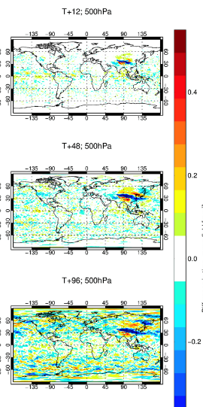
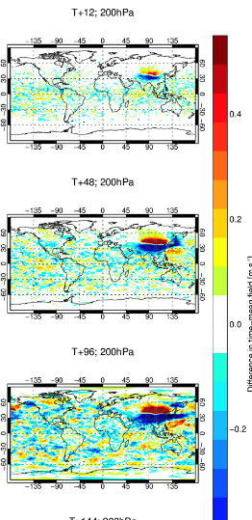
Snow cover data assimilation in mountainous areas
Zonal wind
500hPa 200hPa
12h
48h
96h
1 Year
(Oct 2011-Sep 2012)
Mean change in zonal wind
atmospheric forecasts
IMS DA:
Jet circulation shifted to the north

Slide 13
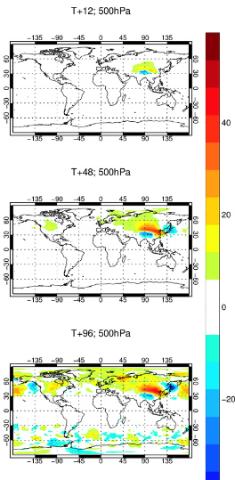
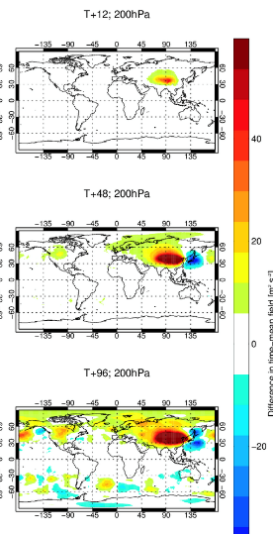
Snow cover data assimilation in mountainous areas
Z
500hPa 200hPa
12h
48h
96h
1 Year
(Oct 2011-Sep 2012)
Mean change in
geopotential height forecasts

Slide 14
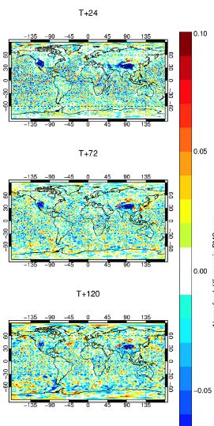
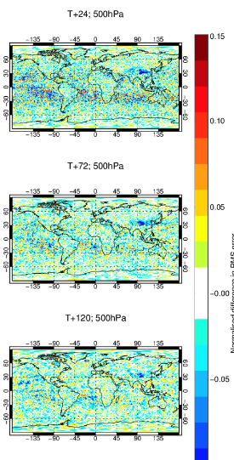
Snow cover data assimilation in mountainous areas
T2m
R 500hPa
12h
48h
96h
1 Year
(Oct 2011-Sep 2012)
Impact on forecasts error
(RMSE normalised difference)
air temperature (T2m) and 500 hPa humidity forecasts

Slide 15
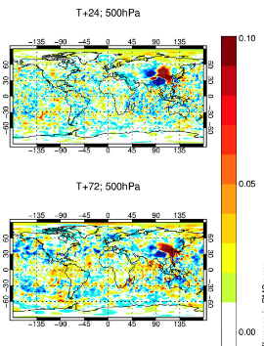
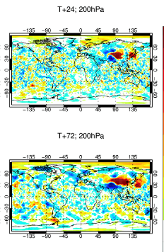
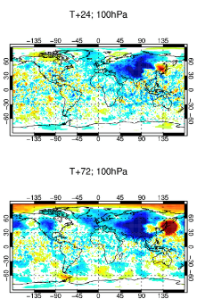

Snow cover data assimilation in mountainous areas
Geopotential height forecats RMSE difference (normalised)
12h
48h
15

Slide 16
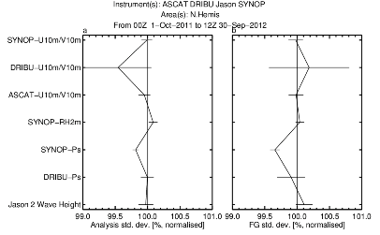
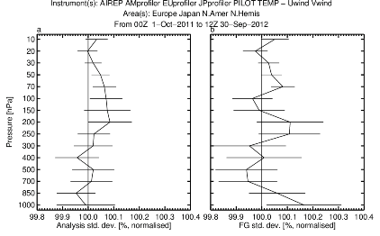
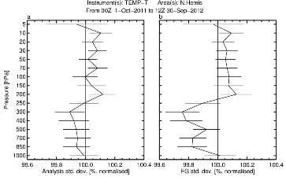
Snow cover data assimilation in mountainous areas
Fit of first guess departure to observations
→ Improved first guess match with Ps and Temp observations
→ Degraded match with wind observations
16

Slide 17

Snow data assimilation score card: winter Impact of IMS DA in mountains
IMS snow DA in the Himalayas
- Improves T2m
Degrades atmospheric FC in East Asia
→ Model issue to solve before activating IMS DA in the IFS
DJF 10-day forecasts verified against observations
Improved Degraded
17

Slide 18

Snow data assimilation score card: spring impact of IMS DA in mountains
IMS snow DA in the Himalayas
- Improves T2m
Degrades FC in East Asia
→ Model issue to solve before activating IMS DA in the IFS
MAM 10-day forecasts verified against observations
Improved Degraded
18

Slide 19
Summary
IMS snow cover provides relevant snow information over the TP, whereas the model overestimates snow over the TP
DA tests for Sept 2011- Dec 2012 with IMS DA activated in mountainous areas
IMS removes snow over the TP and improves snow (compared to in situ data)
Very strong impact on T2m (warmer) and reduced T2m forecasts errors
Shift the jet position and impact Z500 hPa to Z50 hPa significantly
→ Degradations of the some components of the medium range NH forecasts → Model inconsistencies between surface and jet circulation over the TP
→ To be solved before we can activate IMS DA over the TP
19

Slide 20
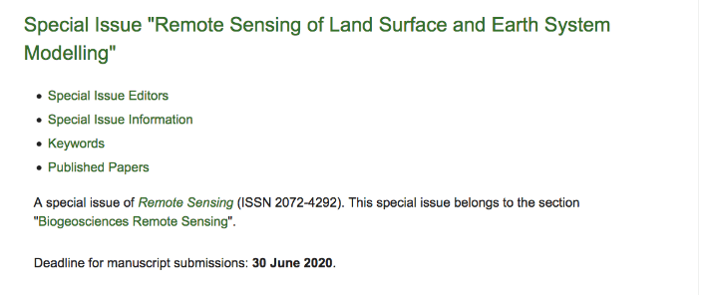

https://www.mdpi.com/journal/remotesensing/special_issues/Land_Surface_Earth_System_Modeling
Land surface data assimilation
Land surface re-analysis
Land surface forward modelling (VIS/IR/MW),
Inverse modelling and machine learning
Land surface parameter retrieval
Coupled assimilation (land-hydrology-atmosphere)
Intercomparison (model and DA)

Slide 21
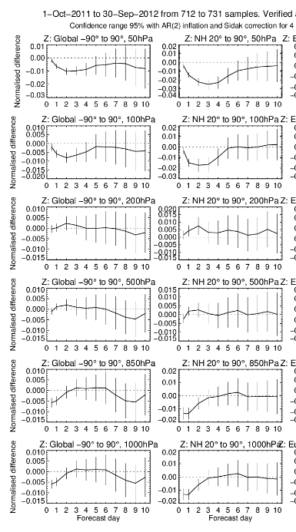
IMS above 1500m DA impact
With IFS 36r4 (2010)
With IFS 43r3 (2018) →

