Slide 1
Surface roughness effect on snow albedo
Terhikki Manninen, Roberta Pirazzini and Kati Anttila
Finnish Meteorological Institute

Slide 2
Co-operation during SNORTEX campaign 2008-2010 and later with
Finnish Meteorological Institute:
  Panu Lahtinen, Niilo Siljamo, Laura Thölix, Aku Riihelä, Anna Kontu, Hanne Suokanerva, Outi Meinander, Emmihenna Jääskeläinen, Petri Räisänen
National Land Surveying Institute:
  Jouni Peltoniemi, Juha Suomalainen, Teemu Hakala, Sanna Kaasalainen, Harri Kaartinen, Antero Kukko
CNRS/Météo-France: Jean-Louis Roujean

Slide 3
Contents
Examples of snow evolution with season
Modelled bulk albedo evolution with season
Surface roughness evolution with season
Measured albedo evolution with season
Measured relationship between albedo and surface roughness
Ray tracing calculation of surface scattering characteristics
Modelling surface roughness effect on total albedo

Slide 4
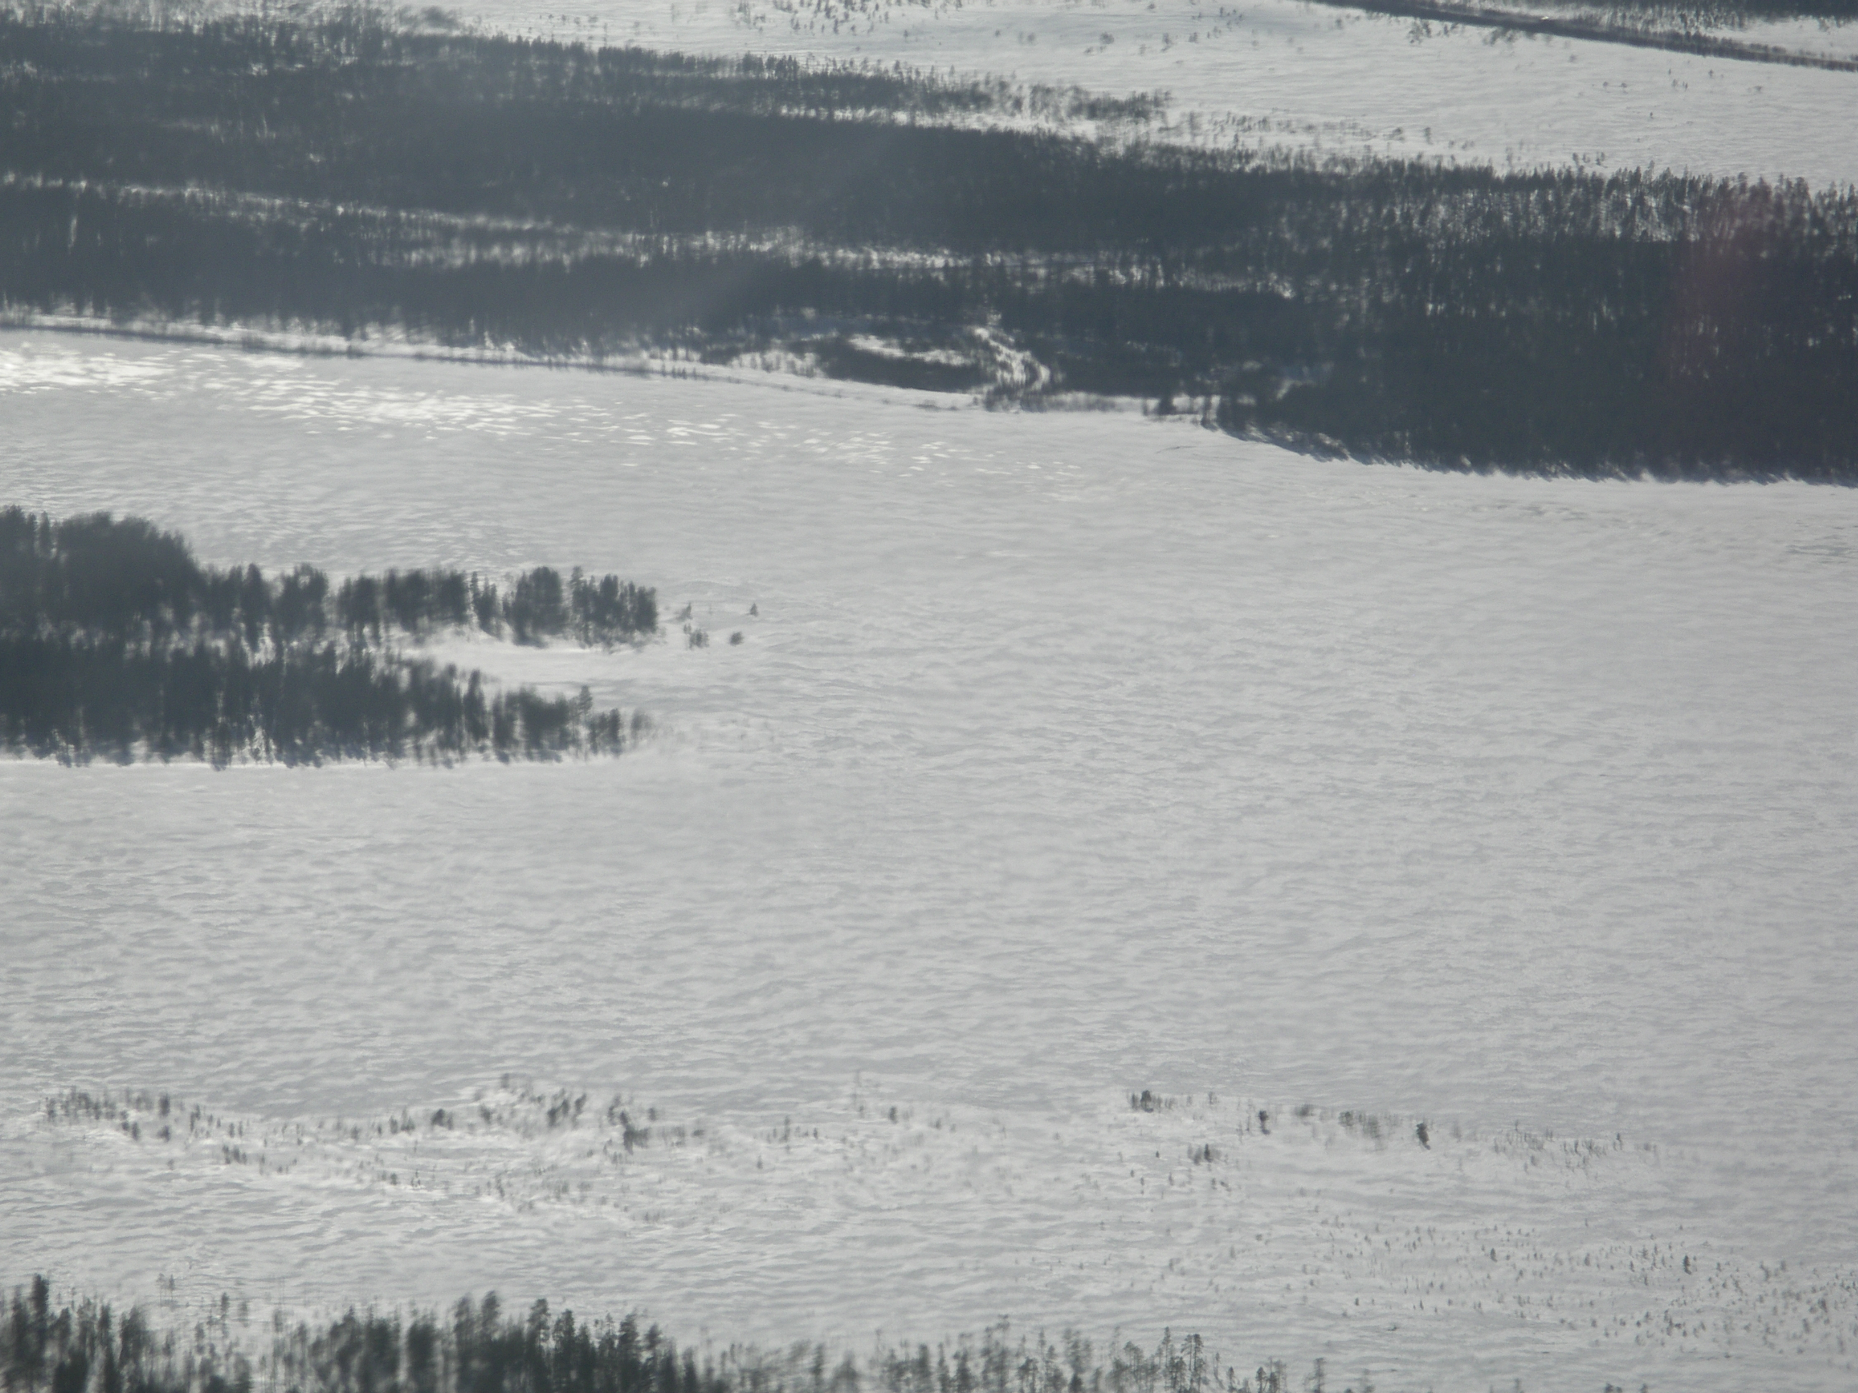
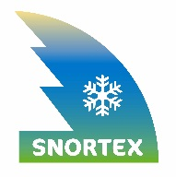
Examples of snow covered scenery

Slide 5
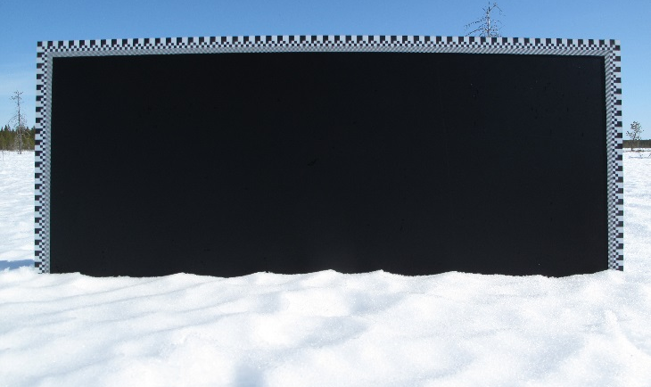
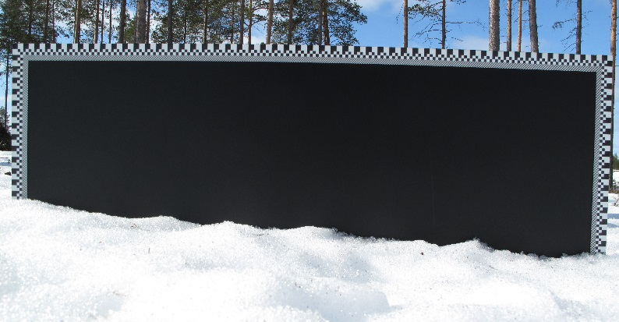
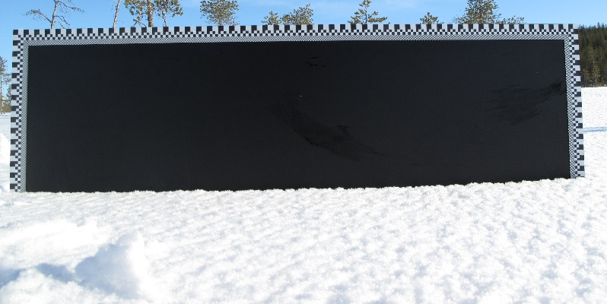
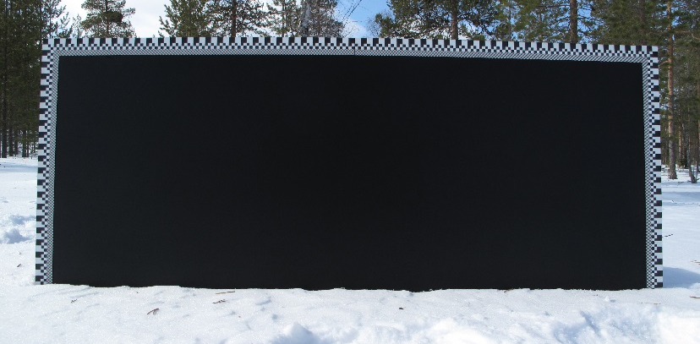
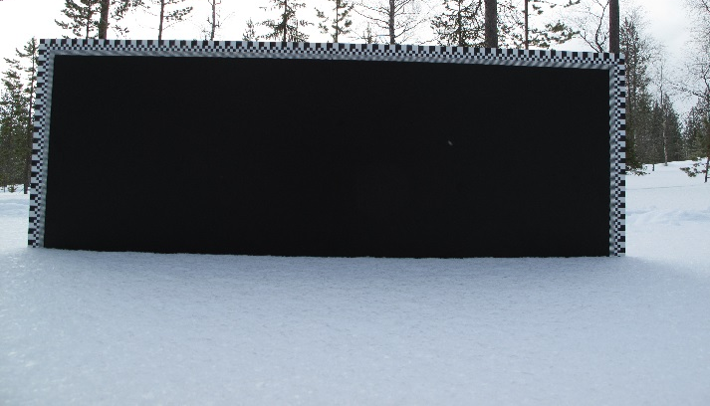
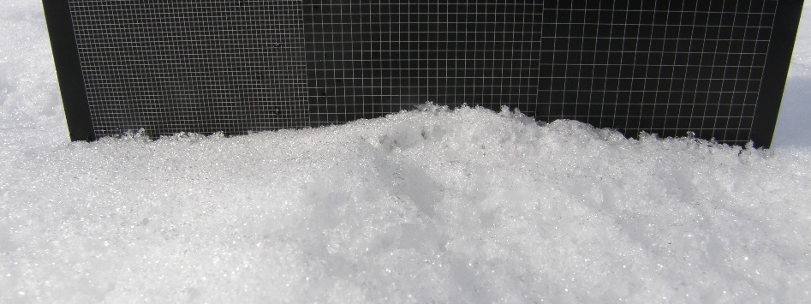
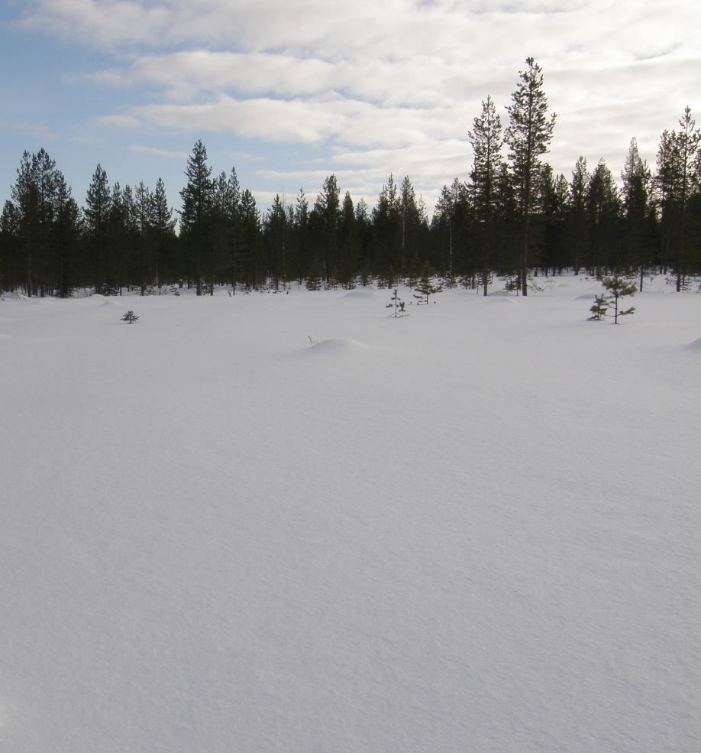
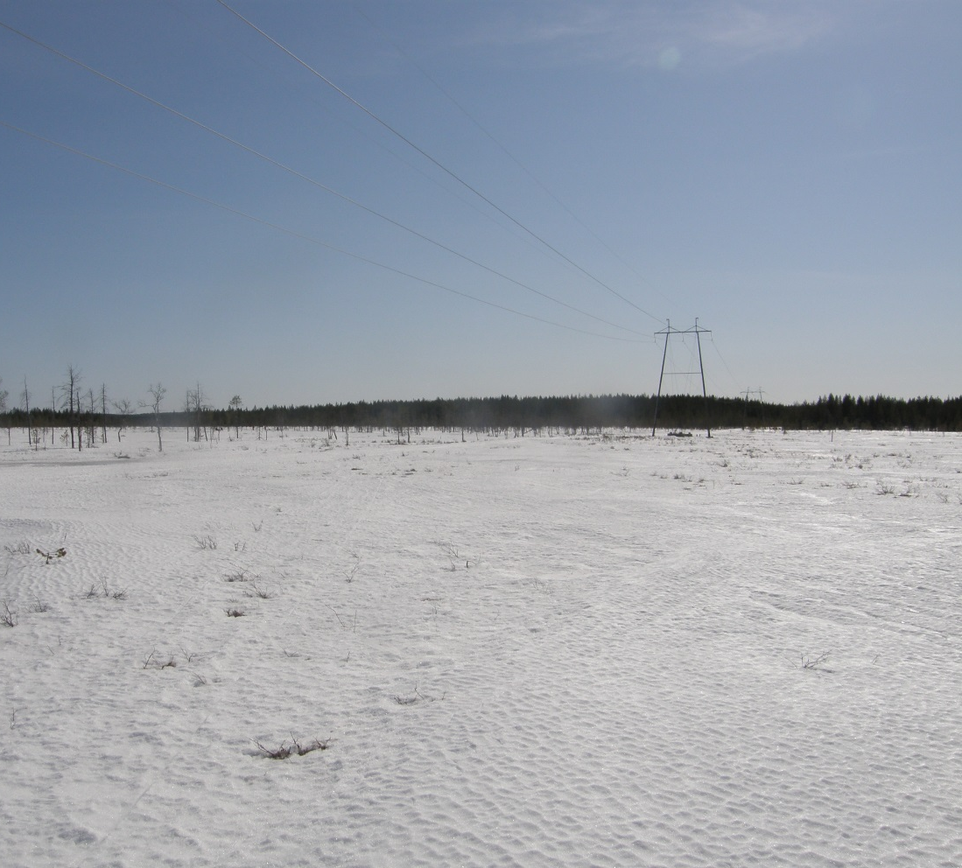
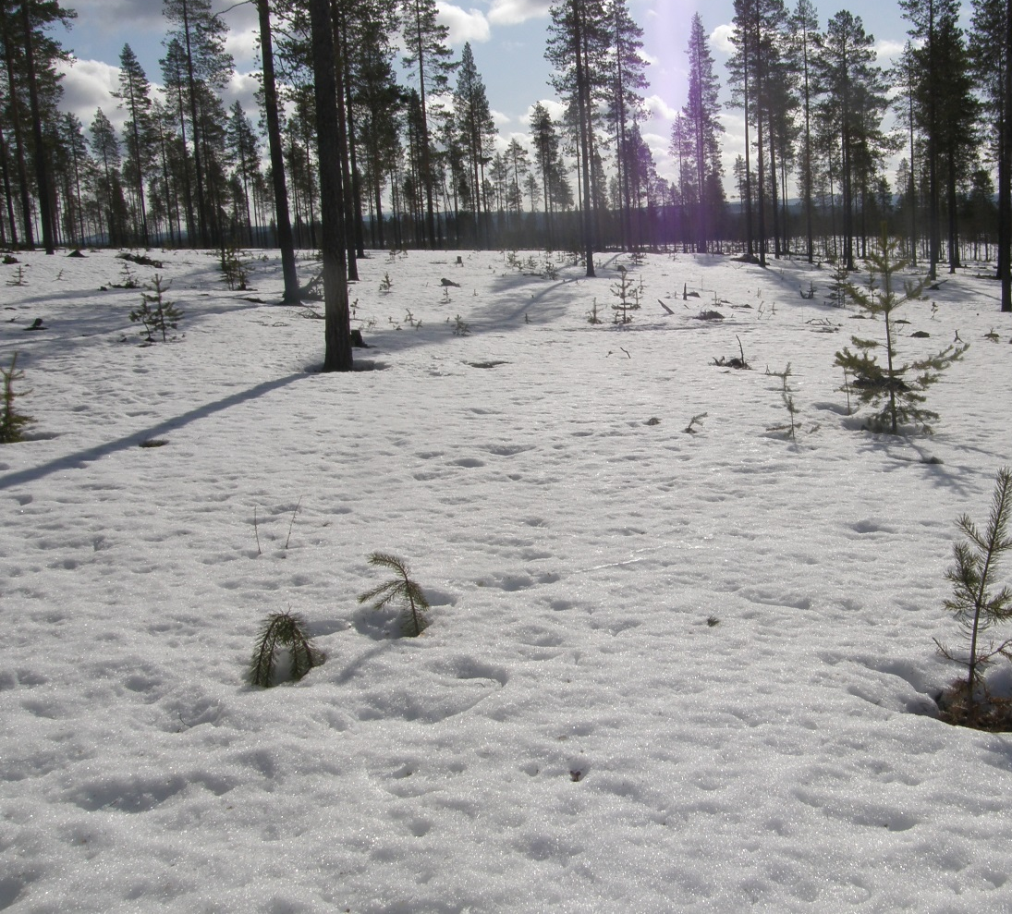
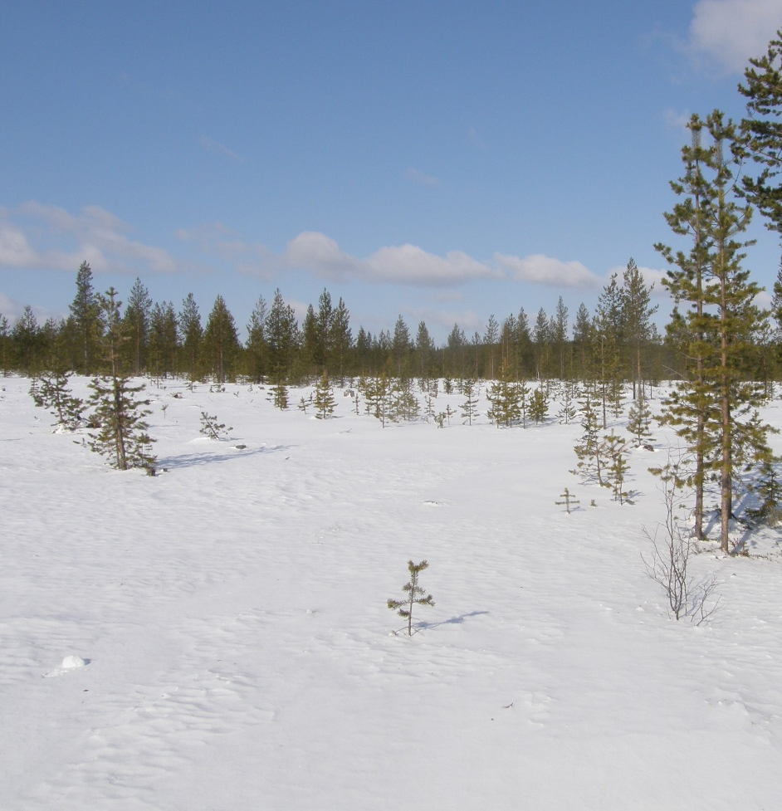
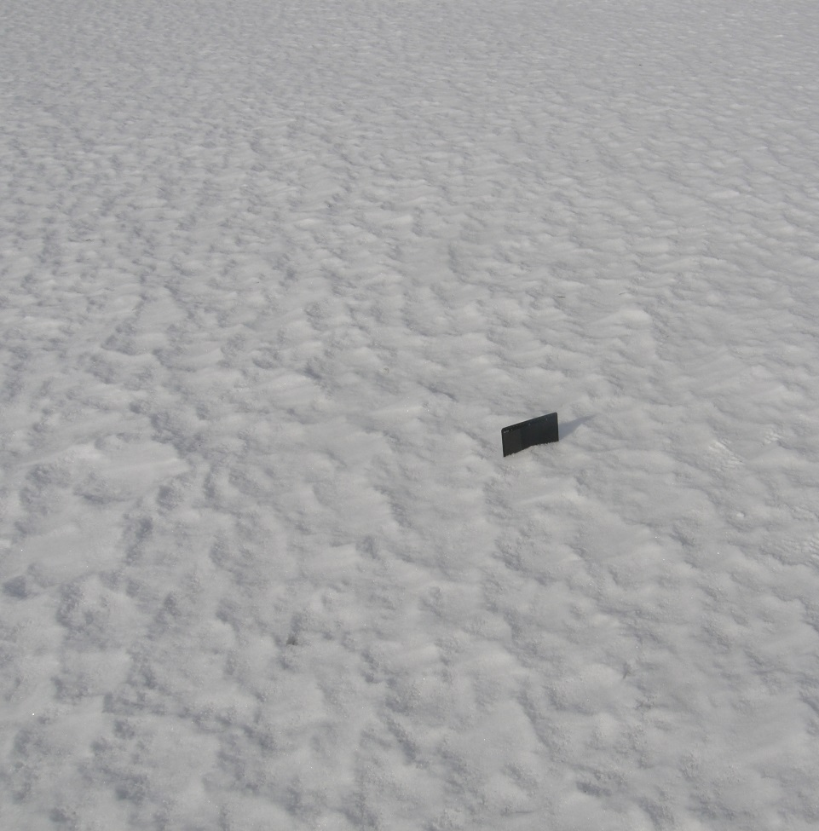
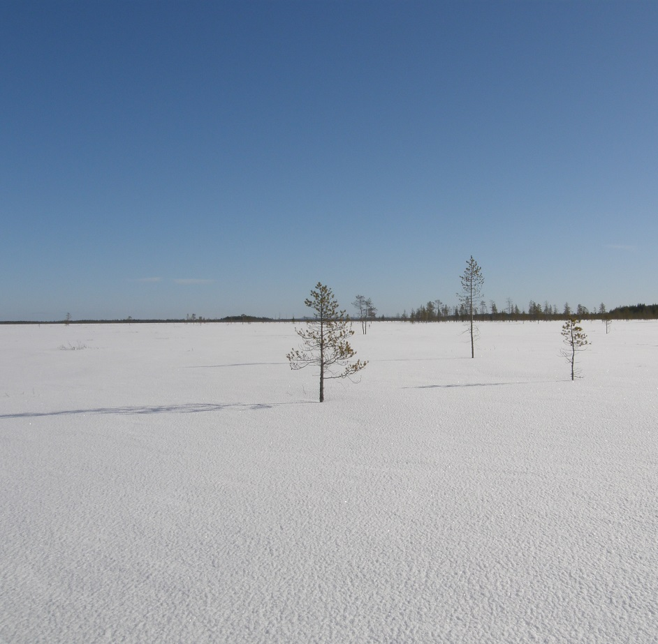
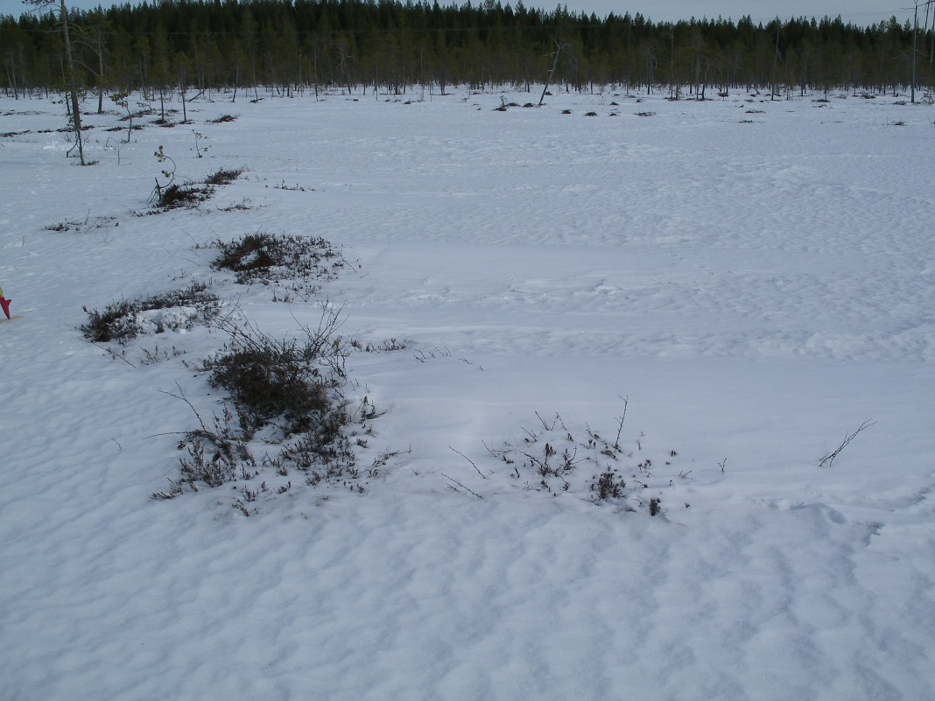
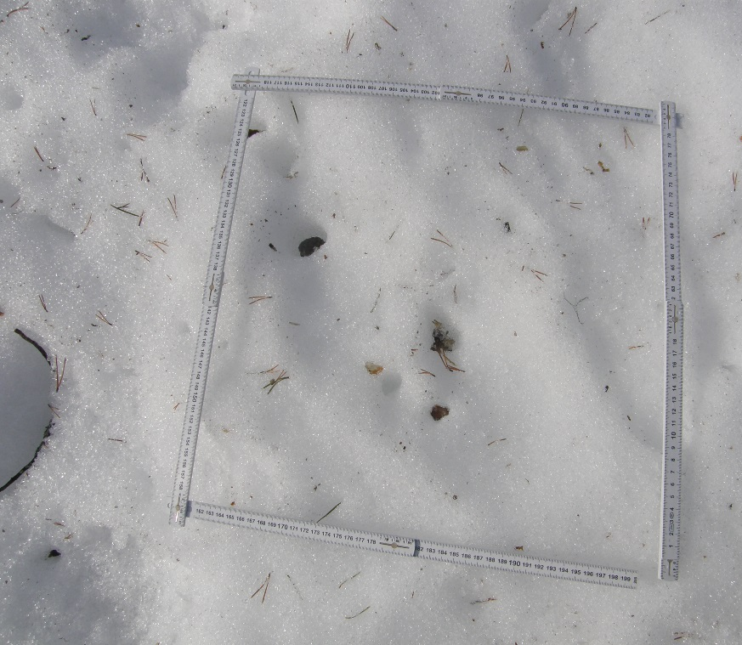
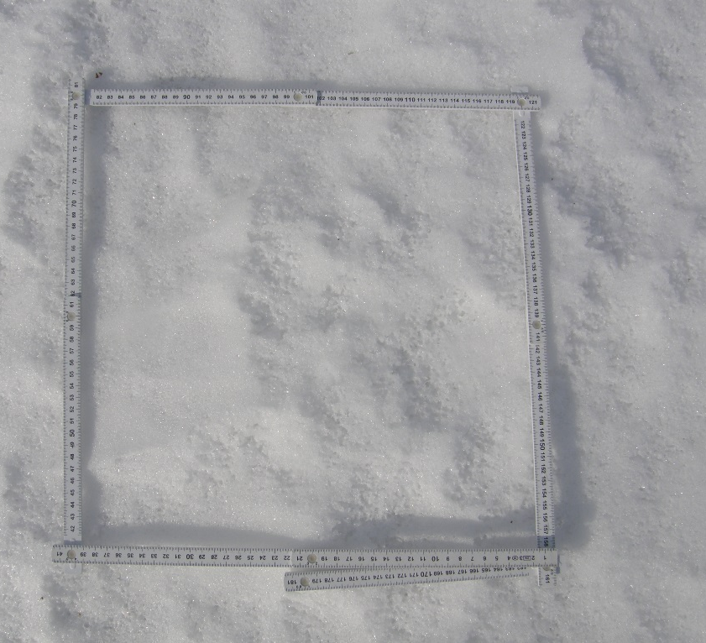
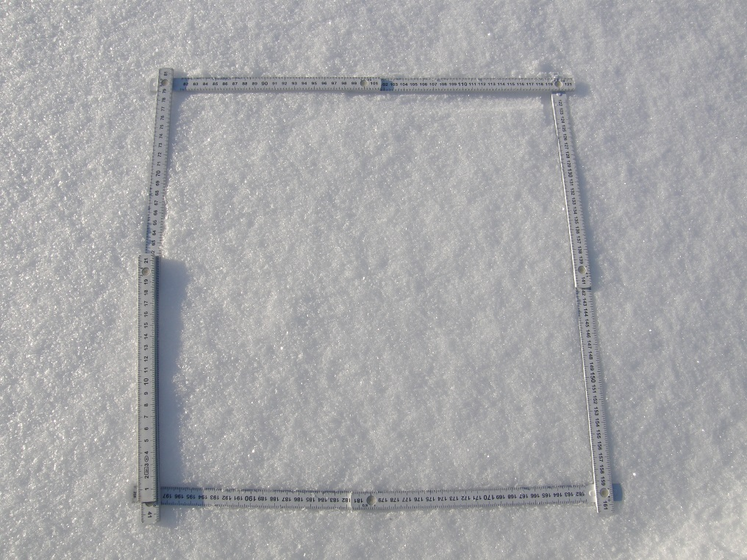
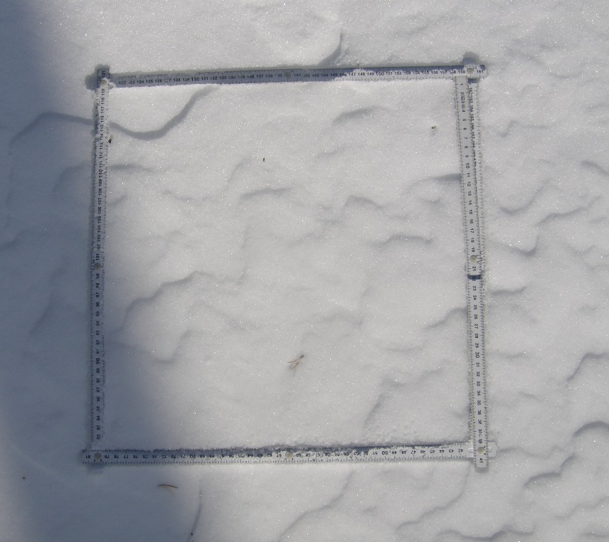
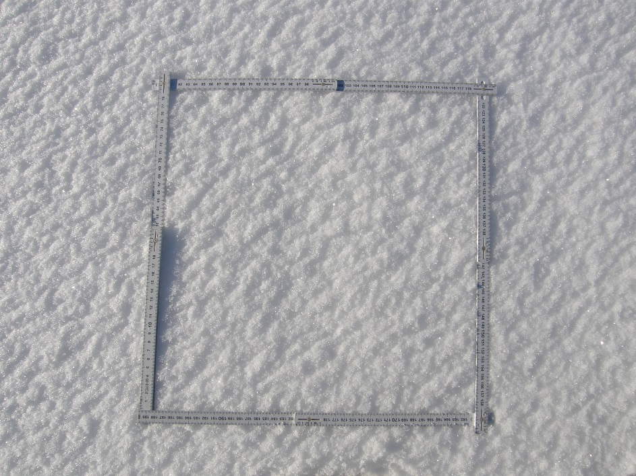
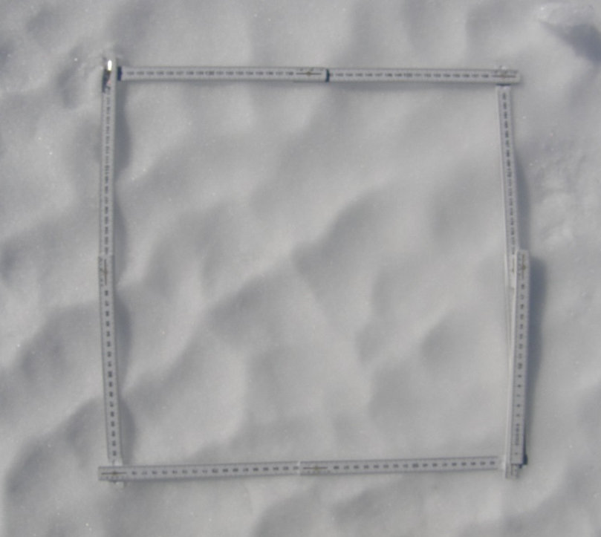
Examples of surface roughness at Sodankylä in 2009 - 2010
April 20, 2009
March 11, 2009
March 17, 2009
April 22, 2009
April 21, 2009
April 27, 2009

Slide 6
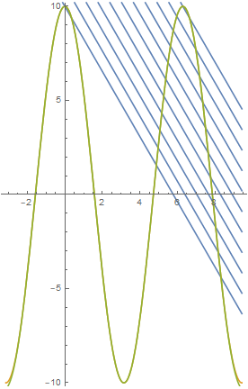
Shadowing effect in mm scale

Slide 7
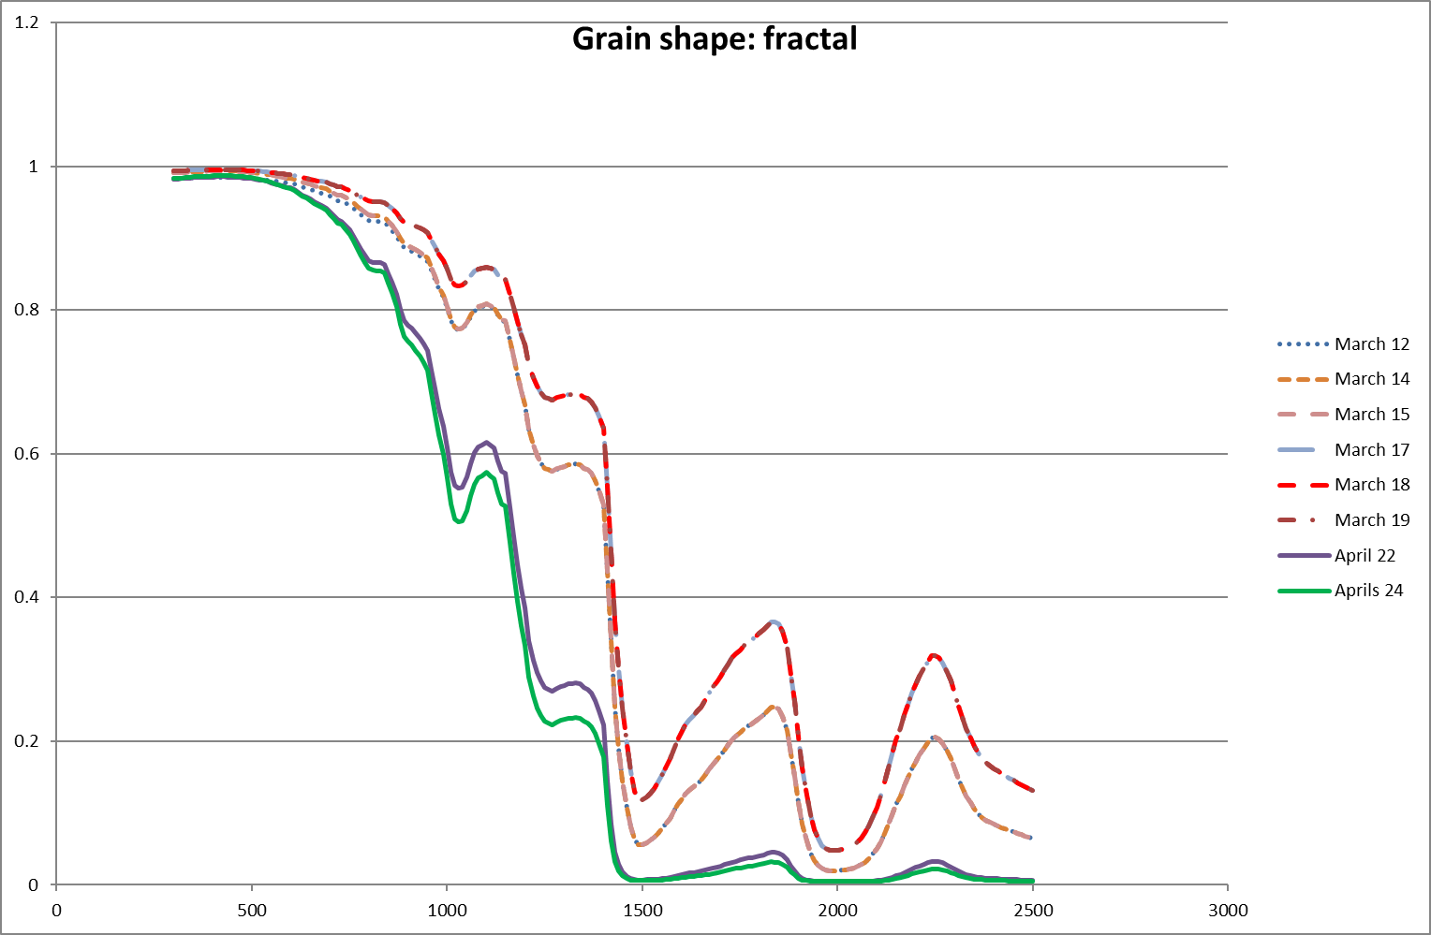
TARTES albedo modelling using grain size data

Slide 8
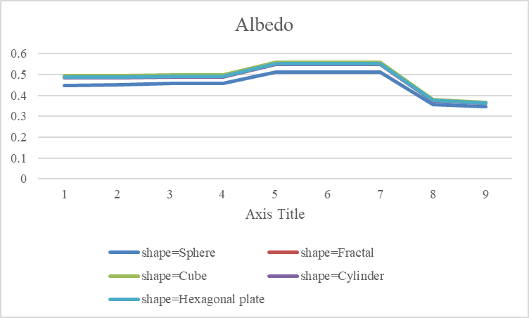
TARTES albedo modelling of the snowpack
1: 12.3.2009, 3 layers
2: 14.3.2009, 3 layers
3: 14.3.2009, 2 layers
4: 15.3.2009, 3 layers
5: 17.3.2009, 3 layers
6: 18.3.2009, 3 layers
7: 19.3.2009, 3 layers
8: 22.4.2009, 2 layers
9: 24.4.2009, 2 layers

Slide 9
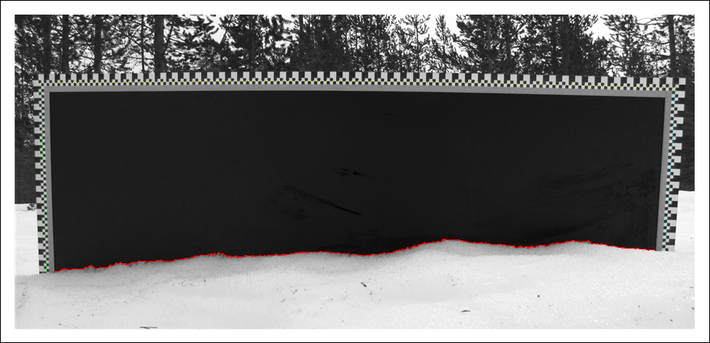
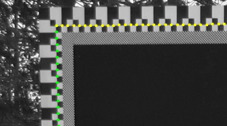
Snow profile measurements
Terhikki Manninen, Kati Anttila, Tuure Karjalainen and Panu Lahtinen, 2012, ” Automatic snow surface roughness estimation using digital photos”, Journal of Glaciology, Volume 58, Number 211, September 2012 , pp. 993-1007(15). DOI: http://dx.doi.org/10.3189/2012JoG11J144.

Slide 10




Description of multiscale snow surface roughness
Brownian motion:
Empirical:
$$rms height σ\left(x\right)=cx^{b}$$
$$σ\left(x\right)=\exp\left(a\right)x^{b}$$
$$correlation length L\left(x\right)=k_{0}x$$
$$L\left(x\right)=k_{00}+k_{0}x$$
Autocorrelation functions in multiscale, such as exponential:
A.T. Manninen, Physica A 319 (2003) 535–551

Slide 11
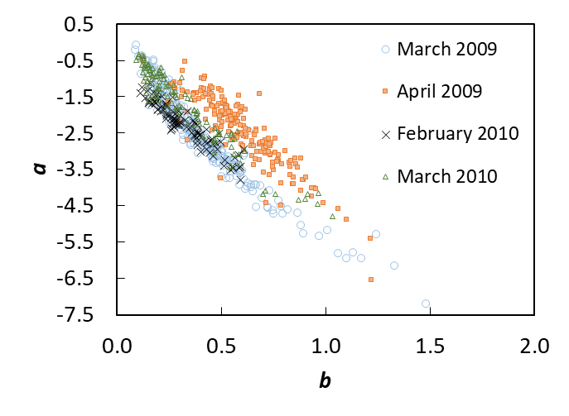
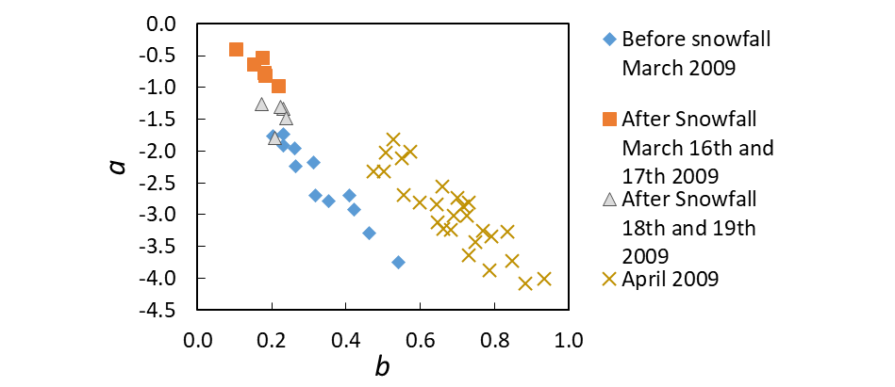
Multiscale parameters to describe snow surface roughness
SNORTEX-campaign in Sodankylä 2009-2010
Measurements made in different locations with different land use
The multiscale parameters can detect the level of melting
The aging of the snow surface can be seen using the multiscale parameters
Anttila, K., T. Manninen, T. Karjalainen, P. Lahtinen, A. Riihelä, and N. Siljamo (2014), The temporal and spatial variability in submeter scale surface roughness of seasonal snow in Sodankylä Finnish Lapland in 2009–2010, J. Geophys. Res. Atmos., 119, 15, pp. 9236-9252, doi:10.1002/2014JD021597.
Notes:
Kun pinnan karkeus on mitattu, sitä pitää kuvata. Koska säteilyn ja heijastumisen kannalta useat eri mittakaavat ovat merkittäviä, tarvitaan muuttujia, jotka kuvaavat eri mittakaavoja.
Tässä väitöstyössä testattiin kahden tällaisen muuttujan käyttöä lumen pinnankarkeuden kuvaamisessa
Nämä muuttujat ovat a ja b, joista a on herkkä pinnan korkeusvaihtelulle ja b korkeusvaihtelun jakautumiselle profiilin matkalla.
Muuttujia testattiin levymetodilla kerätyillä profiileilla, jotka mitattiin Sodankylässä vuosoina 2009 ja 2010.
Profiilit mitattiin SNORTEX-kampanjan aikana.
Levyprofiileja mitattiin eri tyyppisissä paikoissa, esim. järven jäällä, metsässä, suolla jne. Yhteensä kerättiin 669 profiilia.
Tuloksista nähdään, että nämä parametrit kykenevät erottelemaan kevättalven sulavan lumen ja keskitalven lumen toisistaan.
Tämä johtuu siitä että parametri a on herkkä pienten mittakaavojen korkeusvaihtelulle, ja b on herkkä korkeusvaihteluiden jakautumiselle profiilin matkalla siten että epäsäännöllisyys nostaa b:n arvoa
Parametreja käyttäen kyettiin myös näkemään lumisateen vaikutus pinnankarkeuteen ja pintalumen ikääntymisen vaikutus pinnankarkeuteen.

Slide 12
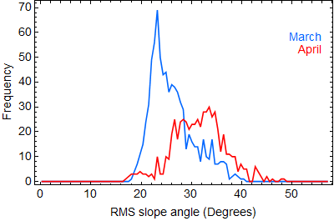
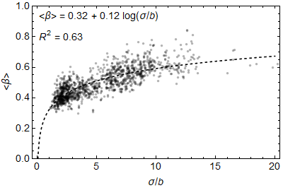
RMS slope (β ) distribution and relation with other roughness parameters

Slide 13
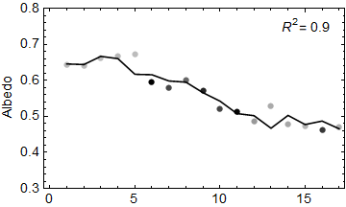
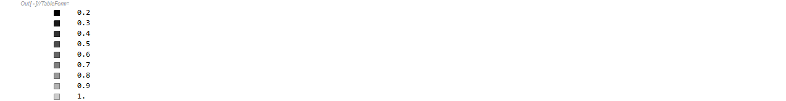
Measured albedo at Sodankylä in March – April, 2009
0312
0313
0314
0315
0316
0317
0318
0319
0420
0421
0422
0423
0424
0425
0426
0427
0428
Fraction of diffuse irradiance
67.368°N, 26.633°E
Solar zenith angle = 73°
Linear regression to roughness parameters b and k₀₀

Slide 14
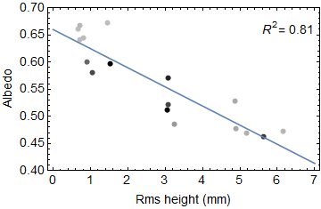
Measured albedo vs. roughness at Sodankylä in March – April, 2009
Fraction of diffuse irradiance
67.368°N, 26.633°E
Solar zenith angle = 73°
Linear regression to rms height

Slide 15

Snow surface roughness during SNORTEX campaign 2009
About 1300 profiles
1 m long, ~ 0.26 mm spatial resolution
March 11 – April 28, 2009
Ray tracing for geometric optics scattering from facets
number of reflections per ray
direction of escaping scattering

Slide 16
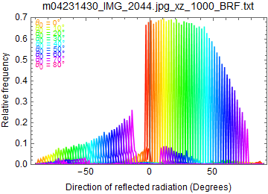
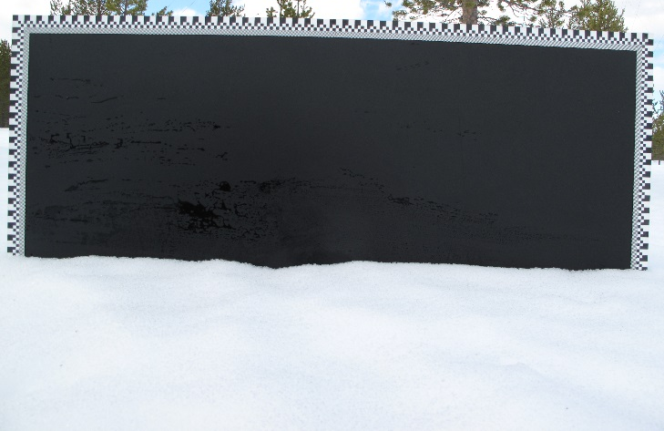
Forward scattering
SNORTEX, April 23

Slide 17
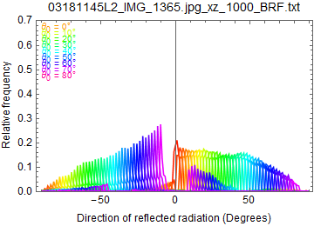
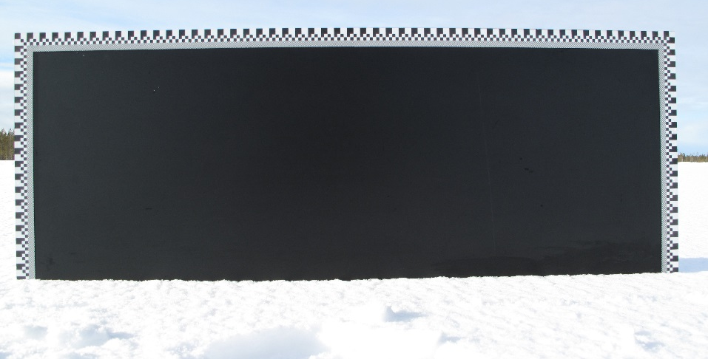
Backward scattering
SNORTEX, March 18

Slide 18
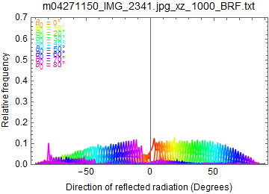
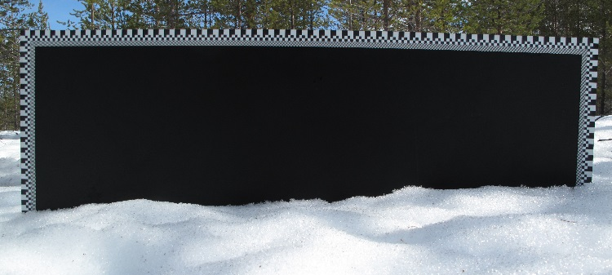
Isotropic scattering
SNORTEX, April 27

Slide 19
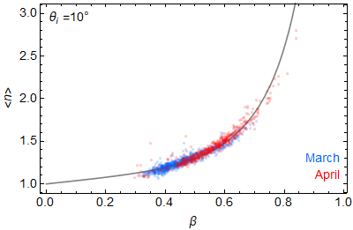
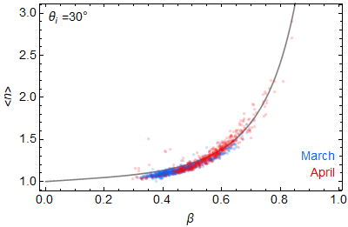
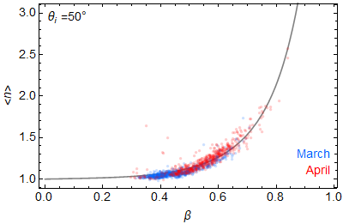
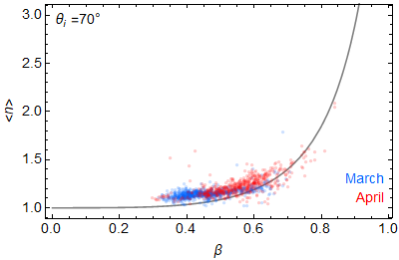
Number of surface reflections per ray vs. RMS slope

Slide 20
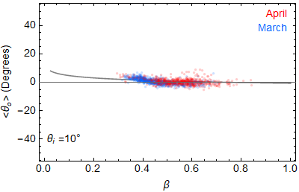
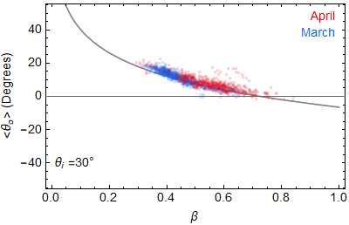
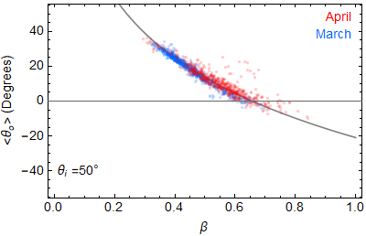
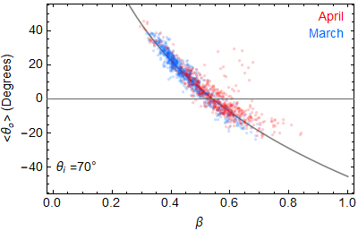
Scattering angle relation with RMS slope

Slide 21
Contribution of snowpack surface to scattering
Multiple reflections on the surface are possible
The photon recollision probability on the surface is not the same as in the bulk part of the snowpack
Each facet can be considered smooth snowpack with local incidence angle

Slide 22
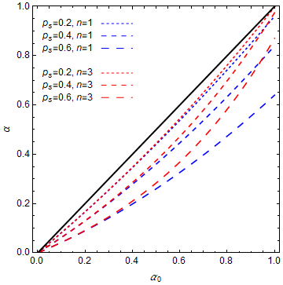
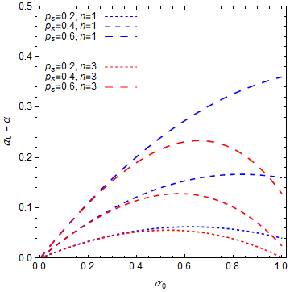
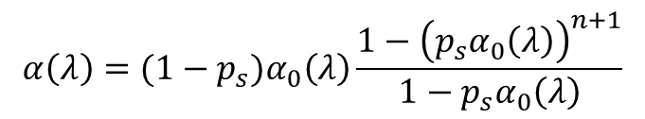
Modelled effect of surface roughness on total snowpack albedo
p_{s} = photon recollision probability of surface
n = number of additional reflections per ray from surface (0, 1, …)
α₀ = bulk albedo of snowpack
α = total albedo of snowpack
$$α\left(λ\right)=(1−p_{s})α_{0}\left(λ\right)\frac{1−{\left(p_{s}α_{0}\left(λ\right)\right)}^{n+1}}{1−p_{s}α_{0}\left(λ\right)}$$

Slide 23

Modelled surface roughness effect of measured diffuse albedo
Each point is based on of 9 (or 7) separate profiles (values of n).
The total albedo value α of each point is the median of the albedo value measured during the diffuse part (diffuse irradiance fraction > 0.8) of the day.
The p_{s} and α₀ values per day are derived by nonlinear fitting of the equation of the total albedo α

Slide 24
Summary
Small scale surface roughness reduces the albedo of the surface due to multiple reflection and in some cases by trapping the incoming radiation completely.
The effect increases with increasing roughness and decreasing reflectance, i.e. the effect increases with gradual melting of snow.
The effect of the surface roughness of the order of 10 % in April 2009 seems possible.
Surface roughness has to be taken into account, if the surface albedo is modelled within the target accuracy defined by GCOS (2%).

Slide 25

Thank you for your attention!

Slide 26




Snow surface in meter scale

Slide 27
Snow surface in mm scale

