Slide 1
Modeling the Evolution of the Structural Anisotropy of Snow
Silvan Leinss, Henning Löwe, Martin Proksch, Anna Kontu
EARSeL 2020
03. Februrary 2020,
Leinss, Löwe et al. «Modeling the Evolution of the Structural Anisotropy of Snow», The Cryosphere, Jan (2020).

Slide 2
Motivation
Microwave measurements (radar satellites, groundbased) of snow indicate a dielectric anisotropy.
Computer tomography measurements (snow lab) indicate a structural anisotropy.
Lab and field experiments indicate an anisotropy in the thermal conductivity, mechanical properties, diffusivity and permeability properties*.
The anisotropy of snow is a key parameter for improving descriptions of many important properties of snow.
No model exists to predict the evolution of the anisotropy of snow. Here, we propose a first simple attempt.
* For references see Leinss, Löwe et al., The Cryosphere, Jan (2020).

Slide 3
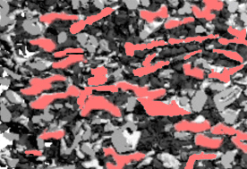
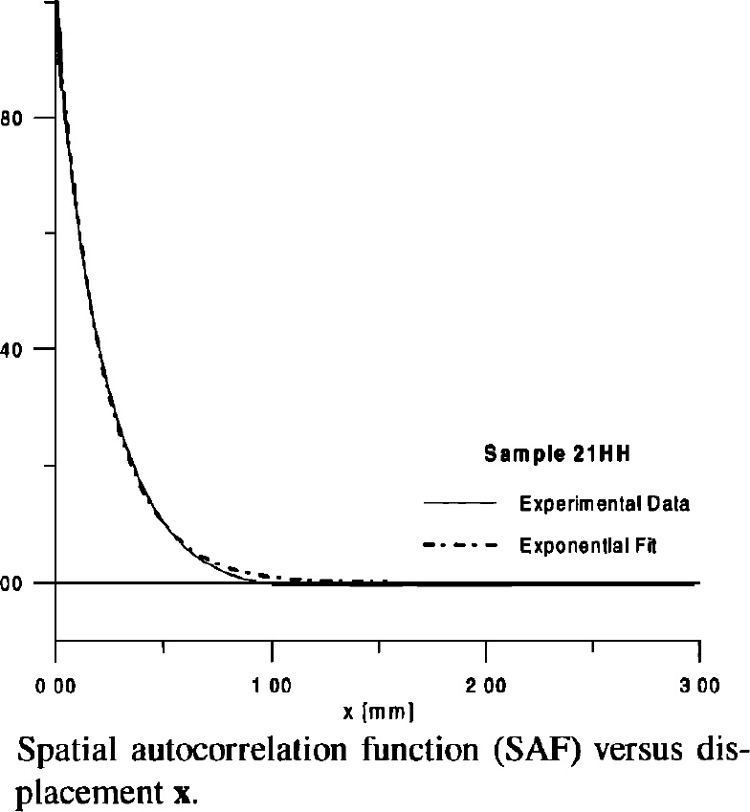
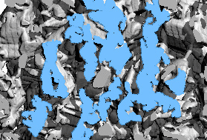
Definition of the structural anisotropy
The shape of the spatial autocorrelation function (SAF) of the ice/air matrix defines different correlation lengths, e.g. the exponential correlation length p_{ex} (from fitting an exponential to the SAF).
„effektive“ snow structure
a_{z}
a_{x}
Snow microstructure of fresh snow (computer tomography)
Anisotropy = Normalized difference of horizontal and vertical length scales
(Wiesmann et al., Radio Science (1998))
e.g. :
a_{x} = p_{ex,x =} p_{ex,y}, a_{z} = p_{ex,z}
Snow microstructure of old snow
Note: the exponential shape of the correlation function is not always given!

Slide 4
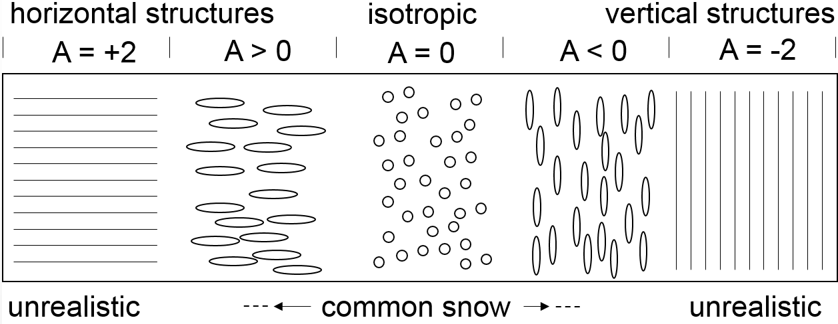
The structural anisotropy of snow
Snow microstructure of fresh snow
A_{min}
Snow microstructure of old snow
A_{max}
For snow, the anisotropy seems to range between -0.4 and +0.4. Perfect horizontal and vertical structures are never reached.

Slide 5
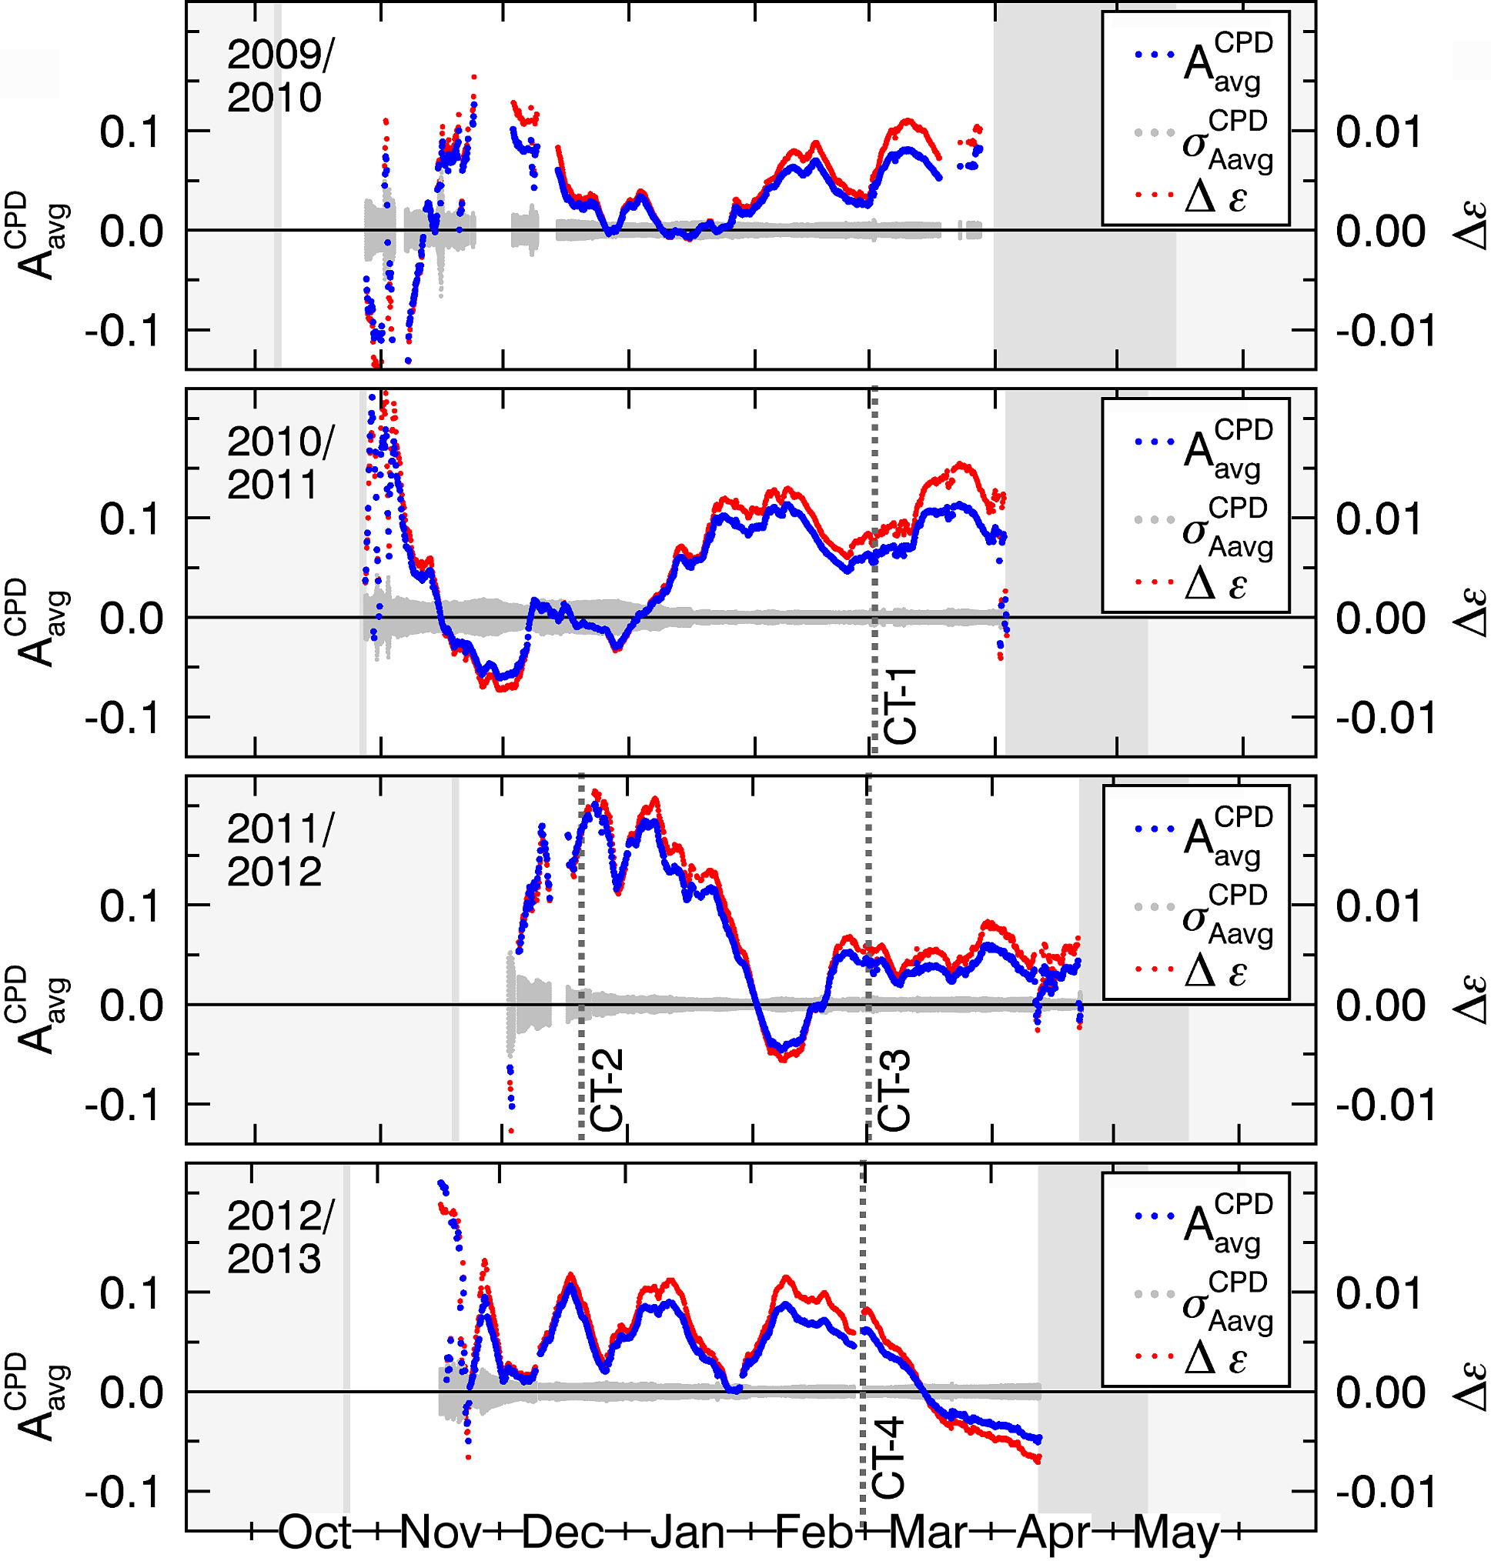
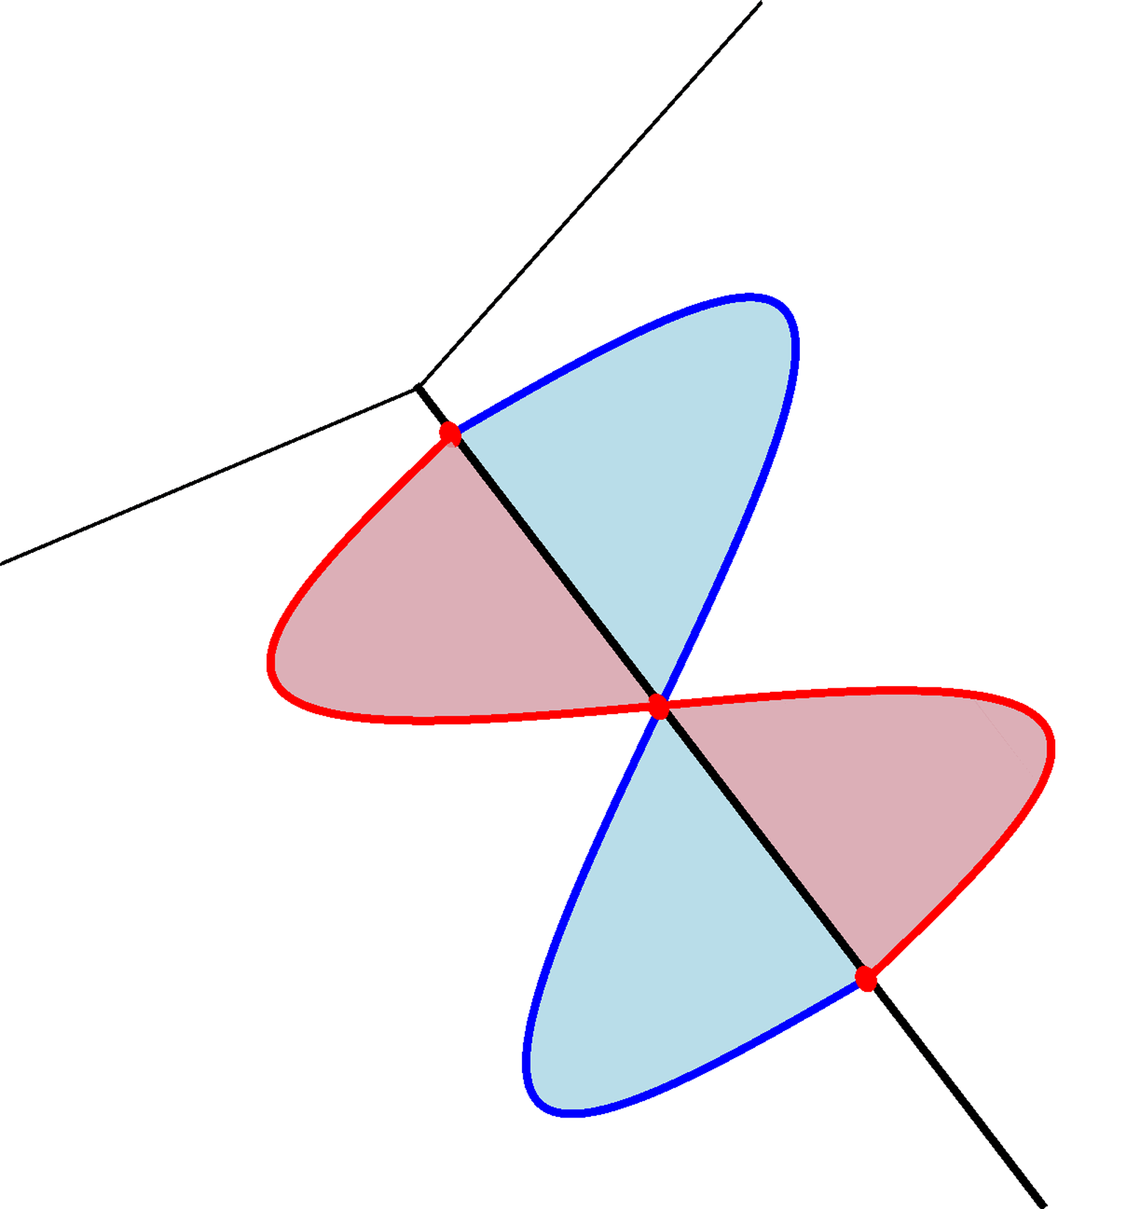
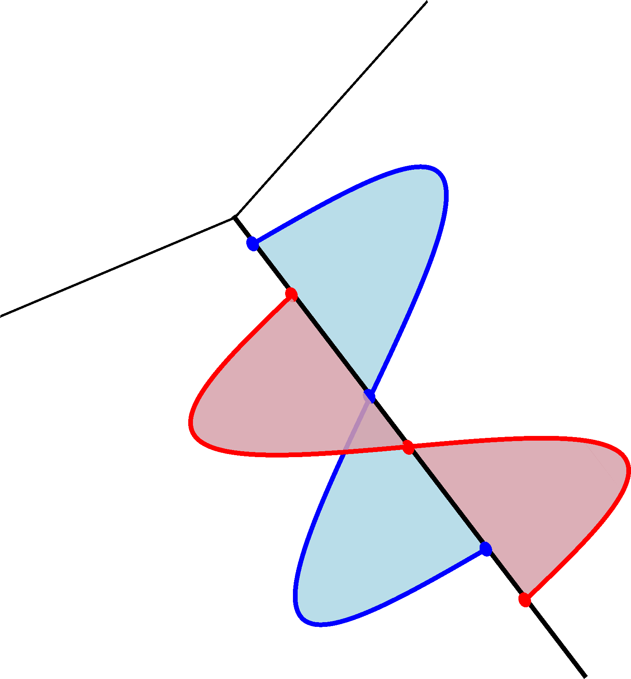
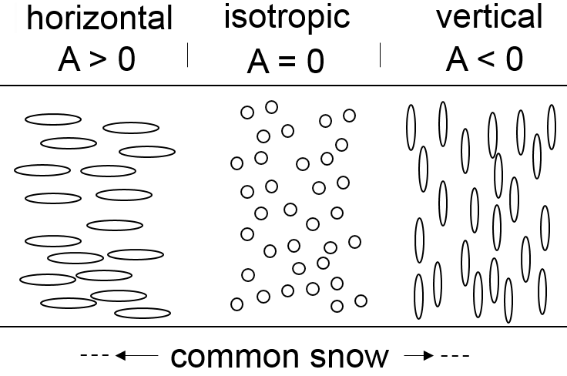
Measuring the anisotropy with radar
Radar transmit
V
receive
V
Co-polar Phase Difference
$$CPD=f(A, Δz, θ,ρ_{snow})$$
H
phase shift
H
Anisotropy $A= f^{−1}(CPD,…)$
θ
snow
Permittivity $ε= \left(\begin{matrix}ε_{x} & 0 & 0 \\ 0 & ε_{y} & 0 \\ 0 & 0 & ε_{z}\end{matrix}\right)$
n² = ε ◊ propagation delay
4 years of anisotropy data!
Δz
z
y
x
$$ε_{x}=ε_{y}≠ε_{z}$$
soil
Method: Leinss et al. «Anisotropy of seasonal snow measured by polarimetric phase differences in radar time series», The Cryosphere (2016)

Slide 6
Four years of anisotropy data from radar
Measured in Sodankylä, Finland.
Longest time series of anisotropy measurements.
Temporal sampling: 4 hours.
Measurements at different frequencies and incidence angles show consistent results.
Unique dataset for development of new physical snow models which consider the anisotropy.
Validation by computer tomography: CT-1, -2, -3, -4.

Slide 7
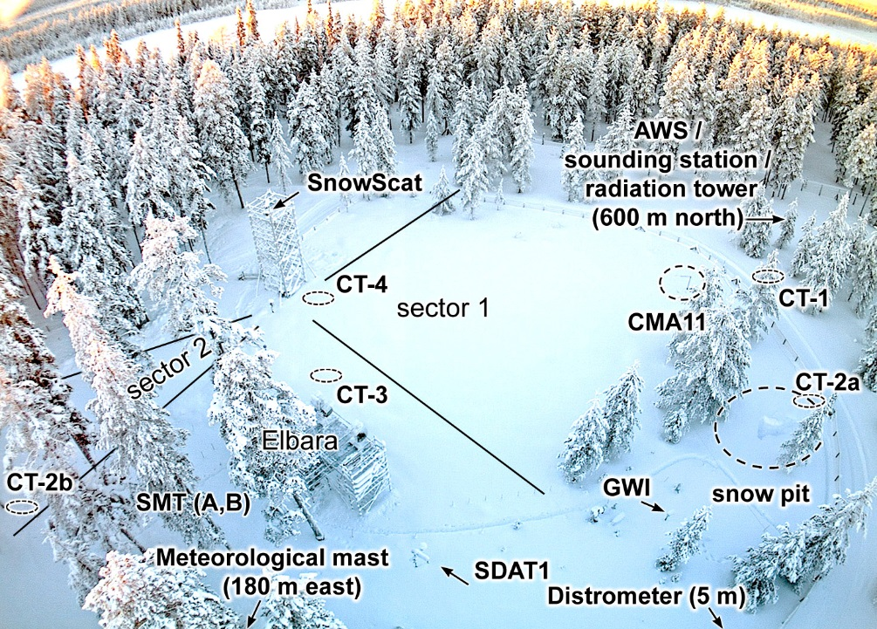
Test site, Sodankylä, Finland.
Webcam image of the Intensive Observation Area (IOA), Sodankylä, Finland (maintenance of the site by the Finish Meteorology Institute, FMI)
Dataset from the Nordic Snow and Radar Experiment (NOSREX I-III) Campaigns (ESA).
Excellently managed test site
Redundant sensors
Different sensors for same parameter (for detection of systematic biases)
Meta data for sensors
Open communication of instrument malfunction
Computer server / data base
High (spatiotemporal) resolution webcam to identify/interpret irregularities in data.

Slide 8
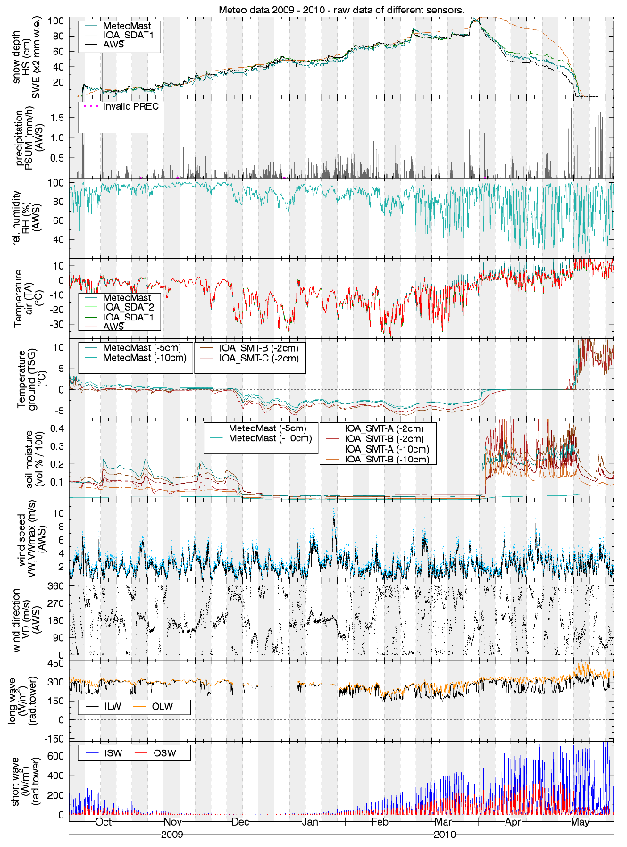
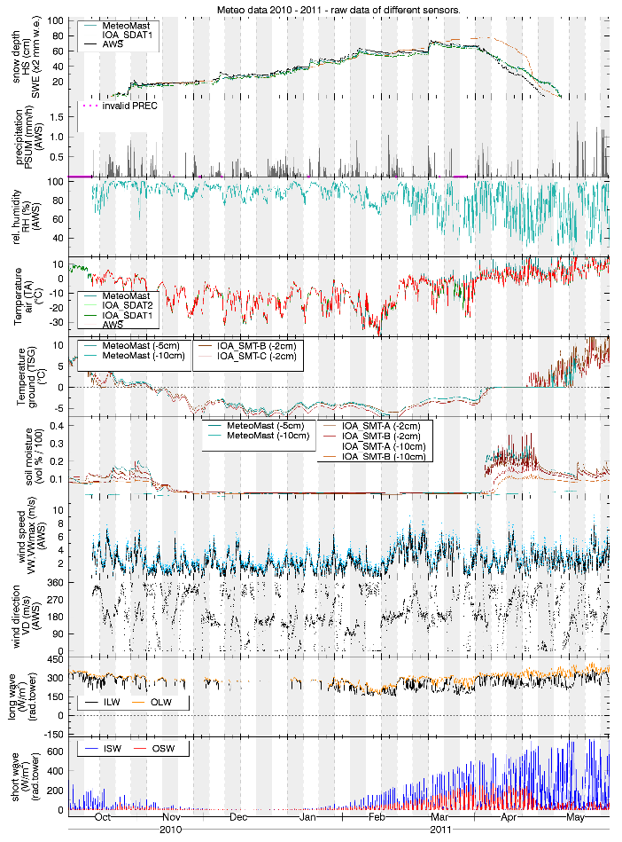
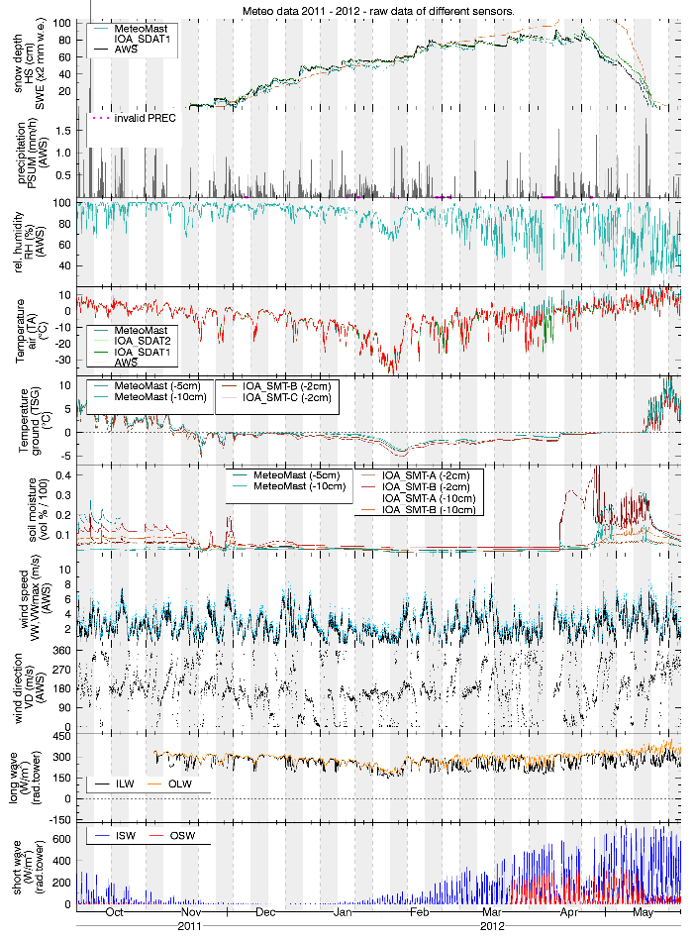
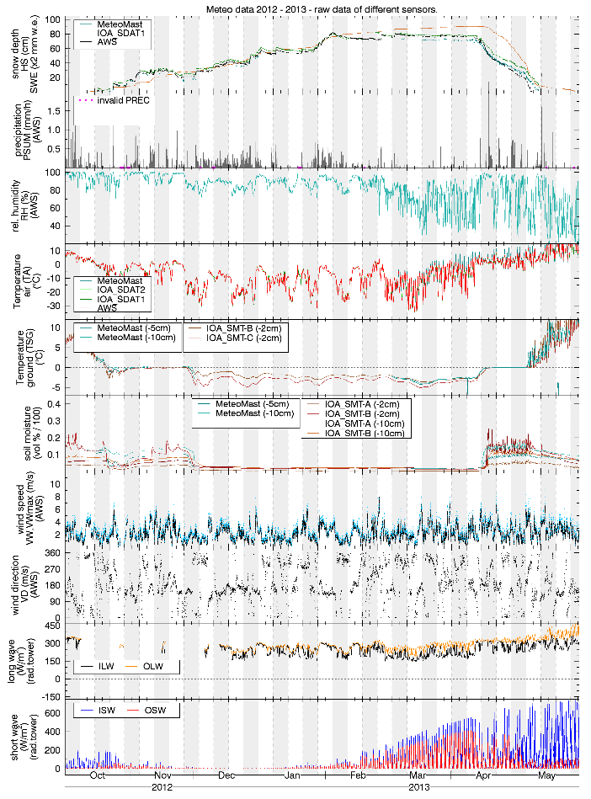
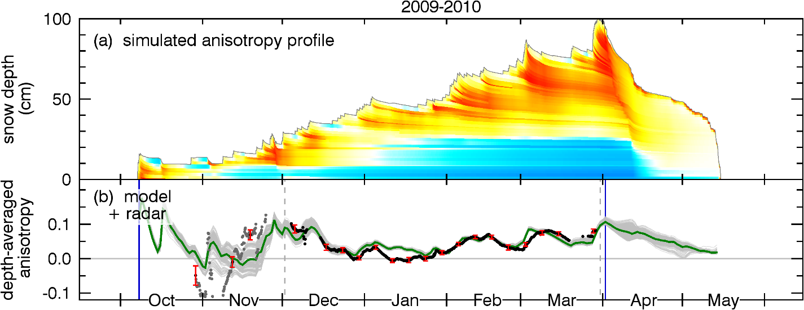
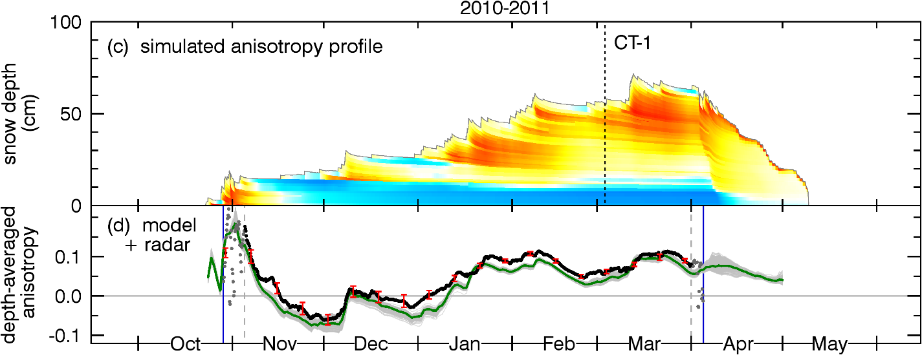
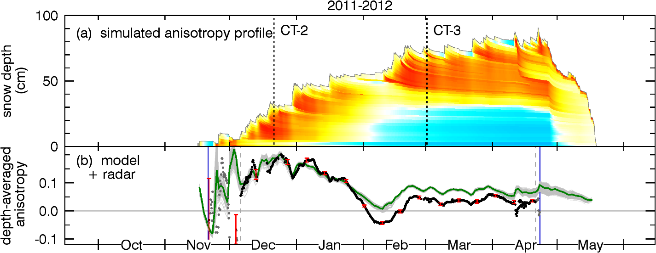
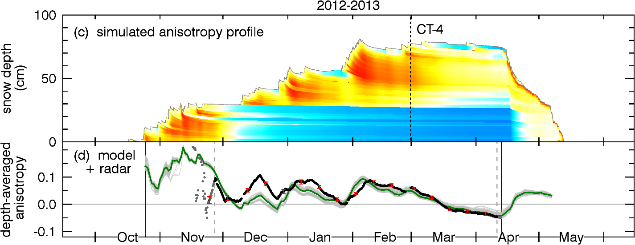
Modeling the anisotropy
New model:
Anisotropy =
f (settling, TGM)
Model: SNOWPACK
4 years of meteorological data

Slide 9
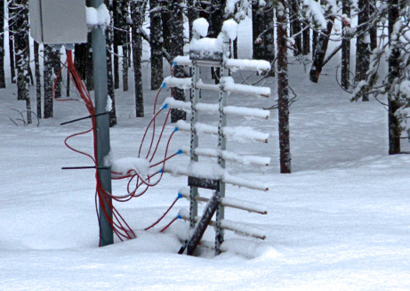
Interlinking of models
Ensemble of input data and settings
Use quality-controlled results from SNOWPACK as input for a second model which simulates the anisotropy for each single snow layer.
To analyze nonlinear responses of the anisotropy model we used an ensemble of the best 300 slightly different snowpack results (of 5000+ ensemble members in total).
HS TS SWE
SNOWPACK
Model framework 1 (SNOWPACK)
Result
Radar, CT (literature)
Validation & Selection
Calibration of SNOWPACK by testing different model options and by calibration of the radiation balance to best reproduces snow temperature and snow height when driven by precipitation (calibrated by SWE measurements).
Best 300 ensemble members
Anisotropy model
Model framework 2 (Anisotropy model)
Result
CT (field)
Snow temperature sensor array
Validation

Slide 10
Model for the evolution of the structural anisotropy
Generic model:
Ficks law for diffusion of water vapor flux:
Apply equation for every snow layer (Langrangian view).
Anisotropy evolution driven by temperature gradient metamorphism (TGM) and by snow settling (strain):
Core of the anisotropy model
Standard thermodynamic relations for water vapor saturation pressure:
Ideal gas equation:
A_{min}, A_{max} estimated from literature, radar; Free parameters: α₁, α₂

Slide 11
Model for the evolution of the structural anisotropy
Generic model:
Apply equation for every snow layer (Langrangian view).
Anisotropy evolution driven by temperature gradient metamorphism (TGM) and by snow settling (strain rate):
Core of the anisotropy model
Water vapor flux J_{v} depends on temperature and temperature gradient.
Strain rate predicted by SNOWPACK.
A_{min}, A_{max} estimated from literature, radar; Free parameters: α₁, α₂

Slide 12
Model for TGM
Metamorphism of snow under TGM
Anisotropy evolution does not depend on the sign of the water vapor flux
Smooth out diurnal temperature cycles of alternating temperature gradients
Limit growth of vertical structures to A_{min}
Phenomenological model parameter (to be determined).
Video from Pinzer et al. (The Cryosphere, 2012)

Slide 13
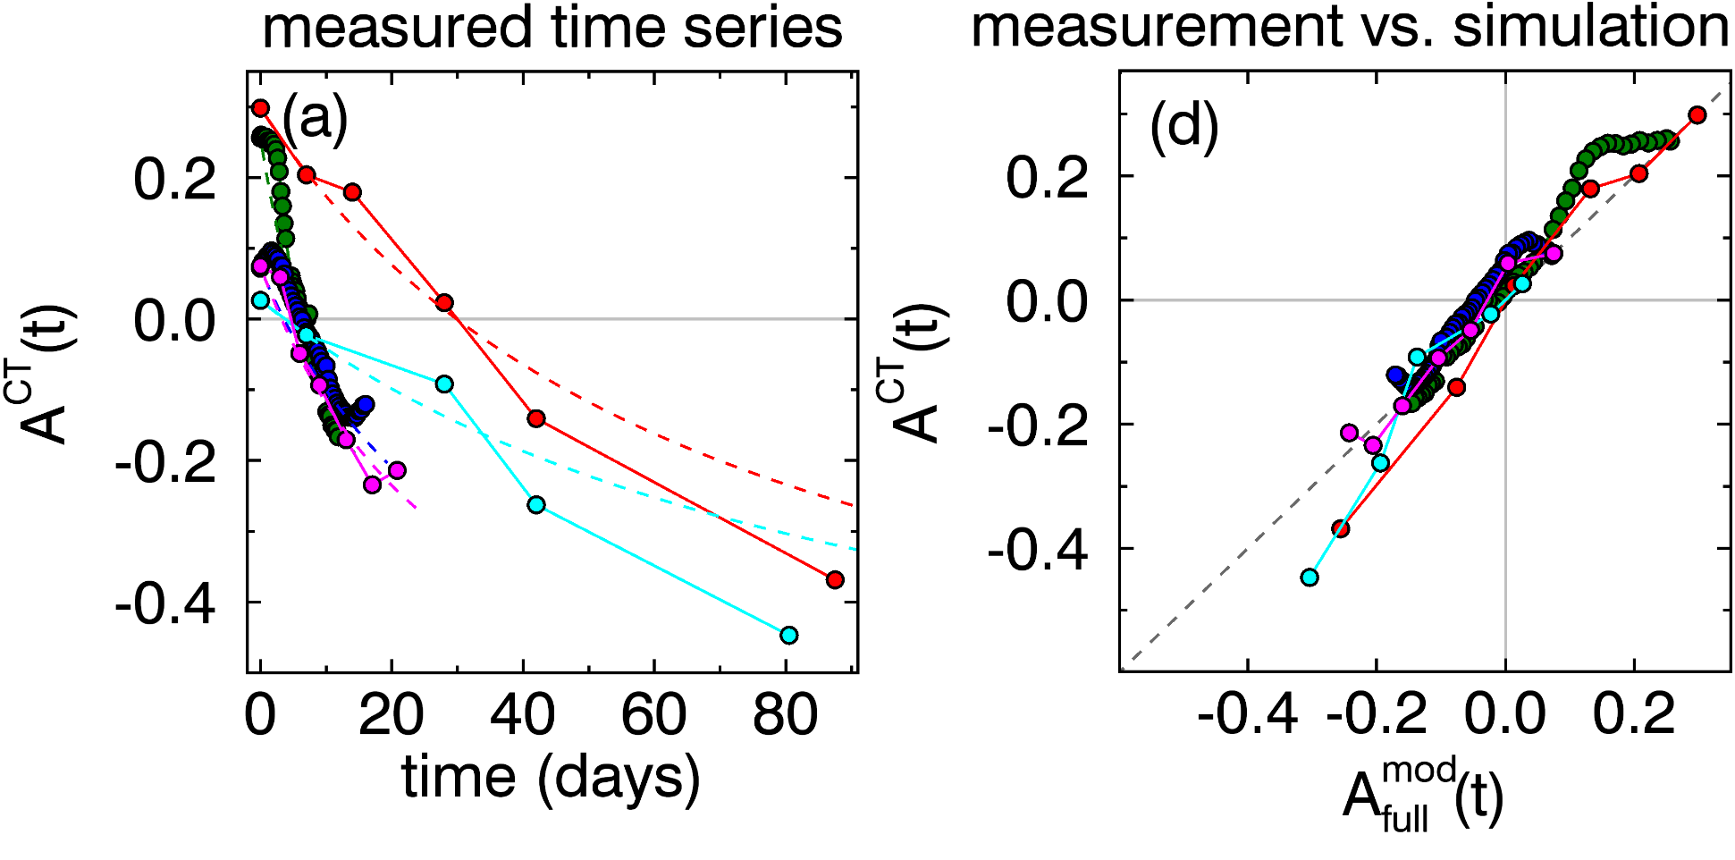
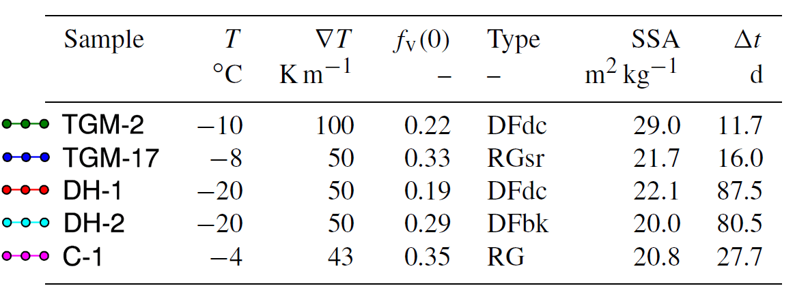
Validation with laboratory data
Anisotropy evolution of laboratory data and simulation agree for different snow temperatures and temperature gradients.
=> Determine free parameters for TGM A_{min} = -0.7 and α₁ = 1.01 m² kg⁻¹
Data from: - T. Kämpfer, GRL (2005); - H. Löwe, TC (2013); - F. Riche, J. Glac. (2013); - N. Calonne, TC (2014).

Slide 14
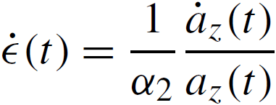
Model for snow settling
Relating strain rate $\dot{ε}(t)$ to Anisotropy A:
Snow volume
Anisotropy:
a_{z}
a_{z}
Consider non-affine effects (ice is incompressible, new contact points between crystals, etc.) by an phenomenological factor α₁:
a_{x}
a_{x}
Affine compression: reduction of correlation length a_{z}
Limits A between ±2 (theoretical extrem cases).
Resolve for
Introduce a natural upper limit based on literature values: A_{max} ≈ 0.3

Slide 15
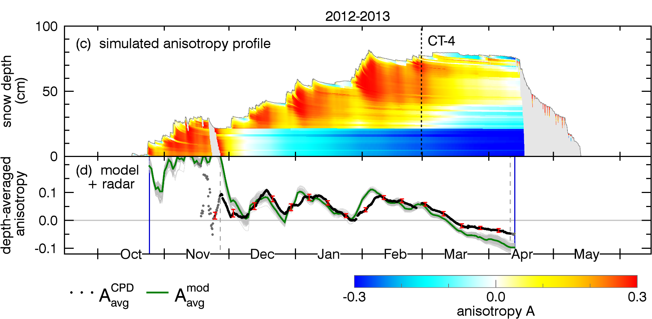
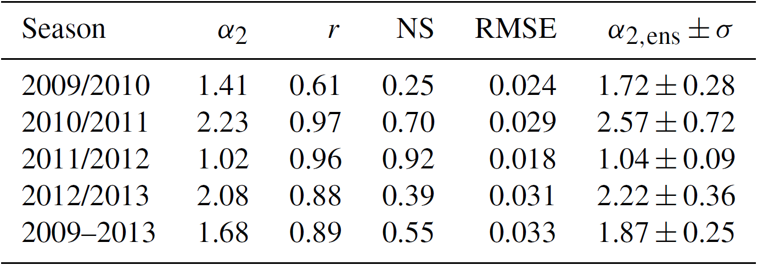
Determination of the free settling parameter α₂
Iterate α₂ until the depth-averaged anisotropy from the model ( ) has the minimum RMSE with respect to the depth-averaged anisotropy measured by radar ( ).
α₂ = 1.0 …. 2.5 (depending on season)
Mean value: α₂ ≈ 1.7 performs well for all seasons. Exact value not very critical due to bounds A_{min}, A_{max}.
No CT data available for calibration/validation of the anisotropy evolution under settling. Fresh snow is very difficult to handle in lab experiments. Radar provides a mean for measuring the anisotropy of fresh snow.

Slide 16
Model results
wet snow
wet snow
wet snow
wet snow
Model results for α₂ ≈ 1.7 applied on all four seasons. Wet snow (matamorphism) excluded from model.

Slide 17
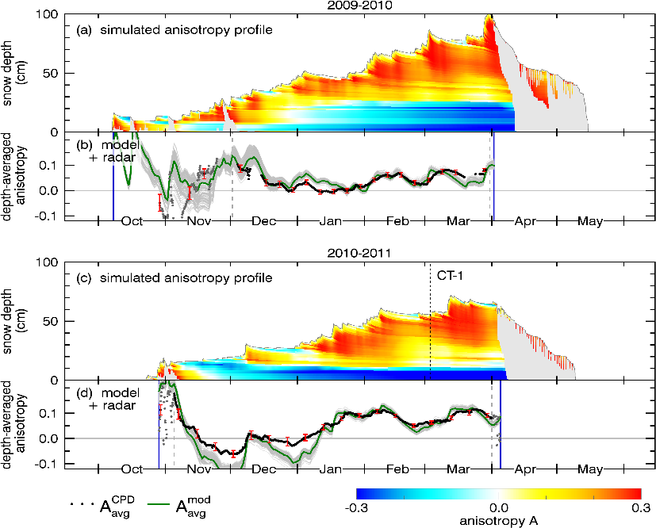
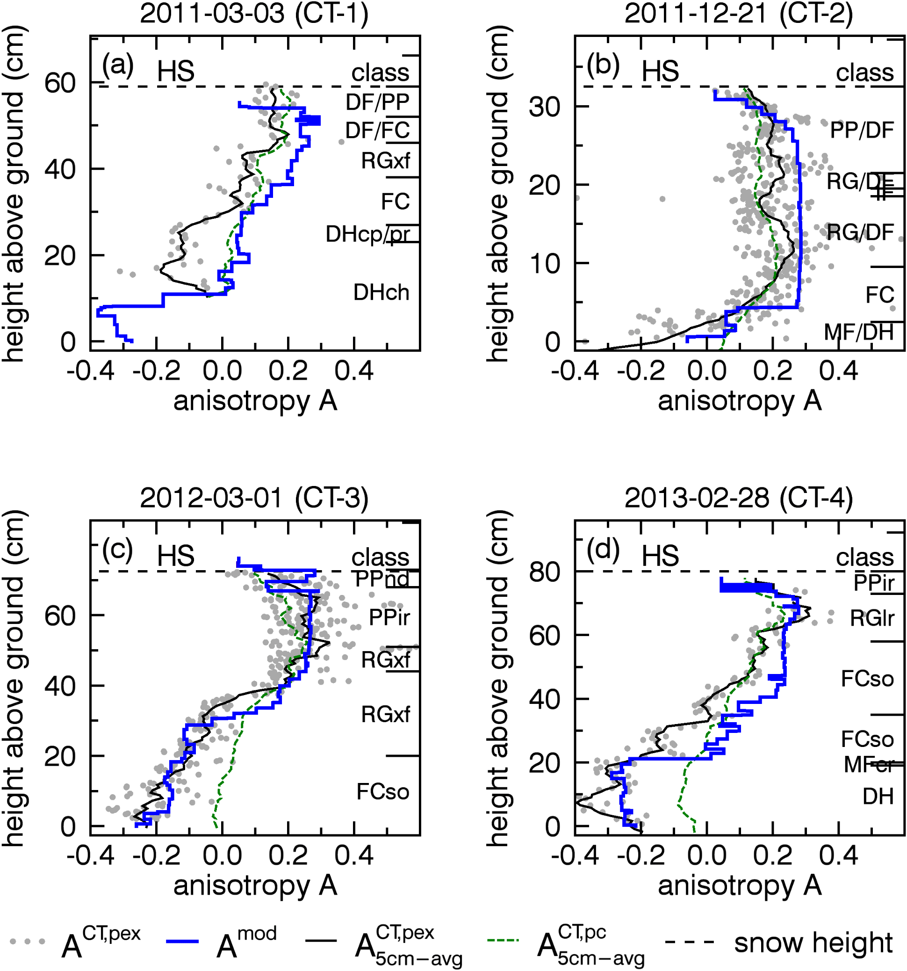
Validation with field-measured µCT data

Slide 18
Conclusion
Good agreement between radar measurements, model and CT data demonstrates that the anisotropy can be measured with polarimetric radar systems at 10 – 20 GHz non-destructively.
Remarkable, that a model that consists of a few simple equations that are based on thermodynamic mean fields ($\dot{ε}$, T, $∇$T) is able to model the structural anisotropy with an good accuracy. → The model allows for improved parametrization of thermal, mechanical and dielectric properties of the snow pack.
We confirmed TGM as one the main driver for the evolution of the structural anisotropy and identified snow settling as the main driver for horizontal structures.
Positive CPD changes measured by polarimetric radar can quantify fresh snow fall Leinss et al., JSTARS (2014). Up to now, no global mapping with VV, HH pol. radar.
The four years of anisotropy measurements, calibrated snowpack time series and CT validation data build a unique base for further development of snow models which consider the structural anisotropy of snow. Dataset available under: https://doi.org/10.3929/ethz-b-000121191.

Slide 19
Model results
Model results for α₂ ≈ 1.7 applied on all four seasons.

Slide 20
Model results (α₂ ≈ 1.7)
Model results for α₂ = (1.4, 2.2, 1.0, 2.1) optimized for each seasons.

Slide 21
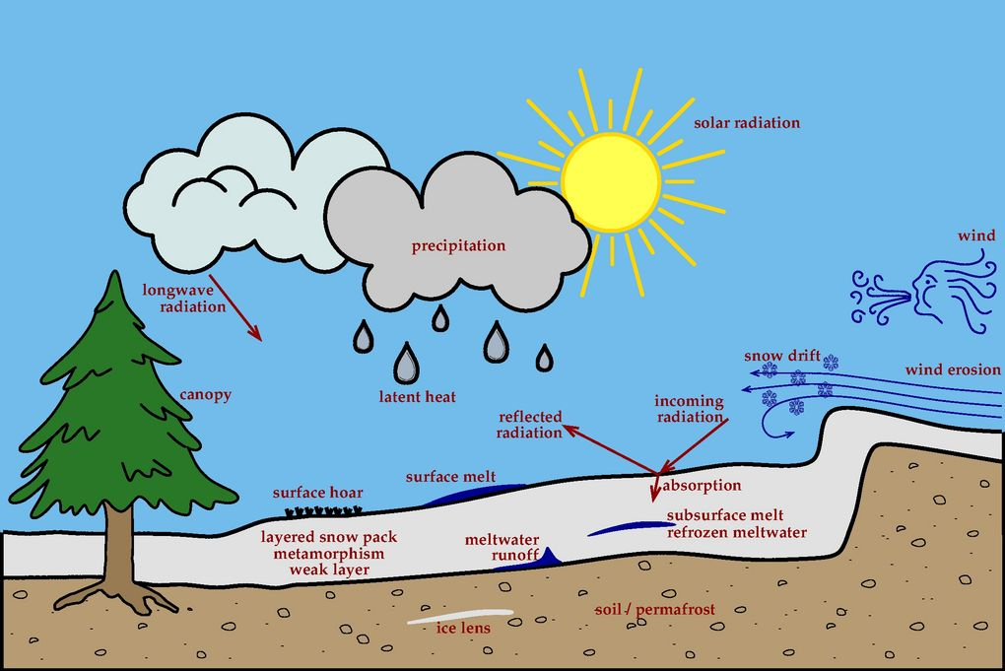
Forcing data for the model SNOWPACK
Required / possible input data:
Software: SNOWPACK by SLF
Defining the boundary condition in nature…
…and for differential equations:
LW incoming radiation,
snow surface temperature, LW emitted radiation, SW incoming radiation, SW reflected radiation,
air temperature, latent heat (rain on snow), relative humidity, precipitation sum /
snow height, precipitation phase,
wind speed,
wind direction, wind deposition,
canopy interception
air temperature
Energy balance Mass balance
Upper boundary
snow pack
soil temperature, geothermal heat flux, soil moisture, heat conductivity, heat capacity,
layered structure.
Lower boundary
Energy balance (Mass balance)
Source: https://www.slf.ch/en/services-and-products/snowpack.html
… hourly sampled.

Slide 22
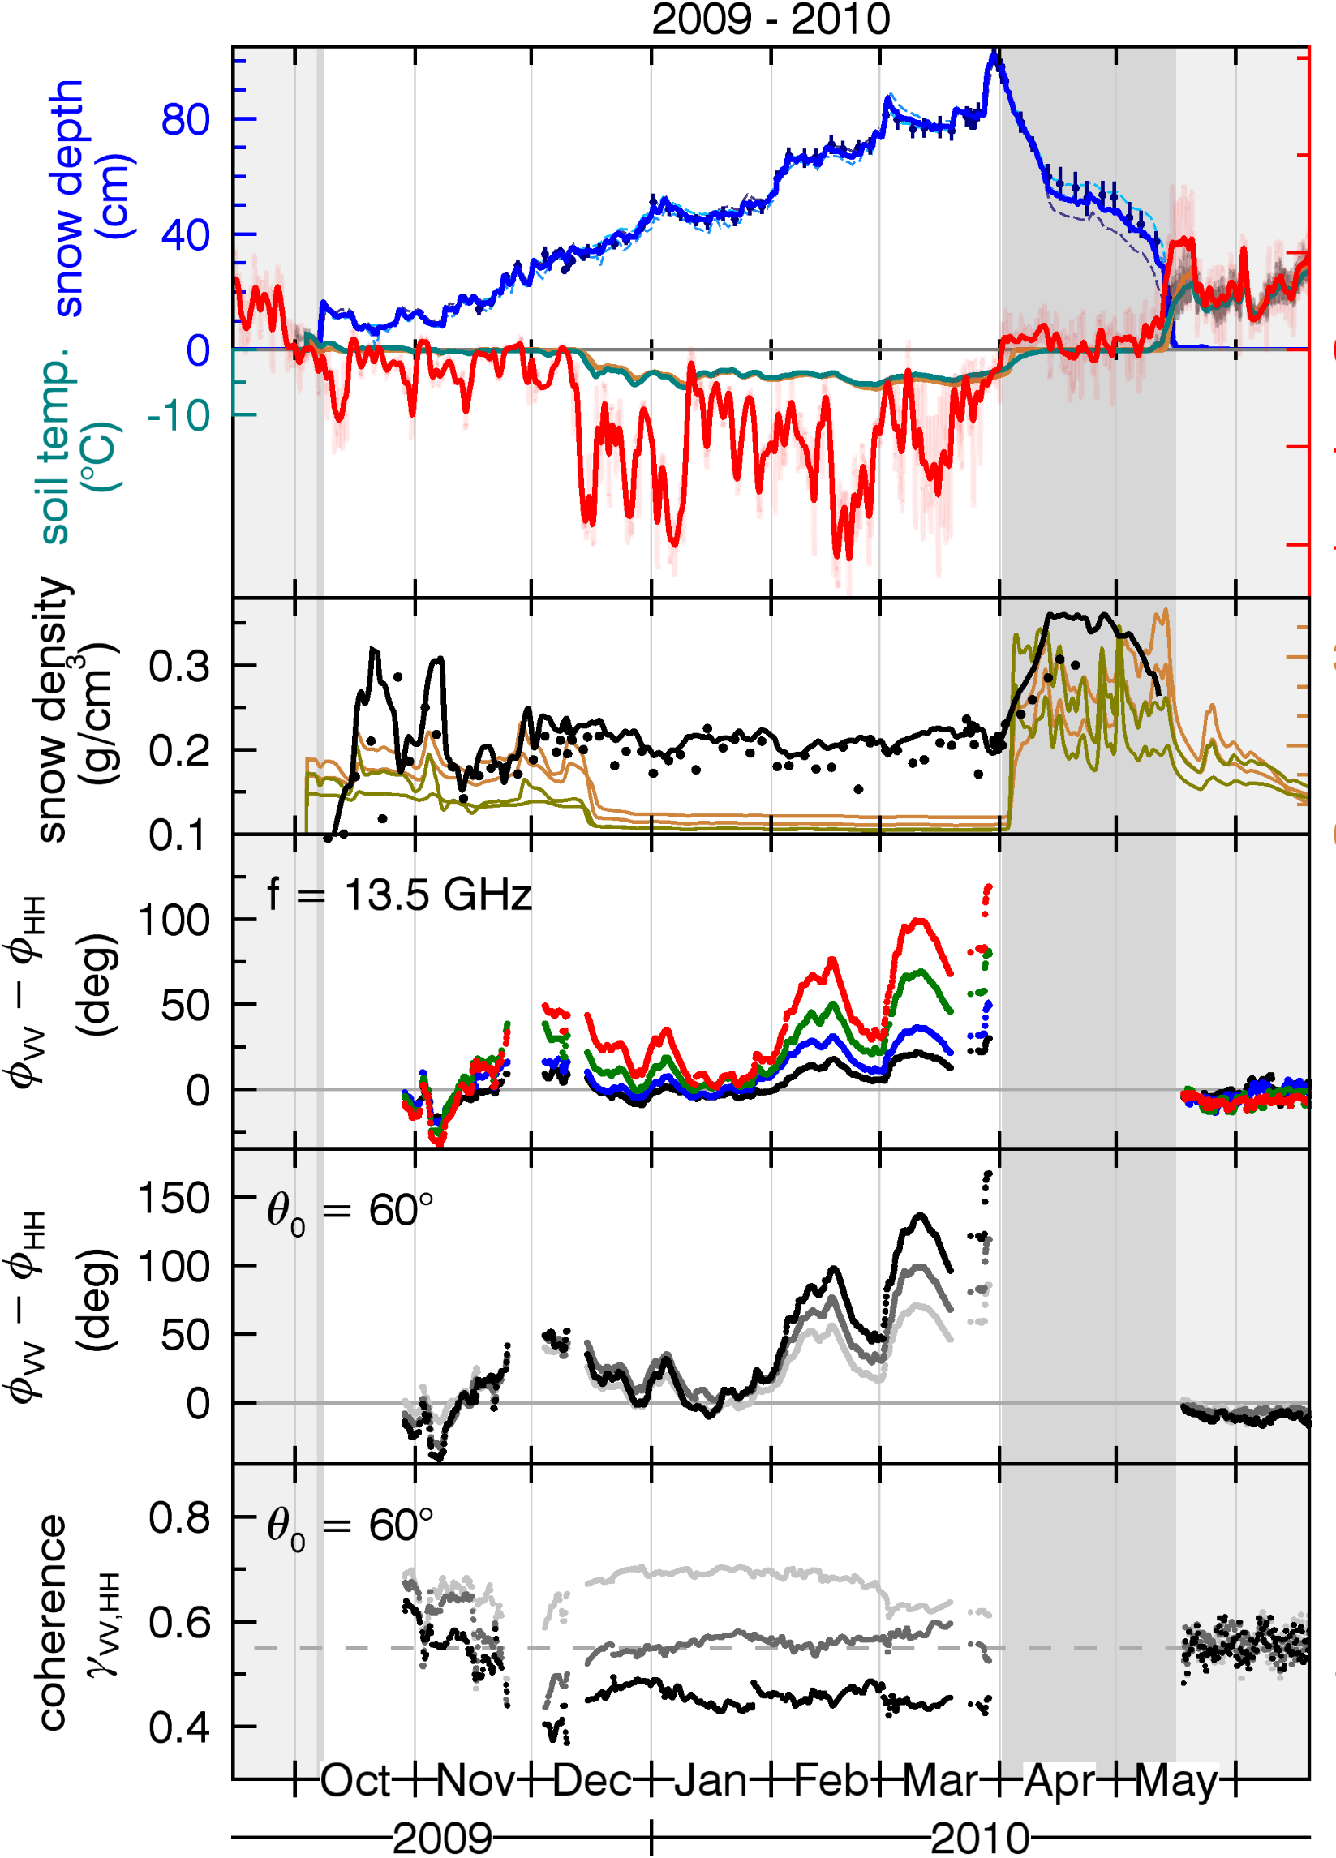
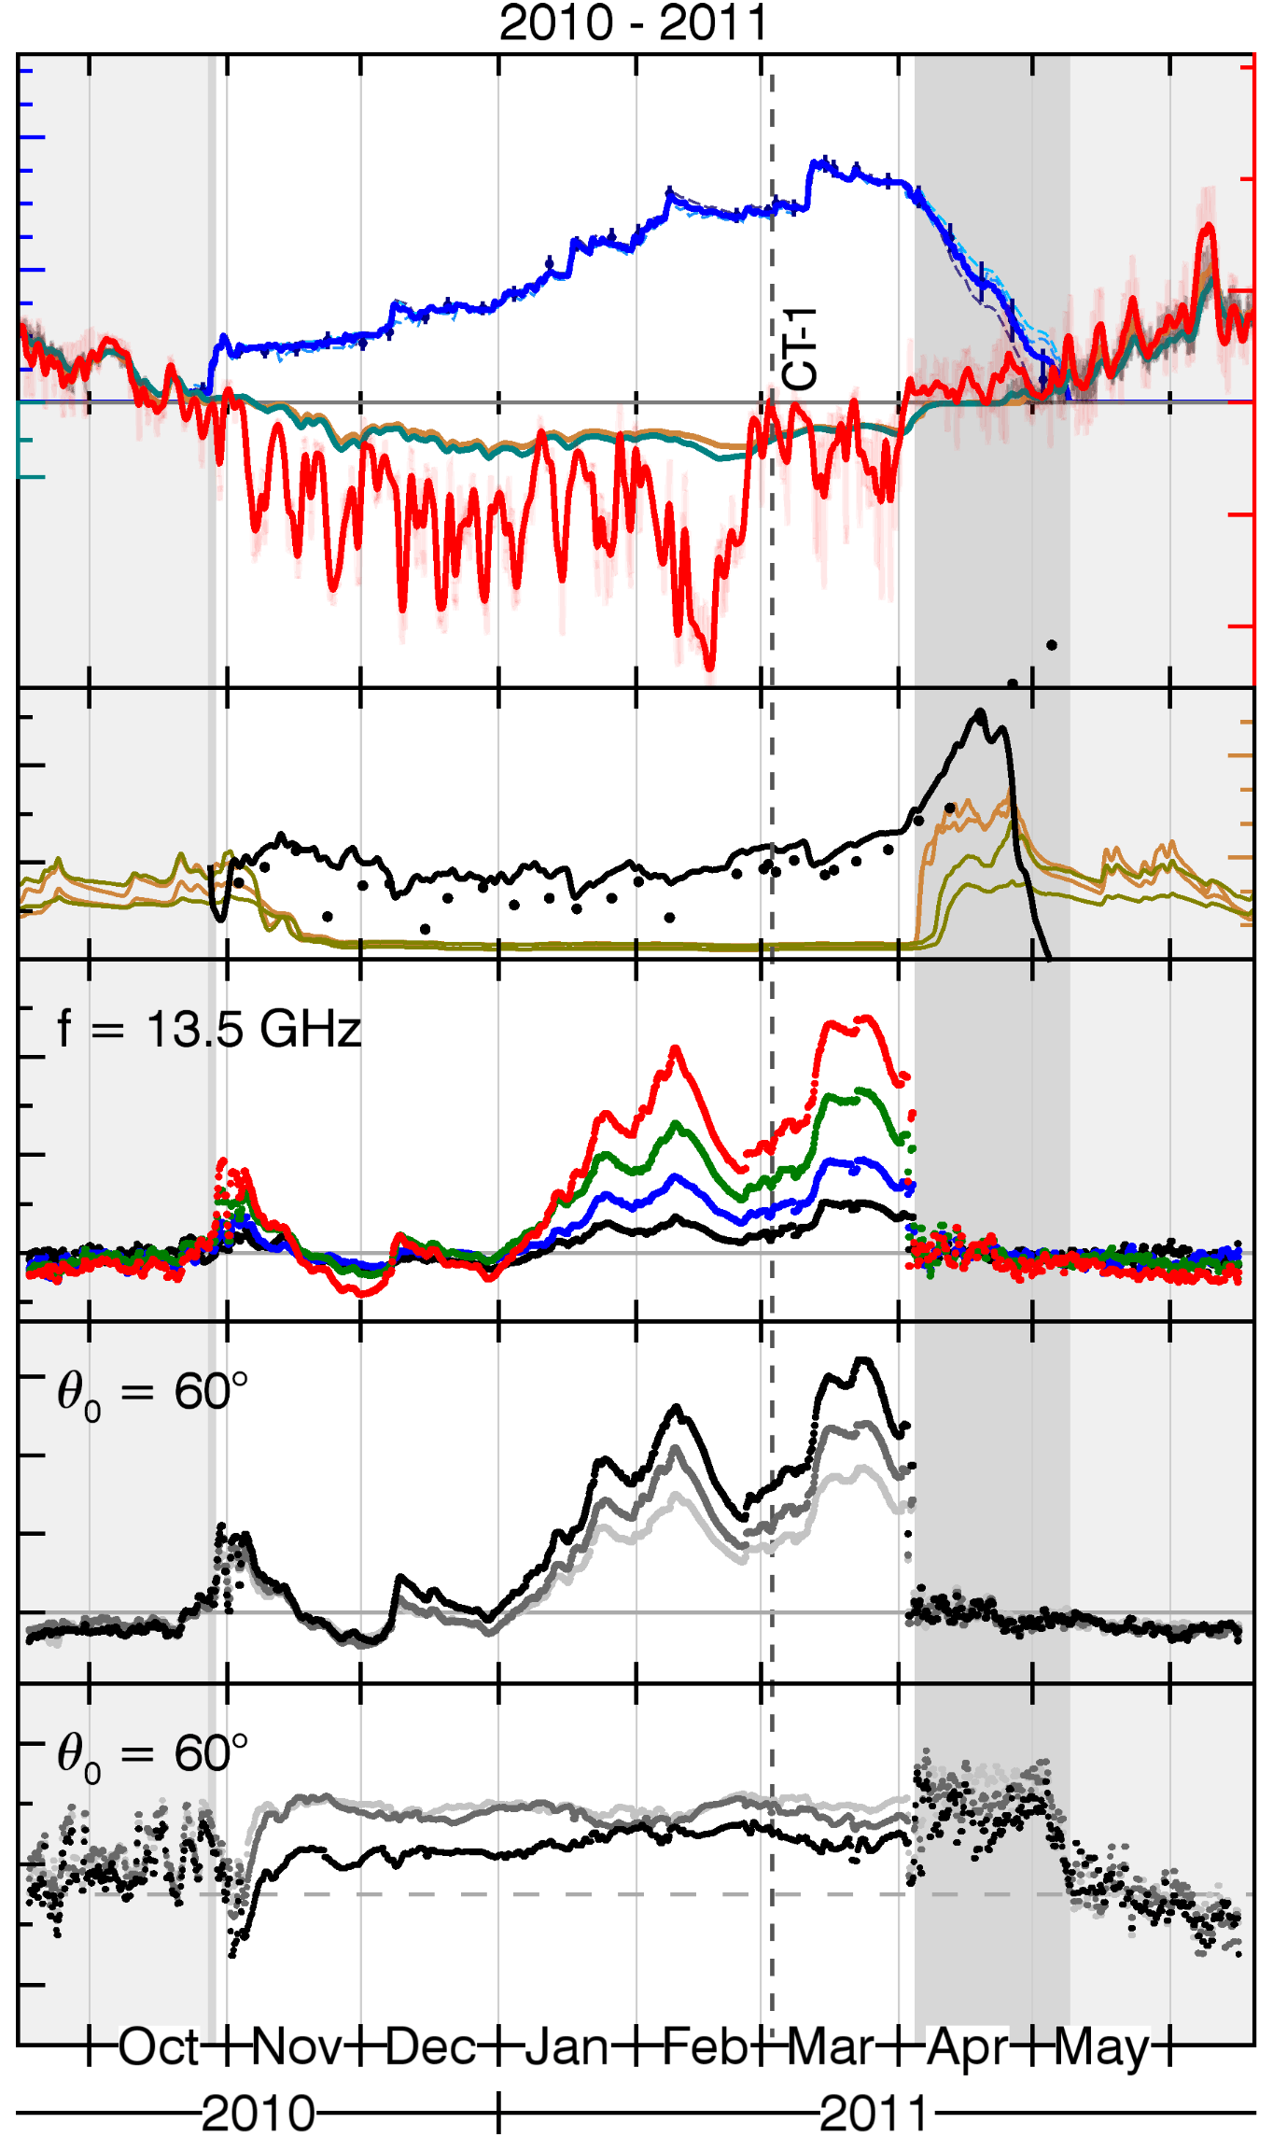
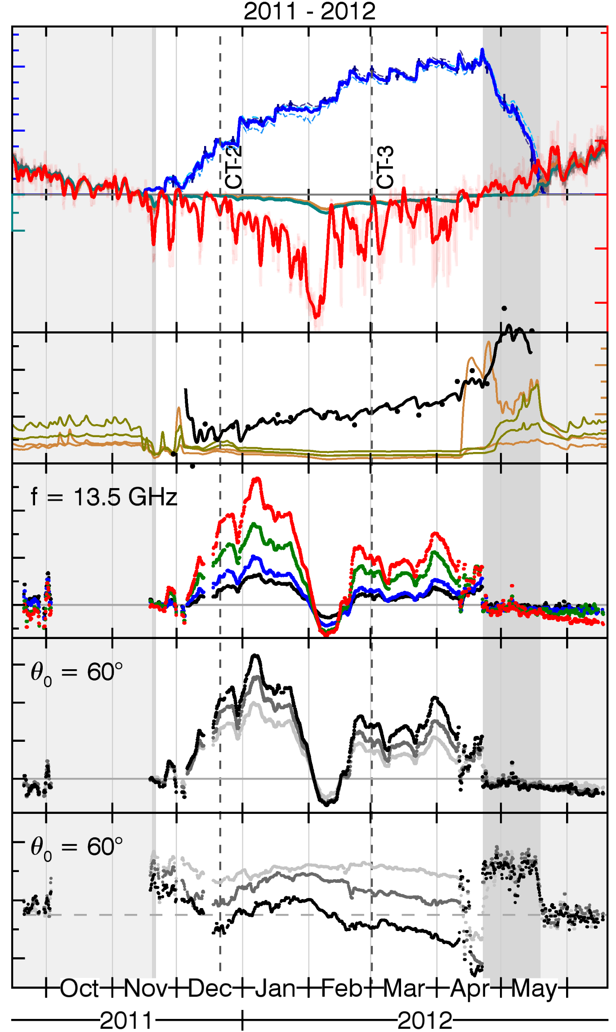
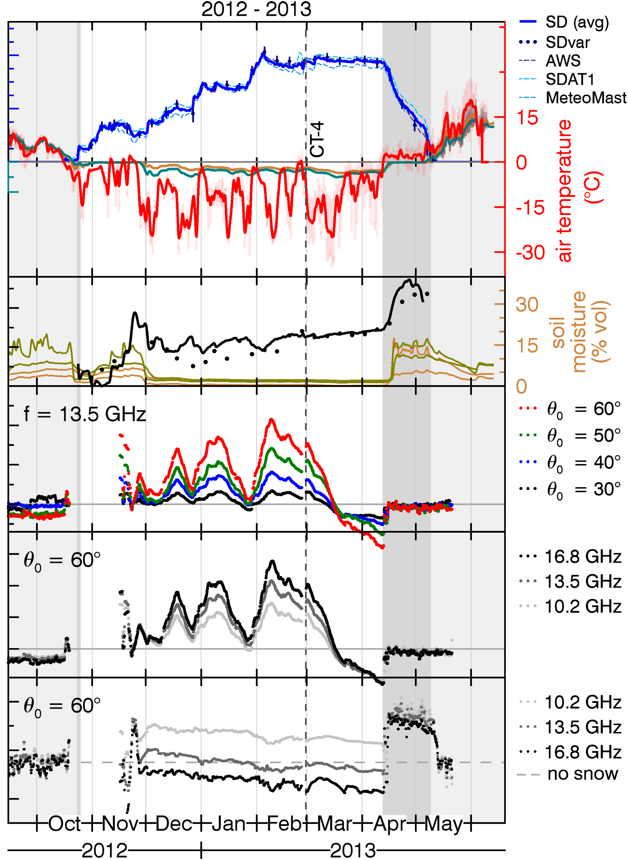
Results: Evolution of the Copolar Phase Difference (CPD)
CPD increases with snow fall and decreases with cold temperatures.

Slide 23
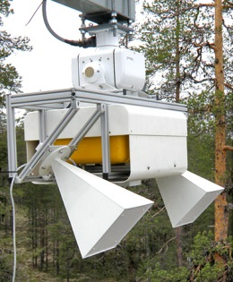
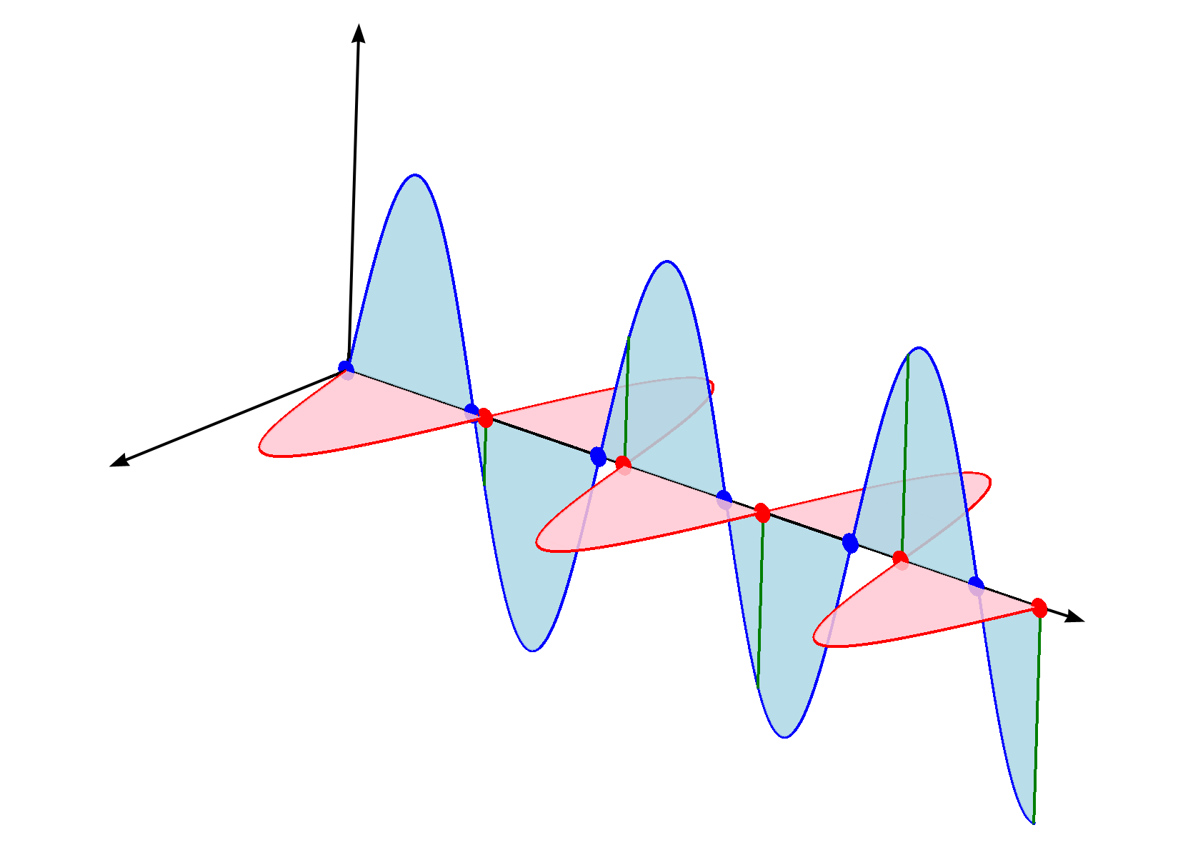
Measuring the dielectric anisotropy
TSX
Vertical
Polarization (V)
Different microwave polarizations propagate at different velocities through the snow pack
H
θ₀
V
SnowScat
Common wave front
φ _{VV} - φ _{HH}
ΔZ
Horizontal Polarization (H)
ε_{H}
ε_{V}
snow
k
Consider snow as a birefringent medium
Copolar Phase Difference (CPD) = accumulated phase difference between the VV and HH polarization:
φ _{VV} - φ _{HH} =
Inversion:
A = f⁻¹(CPD, r_{snow}, Δz)
(BSA)
Permittivity ε_{V}, ε_{H}: function of anisotropy A
23

Slide 24
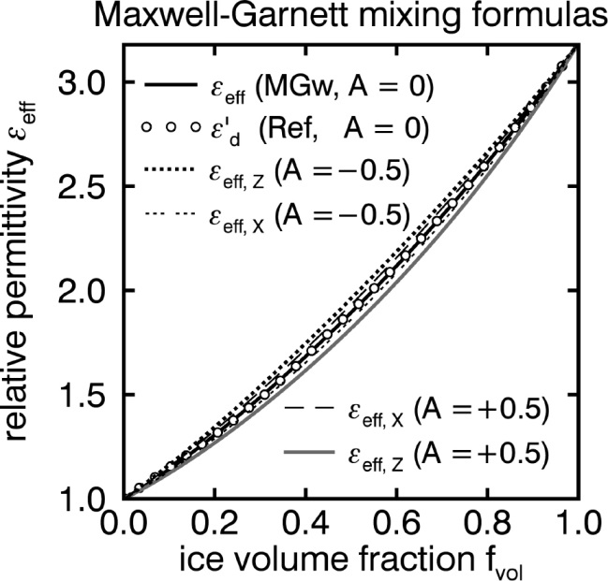
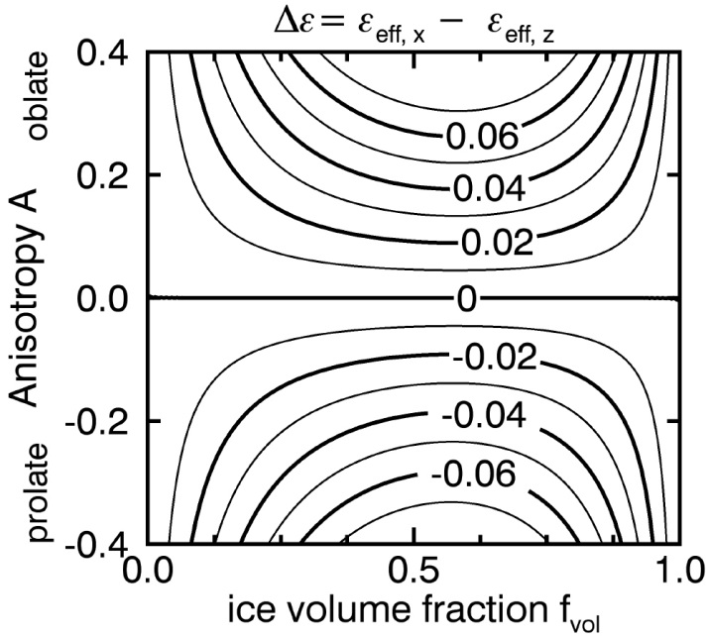
The dielectric anisotropy of snow
ε_{eff,x} > ε_{eff,z}
ε_{eff,x} < ε_{eff,z}
The dielectric permittivity of anisotropic snow deviates a few % from the permittivity of isotropic snow. The permittivity depends on the snow density (~ice volume fraction) and the anisotropy: ε_{eff} = ε(ρ_{snow}, A)
Graph (MGw): Leinss et al. (2016), The Cryosphere 10, 1771–1797. Dots (Ref): Wiesmann (1999), Rem.Sens. of Env., vol. 70, no 3.

Slide 25
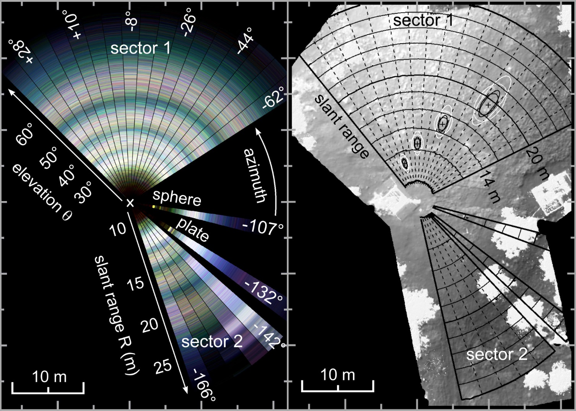
SnowScat: imaging geometry
The SnowScat instrument can rotate around the vertical axis and scans several targets:
- sector 1 (17 steps)
- sector 2 (5 steps)
- calibration sphere (1 step)
- calibration plate (1 step)
The right images (from Laserscan) shows the location of the instrument tower, and several trees on the test site.
The black and white ellipses show the antenna footprint on the ground for H and V polarization and the min and maximum frequency:
9.2 GHz (white) and 17.8 GHz (black).
SnowScat
Polarimetic radar backscatter signal
Terrestrial laser scan of the test site

