Slide 1
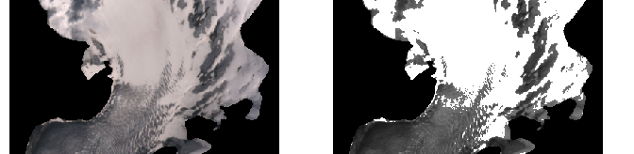
Comparing Automated Classification of Snow on Glaciers based on Sentinel-2 Imagery Using the Automated “SnowIceSen” Tool
Lea Geibel, Johannes Landmann, Daniel Farinotti
ETH Zürich

Slide 2
Table of contents
What is SnowIceSen and why do we need it?
Workflow of SnowIceSen – from the input data to the snow cover map
Validation of the snow cover maps – how good are they?

Slide 3

What is SnowIceSen and why do we need it?
Fully automated tool to map snow cover on glaciers with Sentinel-2 images
Information on snow cover useful to constrain mass balance of glaciers
Sentinel-2: ESA Satellite Mission with multispectral instrument (MSI)
  12 Bands
  10- 60 Meter Resolution
  Available since 2015
  2-3 days revisit time

Slide 4
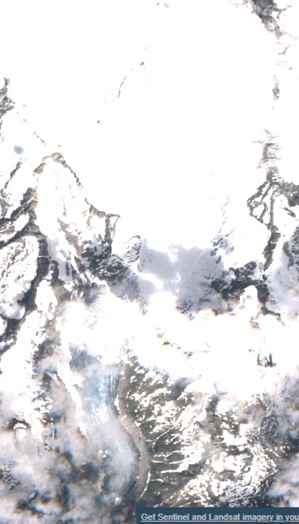
What is Snowicesen and why do we need it?
High revisiting interval: Large amounts of data
  Goal: Automate processing
Problem: Snow Classification on glaciers is challenging
« SnowIceSen »: open source Python tool for
  Data aquisition, downloading, preprocessing and snow mapping
RGB of Sentinel-2 Scene

Slide 5
Workflow of SnowIceSen: Input & Data Retrieval
Shapefile of Glacier Outlines
  e.g. Swiss Glacier Inventory
Digital Elevation Model (DEM)
  Recent aquisition date
  High resolution (10 Meters ideal)
  e.g. SwissALTI3D
Time period of interest
Checking for image availability
Downloading of Data
Preprocessing into glacier-wise directories
Image corrections
Snow Mapping (3 algorithms tested)

Slide 6
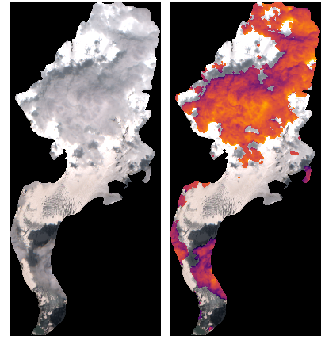
Workflow of SnowIceSen: Image Corrections:
1. Terrain Correction: Ekstrand Correction
2. Cloud Masking: S2cloudless
Machine learning based method
Superior results compared to all other single scene algorithms available for Sentinel-2
3. Masking Debris Cover
NDSI < 0.2 to mask debris cover

Slide 7
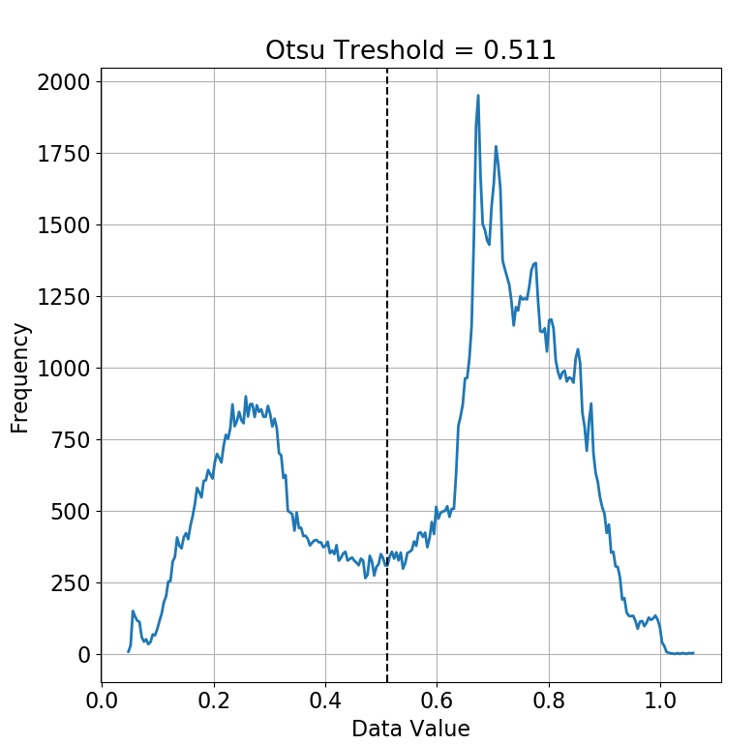
Workflow of SnowIceSen: Snow Mapping
ASMAG (Automated Mapping of Snow and Ice on Glaciers by P. Rastner, 2019):
  Otsu-Thresholding on NIR band

Slide 8
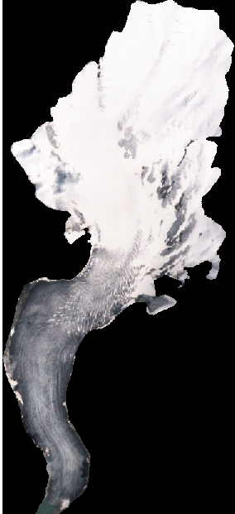
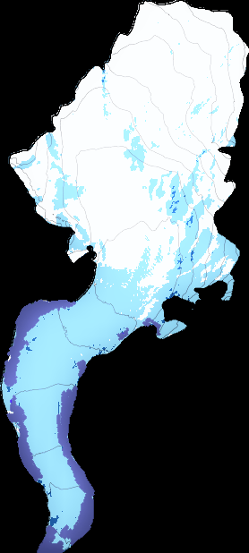
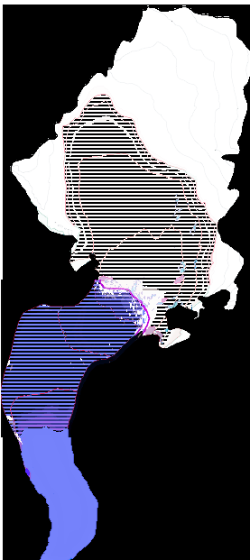
Workflow of SnowIceSen: Snow Mapping
2- Step classification after K. Naegeli, 2019:
  Primary Classification: Ambiguous Area
  Secondary Classification:
    Estimate Snow Line Altitude (SLA)
    Penalty Function
  Outlier Suppresion in Radius of 500 Meters around SLA estimate

Slide 9
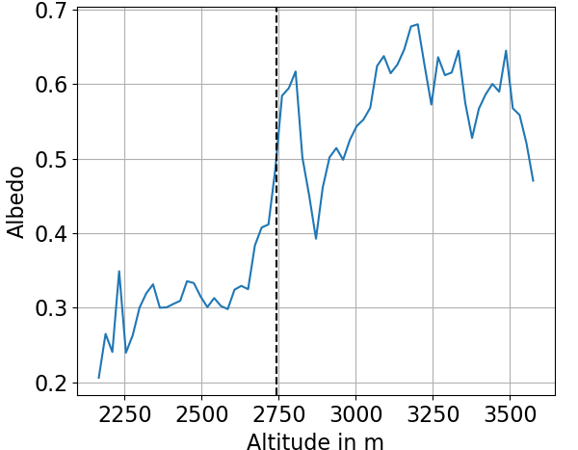
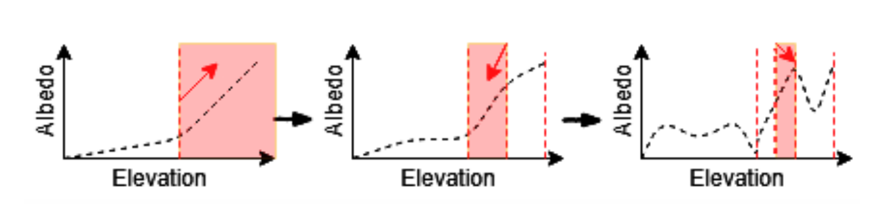
Workflow of SnowIceSen: Snow Mapping
Alternate version of the 2- Step classification after K. Naegeli, 2019:
  Iterative fitting function to estimate SLA
  Flexible value for critical radius based on goodness-of-fit

Slide 10
Validation of the Snow Cover Maps
  Manually created data set for 430 scenes…..
  Pixel-wise comparison

Slide 11
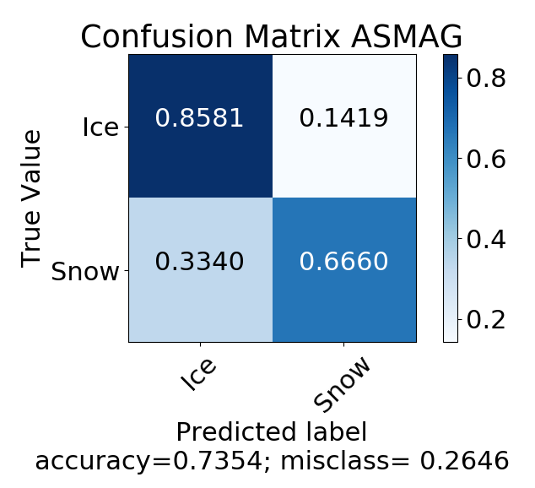
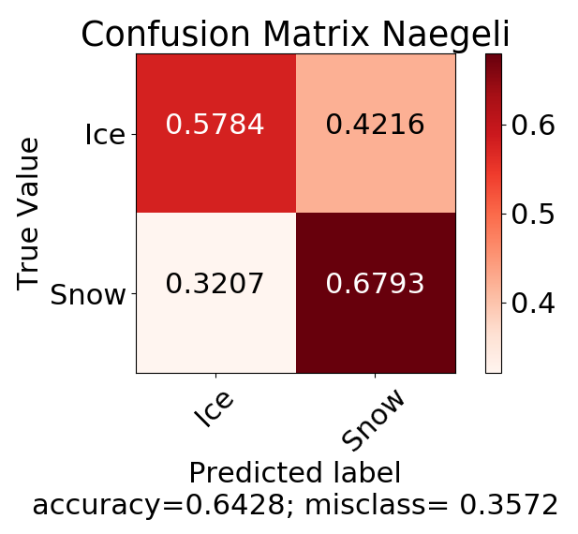
Validation: Confusion Matrix
Cohen‘s Kappa: 0.38 Cohen‘s Kappa: 0.28 Cohen‘s Kappa: 0.41

Slide 12
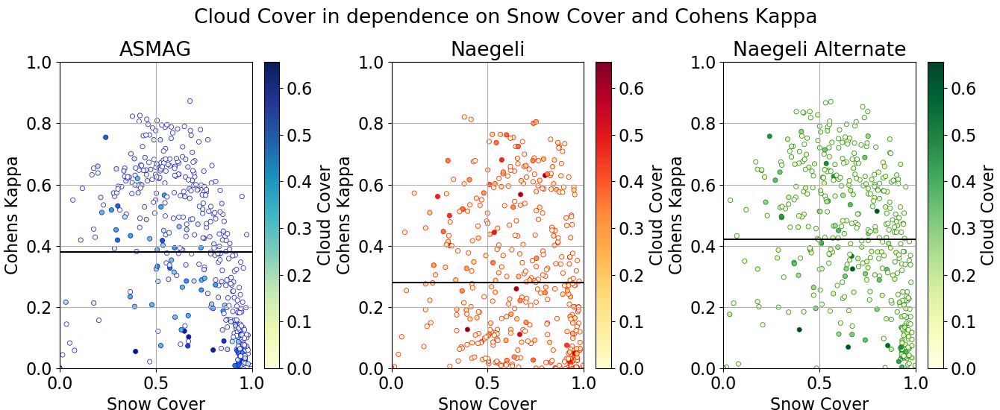
Validation: Influence of Snow Cover and Cloud Cover
Influence of Snow Cover and Cloud Cover

Slide 13
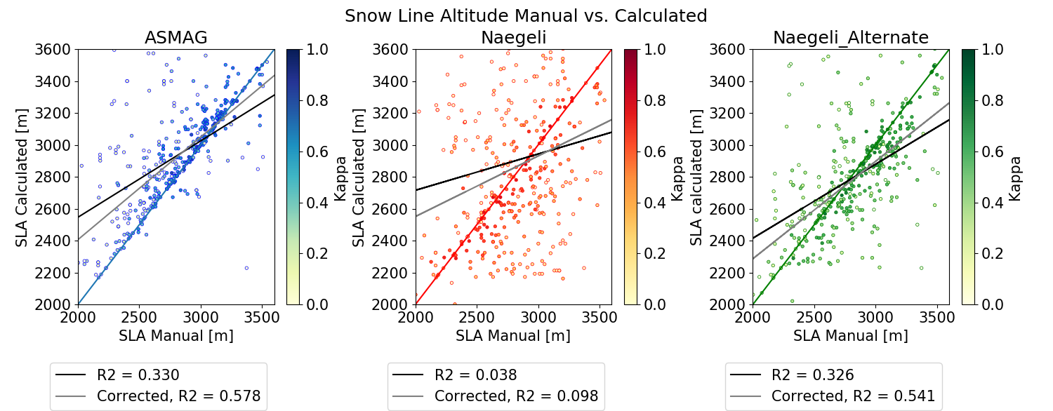
Validation: Snow Line Altitude

Slide 14
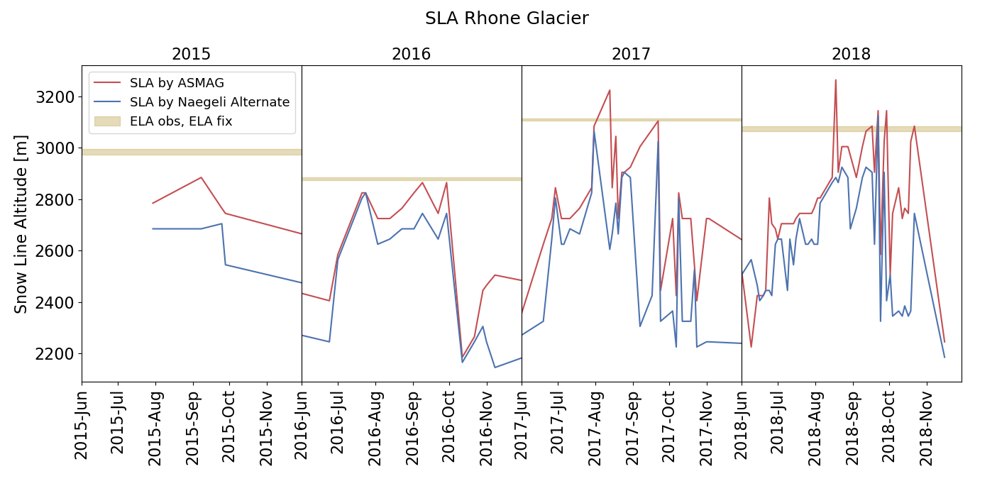
Validation: ELA and end-of-summer SLA

Slide 15
Summary and Outlook: Snow Mapping
  ASMAG and Naegeli Alternate are capable of automatically mapping snow on glaciers
    Weaknesses: Cloud cover over 30 %, high snow cover over 90 %
  Possible to constrain ELA from end-of-summer SLA
  Potential Improvements:
    Combine Otsu-Thresholding and 2- Step classification
    Test different band combinations (machine learning approach)
    Use secondary information: e.g. correlate image time series with precipitation data
Outlook: SnowIceSen Code and technical report available on Github
Potentially usable for any region of interest

Slide 16
Thank you!

Slide 17
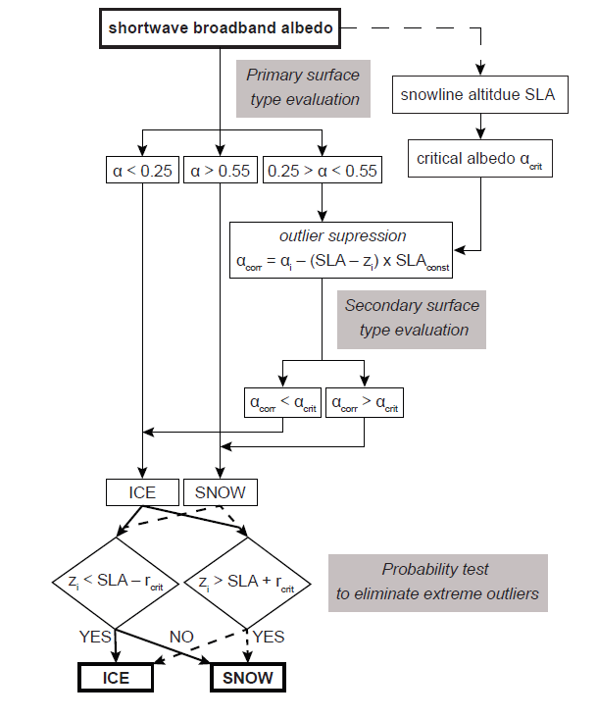
Supplement

Slide 18
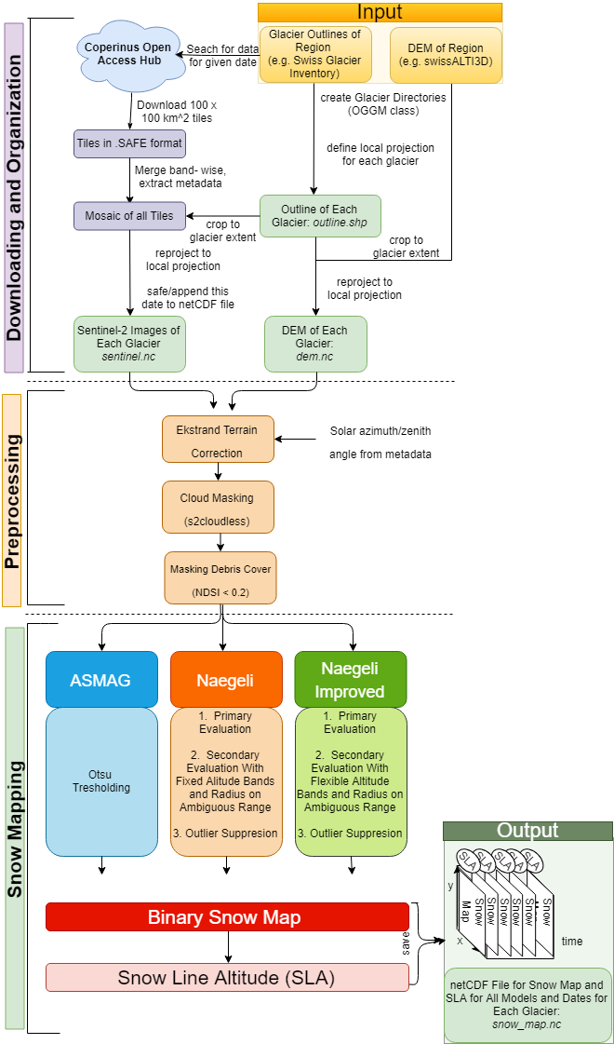
Supplement

Slide 19
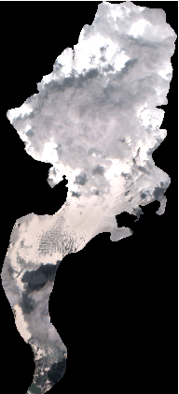
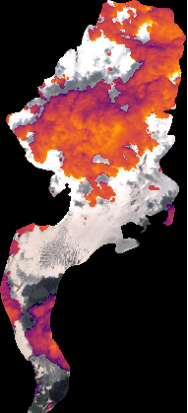
Supplement

Slide 20
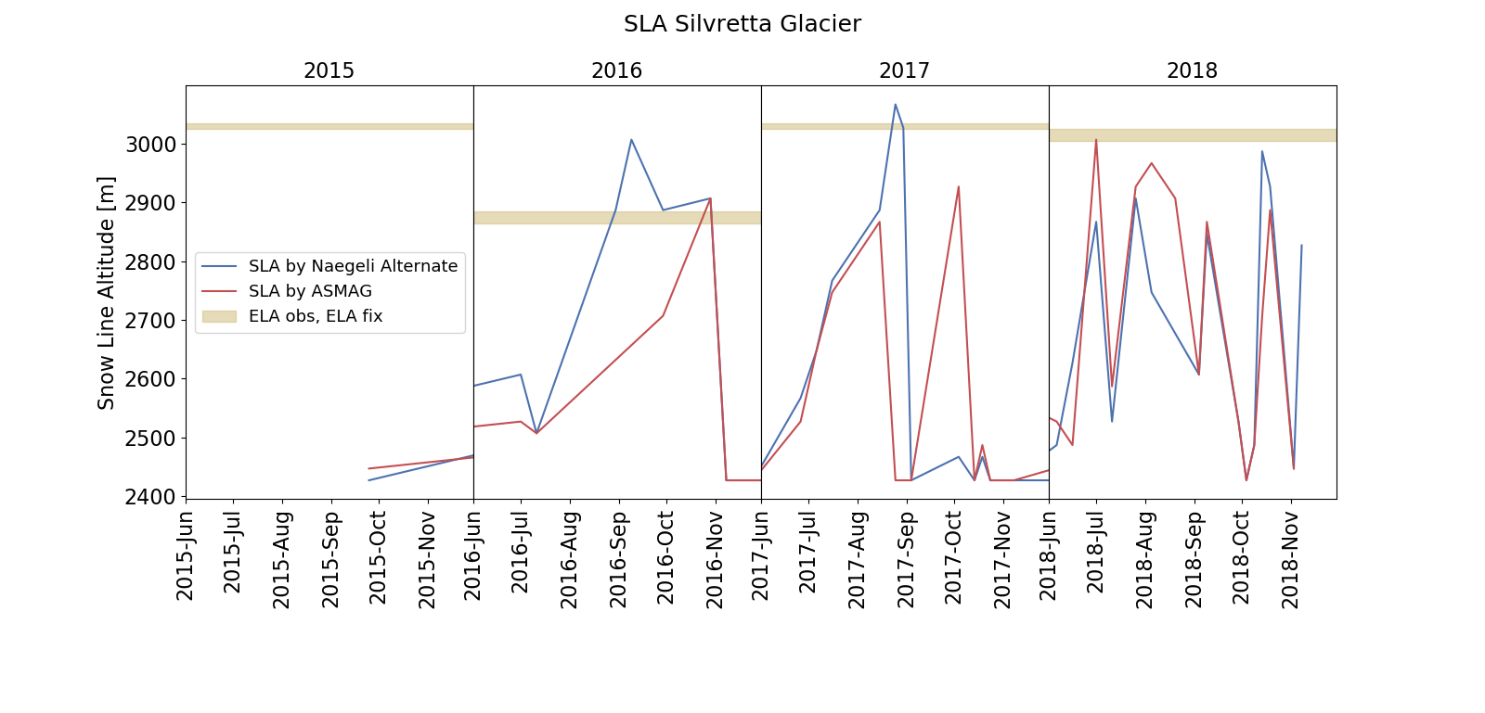
Supplement

