Slide 1





Region-wide estimate of annual glacier mass balance for the Tien Shan and Pamir
from 2000 to 2018
Martina Barandun (1,2), Robert McNabb (3), Kathrin Naegeli (4), Matthias Huss (1,5), Etienne Berthier (6), and Martin Hoelzle (1)
(1) University of Fribourg, Unit of Geography, Geoscience, Fribourg, Switzerland (martina.barandun@unifr.ch), (2) Laboratory of Environmental Chemistry, Paul Scherrer Institute, Villigen, Switzerland, (3) Department of Geoscience, University of Oslo, Oslo, Norway, (4) Department of Geography, Remote Sensing, University of Bern, Bern, Switzerland , (5) Laboratory of Hydraulics, Hydrology and Glaciology (VAW), ETH Zurich, Zurich, Switzerland, (6) CNRS, LEGOS, University of Toulouse, Toulouse, France
9th EARSeL workshop on Land Ice and Snow3-5February 2020 M. Barandun

Slide 2
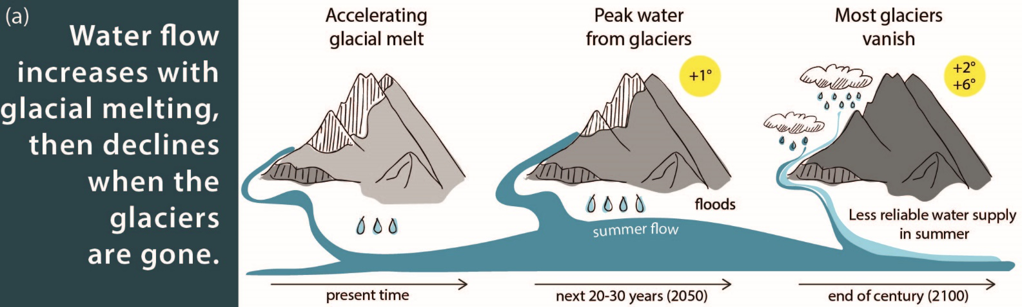
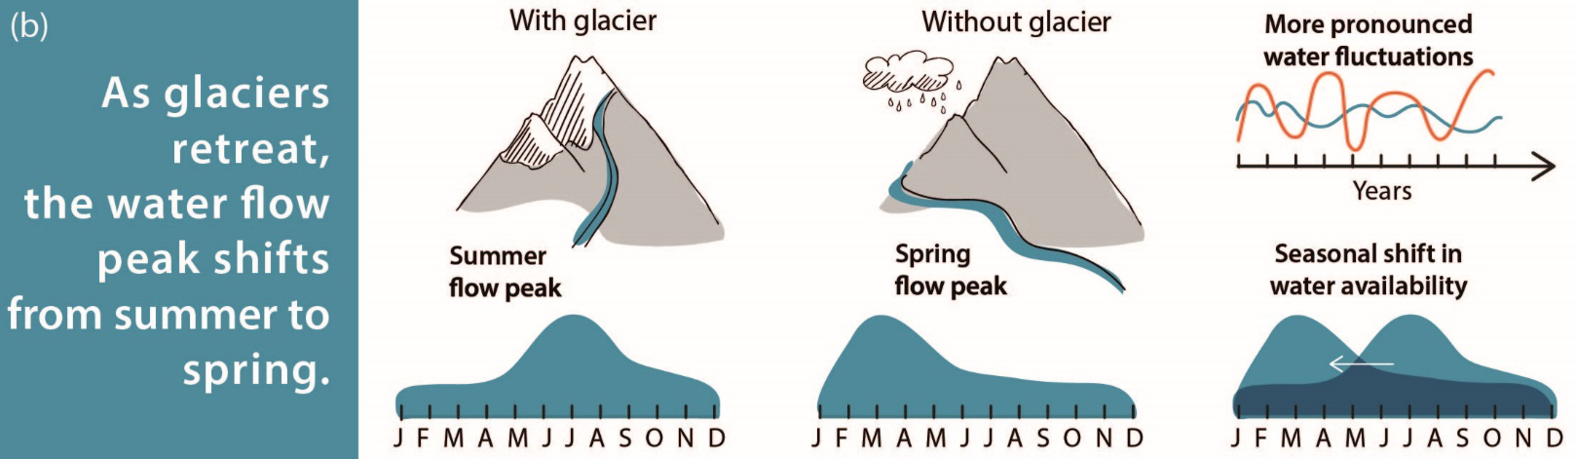
changing water availablity
Introduction
Methods
Results
Discussion
conclusions
glacier melt: important runoff contribution
Central Asia: one of the most vulnerable regions worldwide
(Huss and Hock, 2018)
(Huss and Hock, 2018)
(Zoï Envir. Networks, Geneva)
9th EARSeL workshop on Land Ice and Snow3-5February 2020 M. Barandun

Slide 3
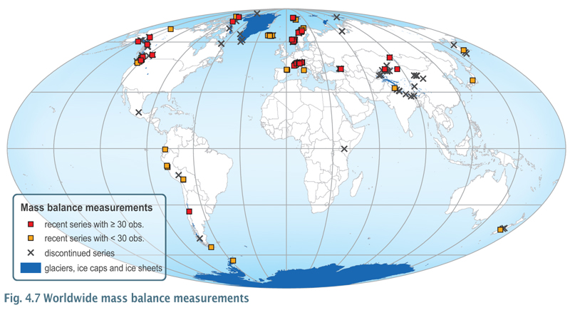
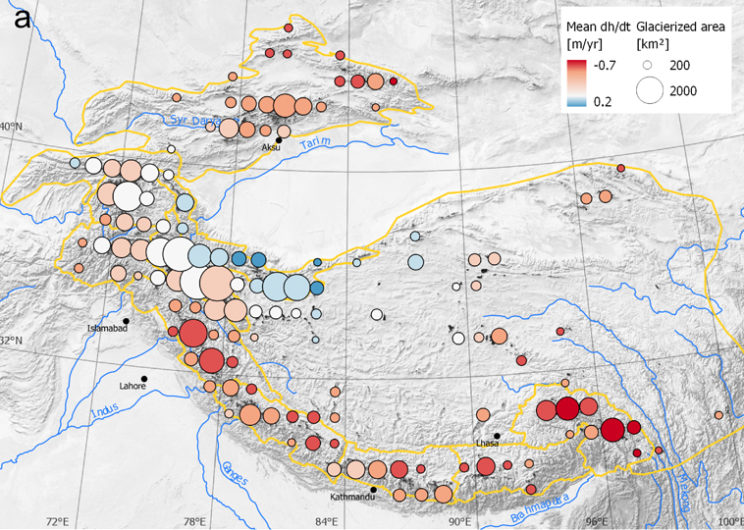
glacier mass change observations in Central Asia
Introduction
Methods
Results
Discussion
conclusions
decadal mass change observations
mountain region | glacier area according to RGI 5.0 in km² | number of mass balance glaciers
European Alps | ca. 2’000 | 64
Tien Shan & Pamir | > 25’000 | 10
improving glacier mass change observations for the Tien Shan and Pamir
on high temporal resolution
on high spatial resolution
(WGMS, 2008, Roer, 2008)
for a region-wide estimate of annual mass balances for Tien Shan and Pamir
(Brun et al., 2017)
annual direct mass balance observations for few selected glaciers
9th EARSeL workshop on Land Ice and Snow3-5February 2020 M. Barandun

Slide 4
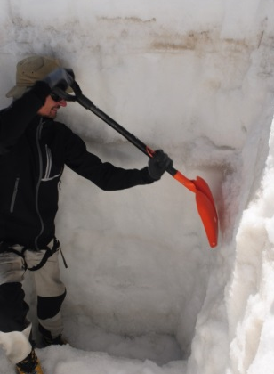
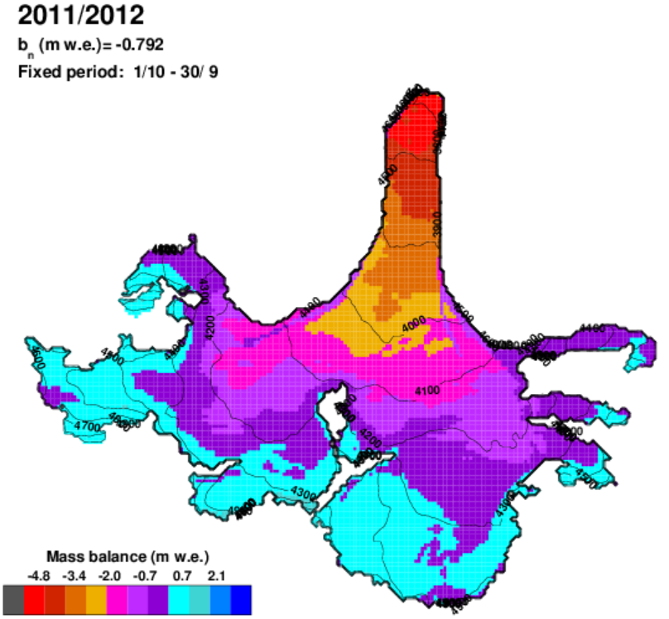
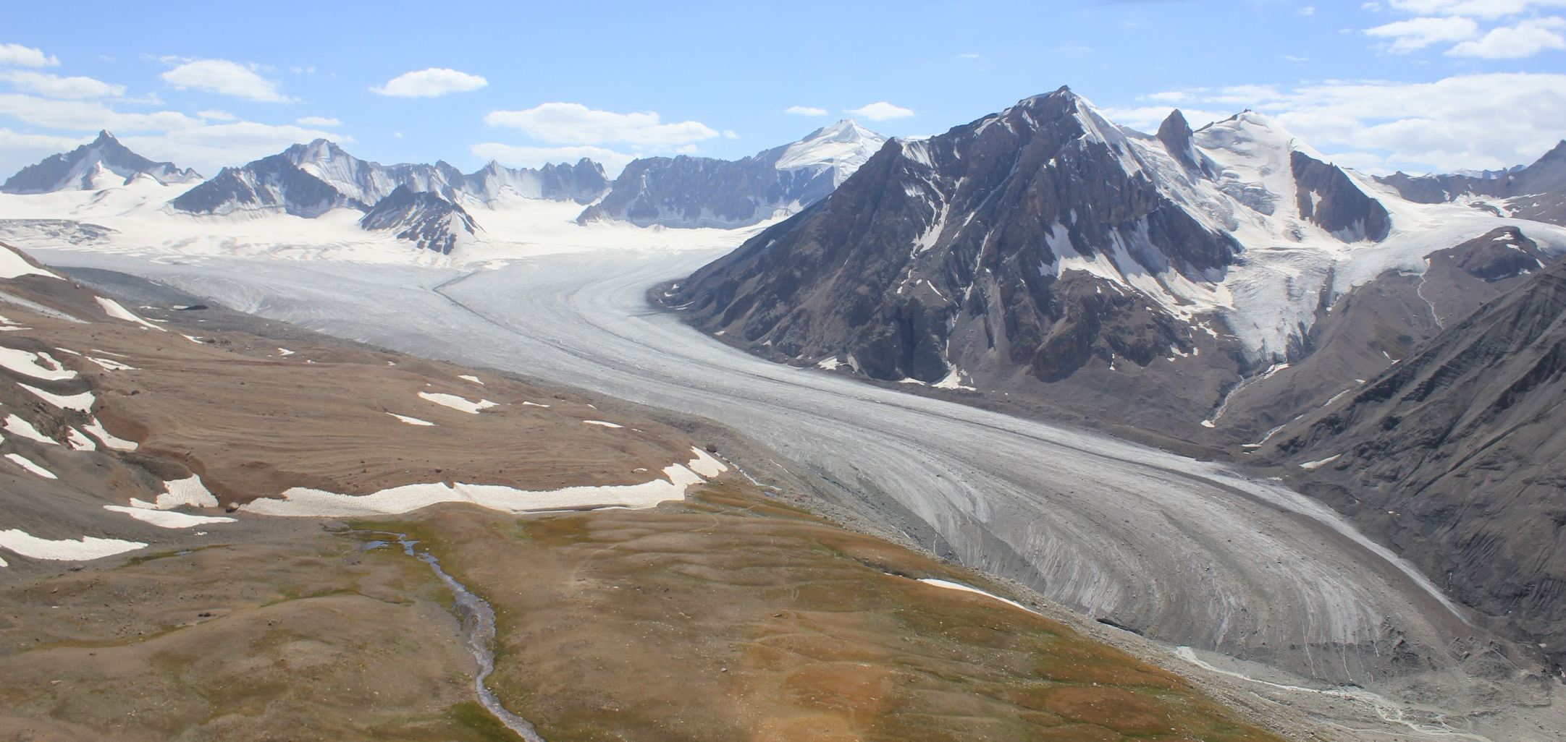
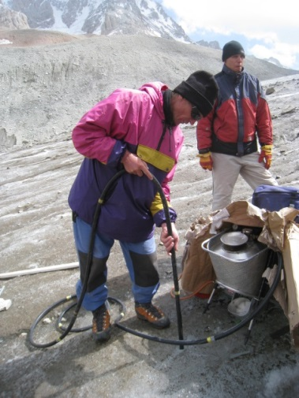
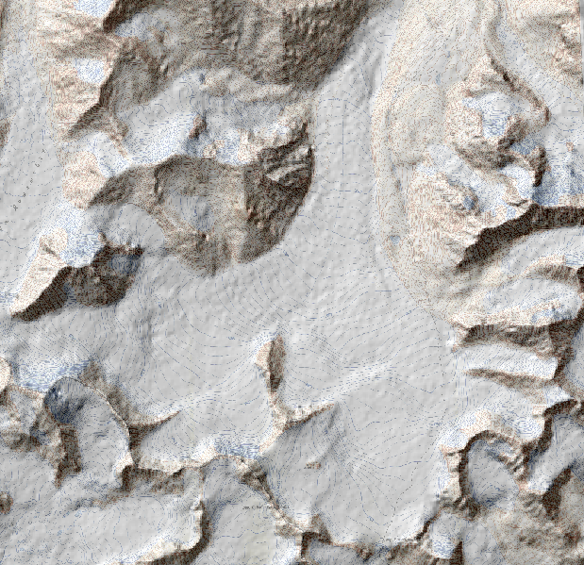
Introduction
Methods
Results
Discussion
conclusions
combining different approaches
1. direct measurements
3. modelling mass balance…
(e.g. Bolch et al., 2008; Pieczonka et al., 2013)
L. Sold
M. Hoelzle
bnbronin
(e.g. Vincent, 2002; Huss, 2008; Azam et al., 2014)
(e.g. Hoinkes, 1955, 1968, 1970; Kasser and Muller 1967; Muller et al., 1977; Haeberli 1998)
2. geodetic measurements
9th EARSeL workshop on Land Ice and Snow3-5February 2020 M. Barandun

Slide 5
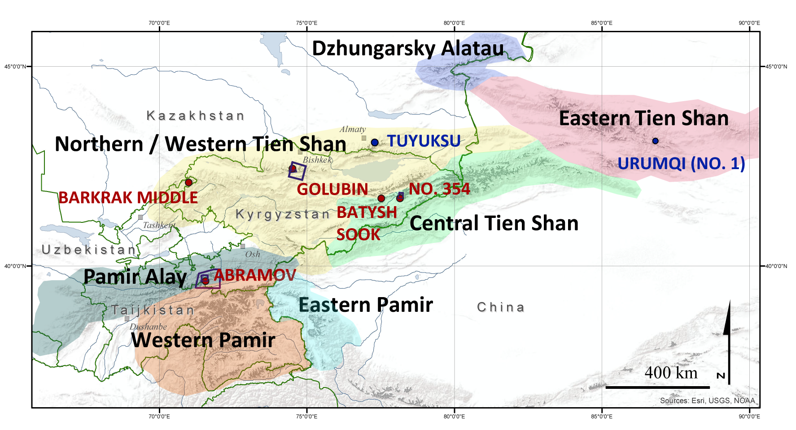
Introduction
Methods
Results
Discussion
conclusions
study sites
DZ = Dzhungarsky Alatau
ETS = Eastern Tien Shan
WTS = Northern & Western Tien Shan
CTS = Central Tien Shan
PA = Pamir Alay
EPM = Eastern Pamir
WPM = Western Pamir
ZULMART
(region divisions after Bolch et al., 2018)
monitored within CICADA
monitored within other programmes
9th EARSeL workshop on Land Ice and Snow3-5February 2020 M. Barandun
Notes:
Introd kyrgyzstan : old monitoring → aprupt breakdown → reestablishment in 2011
Motiviation: underrepresented in WGMS
Need of monitoring: glacier retreat patter/climate influence/hydorlogical porpose

Slide 6

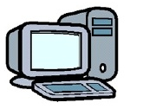
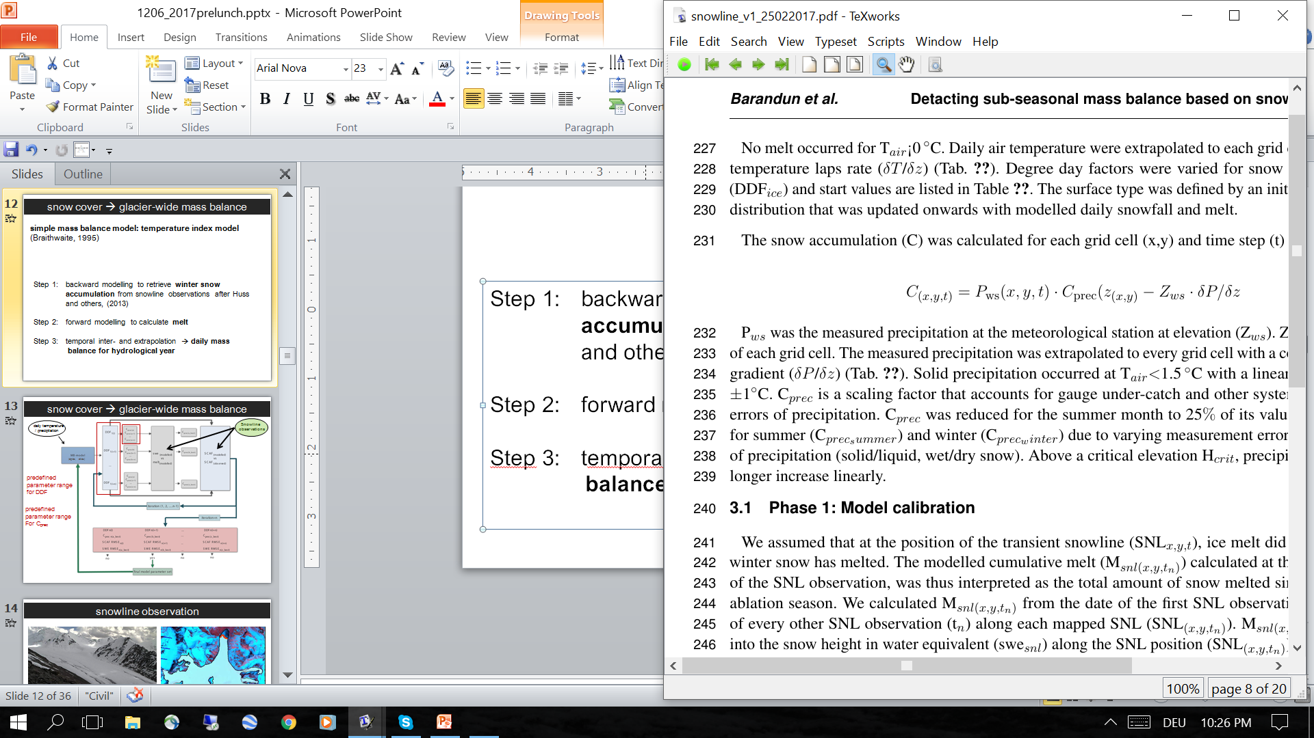
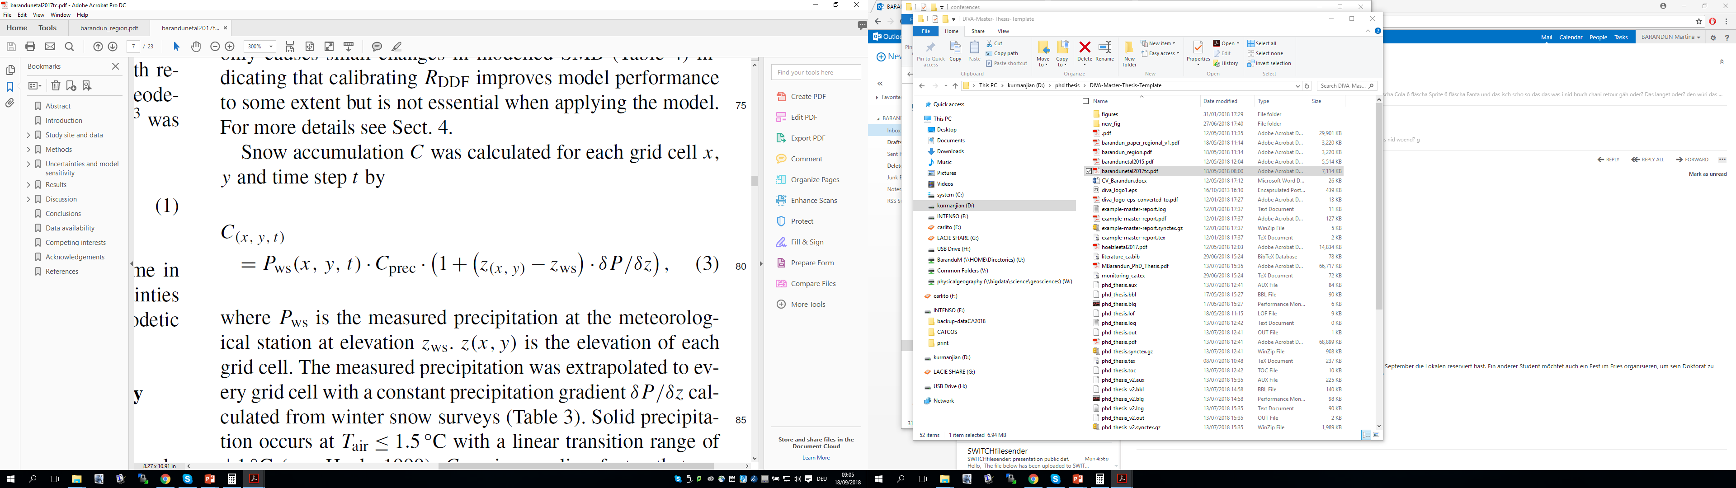
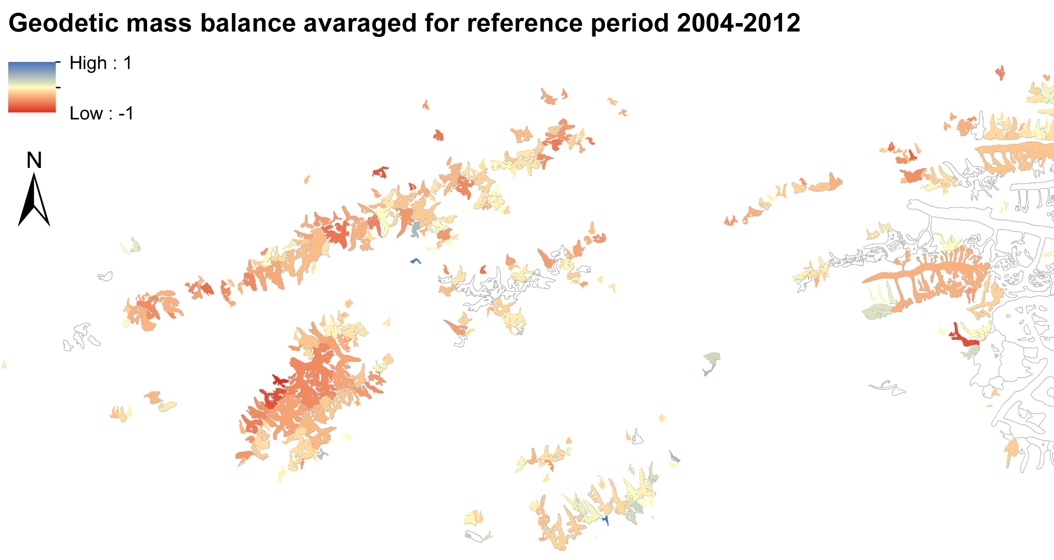
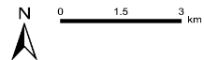

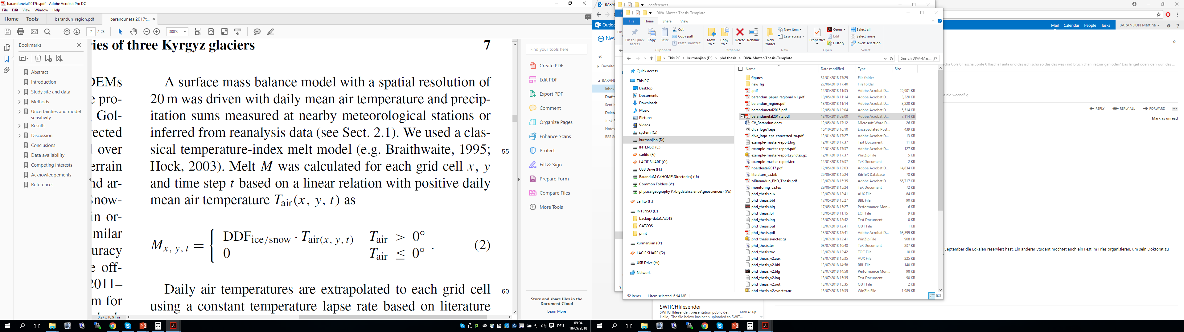
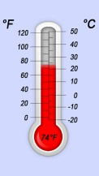
Introduction
Methods
Results
Discussion
conclusions
mass balance modelling: TSL-model
first order calibration:
Using transient snowline observations (TSL) for each glacier & year individually
accumulation:
second order calibration:
using decadal geodetic
mass balances for
each glacier
melt model:
used for calibration
annual surface mass balance
9th EARSeL workshop on Land Ice and Snow3-5February 2020 M. Barandun
Notes:
Introd kyrgyzstan : old monitoring → aprupt breakdown → reestablishment in 2011
Motiviation: underrepresented in WGMS
Need of monitoring: glacier retreat patter/climate influence/hydorlogical porpose

Slide 7


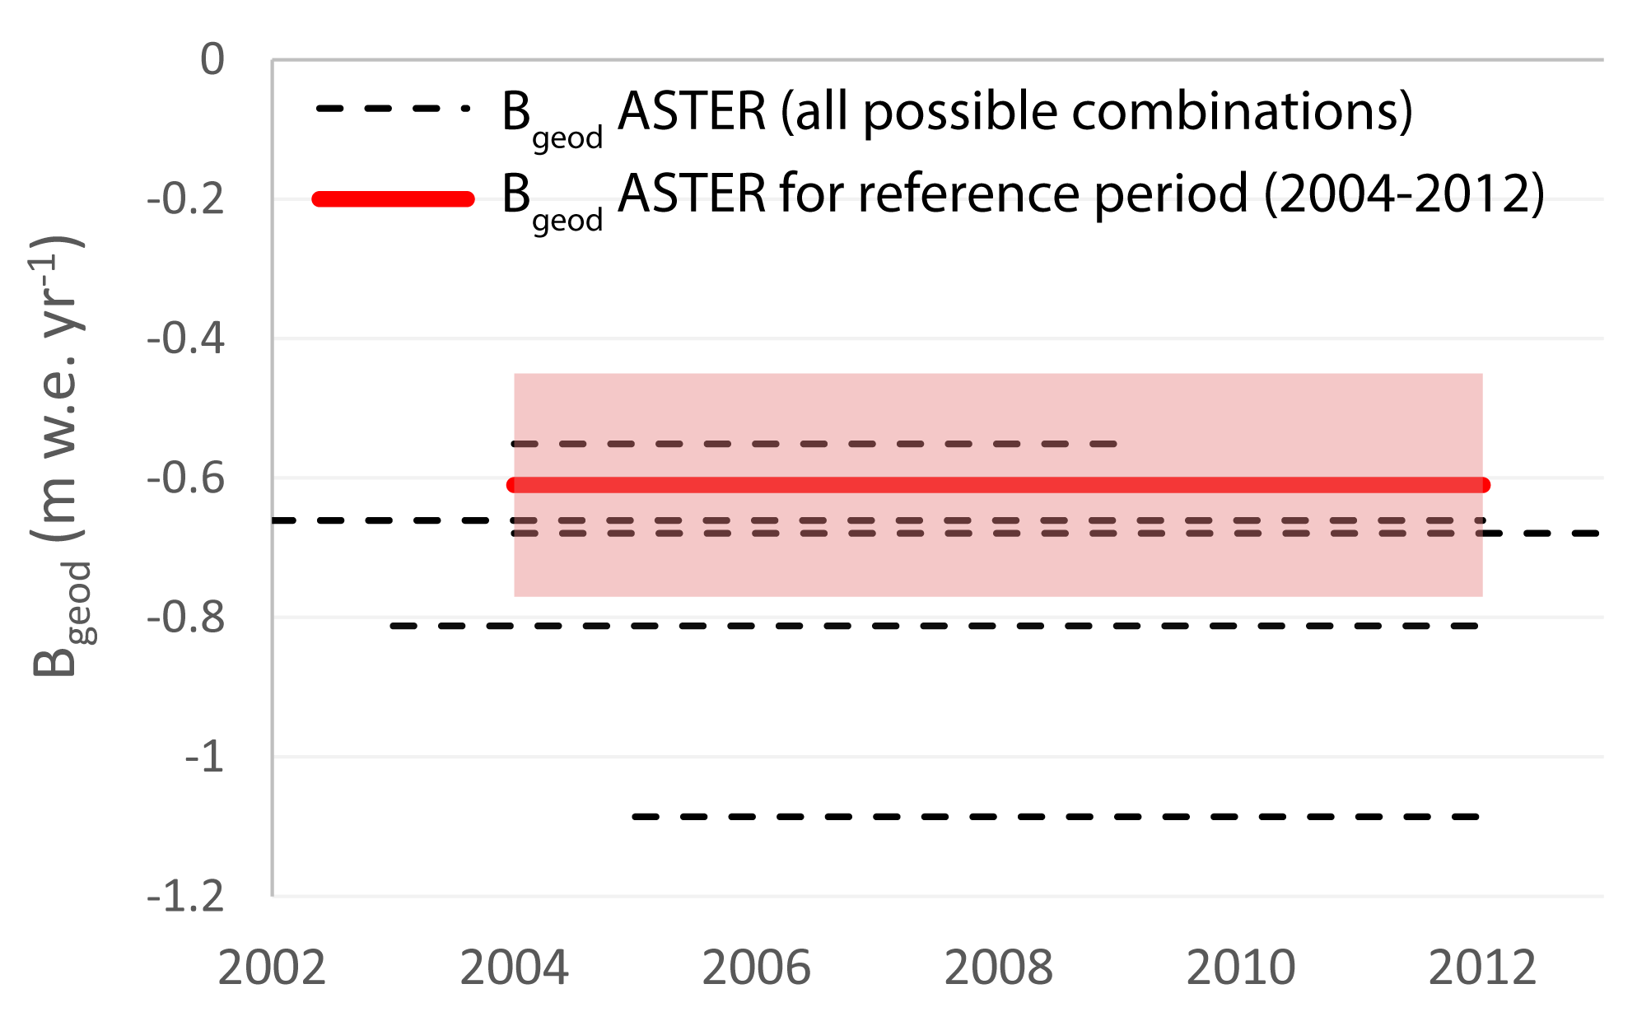
Introduction
Methods
Results
Discussion
conclusions
geodetic mass balance & glaciological measurements
all scenes from ASTER archive / HMA DEMs with cloud-cover < 50%
(using MicMAC ASTER after Girod et al., 2017)
elevation change for all possible scene combinations (min. period: 5 years)
m w.e. yr⁻¹
m
summarized for a reference period using
direct glaciological observations
m w.e. yr⁻¹
m
9th EARSeL workshop on Land Ice and Snow3-5February 2020 M. Barandun
Notes:
Introd kyrgyzstan : old monitoring → aprupt breakdown → reestablishment in 2011
Motiviation: underrepresented in WGMS
Need of monitoring: glacier retreat patter/climate influence/hydorlogical porpose

Slide 8
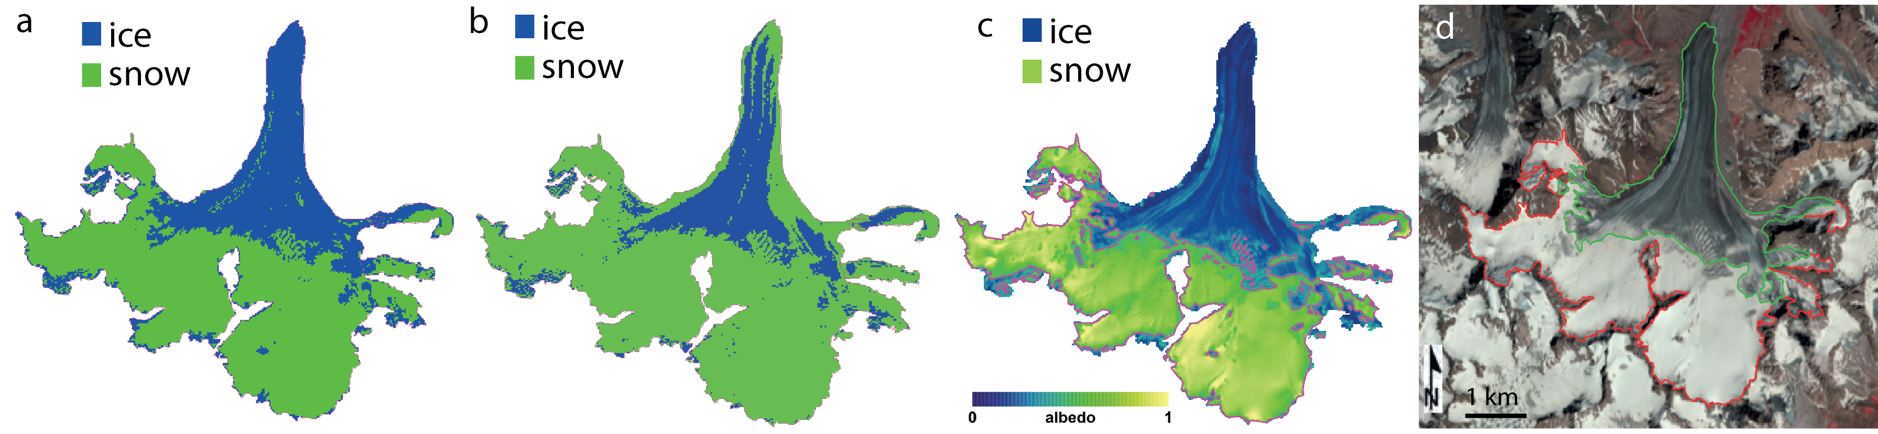
Introduction
Methods
Results
Discussion
conclusions
automatic mapping on satellite images
entire landsat archive 2000 – 2018
Normalized- Difference
Snow Index
(NDSI)
albedo
thresholding
Spectral Angular Mapper
manual
mapping
(Naegeli et al., 2019)
Colloquium in Climatology, Climate Impact and Remote Sensing 23/10/2019

Slide 9
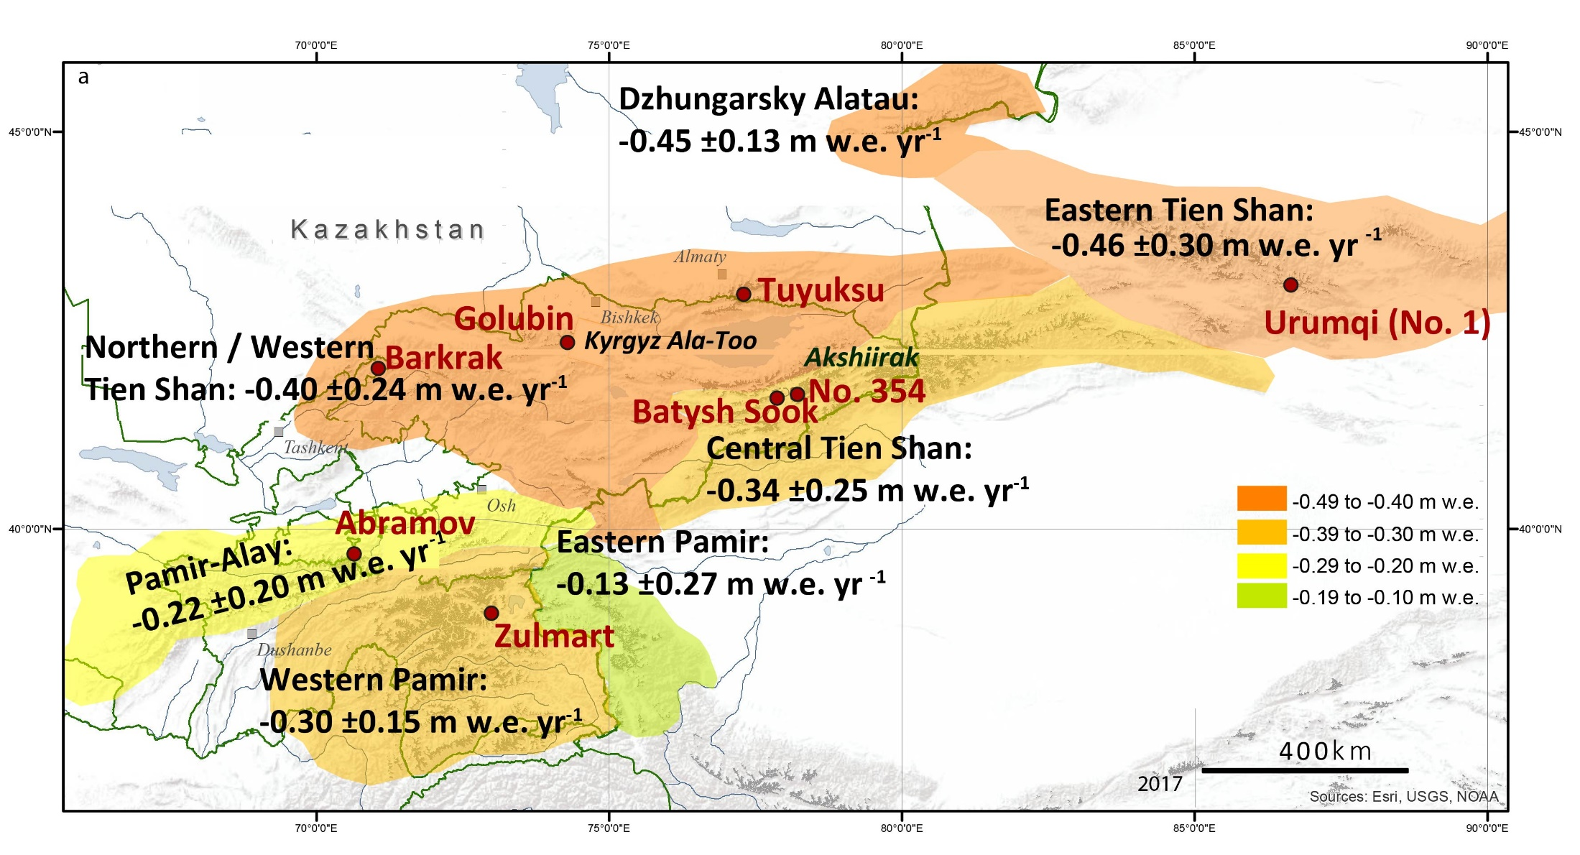
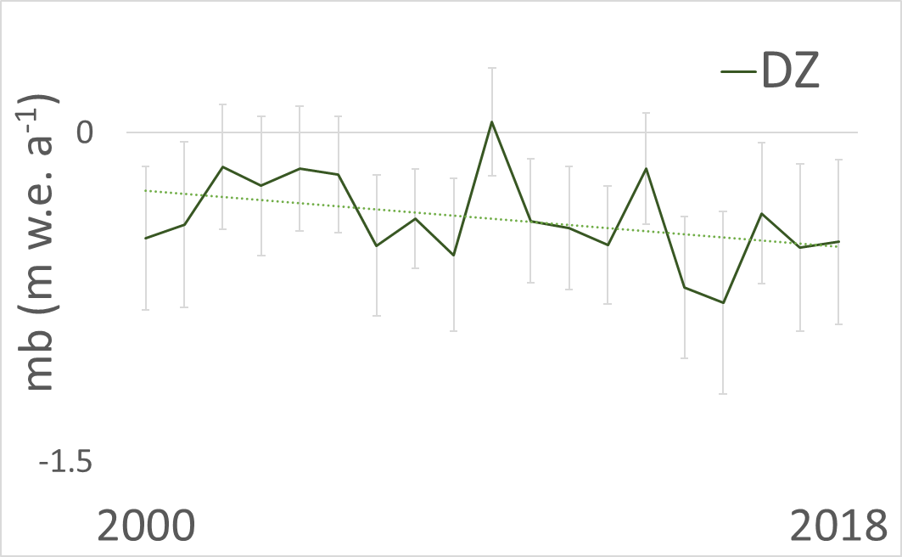
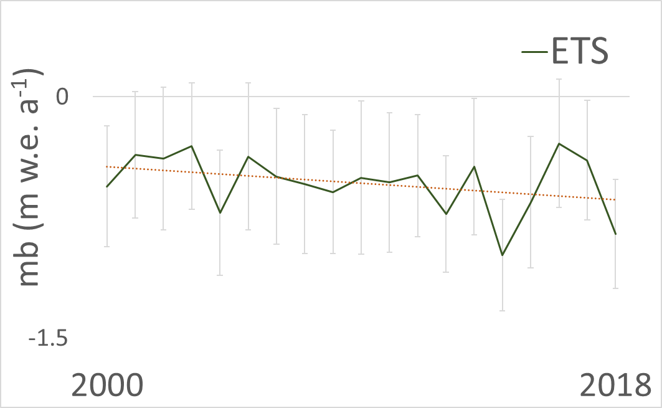
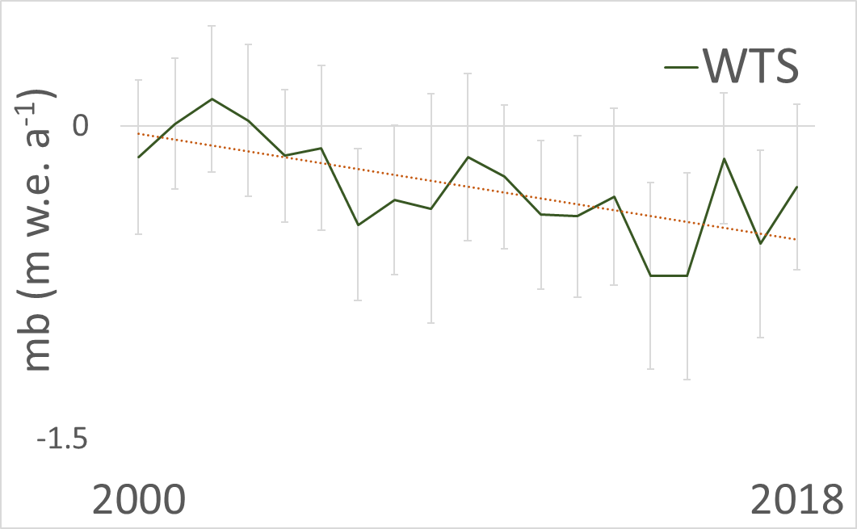
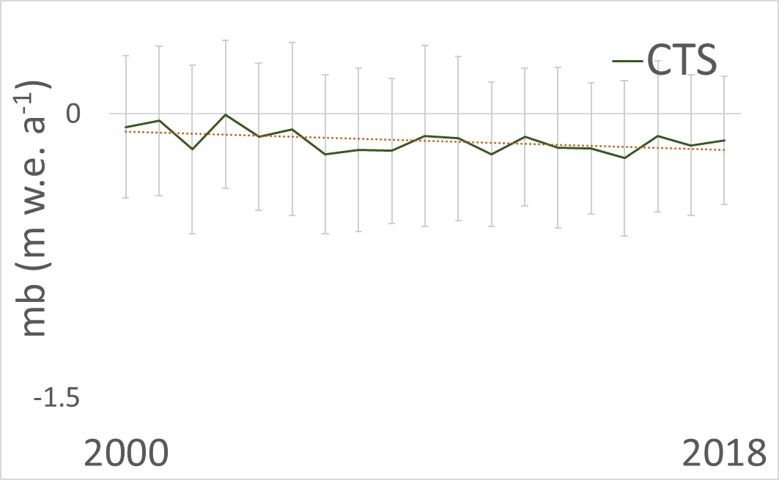
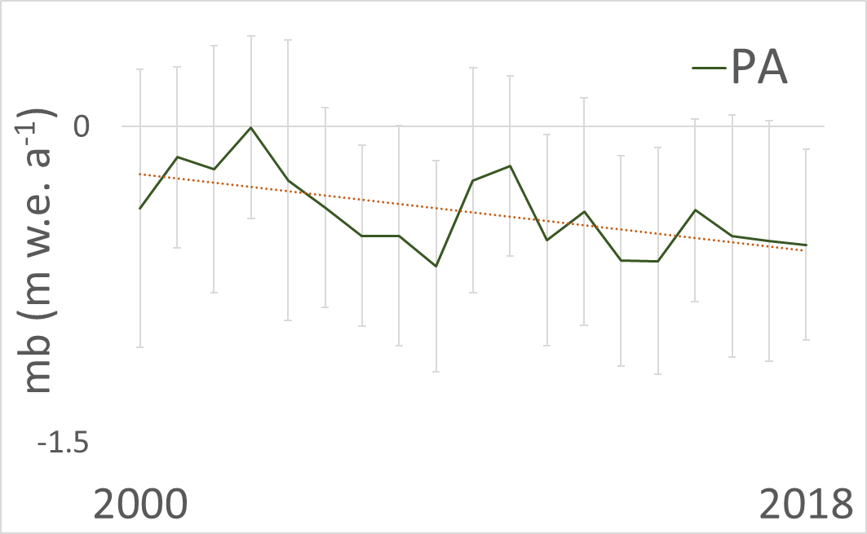
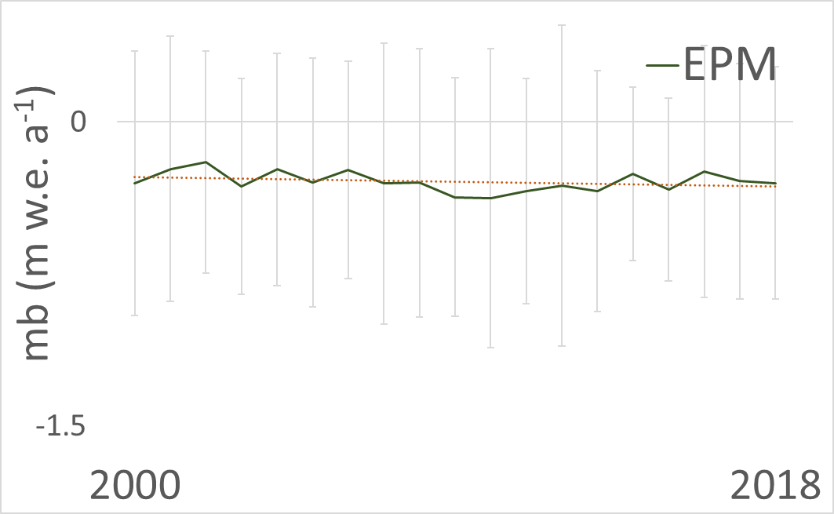
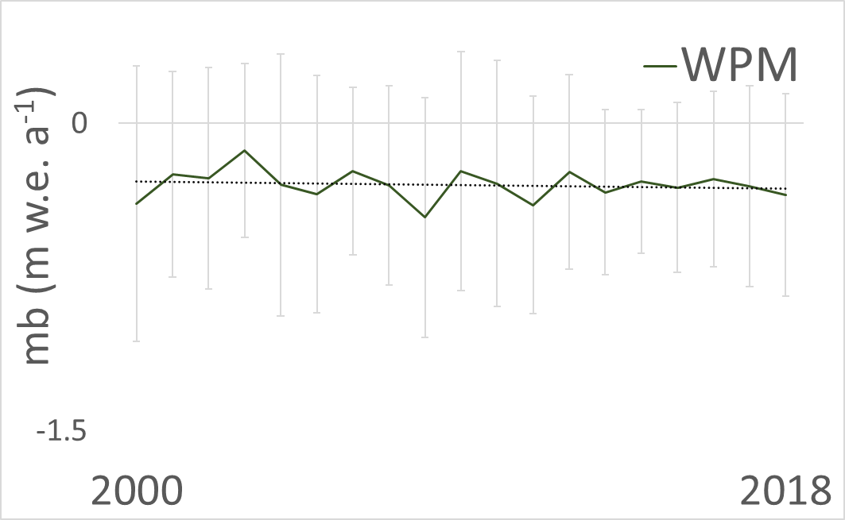
Introduction
Methods
Results
Discussion
conclusions
decadel mass balance
Annual variability decreases with increasing continentally
Glacier > 2km² that have been modelled with TSL model:
82.5% of Pamir / 66.3% of Tien Shan
ETS SMB_{TSL(2000-2018)}:
-0.35 m w.e. yr⁻¹
DZ SMB_{TSL(2000-2018)}:
-0.40 m w.e. yr⁻¹
WTS SMB_{TSL(2000-2018)}:
-0.21 m w.e. yr⁻¹
STD: 0.32 m w.e.
STD: 0.39 m w.e.
STD: 0.44 m w.e.
PA SMB_{TSL(2000-2018)}:
-0.32 m w.e. yr⁻¹
CTS SMB_{TSL(2000-2018)}:
-0.11 m w.e. yr⁻¹
STD: 0.20 m w.e.
STD: 0.40 m w.e.
EPM SMB_{TSL(2000-2018)}:
-0.10 m w.e. yr⁻¹
WPM SMB_{TSL(2000-2018)}:
-0.16 m w.e. yr⁻¹
STD: 0.31 m w.e.
STD: 0.26 m w.e.
9th EARSeL workshop on Land Ice and Snow3-5February 2020 M. Barandun

Slide 10
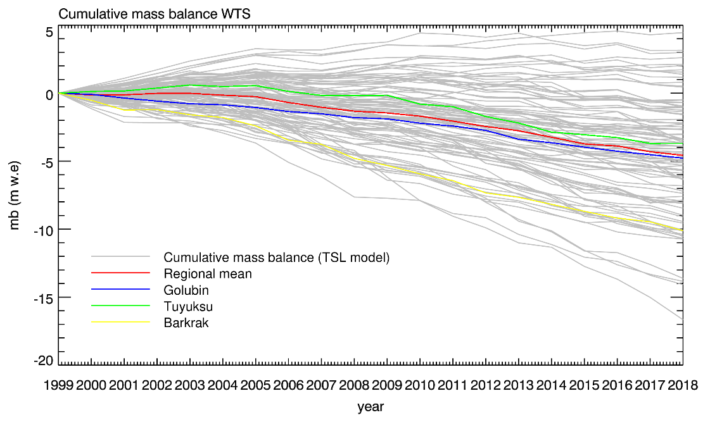
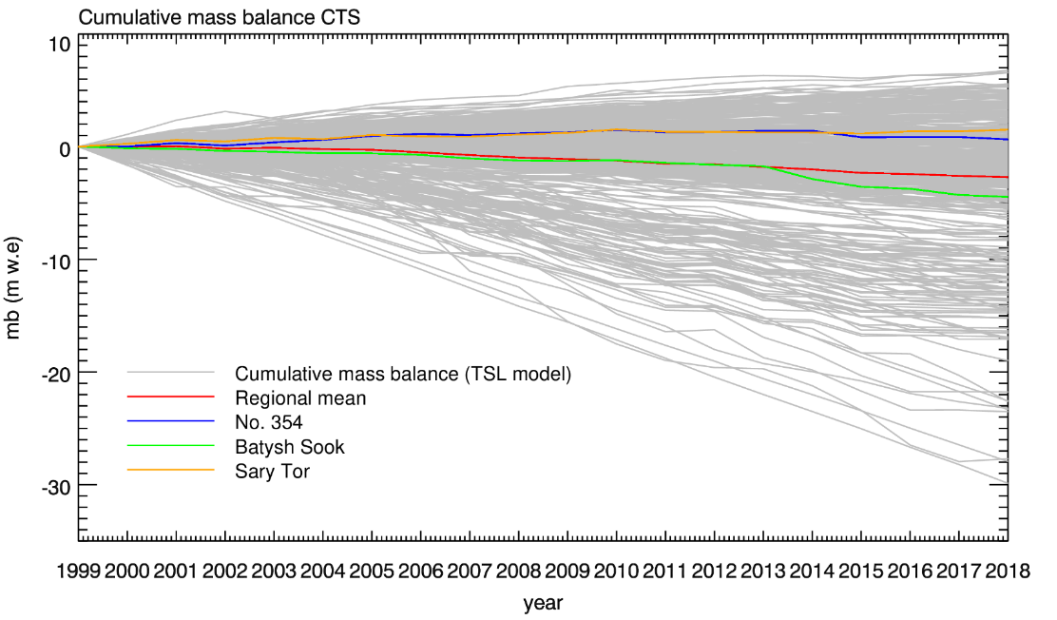
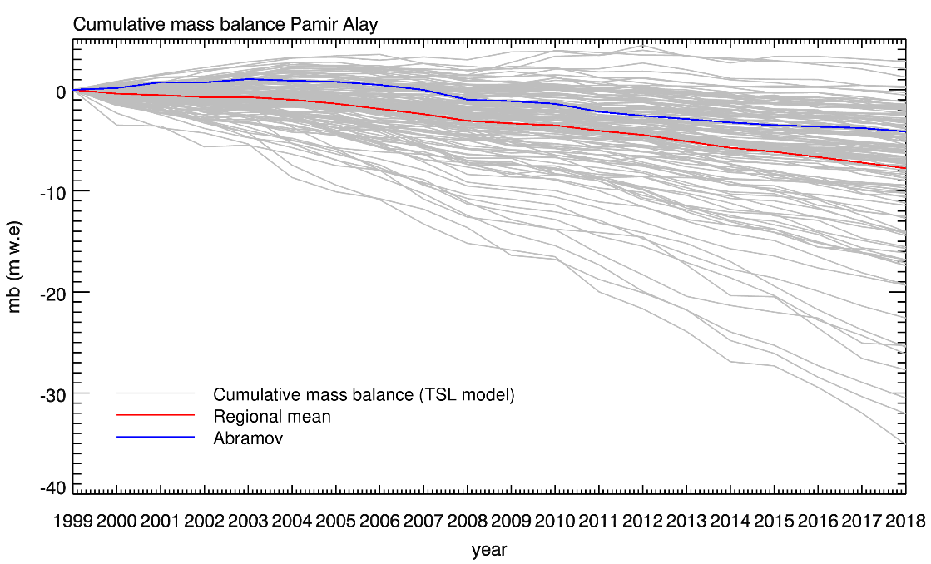
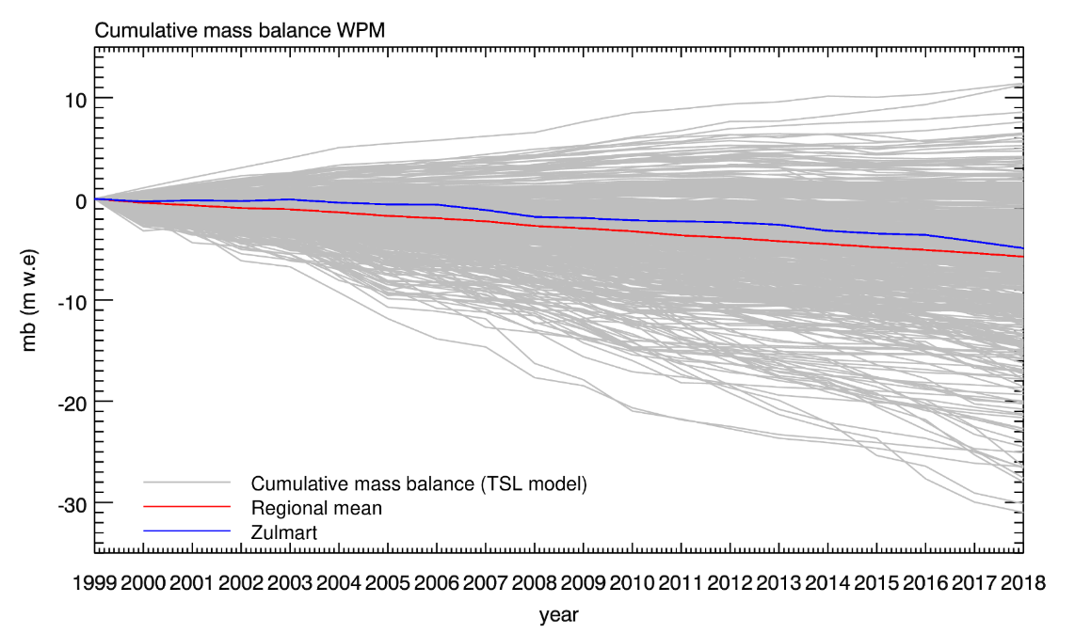
Introduction
Methods
Results
Discussion
conclusions
representativeness of monitored glaciers
9th EARSeL workshop on Land Ice and Snow3-5February 2020 M. Barandun

Slide 11
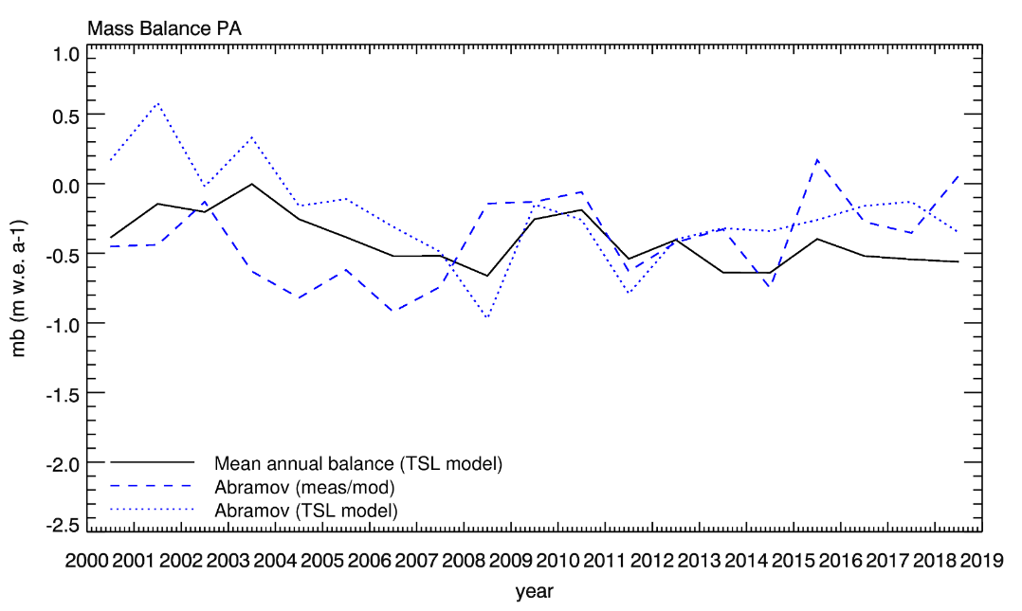
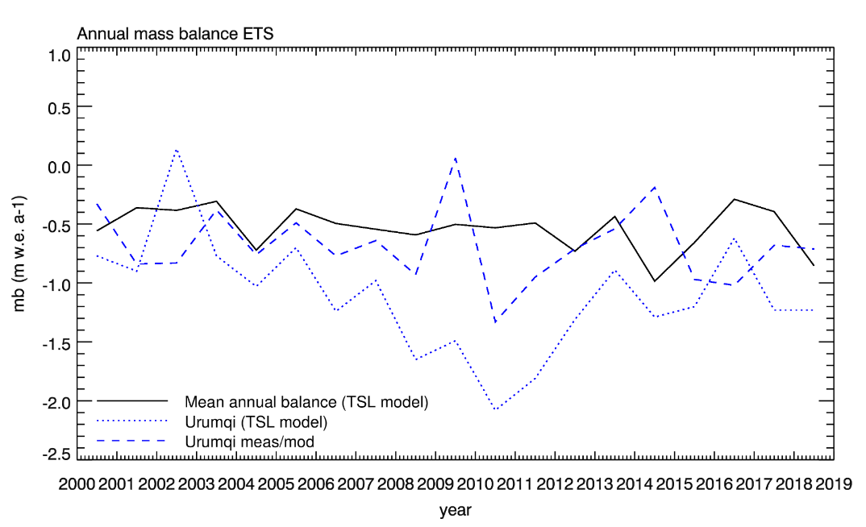
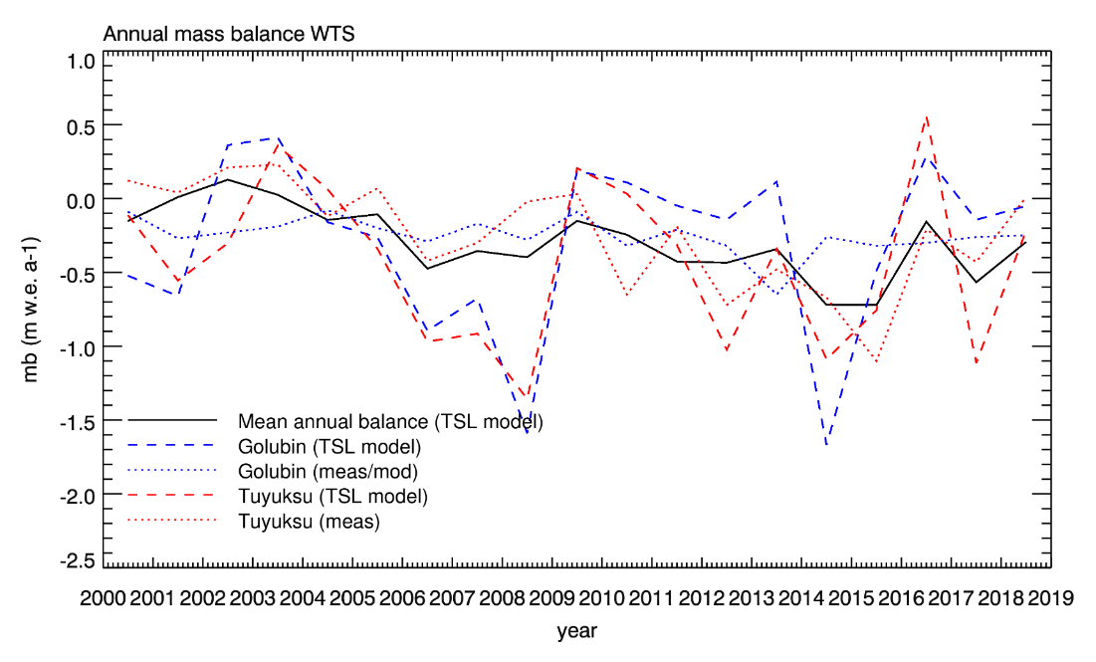
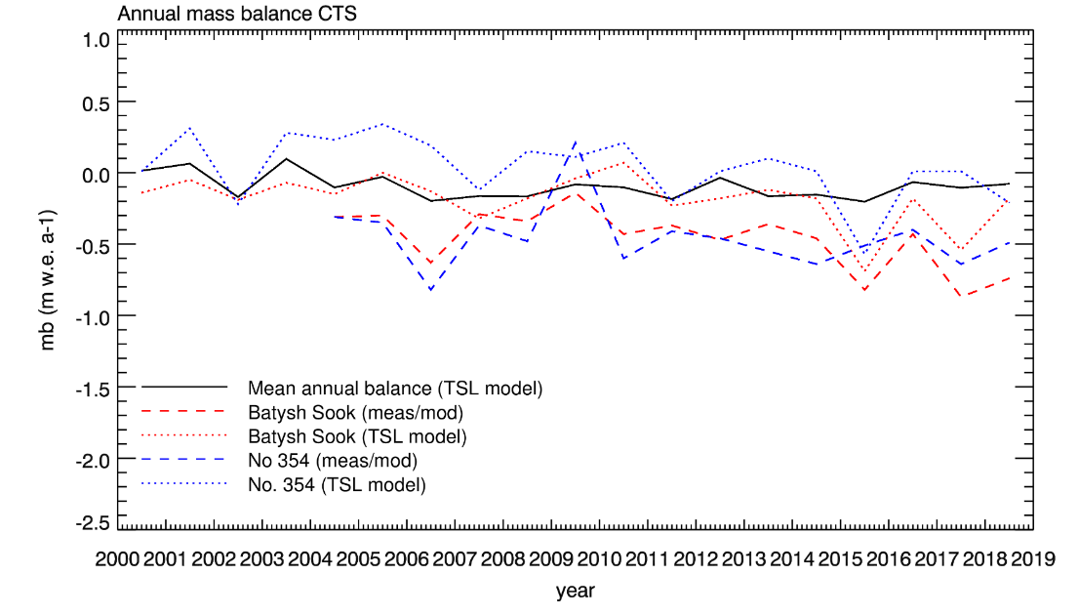
Introduction
Methods
Results
Discussion
conclusions
comparison with glaciological measurements
Abramov: modelled prior 2012
Urumqi: measured series
9th EARSeL workshop on Land Ice and Snow3-5February 2020 M. Barandun

Slide 12
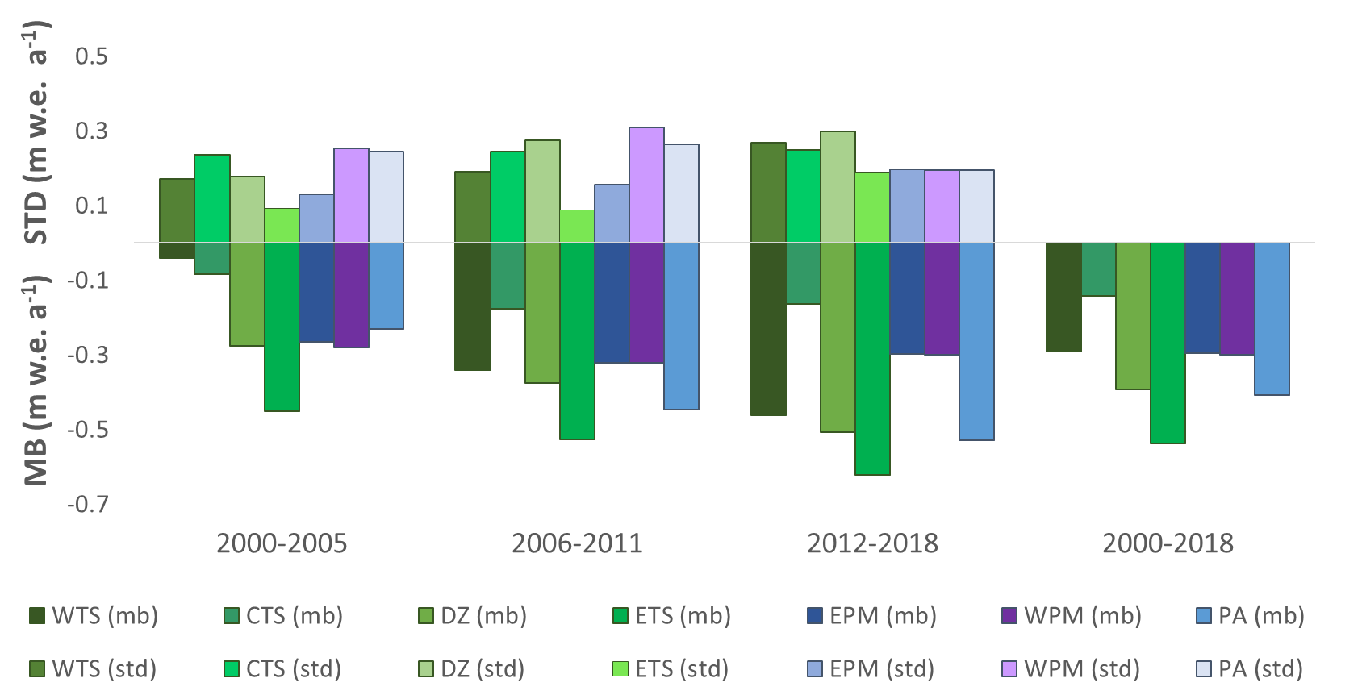
Introduction
Methods
Results
Discussion
conclusions
annual variability
Tien Shan & East Pamir: significant increase of annual variability:
West Pamir & Pamir Alay: increase of annual variability followed by decrease
Tien Shan
Pamir
Tien Shan
Pamir
Tien Shan
Pamir
Tien Shan
Pamir
Tien Shan
Pamir
Tien Shan
Pamir
Tien Shan
Pamir
Tien Shan
Pamir
9th EARSeL workshop on Land Ice and Snow3-5February 2020 M. Barandun

Slide 13
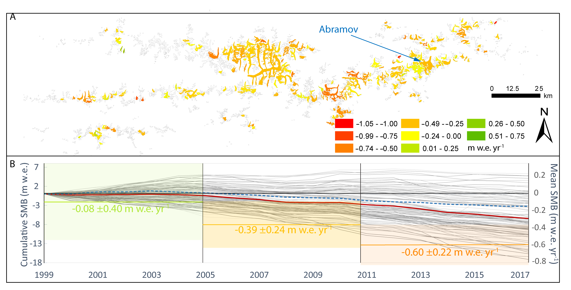
Introduction
Methods
Results
Discussion
conclusions
changing annual variability
Pamir Alay: changes annual of variability might be connected to a shift towards a more uniform region-wide mass loss
9th EARSeL workshop on Land Ice and Snow3-5February 2020 M. Barandun

Slide 14
Introduction
Methods
Results
Discussion
conclusions
conclusions
direct integration of snowline observations and geodetic mass balances into mass balance modelling!
TSL-constrained model successfully applied on mountain range scale (glaciers larger than 2km²):
annual surface mass balance time series for unmeasured and remote glaciers in the Tien Shan and Pamir from 2000 to 2018:
INCREASE IN ANNUAL VARIABILITY FOR THE TIEN SHAN AND EAST PAMIR.
DECREASE FOR THE PAMIR-ALAY AND WEST PAMIR
9th EARSeL workshop on Land Ice and Snow3-5February 2020 M. Barandun
Notes:
Introd kyrgyzstan : old monitoring → aprupt breakdown → reestablishment in 2011
Motiviation: underrepresented in WGMS
Need of monitoring: glacier retreat patter/climate influence/hydorlogical porpose

Slide 15
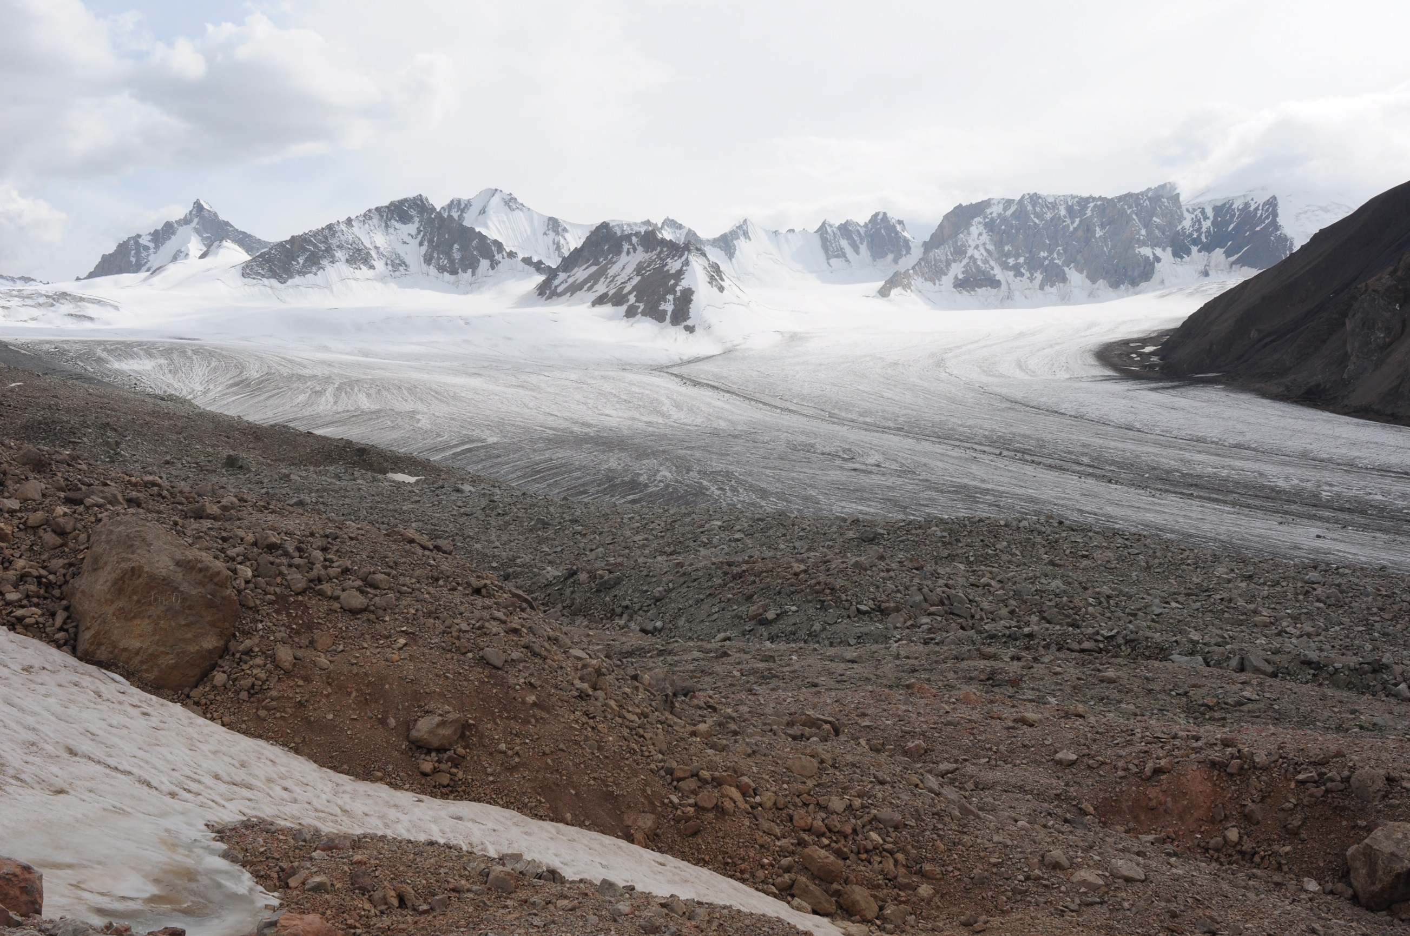
Photo: L. Sold
Thank you for your attention
Notes:
Introd kyrgyzstan : old monitoring → aprupt breakdown → reestablishment in 2011
Motiviation: underrepresented in WGMS
Need of monitoring: glacier retreat patter/climate influence/hydorlogical porpose

Slide 16
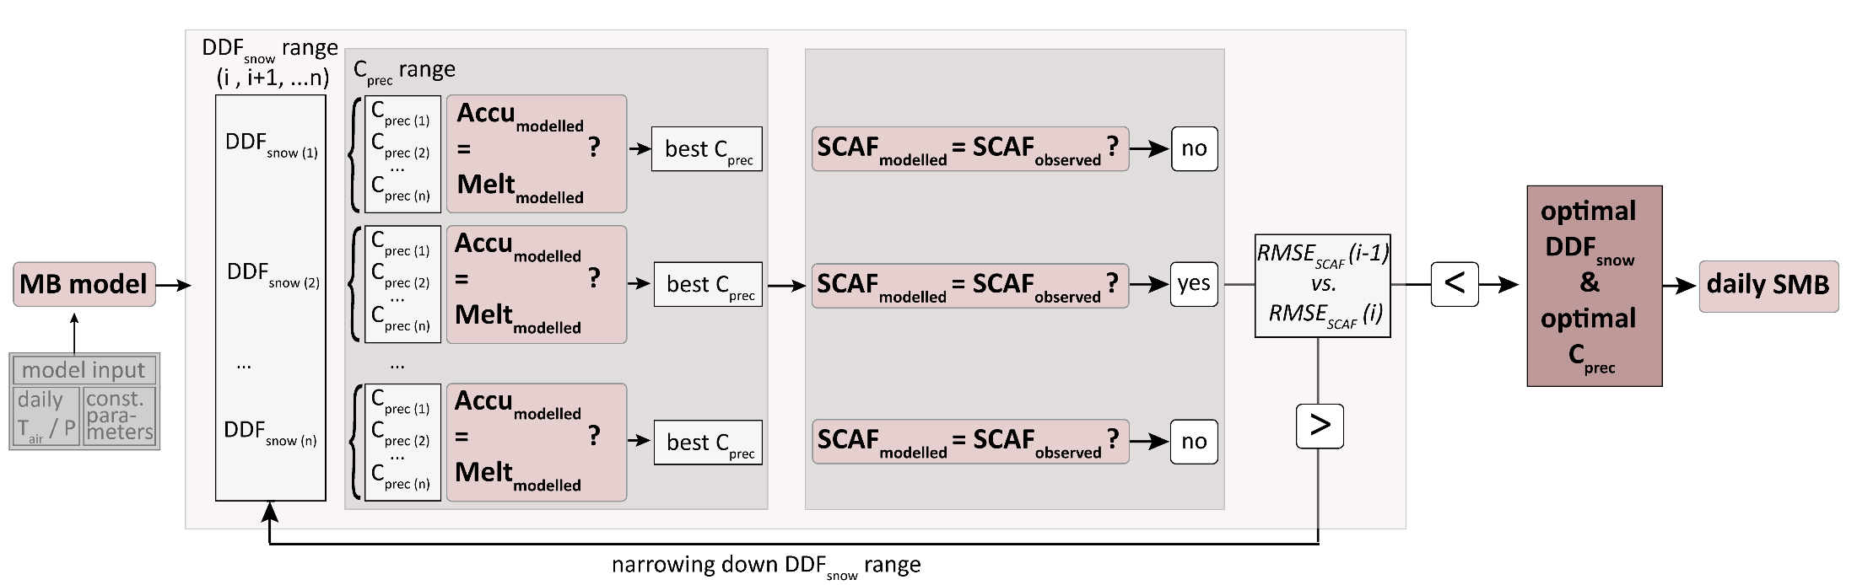
mass balance model constrained with TSL
Paper III:
16 M.Barandun, ALPINE GLACILOGY MEETING, 2018
Notes:
Introd kyrgyzstan : old monitoring → aprupt breakdown → reestablishment in 2011
Motiviation: underrepresented in WGMS
Need of monitoring: glacier retreat patter/climate influence/hydorlogical porpose

Slide 17
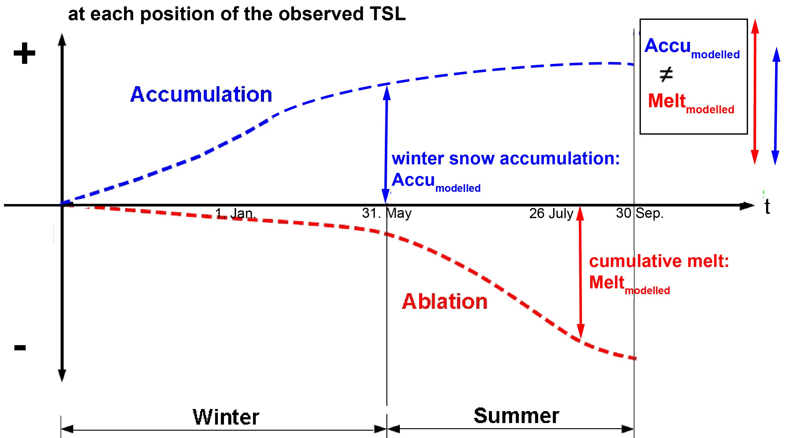
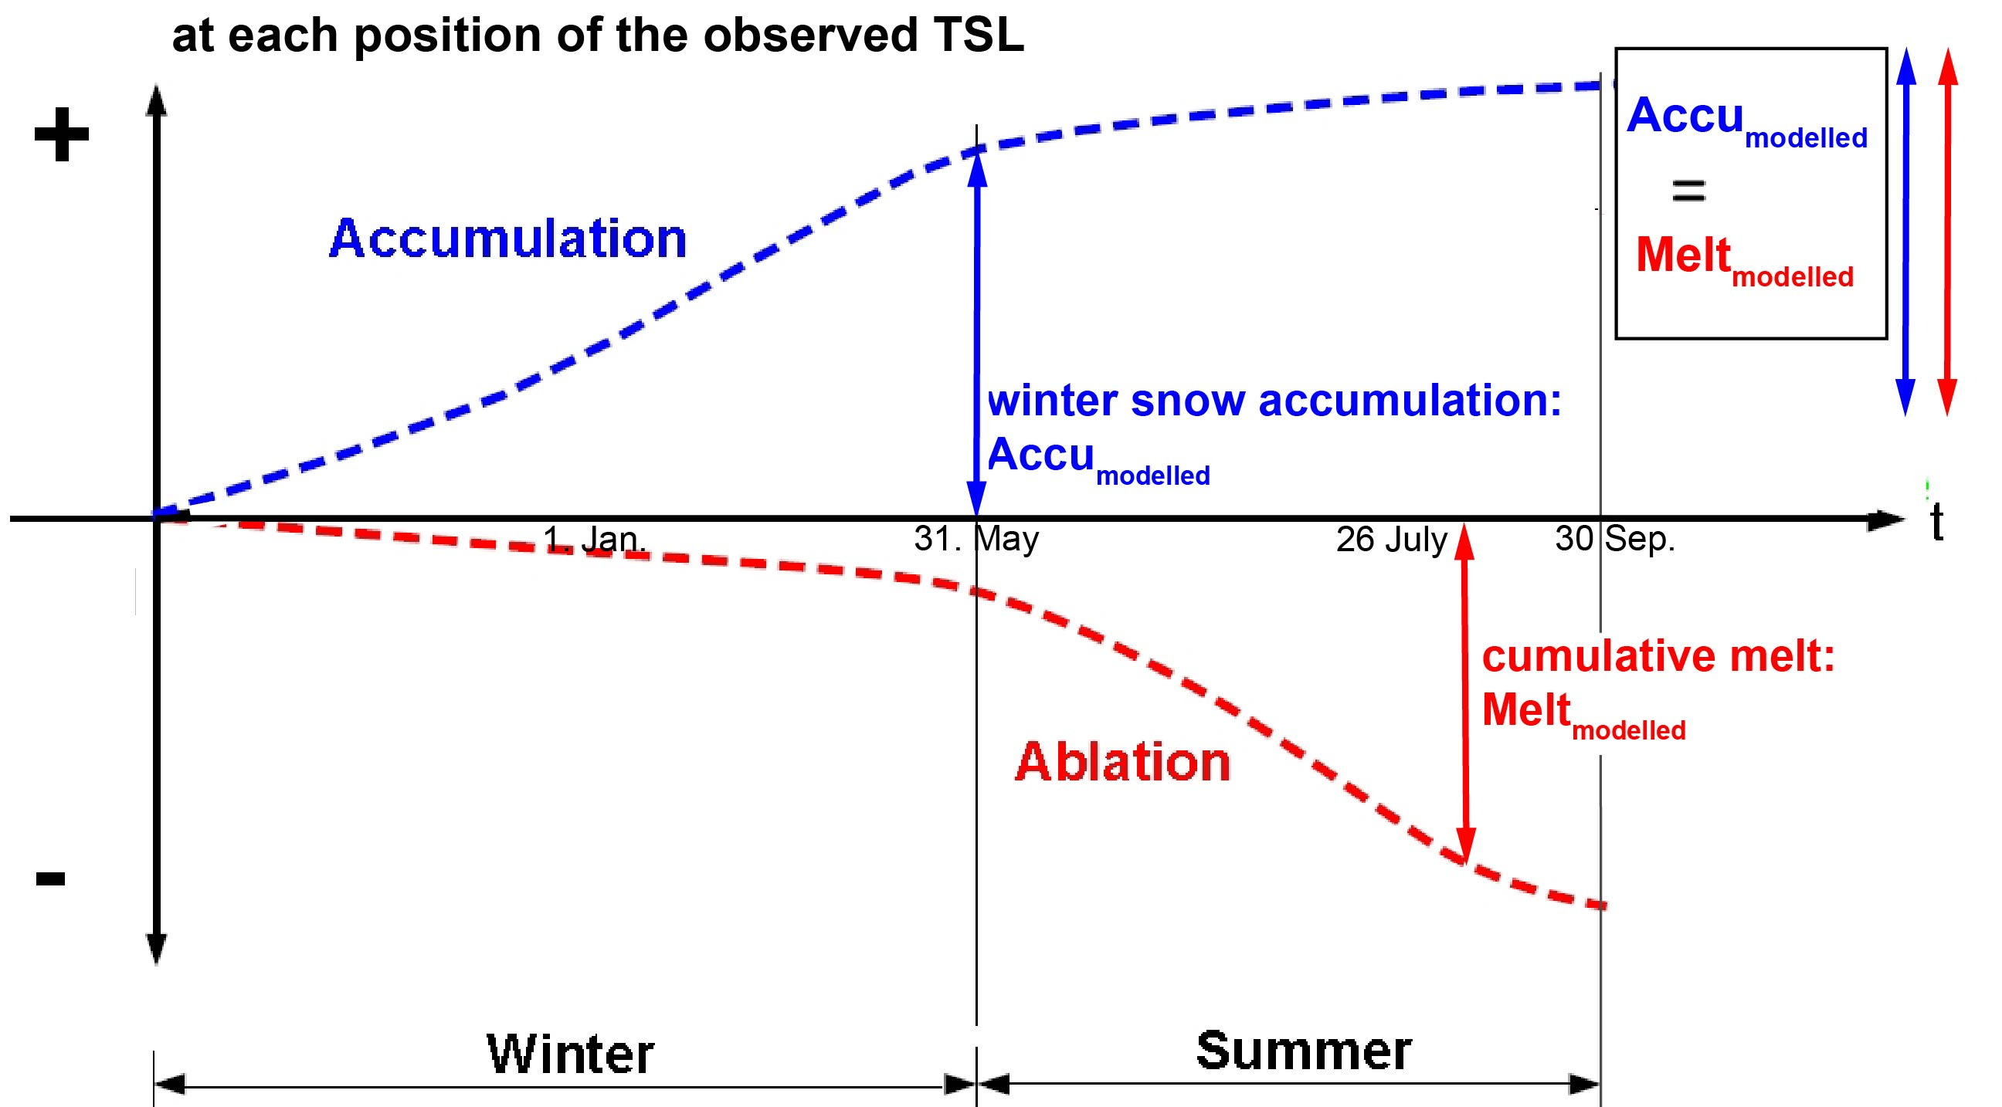
Introduction
Methods
Results
Discussion
conclusions
mass balance model constrained with TSL
Colloquium in Climatology, Climate Impact and Remote Sensing 23/10/2019
Notes:
Introd kyrgyzstan : old monitoring → aprupt breakdown → reestablishment in 2011
Motiviation: underrepresented in WGMS
Need of monitoring: glacier retreat patter/climate influence/hydorlogical porpose

Slide 18
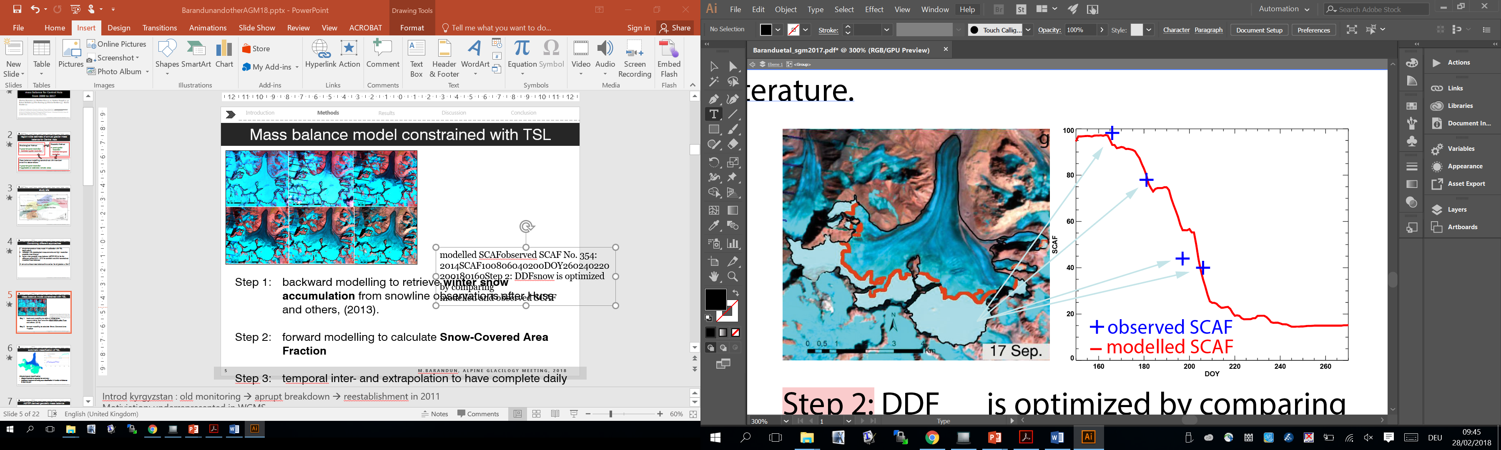
Introduction
Methods
Results
Discussion
conclusions
mass balance model constrained with TSL
observed vs. modelled Snow covered area fraction (SCAF):
Colloquium in Climatology, Climate Impact and Remote Sensing 23/10/2019
Notes:
Introd kyrgyzstan : old monitoring → aprupt breakdown → reestablishment in 2011
Motiviation: underrepresented in WGMS
Need of monitoring: glacier retreat patter/climate influence/hydorlogical porpose

Slide 19
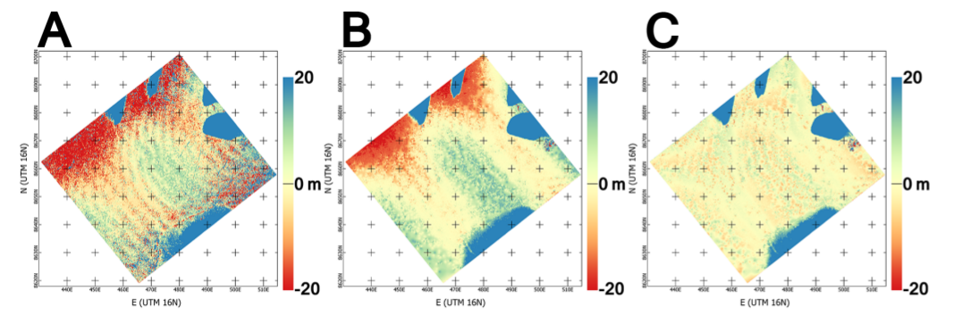
example for sea ice: MMASTER
RMSE: ≈ 21m
RMSE: < 3m
original DEM
generated from the metadata, with associated component of satellite motion (jitter) errors
DEM after cross-track correction
final DEM, after removing the along-track
error component with an external (here, assumed flat surface) DEM.
M.Barandun, ALPINE GLACILOGY MEETING, 2018
Notes:
Introd kyrgyzstan : old monitoring → aprupt breakdown → reestablishment in 2011
Motiviation: underrepresented in WGMS
Need of monitoring: glacier retreat patter/climate influence/hydorlogical porpose

Slide 20
ASTER derived geodetic mass balance
MicMAC ASTER (MMASTER)
free, open-source photogrammetry software package developed at IGN and ENSG (France)
built-in component for processing DEMs from ASTER (Girod et al., 2017)
MMASTER solves for and removes error introduced by cross-track component of satellite motion (jitter) and with a second DEM, can also remove along-track component
20 M.Barandun, ALPINE GLACILOGY MEETING, 2018
Notes:
Introd kyrgyzstan : old monitoring → aprupt breakdown → reestablishment in 2011
Motiviation: underrepresented in WGMS
Need of monitoring: glacier retreat patter/climate influence/hydorlogical porpose

Slide 21
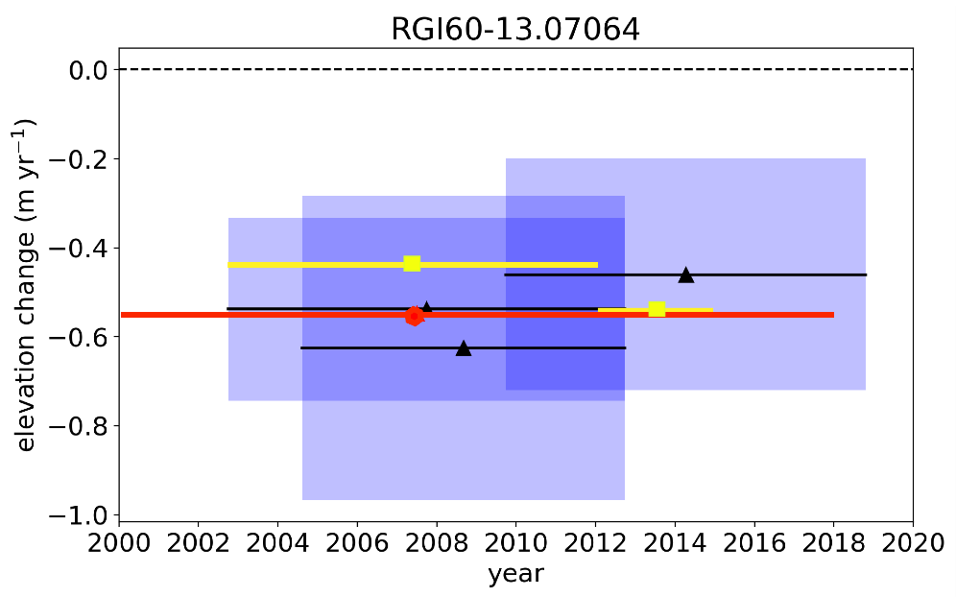
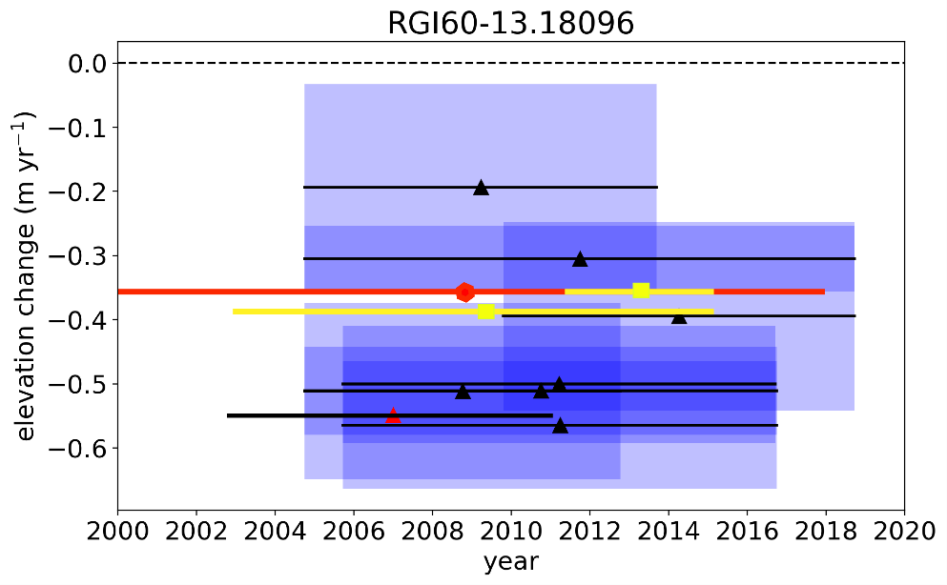
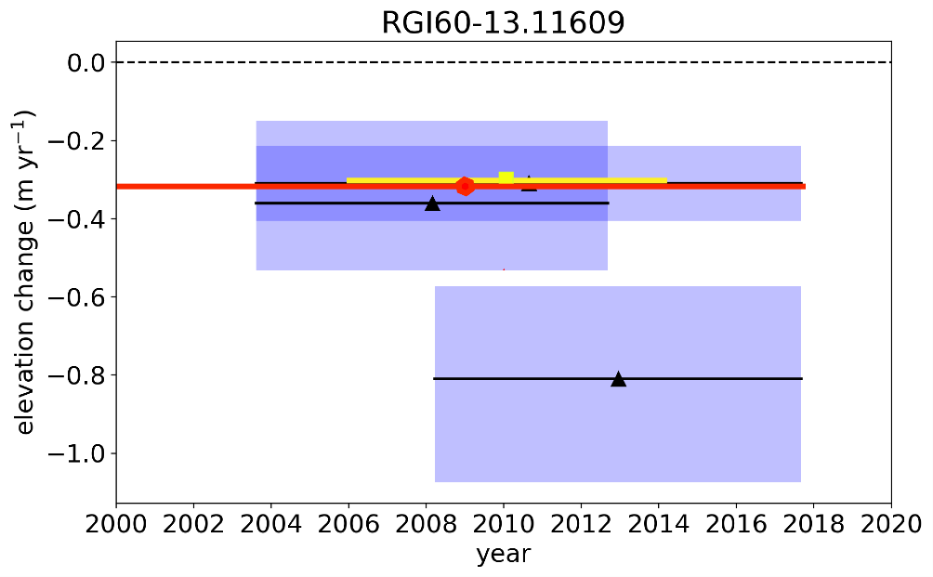
Introduction
Methods
Results
Discussion
conclusions
comparing geodetic mass balances of high and medium resolution satellite images
ASTER derived geodetic mass balance:
relatively large uncertainties
ASTER derived elevation change
& uncertainties
Elevation change (high resolution sensors)
Elevation change (summarized)
9th EARSeL workshop on Land Ice and Snow3-5February 2020 M. Barandun

Slide 22
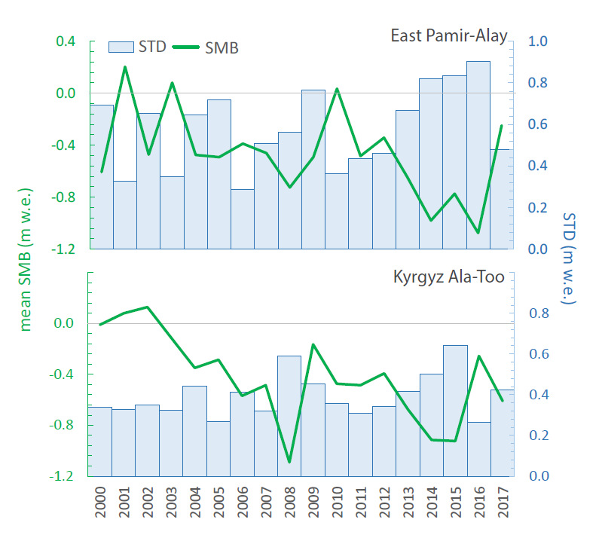
Introduction
Methods
Results
Discussion
conclusions
annual mass balance time series
negative correlation between mean annual surface mass balance (SMB) and standard deviation (STD):
more heterogeneous response with increasing negative mass balance.
Colloquium in Climatology, Climate Impact and Remote Sensing 23/10/2019

Slide 23
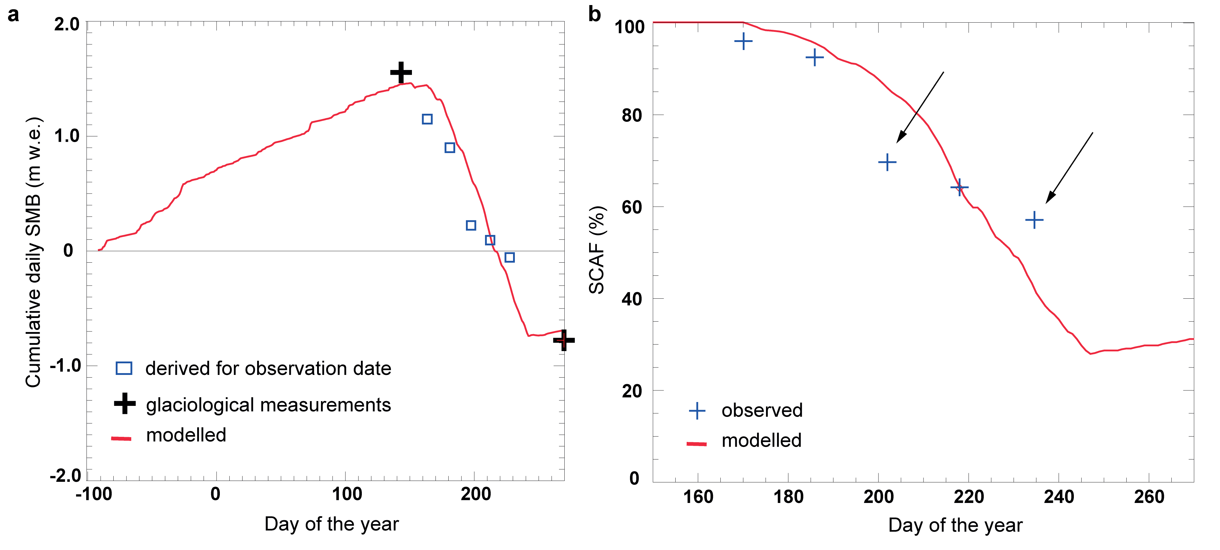
Introduction
Methods
Results
Discussion
conclusions
transient snowline observations
Single observation becomes less important
Colloquium in Climatology, Climate Impact and Remote Sensing 23/10/2019

Slide 24
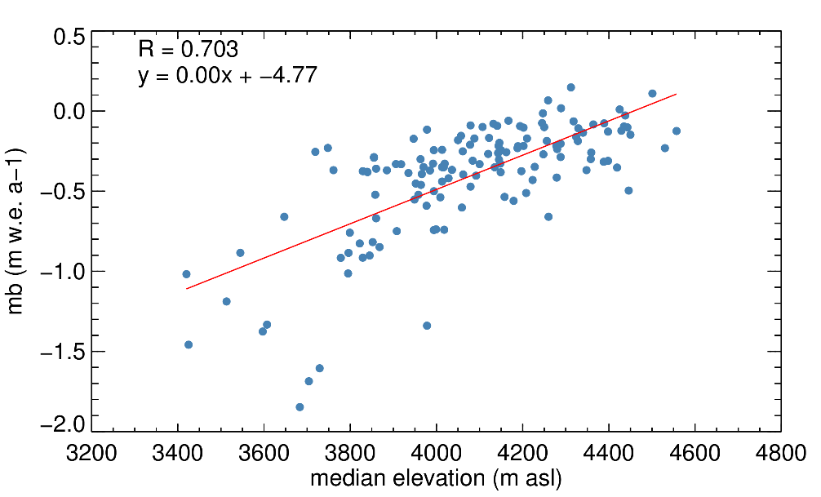
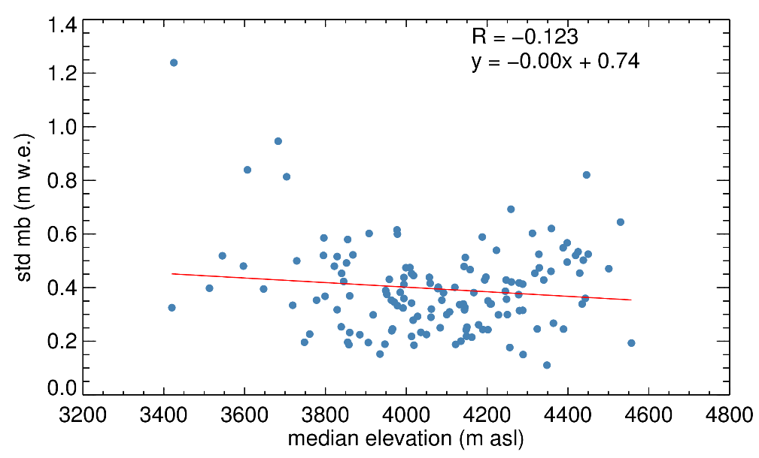






Introduction
Methods
Results
Discussion
conclusions
dependency of on morpho-topographic characteristics
9th EARSeL workshop on Land Ice and Snow3-5February 2020 M. Barandun

Slide 25



Introduction
Methods
Results
Discussion
conclusions
dependency of on morpho-topographic factors
significant decrease of STD with time:
for glaciers < 5km²
for glaciers with slope between 10-20°
for glacier median elevation between in 4000-4500 m a.s.l.
9th EARSeL workshop on Land Ice and Snow3-5February 2020 M. Barandun

Slide 26


Introduction
Methods
Results
Discussion
conclusions
dependency of on morpho-topographic factors
significant increase of STD with time:
glaciers < 5km² and 10-20km²
glacier median elevation between in 4000-4500 m a.s.l.
significant decrease of STD with time:
glacier median elevation between in 4500-5000 m a.s.l.
glacier with slopes between 10-15°
9th EARSeL workshop on Land Ice and Snow3-5February 2020 M. Barandun

Slide 27

Interdependent calibration between cprec and DDFsnow

Slide 28


Introduction
Methods
Results
Discussion
conclusions
superimposed ice
Colloquium in Climatology, Climate Impact and Remote Sensing 23/10/2019

Slide 29
ASTER derived geodetic mass balance
all available ASTER scenes with cloud cover lower than 50% are processed
Elevation change is calculated for all scene-combinations with time difference higher than 5 years and overlap of 50%
Range of geodetic mass balances summarized for reference period based on annual variability of regional glaciological measurements
29 M.Barandun, ALPINE GLACILOGY MEETING, 2018
Notes:
Introd kyrgyzstan : old monitoring → aprupt breakdown → reestablishment in 2011
Motiviation: underrepresented in WGMS
Need of monitoring: glacier retreat patter/climate influence/hydorlogical porpose

Slide 30






Introduction
Methods
Results
Discussion
conclusions
automatic classification of snowlines
critical albedo = where rate of change in albedo is greatest
Shortwave broadband albedo derived based on narrow-to-broadband formula by Liang 2000:
uncertainties related to snowline delineation
Final surface type classification
albedo < 0.25 = ice
Primary surface type evaluation
input data (cloud cover, oversaturation, cast shadows)
general data processing (missing topographic correction on the radiometry)
albedo retrieval (narrow-to-broadband albedo conversion, reclassification scheme)
albedo > 0.55
= snow
Albedo
Albedo
0.25 > albedo < 0.55 = unclear
albedo based classification
(after Naegeli et al., 2019)
9th EARSeL workshop on Land Ice and Snow3-5February 2020 M. Barandun
Notes:
Introd kyrgyzstan : old monitoring → aprupt breakdown → reestablishment in 2011
Motiviation: underrepresented in WGMS
Need of monitoring: glacier retreat patter/climate influence/hydorlogical porpose

Slide 31




Introduction
Methods
Results
Discussion
conclusions
TSL - model vs geodetic mass balance
ETS
PA
WTS
WPM
9th EARSeL workshop on Land Ice and Snow3-5February 2020 M. Barandun

Slide 32
Introduction
Methods
Results
Discussion
conclusions
Data filtering steps
Glacier > 2km2 that have been modelled with TSL model:
82.5% for Pamir / 66.3% Tien Shan
PA: 85%
WPM: 61%
EPM: 87%
WTS: 92%
ETS: 31%
DZ: 94%
CTS: 70%
All glaciers where geod. Mb +/- 2x Error geod mb ≠ Tsl modelled mb
Not complete series: where more than 3 years have not been modelled
Singles values that are higher/lower than median + 3*STD (ind. Glaciers)
Colloquium in Climatology, Climate Impact and Remote Sensing 23/10/2019

Slide 33


Introduction
Methods
Results
Discussion
conclusions
cumulative mass balance
Colloquium in Climatology, Climate Impact and Remote Sensing 23/10/2019

Slide 34


Introduction
Methods
Results
Discussion
conclusions
model validation
model performance → evaluated with direct glaciological measurements / high-resolution geodetic mass balance
for three selected glaciers in Central Asia
34 Barandun et al, EGU 2019
Notes:
Introd kyrgyzstan : old monitoring → aprupt breakdown → reestablishment in 2011
Motiviation: underrepresented in WGMS
Need of monitoring: glacier retreat patter/climate influence/hydorlogical porpose

Slide 35

Introduction
Methods
Results
Discussion
conclusions
improve glacier mass change observations for unmeasured and remote glaciers
more accurate modelling using TSL observations
Abramov:
modelled measured
 | ΔM (geod) | ΔM (meas) | ΔM (mod) | ΔM (TSL mod)
2003-11 | -0.35 ±0.2m w.e. a⁻¹ |  | -0.60 ±0.5m w.e. a⁻¹ | -0.25 ±0.2m w.e. a⁻¹
2011-15 | -0.36 ±0.3m w.e. a⁻¹ | -0.40 ±0.3m w.e. a⁻¹ |  | -0.43 ±0.2m w.e. a⁻¹
Colloquium in Climatology, Climate Impact and Remote Sensing 23/10/2019

Slide 36
Introduction
Methods
Results
Discussion
conclusions
main limitation
internal / basal mass balance
non-winter accumulation-type glaciers / debris covered glaciers
snowline needs to be representative for mass balance: superimposed ice / summer snow fall !
frequency and distribution of transient snowline observations:
terrestrial vs. satellite images
Colloquium in Climatology, Climate Impact and Remote Sensing 23/10/2019
Notes:
Introd kyrgyzstan : old monitoring → aprupt breakdown → reestablishment in 2011
Motiviation: underrepresented in WGMS
Need of monitoring: glacier retreat patter/climate influence/hydorlogical porpose

Slide 37

Rating curves

Slide 38


Introduction
Methods
Results
Discussion
conclusions
comparison to other studies
Comparison of mass balance constrained with transient snowline observations to other studies for Abramov glacier and region-wide studies for Pamir / Pamir-Alay
Barandun et al., 2018
Barandun et al., in prep.
TSL-constrained model for individual glacier = this study
38 Barandun et al, EGU 2019
Notes:
Was kann man tun, wenn es zu wenige SL Beobachtungen gibt um gute rating curve herzuleiten? => idealized curve. Ausserdem musst Du betonen (vorne), dass die Kurve (im Normalfall) jährlich hergeleitet wird, kommt momentan nicht raus

Slide 39


Introduction
Methods
Results
Discussion
conclusions
comparison of mass balance constrained with TSL observations to other region-wide studies and studies for individual glaciers
This study: TSL-constrained modelling
39 M.Barandun, phd-Defence, 25 Sep. 2018

Slide 40
Introduction
Methods
Results
Discussion
conclusions
Std periods
 | PA |  | WPM |  | EPM |  | ETS |  | DZ |  | CTS |  | WTS
2009 | 4.30 | 0.000 | 2.38 | 0.018 | -6.95 | 0.000 | -2.81 | 0.006 | -4.89 | 0.000 | -2.26 | 0.024 | -1.45 | 0.151
2007 | 2.61 | 0.010 | -2.01 | 0.044 | -6.27 | 0.000 | -3.96 | 0.000 | -6.21 | 0.000 | -4.26 | 0.000 | -3.14 | 0.002
2011 | 7.51 | 0.000 | 10.47 | 0.000 | -5.90 | 0.000 | -2.53 | 0.013 | -1.97 | 0.055 | -1.91 | 0.056 | -2.03 | 0.045
2000-2005 vs. 2006-2011 | -1.00 | 0.319 | -6.97 | 0.000 | -1.42 | 0.158 | -1.00 | 0.320 | -1.00 | 0.322 | -1.87 | 0.062 | -2.41 | 0.018
2006-2011 vs 2012-2018 | 6.60 | 0.000 | 15.88 | 0.000 | -1.64 | 0.105 | -2.44 | 0.017 | -0.75 | 0.457 | 0.81 | 0.419 | -3.35 | 0.001
2000-2005 vs 2000-2018 | -0.73 | 0.468 | 3.02 | 0.003 | -5.85 | 0.000 | -3.18 | 0.002 | 0.24 | 0.810 | -4.95 | 0.000 | -5.63 | 0.000
2006-2011 vs 2000-2018 | -10.43 | 0.000 | -20.05 | 0.000 | -3.22 | 0.002 | 0.91 | 0.366 | 1.52 | 0.134 | -6.85 | 0.000 | -0.57 | 0.569
2012-2018 vs 2000-2018 | -1.00 | 0.319 | -7.14 | 0.000 | -1.42 | 0.158 | -1.00 | 0.320 | -1.00 | 0.322 | -8.36 | 0.000 | -8.25 | 0.000
2000-2005 vs 2012-2018 | -1.00 | 0.319 | 9.98 | 0.000 | -1.42 | 0.158 | -1.00 | 0.320 | -1.00 | 0.322 | -1.05 | 0.294 | -5.38 | 0.000
Colloquium in Climatology, Climate Impact and Remote Sensing 23/10/2019

Slide 41
Introduction
Methods
Results
Discussion
conclusions
Morpho-topo. factors
PA -mb |  |  |  |  | WPM |  |  |  | EPM |  |  |  | WTS |  |  |  | CTS |  |  |  | DZ |  |  |  | ETS
area |  |  |  |  | area |  |  |  | area |  |  |  | area |  |  |  | area |  |  |  | area |  |  |  | area
Spearman's | correlation: | 0.106202 | 0.202015 |  | Spearman's | 0.147245 | 0.000251 |  | Spearman's | 0.517999 | 1.06E-10 |  | Spearman's | 0.467534 | 1.21E-07 |  | Spearman's | 0.326183 | 5.23E-14 |  | Spearman's | -0.0907 | 0.539809 |  | Spearman's | 0.77301 | 4.68E-30
Kendalls's | correlation: | -0.12038 | 0.031092 |  | Kendalls's | -0.03471 | 0.198343 |  | Kendalls's | -0.6053 | 0 |  | Kendalls's | -0.17634 | 0.005009 |  | Kendalls's | -0.08191 | 0.00588053 |  | Kendalls's | -0.07276 | 0.465717 |  | Kendalls's | -0.6249 | 0
---------------------------------------------- |  |  |  |  | ---------------------------------------------- |  |  |  | ---------------------------------------------- |  |  |  | ---------------------------------------------- |  |  |  | ---------------------------------------------- |  |  |  | ---------------------------------------------- |  |  |  | ----------------------------------------------
median | mb |  |  |  | median |  |  |  | median |  |  |  | median |  |  |  | median |  |  |  | median |  |  |  | median
Spearman's | correlation: | 0.690685 | 5.12E-22 |  | Spearman's | 0.524995 | 8.41E-45 |  | Spearman's | 0.045788 | 0.596581 |  | Spearman's | 0.716239 | 1.60E-19 |  | Spearman's | 0.459436 | 8.65E-28 |  | Spearman's | 0.393573 | 0.005648 |  | Spearman's | 0.829854 | 4.67E-38
Kendalls's | correlation: | 0.334515 | 0 |  | Kendalls's | 0.280221 | 0 |  | Kendalls's | -0.42597 | 0 |  | Kendalls's | 0.046665 | 0.457674 |  | Kendalls's | 0.022329 | 0.452766 |  | Kendalls's | 0.257778 | 0.009755 |  | Kendalls's | -0.56103 | 0
---------------------------------------------- |  |  |  |  | ---------------------------------------------- |  |  |  | ---------------------------------------------- |  |  |  | ---------------------------------------------- |  |  |  | ---------------------------------------------- |  |  |  | ---------------------------------------------- |  |  |  | ----------------------------------------------
slope |  |  |  |  | slope |  |  |  | slope |  |  |  | slope |  |  |  | slope |  |  |  | slope |  |  |  | slope
Spearman's | correlation: | -0.35368 | 1.19E-05 |  | Spearman's | 0.01399 | 0.729352 |  | Spearman's | -0.64014 | 4.84E-17 |  | Spearman's | 0.019919 | 0.831922 |  | Spearman's | -0.00527 | 0.905862 |  | Spearman's | 0.383812 | 0.007081 |  | Spearman's | -0.03312 | 0.692457
Kendalls's | correlation: | -0.30522 | 5.96E-08 |  | Kendalls's | -0.01091 | 0.686024 |  | Kendalls's | -0.57232 | 0 |  | Kendalls's | -0.19427 | 0.001989 |  | Kendalls's | -0.07115 | 0.0167376 |  | Kendalls's | 0.211556 | 0.033922 |  | Kendalls's | -0.60326 | 0
---------------------------------------------- |  |  |  |  | ---------------------------------------------- |  |  |  | ---------------------------------------------- |  |  |  | ---------------------------------------------- |  |  |  | ---------------------------------------------- |  |  |  | ---------------------------------------------- |  |  |  | ----------------------------------------------
aspect |  |  |  |  | aspect |  |  |  | aspect |  |  |  | aspect |  |  |  | aspect |  |  |  | aspect |  |  |  | aspect
Spearman's | correlation: | 0.041097 | 0.622355 |  | Spearman's | -0.05314 | 0.188511 |  | Spearman's | -0.17752 | 0.0386783 |  | Spearman's | 0.023482 | 0.80243 |  | Spearman's | -0.22433 | 3.42E-07 |  | Spearman's | -0.01303 | 0.929951 |  | Spearman's | -0.43662 | 4.02E-08
Kendalls's | correlation: | -0.03637 | 0.514817 |  | Kendalls's | -0.07228 | 0.00739 |  | Kendalls's | -0.45748 | 0 |  | Kendalls's | -0.163 | 0.009483 |  | Kendalls's | -0.22175 | 0 |  | Kendalls's | -0.08549 | 0.391415 |  | Kendalls's | -0.68705 | 0
---------------------------------------------- |  |  |  |  | ---------------------------------------------- |  |  |  | ---------------------------------------------- |  |  |  | ---------------------------------------------- |  |  |  | ---------------------------------------------- |  |  |  | ---------------------------------------------- |  |  |  | ----------------------------------------------
STD |  |  |  |  |  |  |  |  | STD |  |  |  | Std |  |  |  | STD |  |  |  | STD |  |  |  | std
area |  |  |  |  | area |  |  |  | area |  |  |  | area |  |  |  | area |  |  |  | area |  |  |  | area
Spearman's | correlation: | 0.177471 | 0.032113 |  | Spearman's | 0.022102 | 0.584657 |  | Spearman's | 0.727495 | 1.12E-23 |  | Spearman's | 0.341199 | 0.000178 |  | Spearman's | 0.227089 | 2.43E-07 |  | Spearman's | -0.13537 | 0.358954 |  | Spearman's | 0.70738 | 2.65E-23
Kendalls's | correlation: | -0.06868 | 0.218669 |  | Kendalls's | -0.12041 | 8.11E-06 |  | Kendalls's | -0.41355 | 0 |  | Kendalls's | -0.27616 | 1.11E-05 |  | Kendalls's | -0.15341 | 2.38E-07 |  | Kendalls's | -0.14184 | 0.155001 |  | Kendalls's | -0.69655 | 0
---------------------------------------------- |  |  |  |  | ---------------------------------------------- |  |  |  | ---------------------------------------------- |  |  |  | ---------------------------------------------- |  |  |  | ---------------------------------------------- |  |  |  | ---------------------------------------------- |  |  |  | ----------------------------------------------
med | std |  |  |  | med |  |  |  | med |  |  |  | med |  |  |  | med |  |  |  | med |  |  |  | med
Spearman's | correlation: | 0.144822 | 0.081149 |  | Spearman's | -0.54533 | 0 |  | Spearman's | -0.46816 | 9.07E-09 |  | Spearman's | 0.156379 | 0.093671 |  | Spearman's | 0.145016 | 0.00107054 |  | Spearman's | 0.138042 | 0.349449 |  | Spearman's | 0.732045 | 1.32E-25
Kendalls's | correlation: | -0.08461 | 0.129688 |  | Kendalls's | -0.44185 | 0 |  | Kendalls's | -0.75281 | 0 |  | Kendalls's | -0.41962 | 0 |  | Kendalls's | -0.21271 | 0 |  | Kendalls's | 0.056839 | 0.568782 |  | Kendalls's | -0.67887 | 0
---------------------------------------------- |  |  |  |  | ---------------------------------------------- |  |  |  | ---------------------------------------------- |  |  |  | ---------------------------------------------- |  |  |  | ---------------------------------------------- |  |  |  | ---------------------------------------------- |  |  |  | ----------------------------------------------
slope |  |  |  |  | slope |  |  |  | slope |  |  |  | slope |  |  |  | slope |  |  |  | slope |  |  |  | slope
Spearman's | correlation: | 0.183838 | 0.026338 |  | Spearman's | -0.04764 | 0.23851 |  | Spearman's | -0.45669 | 2.29E-08 |  | Spearman's | -0.16373 | 0.079047 |  | Spearman's | -0.10725 | 0.015797 |  | Spearman's | 0.289933 | 0.045616 |  | Spearman's | -0.16888 | 0.042303
Kendalls's | correlation: | 0.065375 | 0.241659 |  | Kendalls's | -0.05511 | 0.041106 |  | Kendalls's | -0.42414 | 0 |  | Kendalls's | -0.32032 | 3.58E-07 |  | Kendalls's | -0.13925 | 2.86E-06 |  | Kendalls's | 0.150977 | 0.130114 |  | Kendalls's | -0.68687 | 0
---------------------------------------------- |  |  |  |  | ---------------------------------------------- |  |  |  | ---------------------------------------------- |  |  |  | ---------------------------------------------- |  |  |  | ---------------------------------------------- |  |  |  | ---------------------------------------------- |  |  |  | ----------------------------------------------
aspect |  |  |  |  | aspect |  |  |  | aspect |  |  |  | aspect |  |  |  | aspect |  |  |  | aspect |  |  |  | aspect
Spearman's | correlation: | -0.13946 | 0.093183 |  | Spearman's | -0.0156 | 0.699685 |  | Spearman's | -0.43583 | 1.14E-07 |  | Spearman's | -0.34713 | 0.000135 |  | Spearman's | -0.0748 | 0.0928081 |  | Spearman's | 0.087245 | 0.555431 |  | Spearman's | -0.48168 | 8.59E-10
Kendalls's | correlation: | -0.15426 | 0.005731 |  | Kendalls's | -0.04786 | 0.076089 |  | Kendalls's | -0.58068 | 0 |  | Kendalls's | -0.36455 | 0 |  | Kendalls's | -0.11472 | 0.00011456 |  | Kendalls's | -0.02847 | 0.775314 |  | Kendalls's | -0.68053 | 0
Colloquium in Climatology, Climate Impact and Remote Sensing 23/10/2019

Slide 42

Introduction
Methods
Results
Discussion
conclusions
Trends
PA
epm
WPM
Colloquium in Climatology, Climate Impact and Remote Sensing 23/10/2019

Slide 43




Introduction
Methods
Results
Discussion
conclusions
Trends
ets
cts
dz
wts
Colloquium in Climatology, Climate Impact and Remote Sensing 23/10/2019

Slide 44

Introduction
Methods
Results
Discussion
conclusions
Trends
PA
epm
WPM
Colloquium in Climatology, Climate Impact and Remote Sensing 23/10/2019

Slide 45




Introduction
Methods
Results
Discussion
conclusions
Trends
ets
cts
dz
wts
Colloquium in Climatology, Climate Impact and Remote Sensing 23/10/2019

Slide 46



Introduction
Methods
Results
Discussion
conclusions
Trends
PA
epm
WPM
Colloquium in Climatology, Climate Impact and Remote Sensing 23/10/2019

Slide 47
Introduction
Methods
Results
Discussion
conclusions
automatic classification of snowlines
critical albedo = where rate of change in albedo is greatest
Shortwave broadband albedo derived based on narrow-to-broadband formula by Liang 2000:
Final surface type classification
albedo < 0.25 = ice
Primary surface type evaluation
albedo > 0.55
= snow
Albedo
Albedo
0.25 > albedo < 0.55 = unclear
albedo based classification
(after Naegeli et al., 2019)
9th EARSeL workshop on Land Ice and Snow3-5February 2020 M. Barandun
Notes:
Introd kyrgyzstan : old monitoring → aprupt breakdown → reestablishment in 2011
Motiviation: underrepresented in WGMS
Need of monitoring: glacier retreat patter/climate influence/hydorlogical porpose

