Slide 1
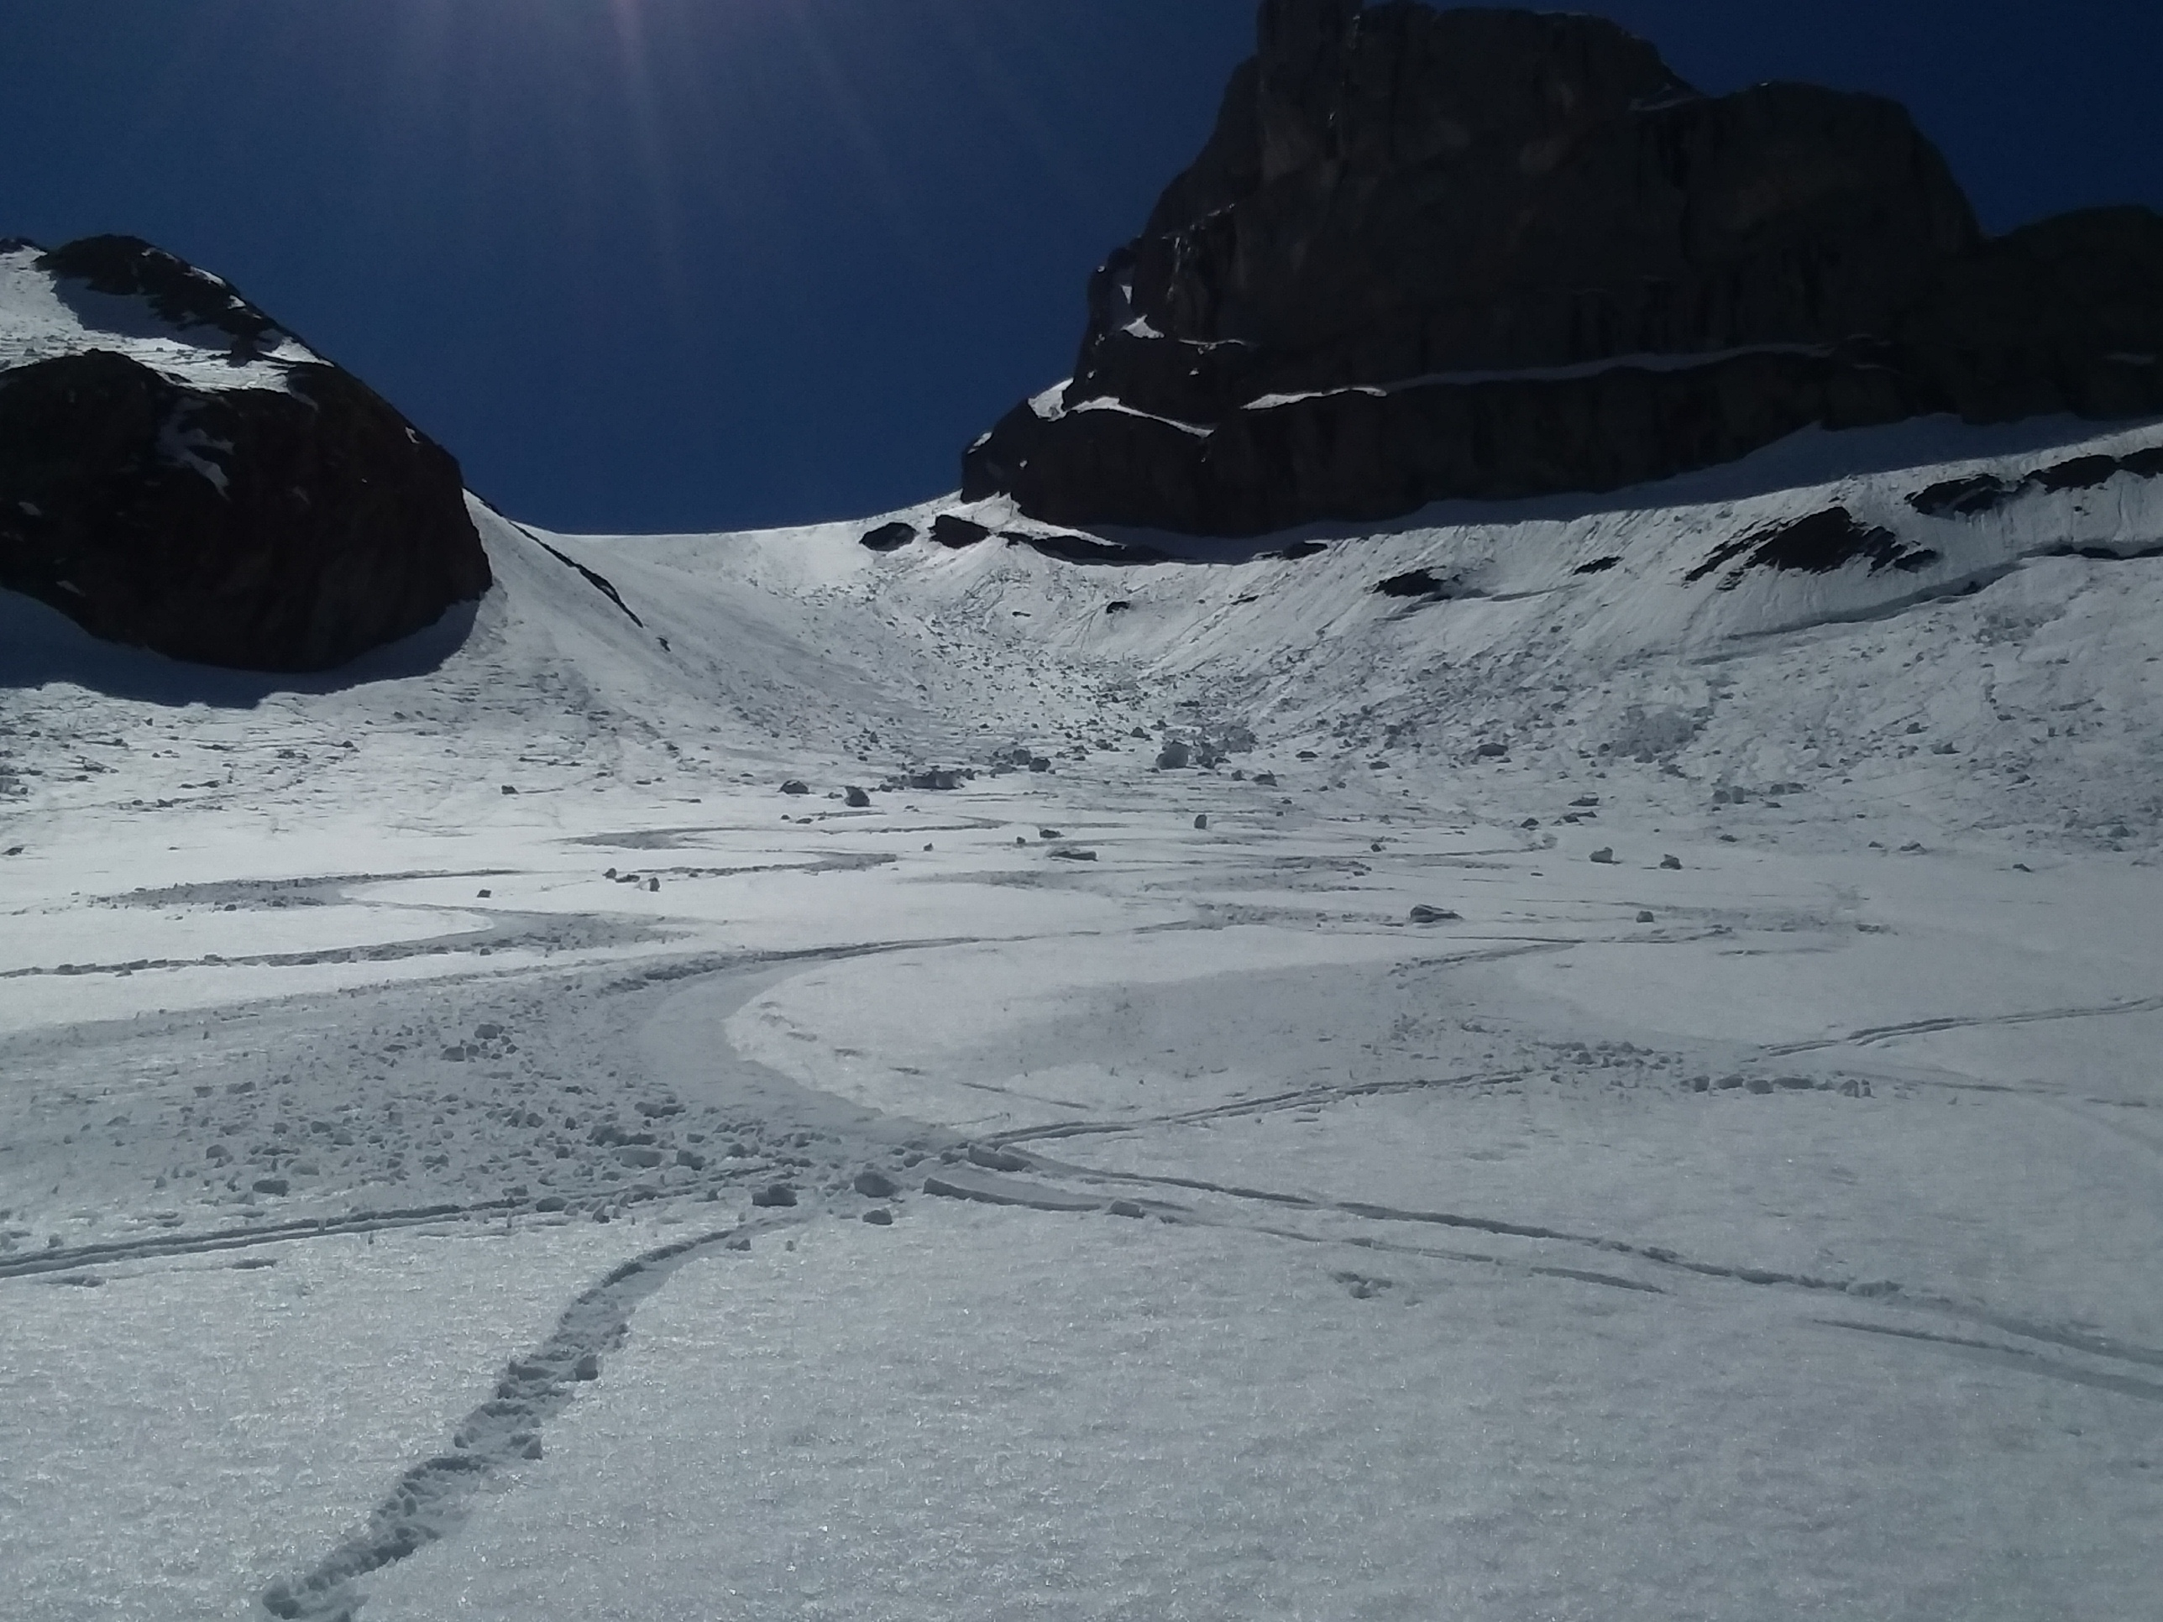




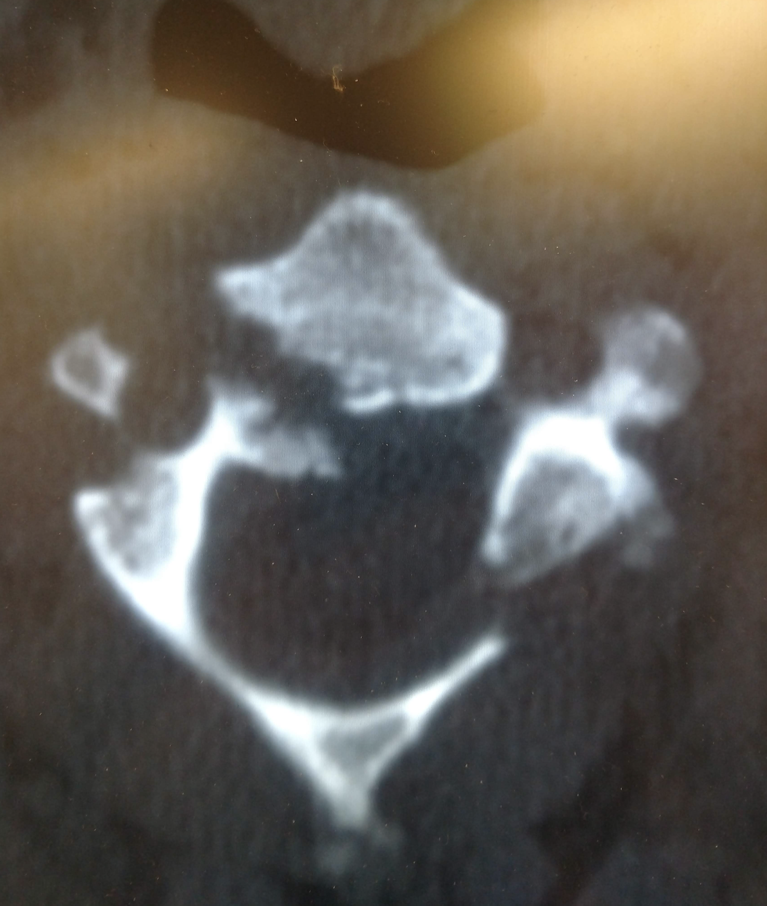
Multi-platform, multi-sensor snow surface properties
Karl Rittger¹
Kat Bormann², William Kleiber¹, Edward Bair³,
Thomas Painter⁴, Jeff Dozier³
Notes:
Hi, today I’m going to talk about snow surface properties derived from satellites. These snow surface properties can be used to better understand snow independently, as input for energy balance models, or for validation and calibration for modeling. A number of folks have contributed time and effort to this work through various projects. Many of my slides will note their contributions. I will say that if you came to my talk at AGU in December, you are welcome to take a short nap, step out, or do some emailing.

Slide 2
Methods for mapping snow and snow surface properties
Simple:
  Normalized difference snow index (NDSI)
Physically based :
  Spectral mixture analysis
  Spectral differencing
Other sophisticated models
  Machine learning
    Neural networks
    Random forests
Dozier 1989
Painter 2003, 2009
Painter 2012
Snow cover fraction only
Not physically based
Snow cover fraction and snow albedo
Physically based
Notes:
Snow mapping began with simple methods, using band ratios like NDSI developed in 1980’s by Jeff Dozier and others. The most widely used snow product, MOD10A1 based on it. Most people use MODIS interchangeably with MOD10A1. It uses only 2 bands of reflectance data. More recently, physically based models that use spectral properties have been applied to map more than just snow cover. They use all the observed land bands which provide much more information. Machine learning has become much more popular in recent years.
Jason Box (yesterday) says outperforming MODIS – but that is MOD10A1
Slope/Aspect undulations affect illumination. Shade endmember takes care of this issue
Also: Stoeve 2002 is for full 100% snow cover
Depends oon solar zenith angle
MCD43 is for full snow covered pixels
“Surface albedo” or “whole pixel albedo”
WE DO GRAIN SIZE. Not sensitive to solar zenith

Slide 3
Snow surface properties (SSPs)
Fractional snow covered area
Snow grain size
  Clean snow albedo
Additional absorption from dust (△ vis)
  Combined with grain size, actual (dirty) snow albedo
Considerations for satellite observations
Temporal resolution: Varies from daily to 16 day
Spatial resolution: Varies from 1 m to 1 km
Spectral characteristics: Wavelengths, Calibration
Notes:
When I talk about snow surface properties, I mean: fractional snow cover, snow grain size from which we can derive clean snow albedo, and the additional absorption from dust also called delta vis which when combined with the grain size can give you the actual snow albedo.
Snow is interesting to view from satellites because it changes faster than other land surfaces but slower than clouds. There are a mix of satellites with different characteristics that are helpful for measuring snow.

Slide 4
Satellites/Sensors in this talk
Satellite | Sensor | Spatial Resolution | Temporal Resolution | Wavelengths | Time period
Terra | MODIS | 500 m | Daily | VIS,NIR, SWIR | 2000 - present
Suomi | VIIRS | 1 km | Daily | VIS,NIR, SWIR | 2011 - present
Landsat 4/5/7 | TM/ETM+ | 30 m | 16-day | VIS,NIR, SWIR | 1984 - present
Landsat 8 | OLI | 30 m | 16-day | VIS,NIR, SWIR | 2013 - present
Sentinel 2a/b | MSI | 20 m | 10-day (1) 5-day (2) | VIS,NIR, SWIR | 2015 and 2017 - present
Digital Globe | various | ~1 m | Up to daily | Various | 2007 - present
Planet | various | ~1 m | Up to daily | VIS,NIR | 2014 - present
Notes:
In this talk I’ll touch on the set of satellites here. Primarily we use MODIS Terra with Landsat 5,7, and 8 for validation. However, MODIS is likely reaching near the end of its lifespan so along with Kat Bormann, I’ve been working on VIIRS to become the future work horse. Landsat 8 has an advantage over Landsat 5&7 in that is doesn’t saturate in the visible bands over snow an advantage for retrieving snow albedo. We expect with generalized processing at CU Boulder we’ll soon be using Sentinel as well, most likely the homogenized Landsat/Sentinel data. Commercial satellite data can also be used and is a hot topic right now as you have seen with the last 2 talks.

Slide 5
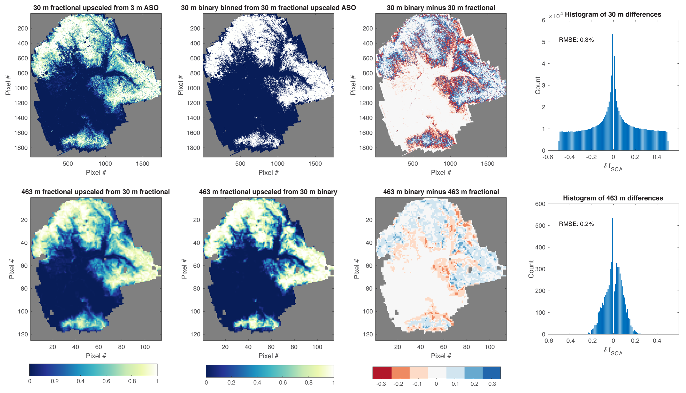
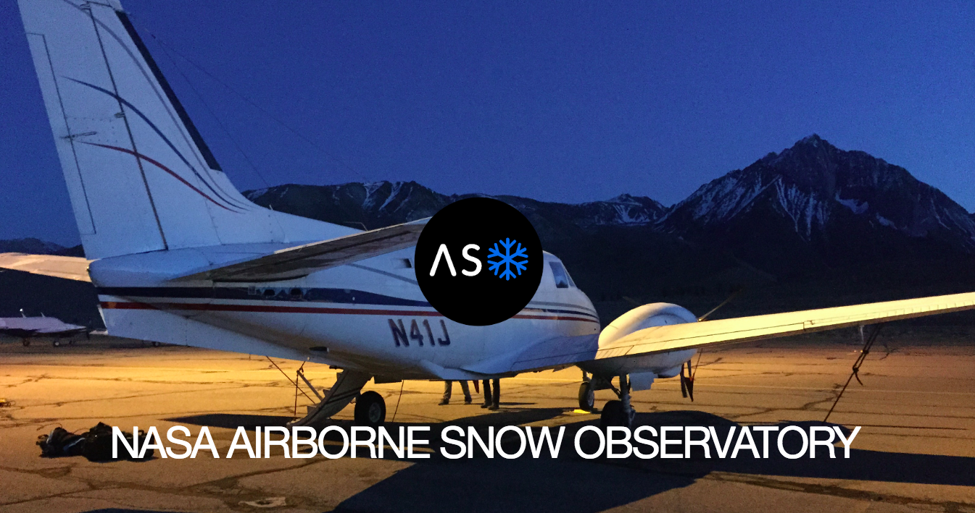
Is binary snow cover data useful?
Snow cover distribution from from the Airborne Snow Observatory
Painter et al, 2016; Rittger et al, in prep
Notes:
If you don’t get the spatial dirstriboution right you aren’t going to get the storages and fluxes right

Slide 6
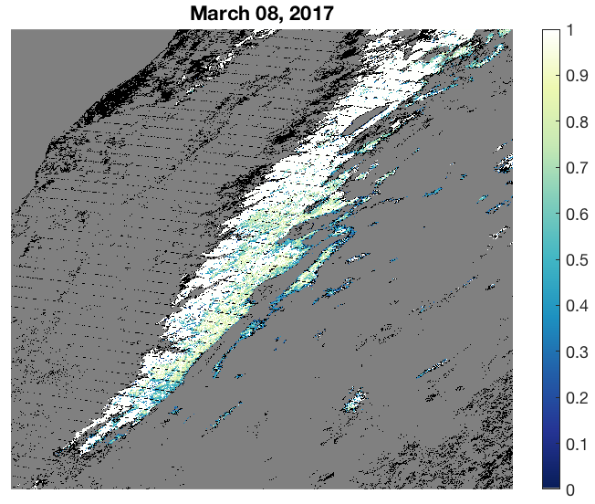
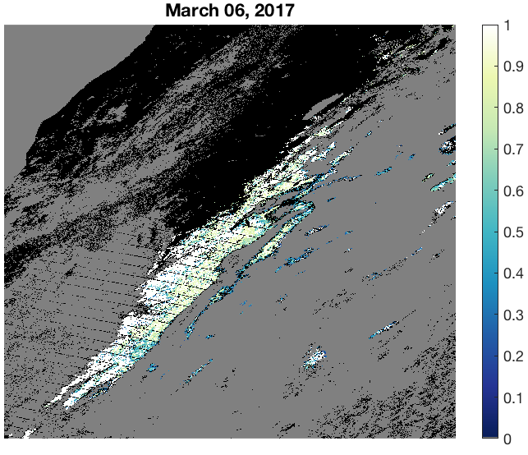
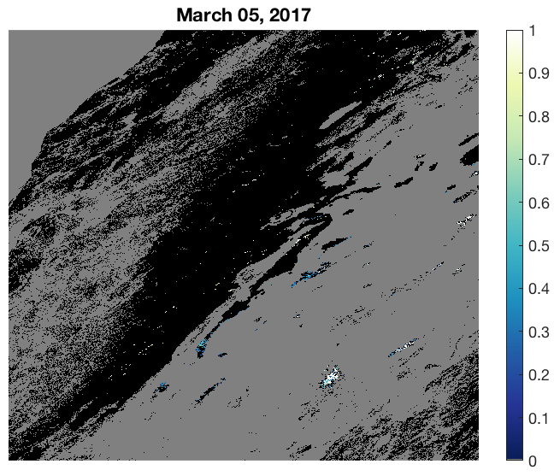
Sierra Nevada snow fraction (Terra-MODIS)
Even on relatively clear days – data gaps exist
Those partially cloudy days
Those pesky
cloud cover days
Rittger et al, 2019
Painter et al. 2009
Dozier et al. 2008
Notes:
The issue with optical data and any algorithm is: even on a relatively clear day – data gaps still exist. On some days, only parts of a mountain range can be viewed. And on others, virtually no part.

Slide 7
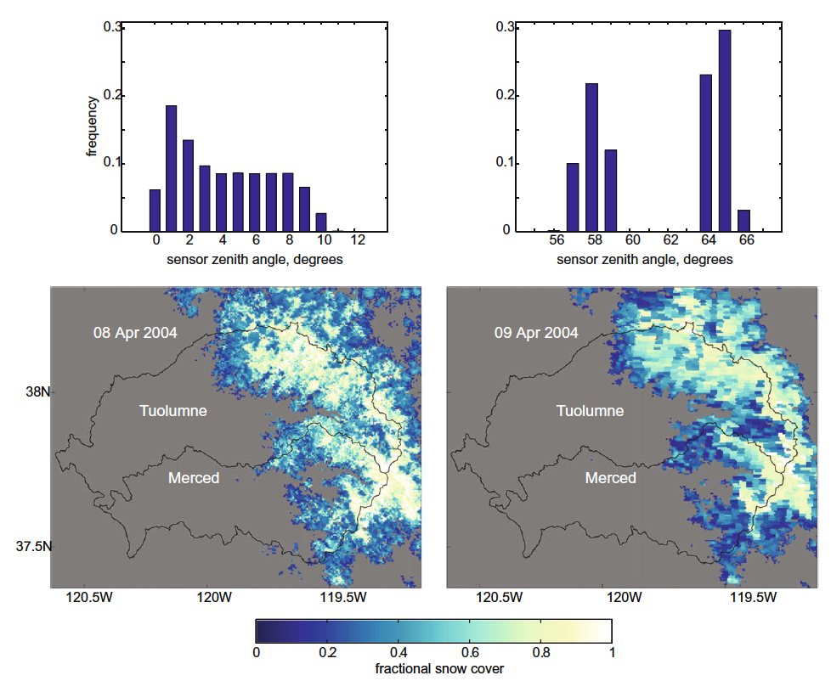
Nadir and off nadir views (Terra- MODIS)
Sensor view zenith angle
NADIR
OFF-NADIR
Dozier et al. 2008
Painter et al. 2009
Notes:
In addition, Jeff Dozier showed us in 2008 how the sensor view zenith, effects snow cover mapping. The top graph shows the view zenith angle and the bottom show the snow maps. On the top left which is April 8, you have satellite view zenith angles from 0 to 10 degrees and on the right on April 9, the view zenith ranges from 56 to 66 degrees. You can see that the snow mapping appears quite different, especially in the forested areas.

Slide 8
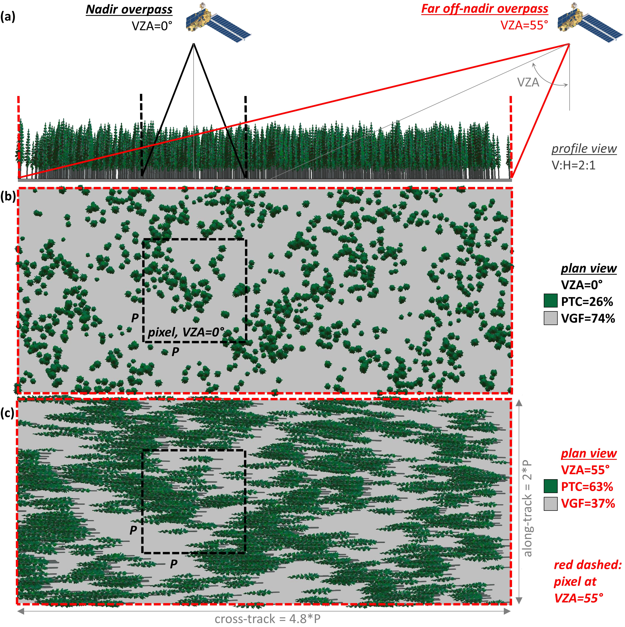
Nadir and off-nadir viewing in forests
View zenith angle of 55°
  Larger area is viewed x 8 the size of 0°
  Projected view of forest covers more of the ground
    26% tree canopy for 0° vs 63% for 55°
Rittger et al. 2019
Notes:
In forested areas, off-nadir views can present even more difficulty for satellite observations. This figure shows the profile view and plan views for a satellite view angle of 0 degrees and where the view zenith angle equals 55 degrees. The footprint of the satellite changes from the little square to the big rectangle. In addition the off nadir views see much more of the trees than the nadir view. The percent tree canopy more than doubles going from 26 to 63

Slide 9
Spatially and temporally complete (STC) snow surface properties (SSPs)
Uses MODSCAG for snow cover fraction, grain size, and vegetation fraction
Adjusts fSCA using fSCA/(1-fveg) in areas with significant vegetation height (lidar derived)
Uses MODDFRS for 𝚫 vis (% change in albedo in visible) and radiative forcing (W/m²)
Applies advanced cloud filtering
Weights interpolated fSCA by view zenith angle
Dozier et al., 2008; Painter et al, 2009, Rittger et al., 2019
Notes:
Most folks looking at snow don’t want to deal with all these issues. So, we have. We apply an adjustment to account for forests that obscure the ground surface from satellites, apply advanced cloud filtering and account for off-nadir views by weighting the nadir views more heavily than off nadir views. The products we create are spatially and temporally complete, or gap-filled.

Slide 10
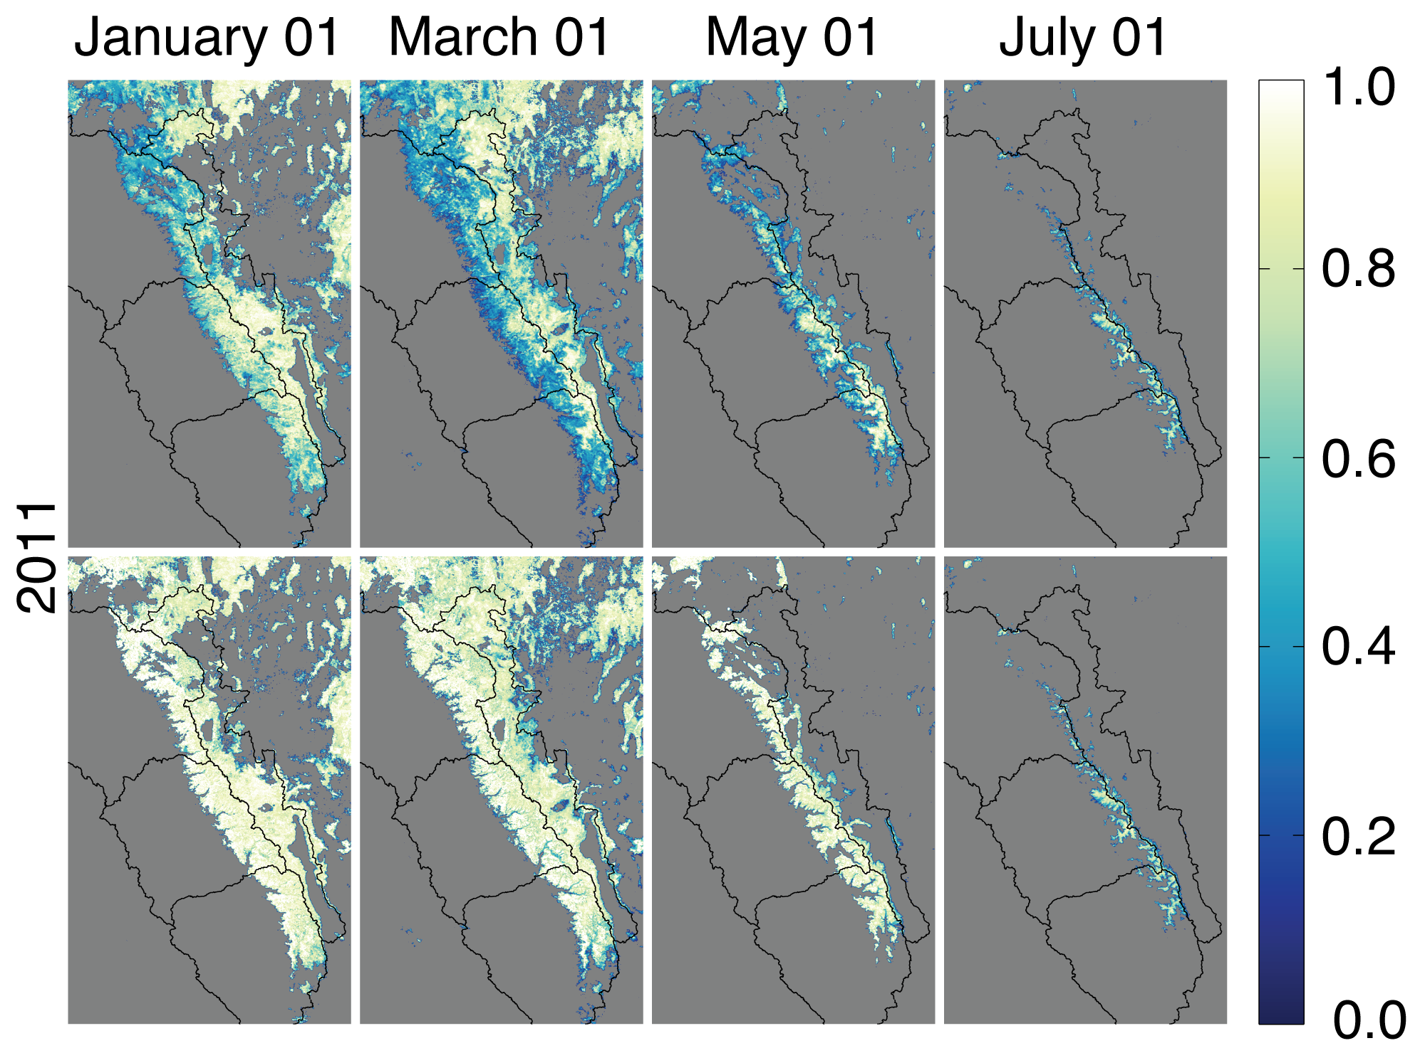
Example: Sierra Nevada
MODIS STC-snow cover
Viewable
Canopy adjusted
Rittger et al., 2016;
Rittger et al., 2019
Notes:
Here are some images from 2011 that show Interpolated and corrected for viewing angle and forest. The top shows the viewable snow cover and the bottom our canopy adjusted snow cover or snow on the ground.

Slide 11
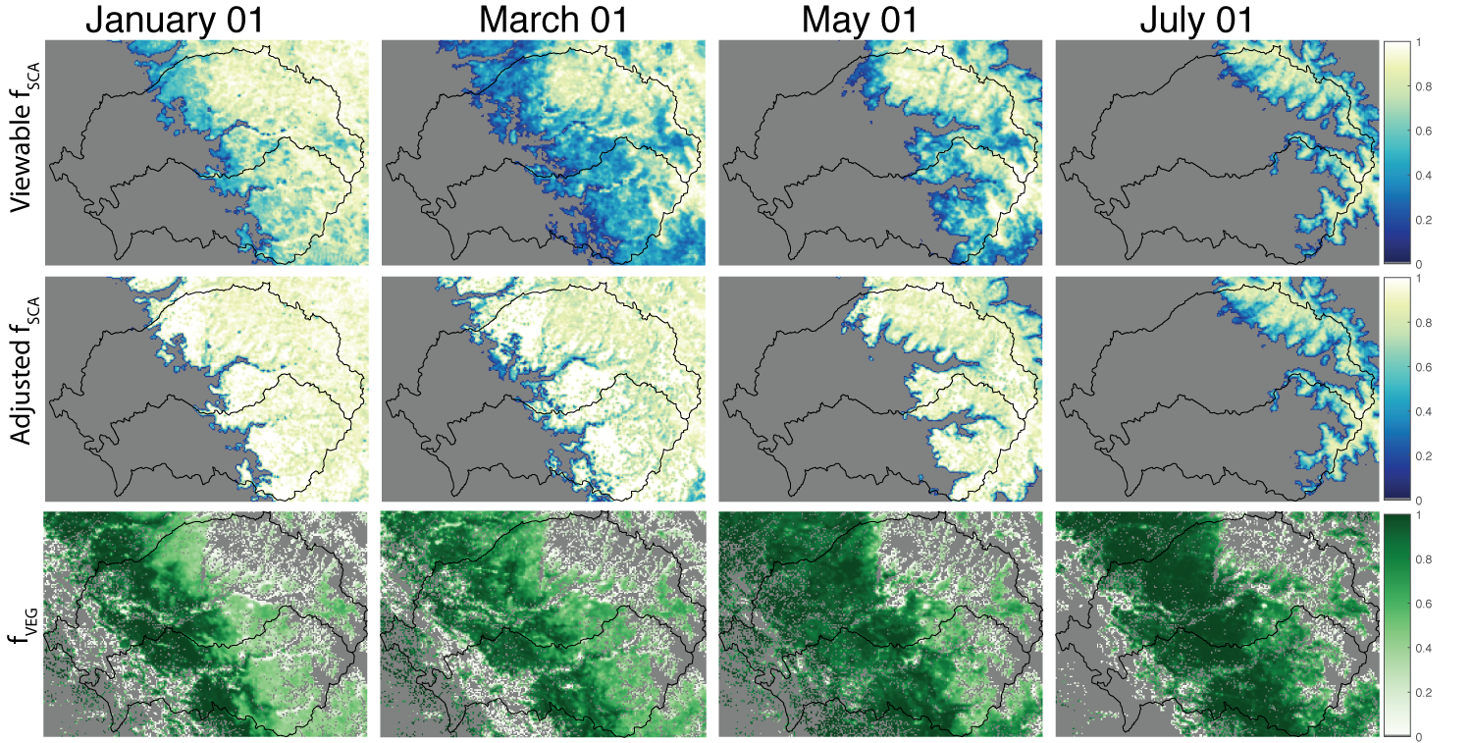
Example: Tuolumne
MODIS STC-snow cover
Rittger et al., 2016;
Rittger et al., 2019
Notes:
Looking a little more closely here at the Tuolumne in 2011 ( a large snow year) again at the viewable snow cover and adjusted snow cover. In January through May you can see significant adjustments to snow cover in the forested areas. In the Alpine area the images look the same.

Slide 12
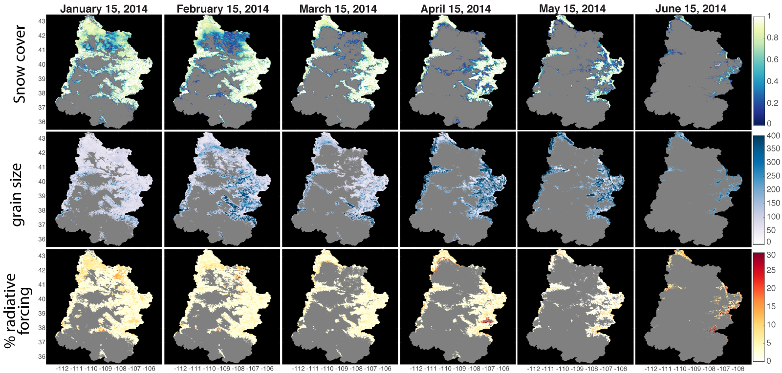
Example: Upper Colorado
MODIS STC-SSP (snow cover, grain size, △ vis)
Notes:
This example is a time series from the Upper Colorado River basin showing the 3 different snow surface properties, snow cover, grain size, and delta vis

Slide 13
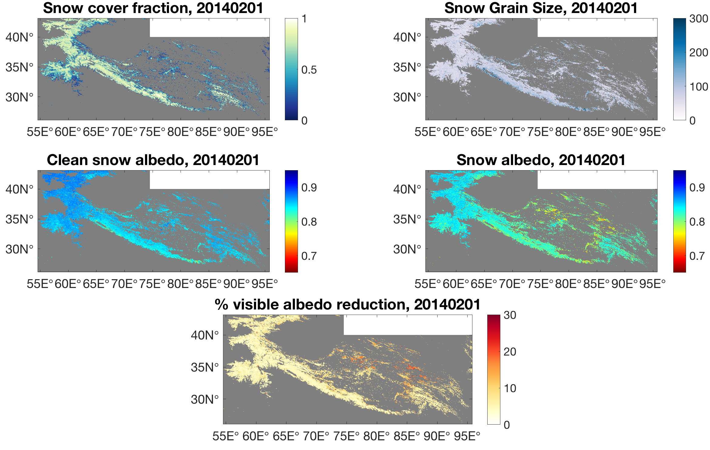
Example: High Mountain Asia
MODIS STC-SSP (snow cover, grain size, △ vis)
High Mountain Asia
Painter et al, 2009
Rittger et al, 2019
Sarangi et al, 2019
Notes:
We’ve also done some large scale processing over High Mountain Asia

Slide 14
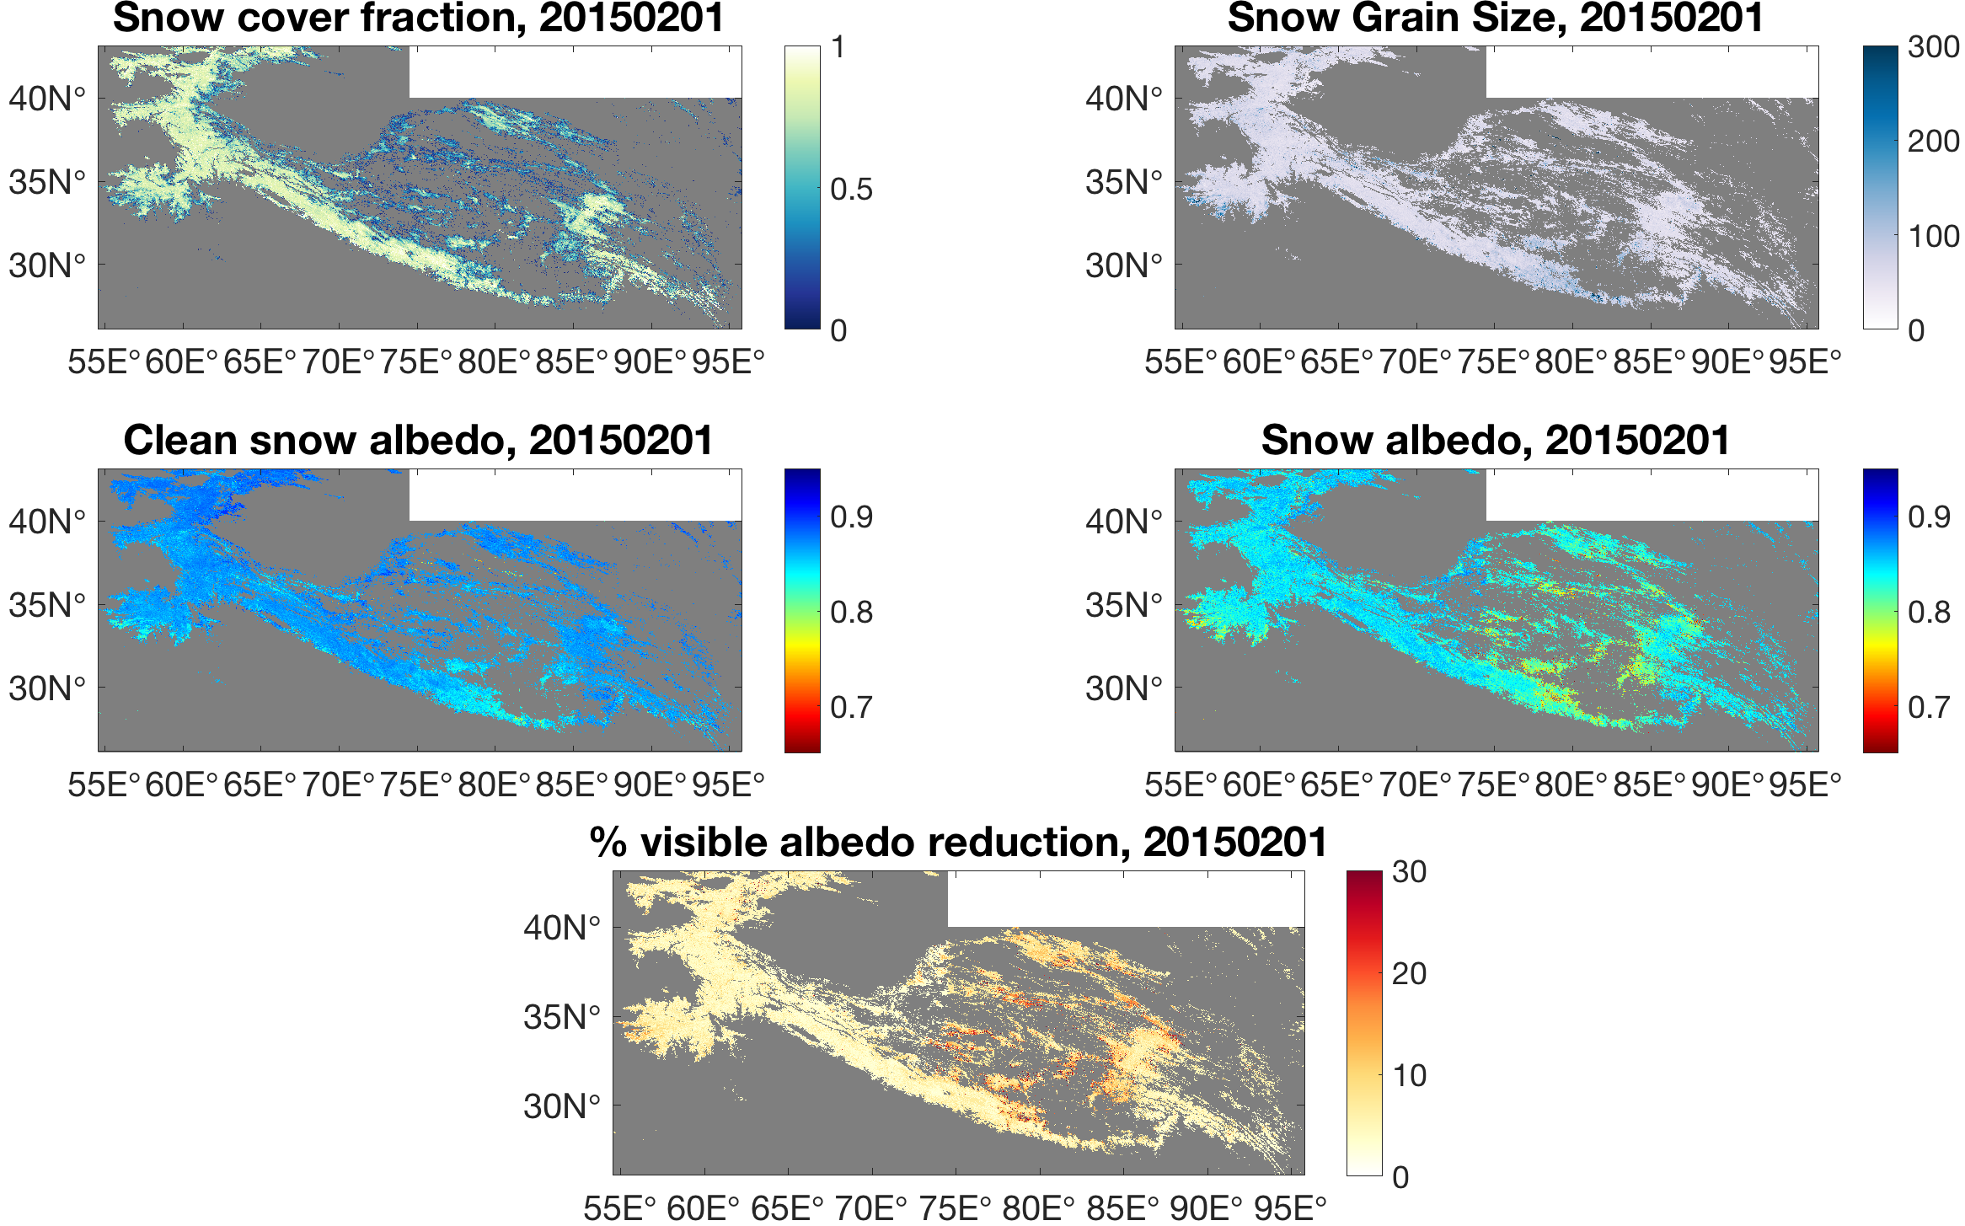
Example: High Mountain Asia
MODIS STC-SSP (snow cover, grain size, △ vis)
High Mountain Asia
Painter et al, 2009
Rittger et al, 2019
Sarangi et al, 2019
Notes:
We’ve also done some large scale processing over High Mountain Asia

Slide 15
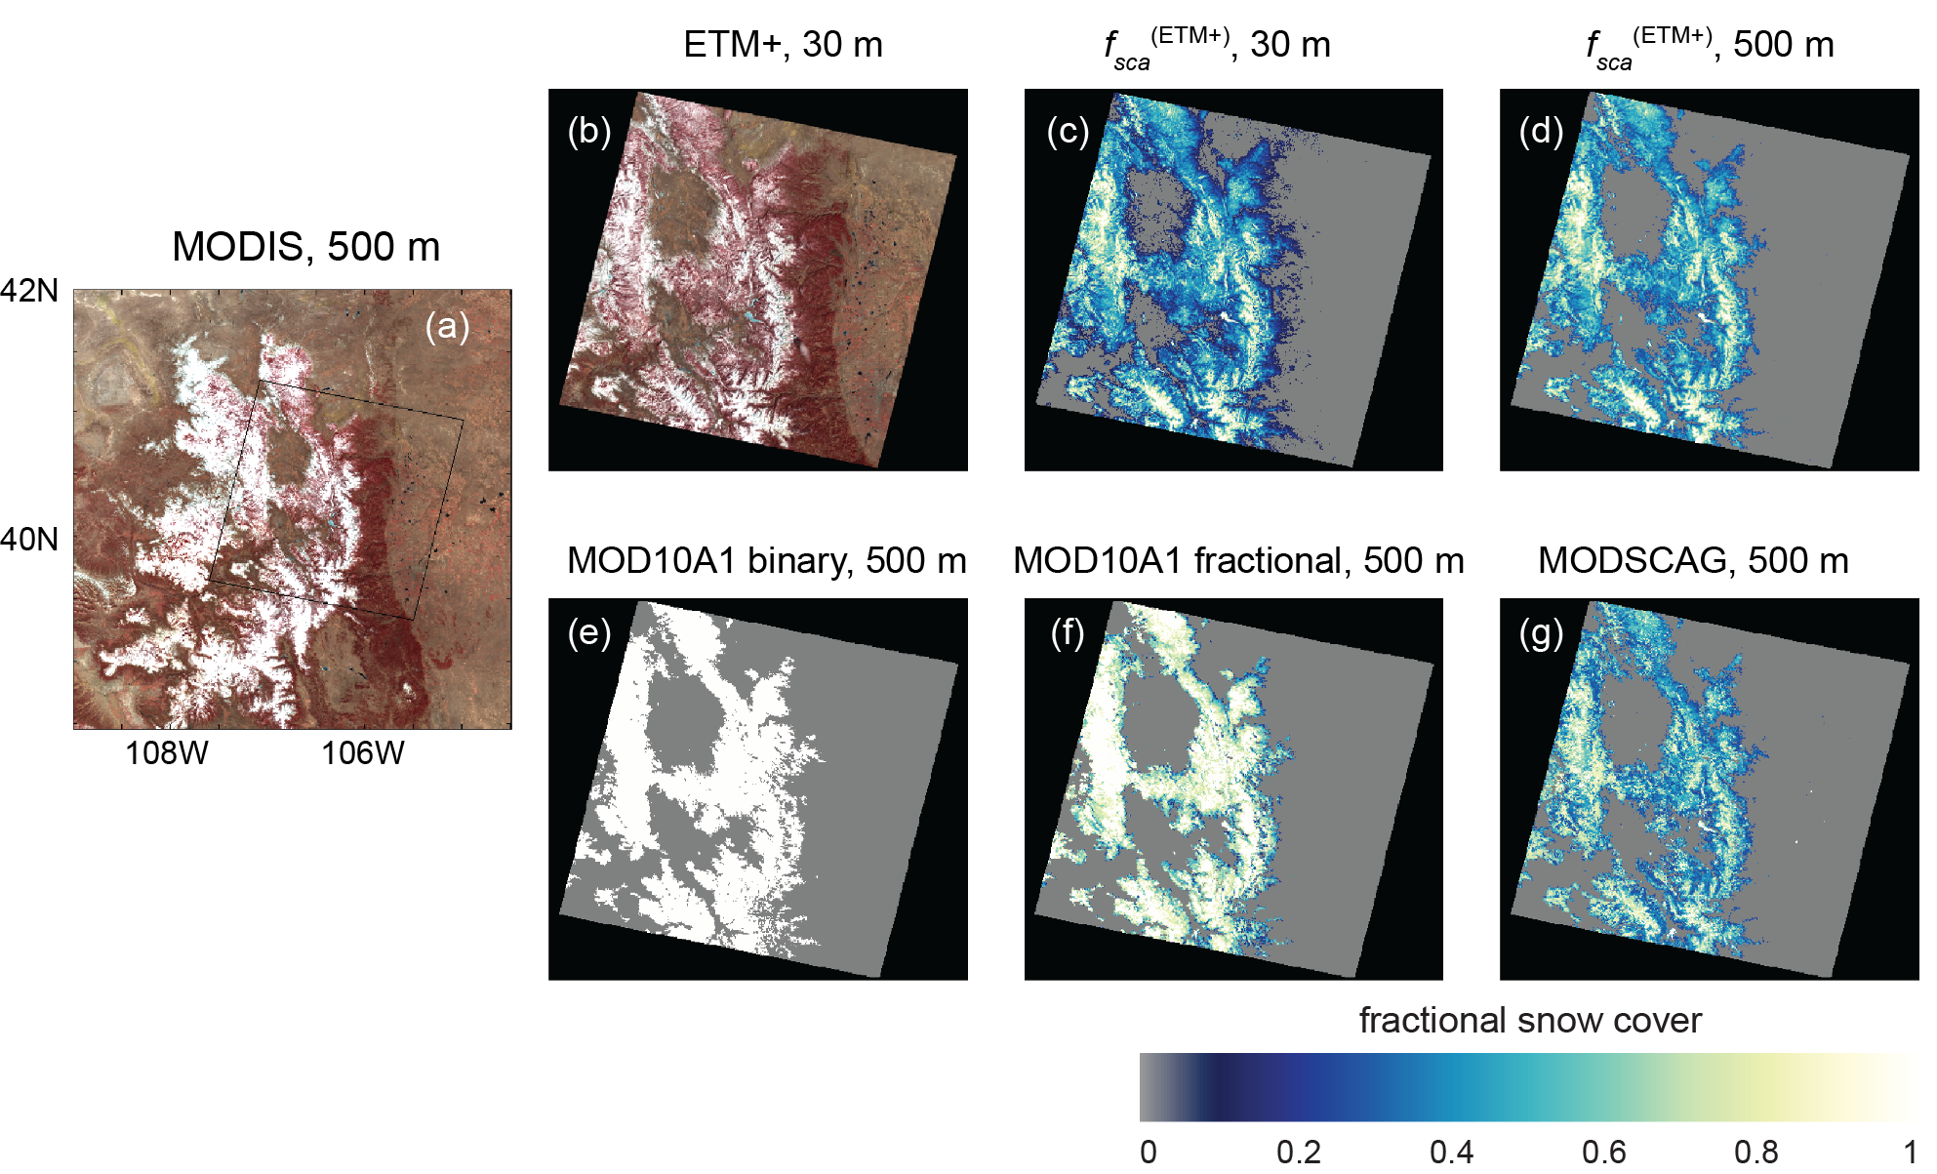
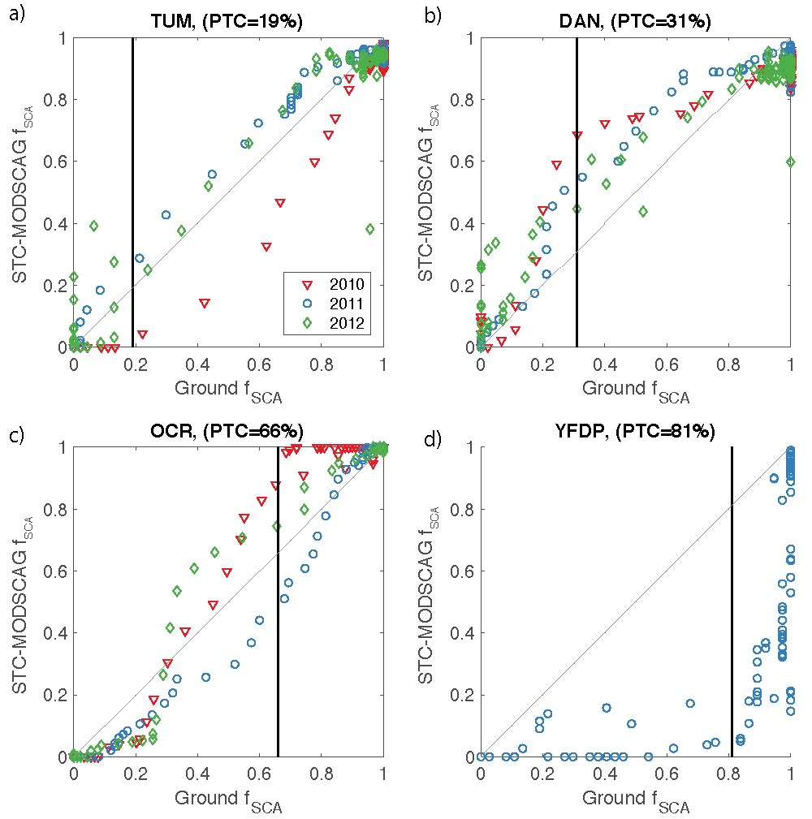
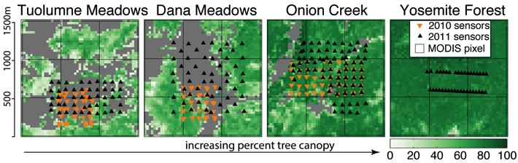
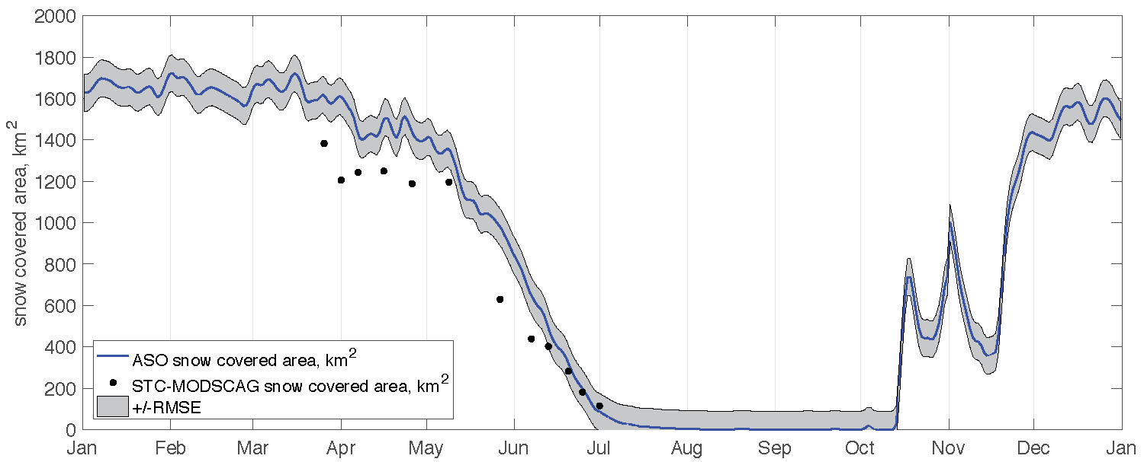
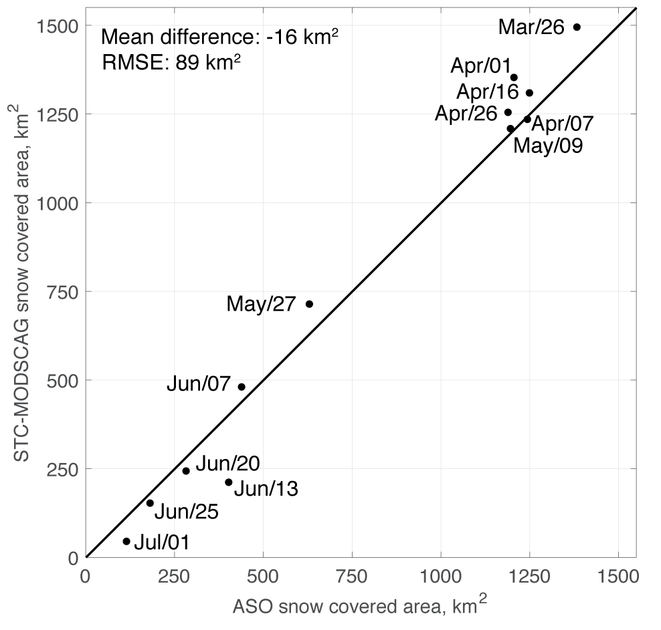
Snow Cover validation: Satellite, Airborne, & Ground
Comparison to 30 m data from Landsat
Landsat 7
MODIS
Rittger et al., 2013
Comparison to temp. sensors (ground)
Comparison to 2 m data
from ASO (airborne)
Painter et al,
2016
Rittger et al., 2019
Rittger et al., in prep
Notes:
We’ve done extensive validation using Landsat 7 that we published in 2012, this year we published the algorithm and validation in various density forests using temperature sensors buried in the ground. We’ve also compared the data to ASO.

Slide 16
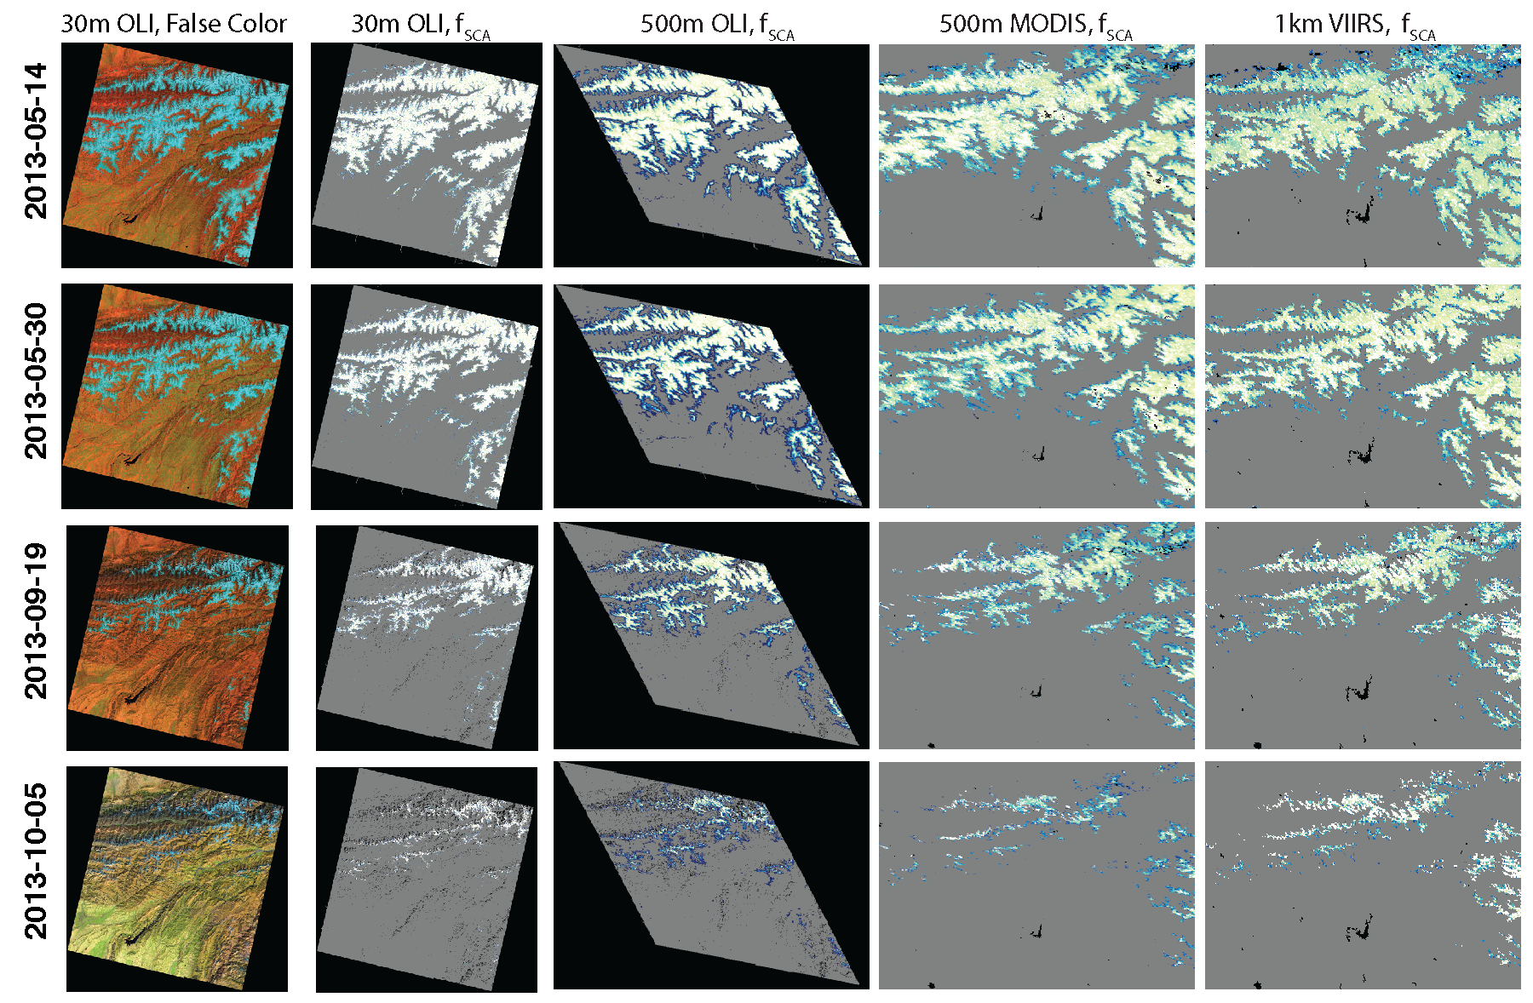
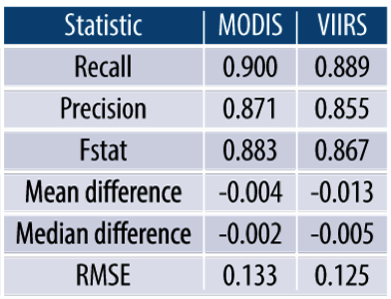
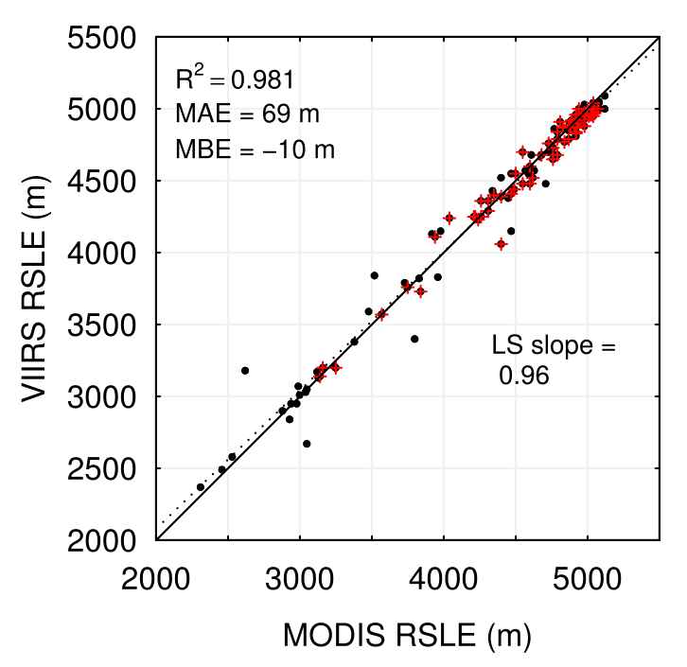
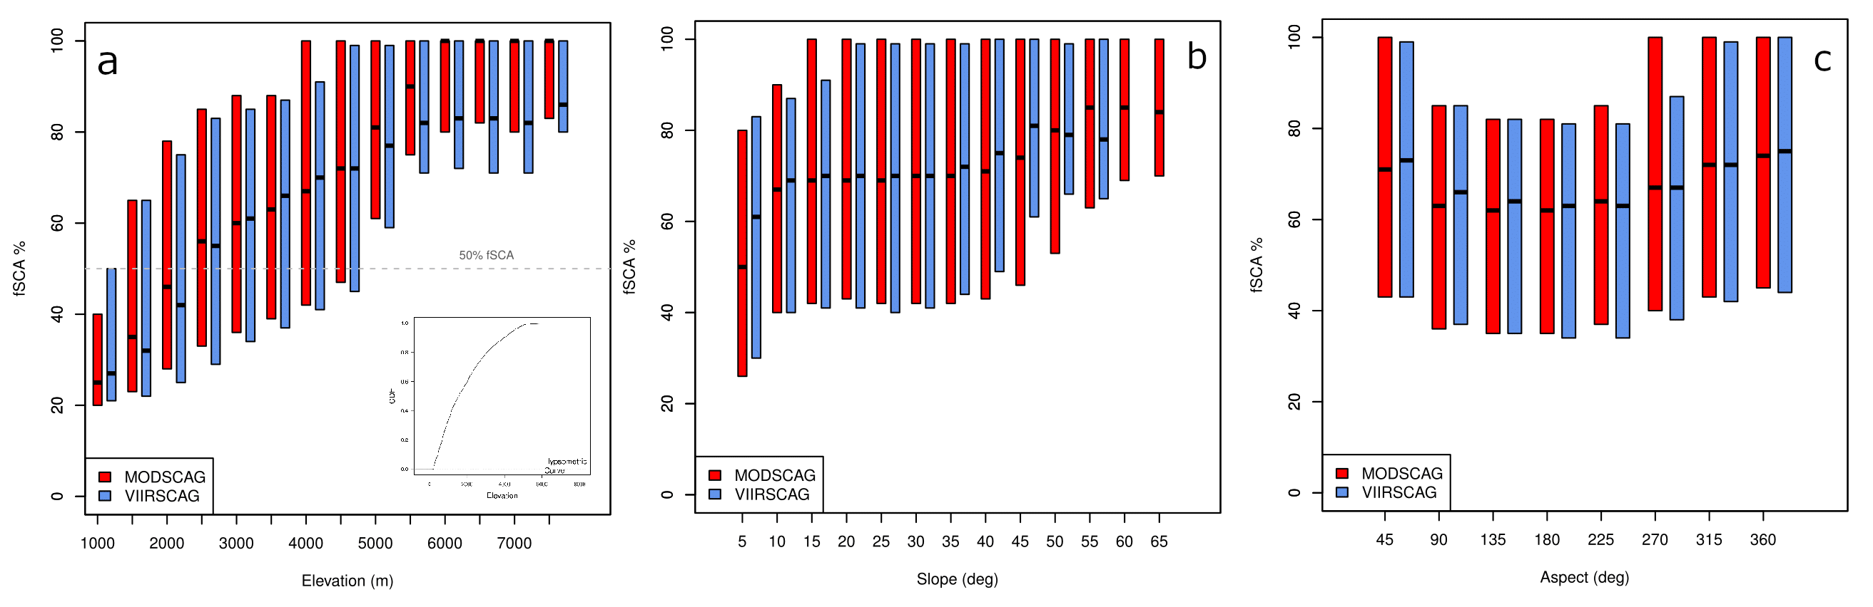
Landsat 8, MODIS, and VIIRS
Snow line
Elevation
Slope
Aspect
Rittger et al, in prep for April 30th
Notes:
Our most recent work applies the SCAG algorithm to both Landsat 8 and VIIRS. We find nearly no bias in snow cover maps from either MODIS or VIIRS when compared to Landsat 8. Over elevation, slope and aspect the retrievals are similar and snow line elevations are also similar. Despite the coarser spatial resolution of 1km, VIIRS performs as well as MODIS which is promising for the future as 2 VIIRS instruments have been launched in 2011 and 2017 with another planned in March 2022.

Slide 17
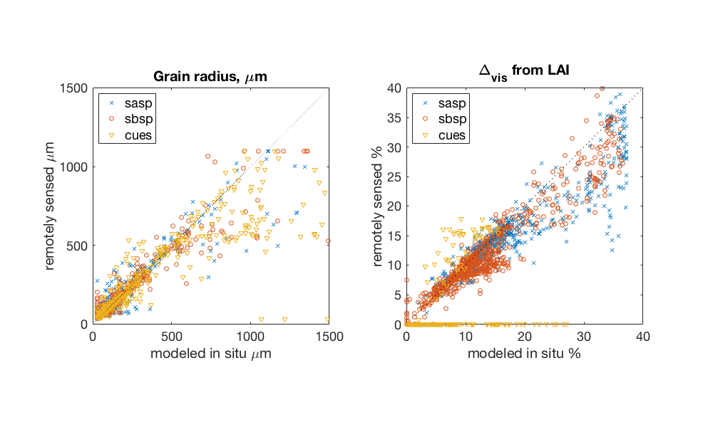
Snow albedo combines grain size and △ vis
In-situ observations from Sierra, CA; Senator Beck, CO
CUES 64.6μm
SASP 0.8um
SBSP 6.0um
Comparison to BATS
CUES 1.5%
SASP 1.6%
SBSP 1.3%
Bair et al, 2019
Notes:
In addition to the snow cover products, we’ve also validated our albedo product that combines the snow grain size with delta vis using 7 years of data from a sub-alpine site in CA and ten years of a subalpine site and alpine site in CO. These sites are the only terrain corrected sites that we are aware of in the world. For ΔVIS, the RMSE is 0.5 to 1.6%. In comparison, previous studies show that age-based models, which require precise in situ knowledge about when each snowfall ended, show RMSE values of 7 to 17% (Bair et al.2016; Bair et al. 2018).
Grain size not sensitive to solar zenith or shading

Slide 18
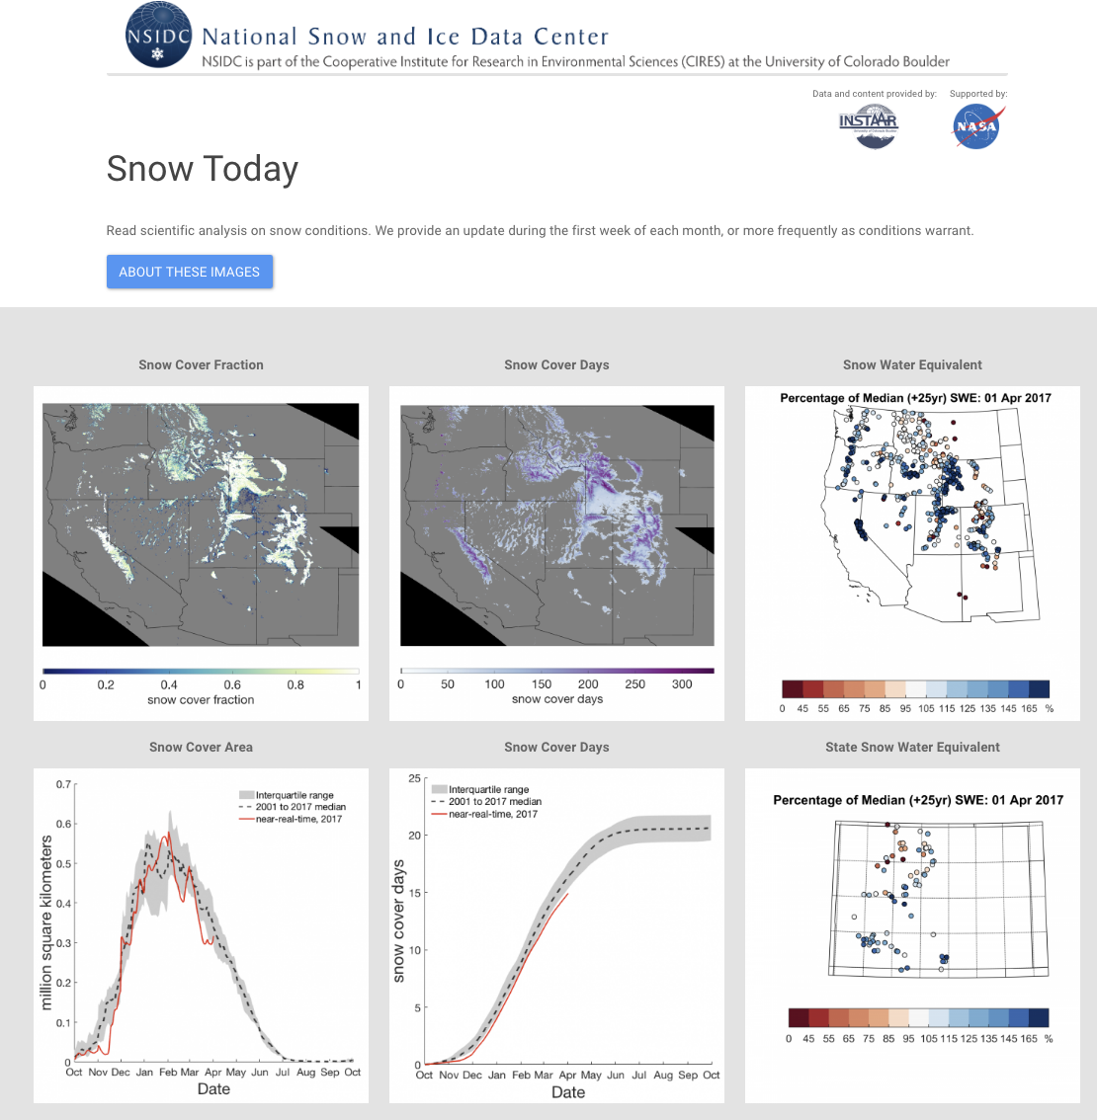
https://nsidc.org/snow-today
Live:
February 2020
Near-real time MODIS snow cover fraction and snow cover days
Rittger et al., 2019
Notes:
In February of 2020 we’ll bring a website online with these snow products showing snow cover fraction and snow cover days along with snow water equivalent in context with the record since 2001.

Slide 19
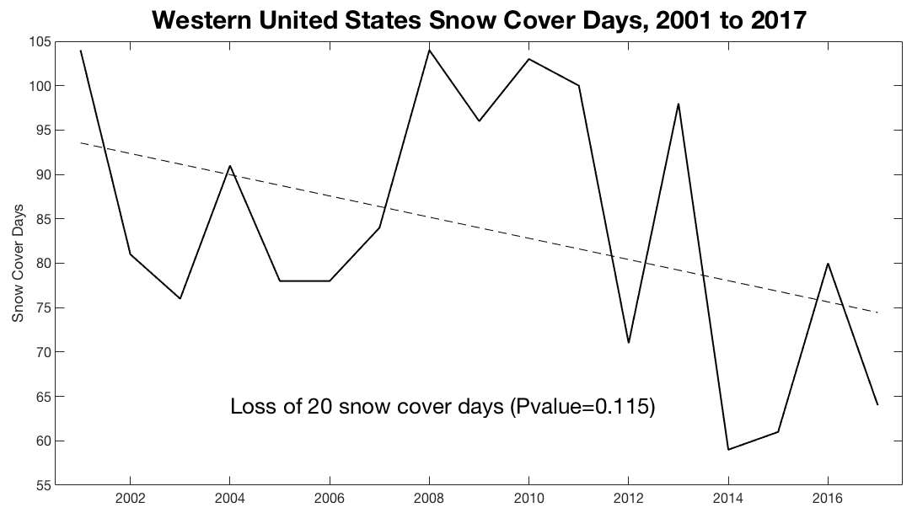
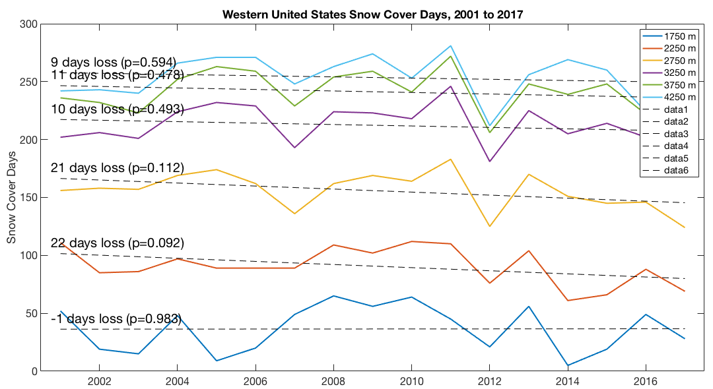
Snow covered area, trends in snow cover days
Notes:
I also looked at the data by elevation in 500 m elevation increments. Though none are statistcally signficant at the 0.05 level. The lowest elevation bin actually has single day gain, but the p value is the highest because this data is noisy and there aren’t as many pixels at this elevaiton with snow. All other elevations show a loss from with the largest losses in snow cover days at the lower elevations bins of 2250m and 2750m. However, losses occur all the way to the highest elevations.

Slide 20
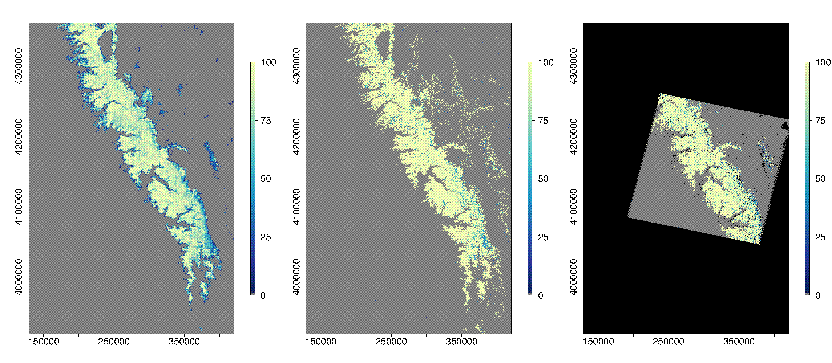
30 m daily snow cover from the fusion of MODIS and Landsat
From daily 500m MODIS
From 16-day 30m Landsat
Fused
2 stage machine learning model (random forest)
Rittger et al, in prep for April 30th
Notes:
The snow products are ideal candidates for fusion given the small bias. This figure shows the 500m MODIS on the left, the 30m Landsat in the Center and the fused 30m daily product on the right. We used a 2 stage machine learning model for this work.
We plan on producing a 19 year record for the Sierra Nevada early in 2020 as part of a project funded by the Department of Fish and wildlife.

Slide 21
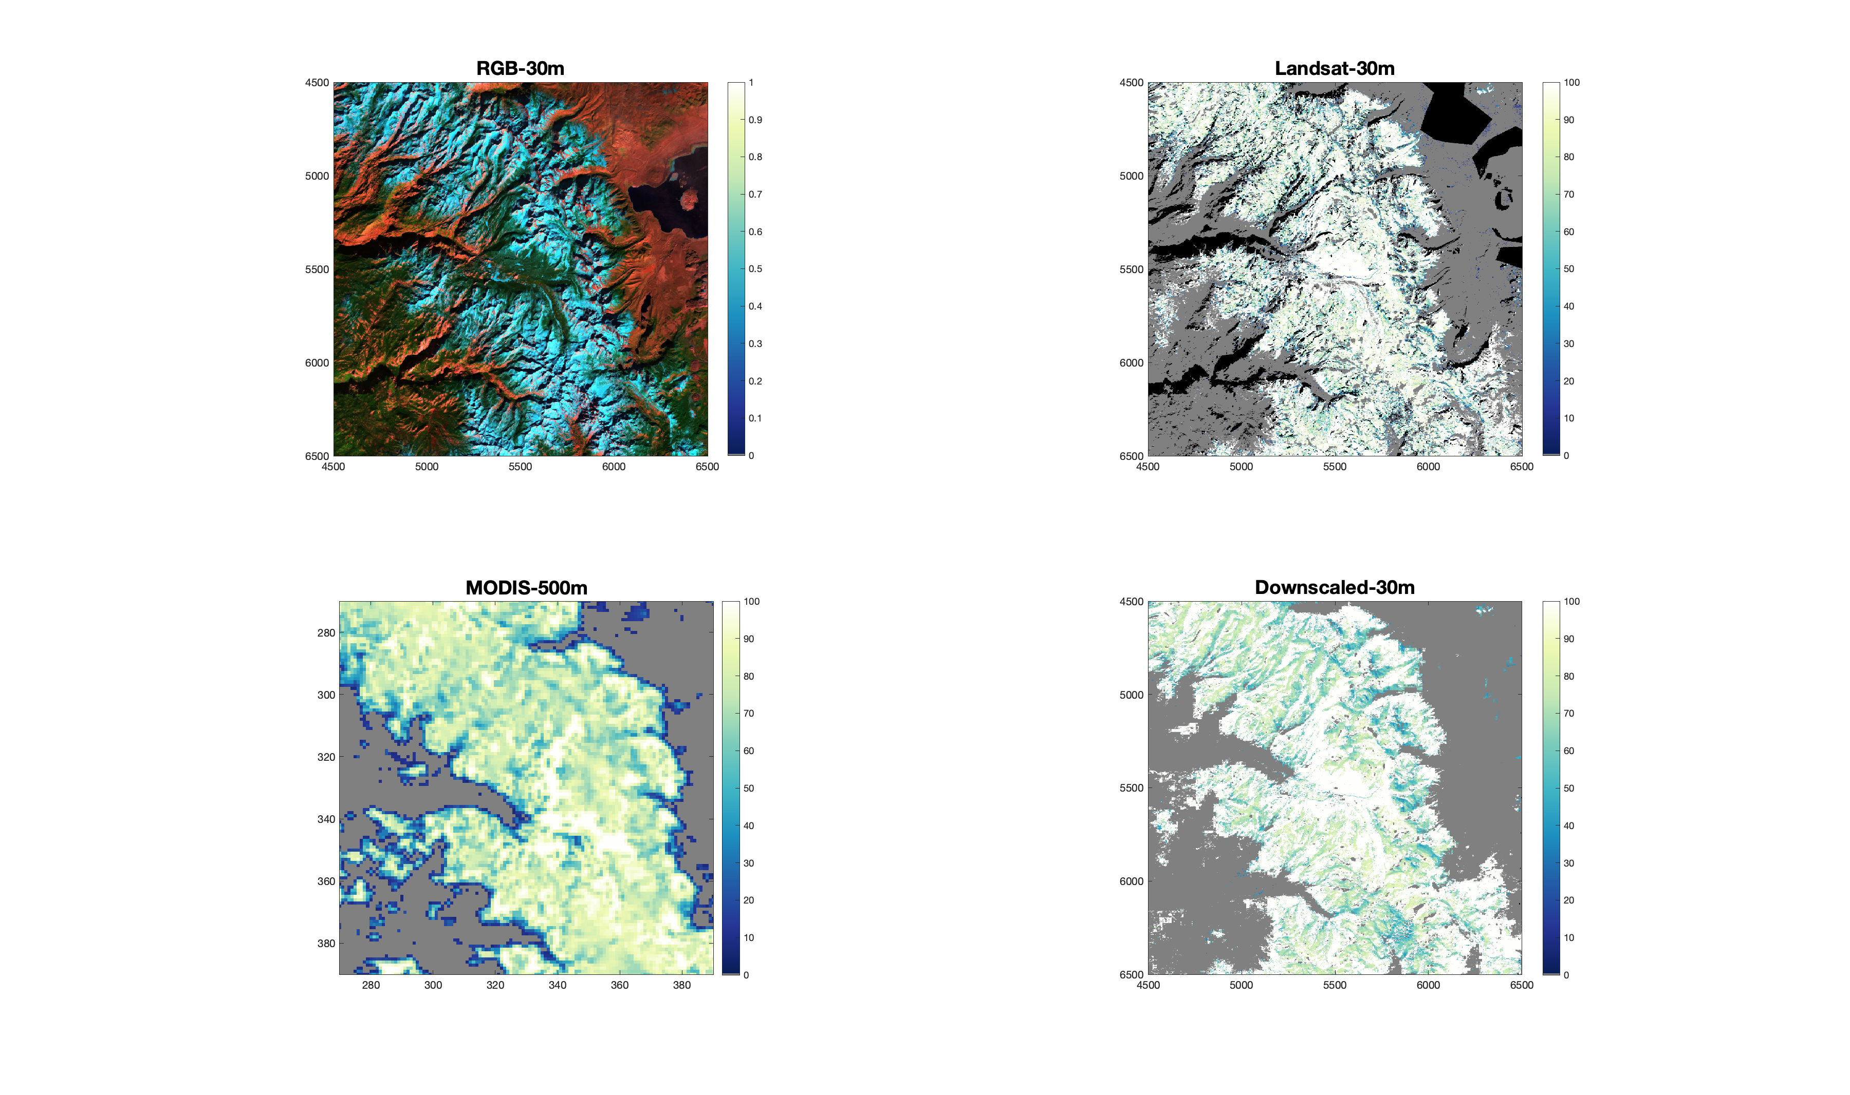
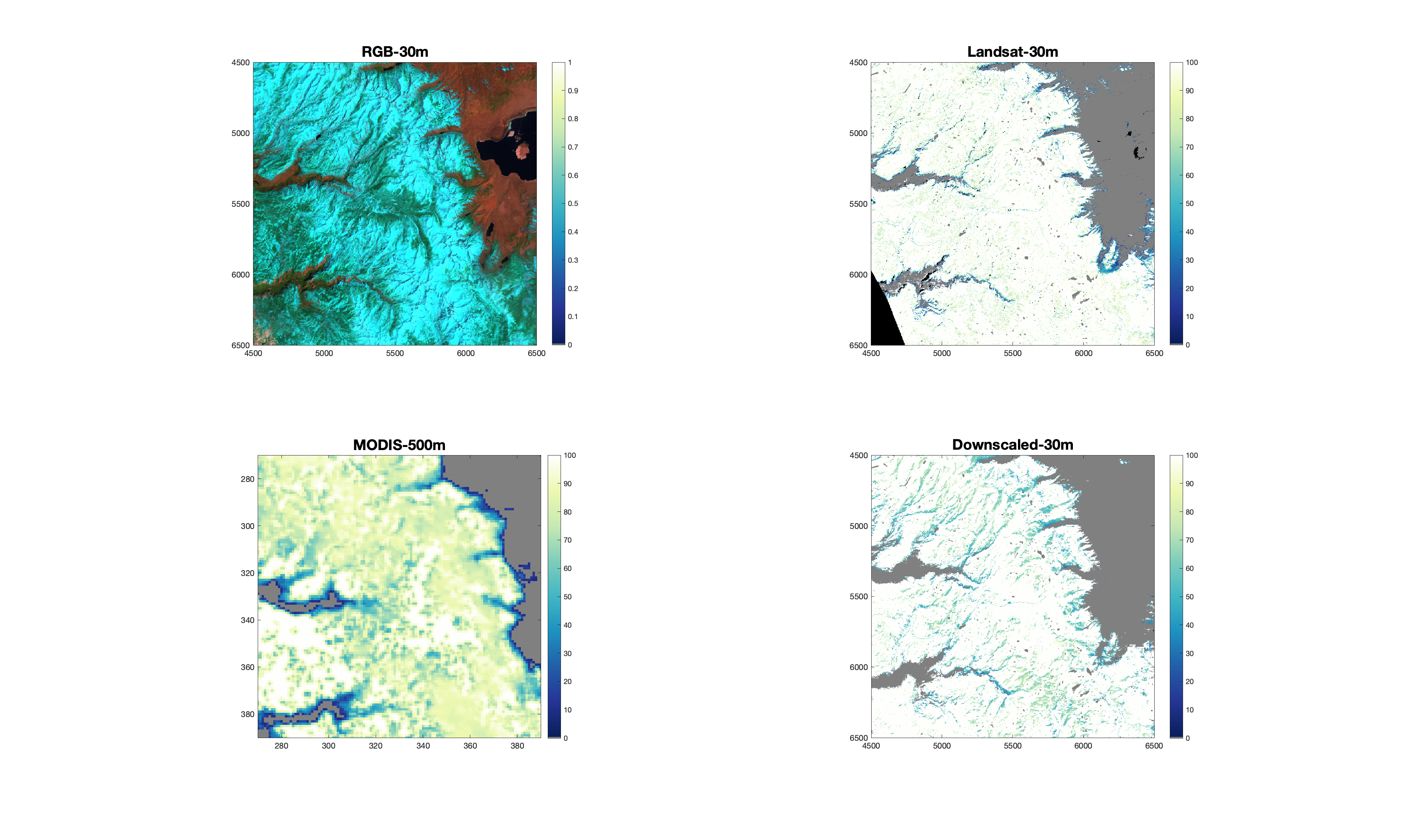
30 m daily snow cover from the fusion of MODIS and Landsat
December 08, 2002
April 23, 2003
Rittger et al, in prep for April 30th
Notes:
Left, false color 30m, snow fraction 30m from Landsat, snow fraction 500m from MODIS, downscaled 30m daily fused
Deep shadowing is an issue with the Landsat observation, but not the fused product.
Improved snow fraction over whole image be especially at snow line where MODIS sees mixed pixels

Slide 22
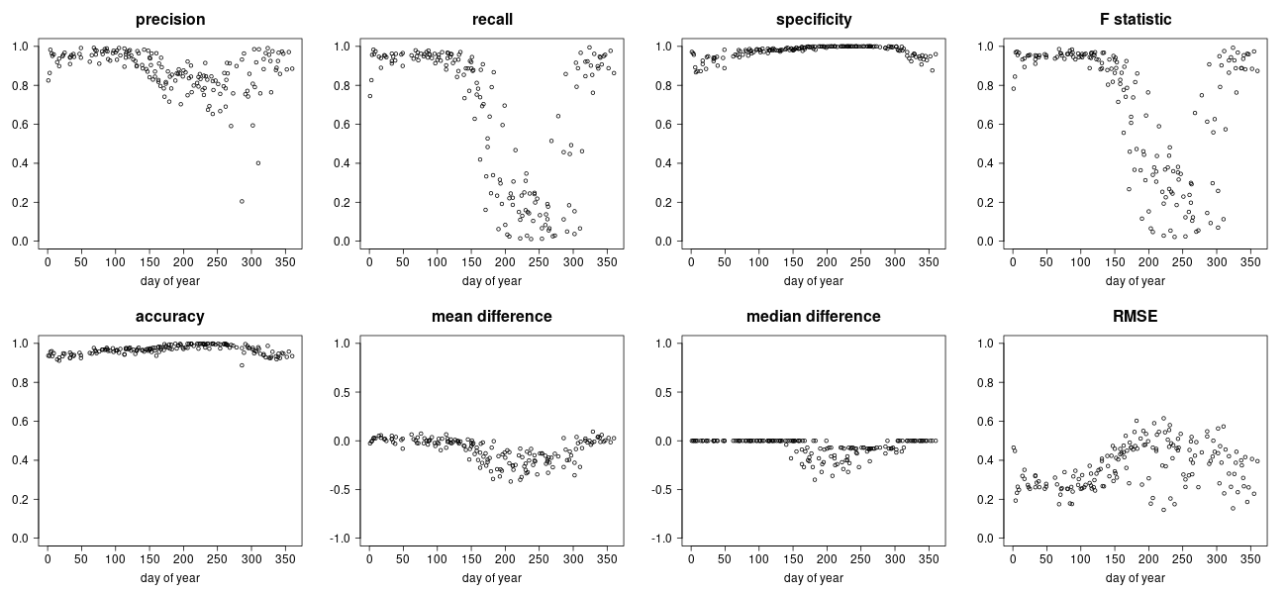
30 m daily snow cover from the fusion of MODIS and Landsat
Rittger et al, in prep for April 30th
Notes:
Left, false color 30m, snow fraction 30m from Landsat, snow fraction 500m from MODIS, downscaled 30m daily fused
Deep shadowing is an issue with the Landsat observation, but not the fused product.
Improved snow fraction over whole image be especially at snow line where MODIS sees mixed pixels

Slide 23
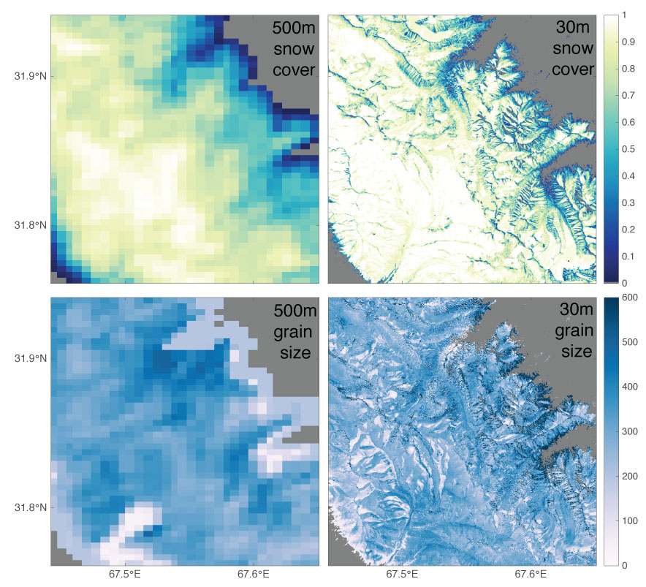
Next fusion: grain size for snow albedo
500 m
30 m
Snow cover
Grain size
Notes:
We also plan on fusing grain sizes next. Given the uncertainty in retrievals in pixels with low snow fractions shown with red arrows, we hope to increase the accuracy of the daily product near the snowline where melt is occurring and snow albedo is important.

Slide 24
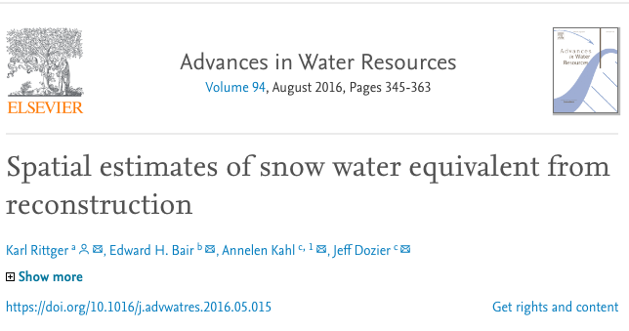
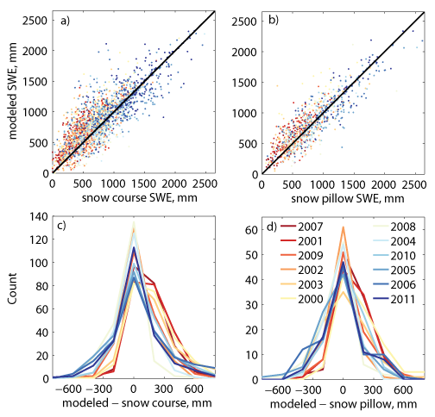
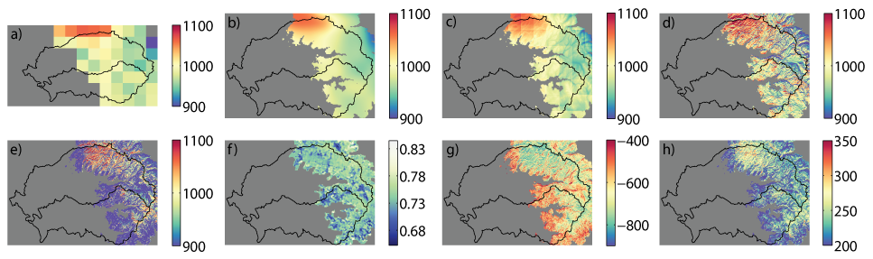
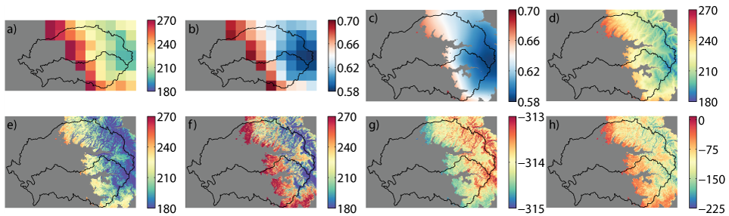
SSP as inputs to models: ParBal
SWE evaluation with snow pillows and snow courses
Downscaling solar
Downscaling longwave
Notes:
Now that I’ve take you through our remote sensing retrievals, I’m going to show you a few examples of the data in use. The first real use was in estimating snow water equivalent for the Sierra Nevada in an energy balance reconstruction model we call ParBal. With the MODIS snow surface properties we were able to accurately estimate SWE when compared to snow pillows and snow courses.

Slide 25
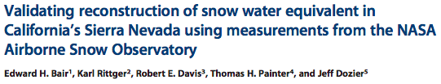

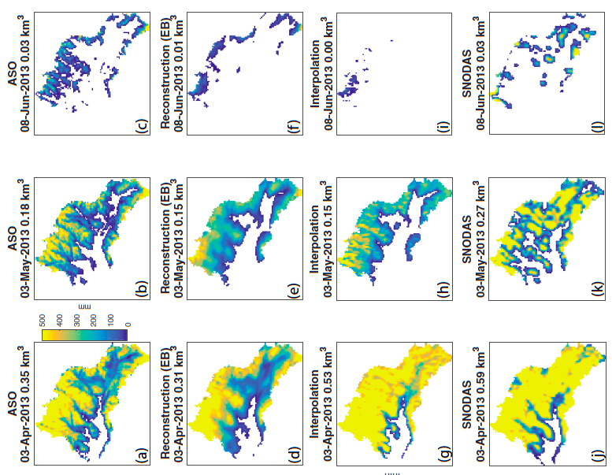
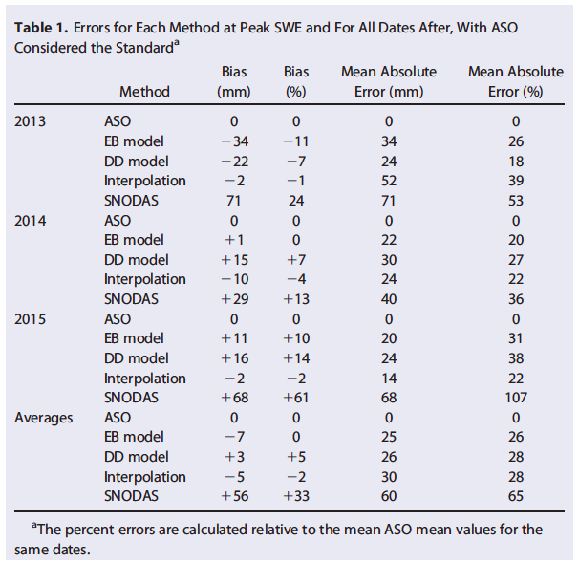
SSP as inputs to models: ParBal
ASO, Reconstruction, Interpolation, and SNODAS SWE
Notes:
My Co-author Ned also showed in 2016 that our full energy balance model, without ground observations, performed slightly better than spatial interpolation from snow pillows, having no systematic bias and 26% mean absolute error when compared to SWE from ASO. A temperature index reconstruction, the energy balance reconstruction, and the interpolation using the gap filled MODIS products were more accurate than the widely used SNODAS.

Slide 26
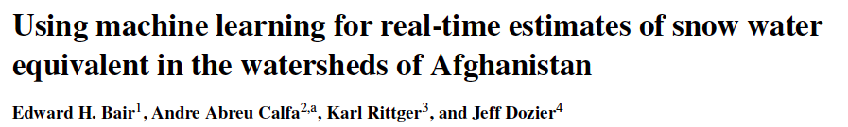
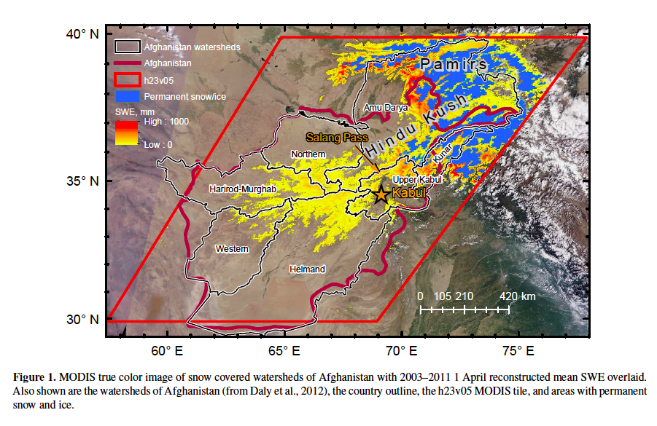
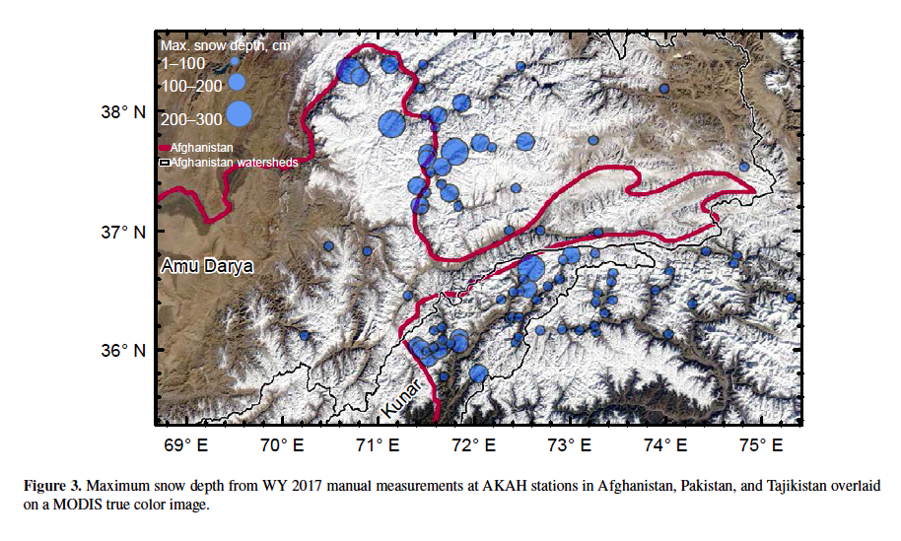
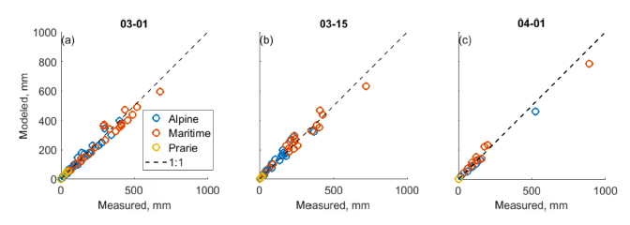
SSP as inputs to models: ParBal
Notes:
The nice thing about this model is that it doesn’t require ground observations or uncertain precipitation estimates so we can apply it in regions with few observations like Afghanistan.

Slide 27
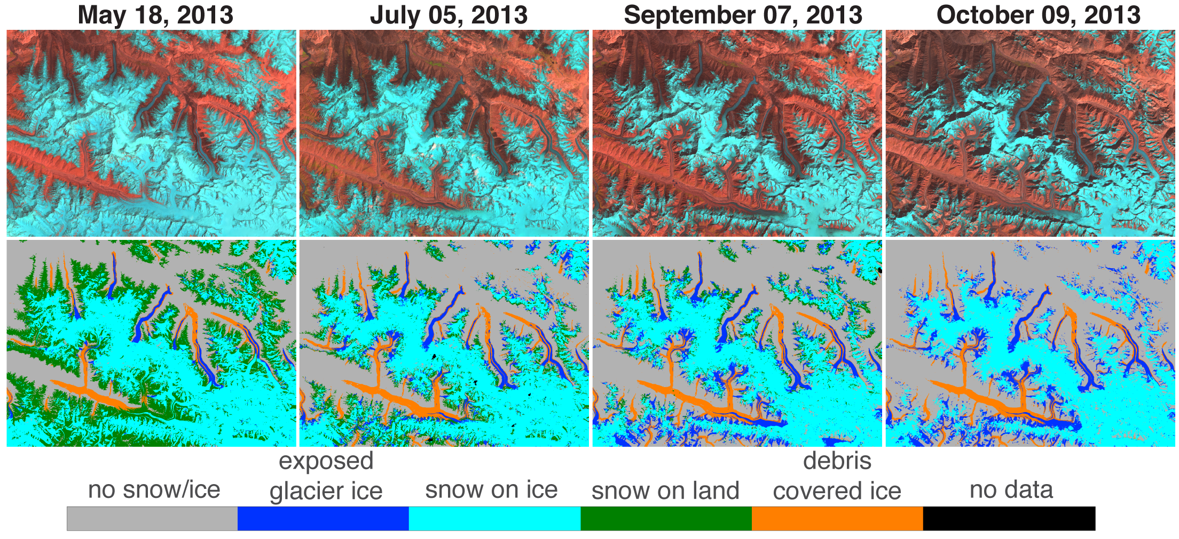
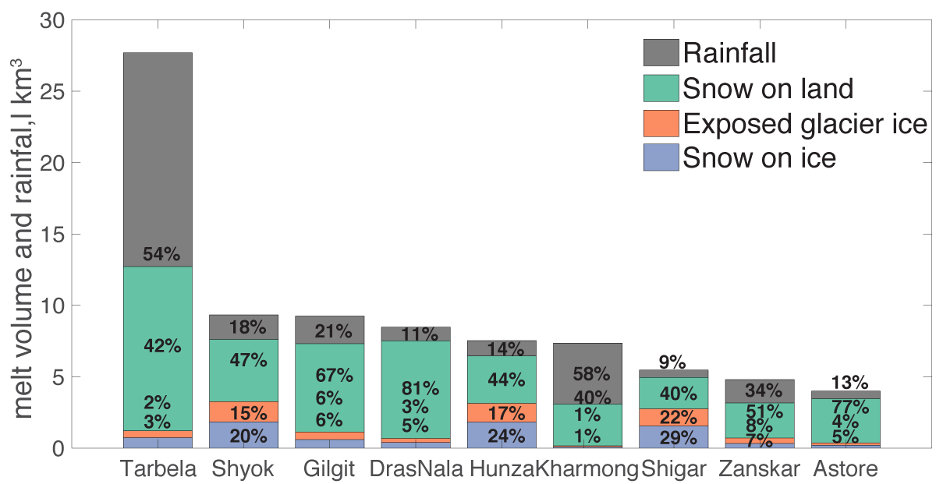
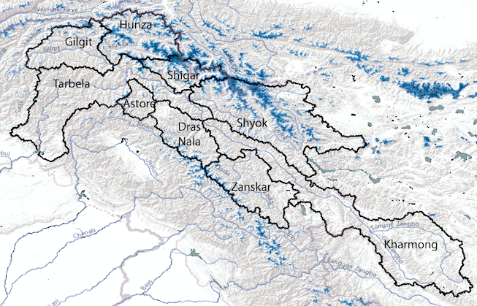
Snow melt source? Snow or Ice?
Armstrong et al, 2018;
Racoviteanu et al, 2019
Notes:
A central remote sensing task requires differentiating land surface areas. This figure shows the 30m Landsat false color on the top row and a class map with 5 different surfaces on the bottom row.

Slide 28
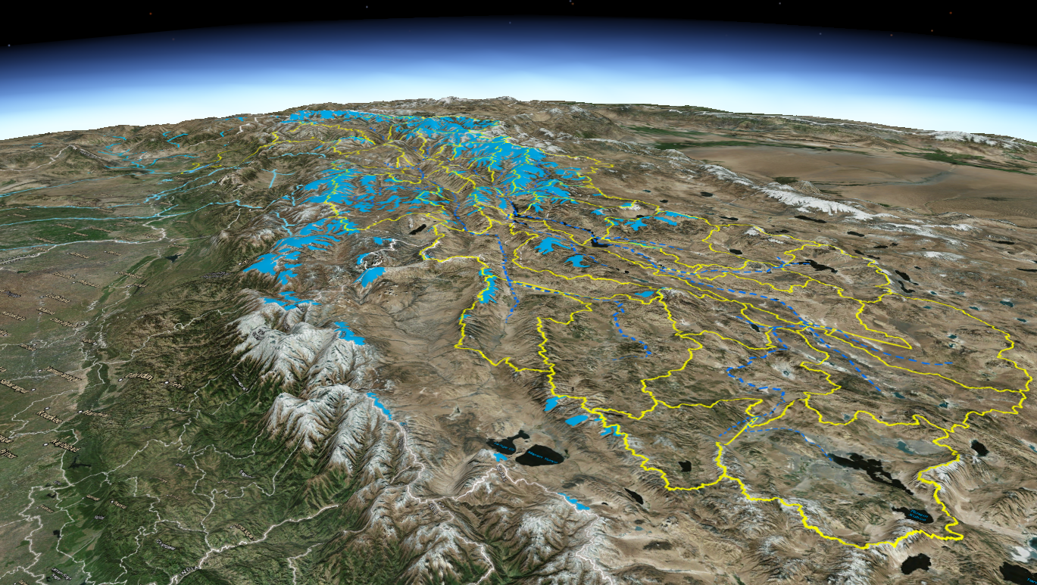
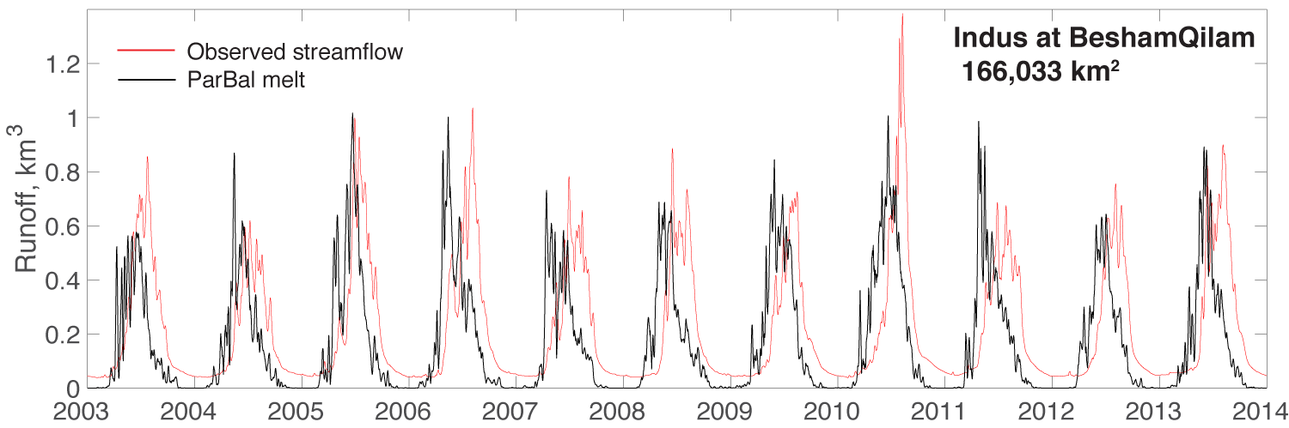
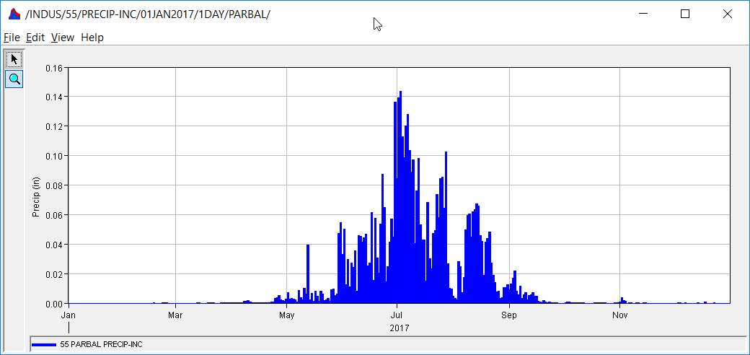
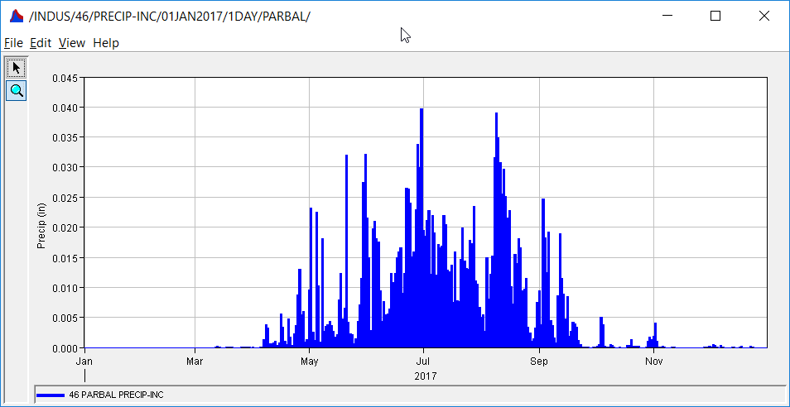


SSPs → SWE input for streamflow in HEC-HMS for Indus River basin
Upper Indus Basin broken-down into 49 Subbasins
Using Par-Bal calculated snow water melt to estimate long-term and real-time Tarbela Reservoir Inflows and resulting WAPDA hydropower generation and IBIS irrigation support for summer and fall.
Observed and Modelled Inflows to Tarbela Reservoir for 2017
Notes:
In the Indus River basin we’re working with the Army Corp of engineers to forecast flow using the HEC-HMS model. Melt from ParBal shown in the top graph matched the magnitude well, but with some lag. When the melt was used in HEC-HMS we were able do match flow well except in the monsoon season where we’ll need to add rainfall

Slide 29








SSP to calibrate forecasting models
NOAA National Water Model (NWM)
Feb
Mar 1
Apr 1
May 1
Jun
Notes:
We’re also using the snow surface properties in a project with NCAR to improve the National Water Model. We’re focusing on the Long-range forecast for the NWM for forecasts out to 30 days.

Slide 30






SSPs to validate or improve models
GFDL: snow cover
Courtesy of: Veronica Chan
C43C-08 - Albedo Reduction by Light Absorbing Impurities and the Associated Radiative Forcing over High Mountain Asia: GFDL Global Climate Model and MODIS Observations.
Moscone West, 2006-L2 3:25pm
GFDL-GCM
MODIS
Notes:
The last example are comparisons with the global climate model run at GFDL.

Slide 31
Summary
Not just snow cover, but snow surface properties (SSPs) with multispectral sensors
Accurate snow cover and snow albedo
  Physically based methods
SSPs can drive models to accurately estimate SWE
SSPs can be used to calibrate and validate large scale models land surface models

Slide 32
Request for collaboration
Future of satellite remote sensing is
  fractional snow cover at 500 m or even 30 m
  snow albedo (fractional pixel), not just whole pixel albedo
Not yet a global product
  Continuing validation (Alps?!!)
  Regional model validation (USA, High Mountain Asia)
Contact: Karl.Rittger@Colorado.edu

