Slide 1
Notes:
First GLOBAL time series
over such a long time period -> 37 years

Slide 2
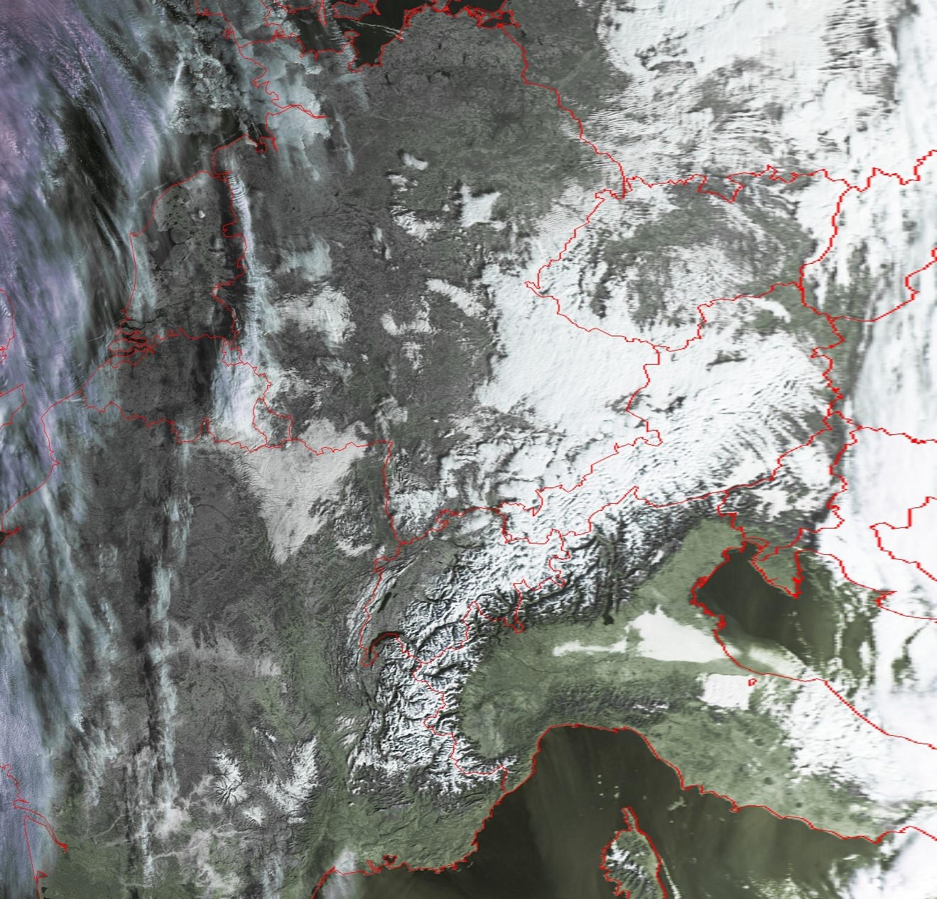
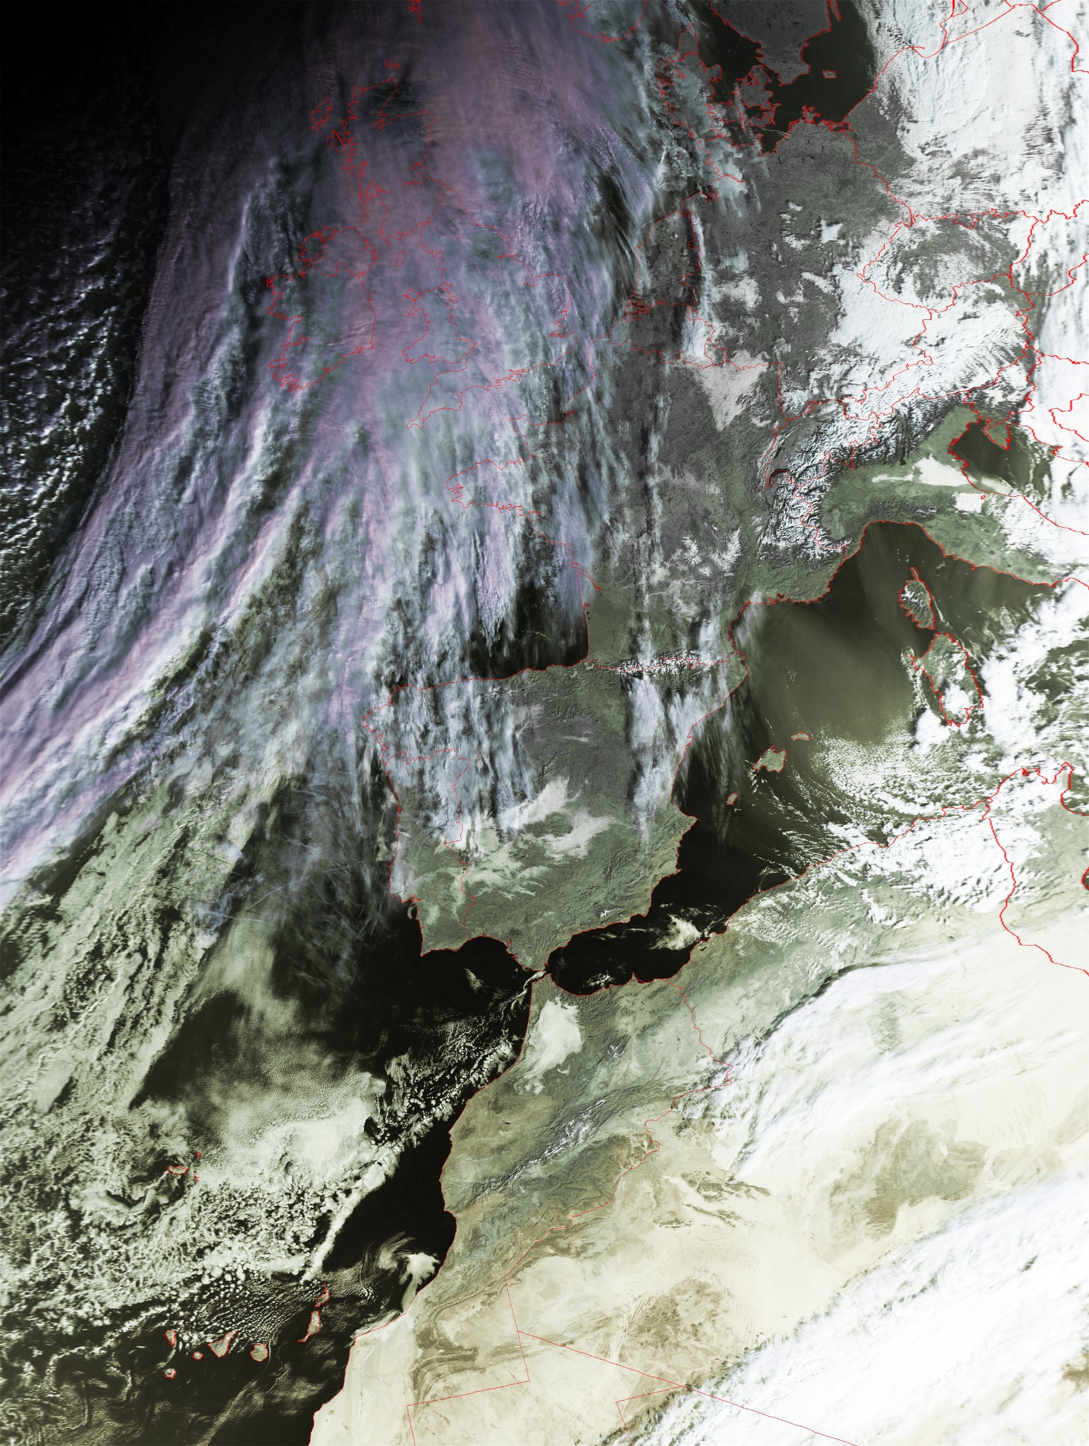
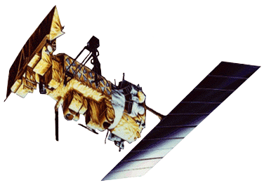
Data
Advanced Very High Resolution Radiometer
(AVHRR)
LAC = Local Area Coverage
GAC = Global Area Coverage
Metop-A 2019-12-10 09:37
Notes:
Our group is receiving AVHRR data with an antenna located on a buidling about 3 minutes from here
AVHRR – either LAC or GAC -> different resolution and sampling -> more details later on
Zoom: challenge cloud-snow

Slide 3
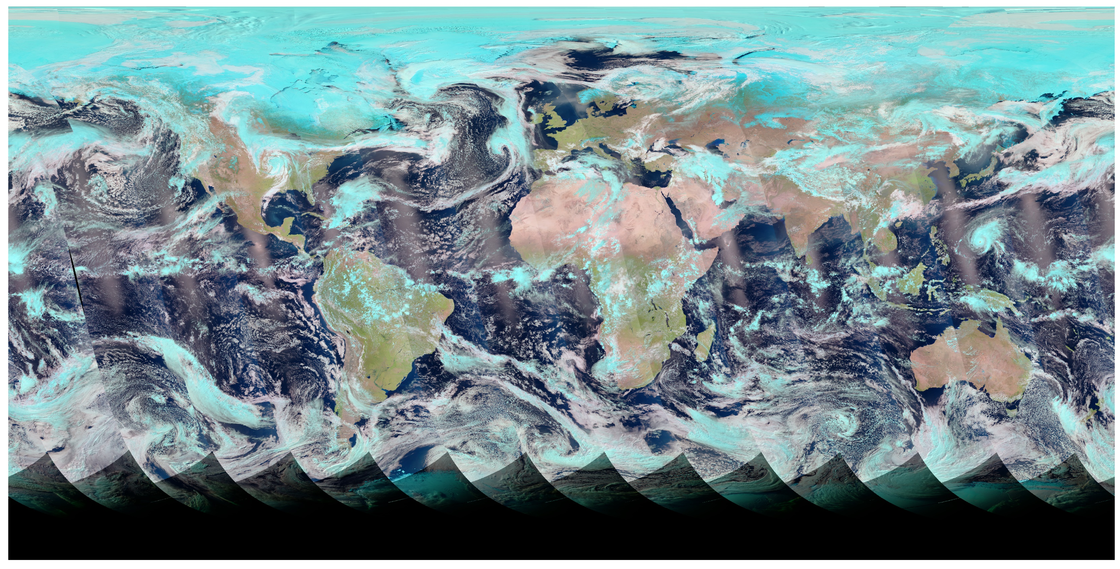
AVHRR (Advanced Very High Resolution Radiometer)
> AVHRR GAC FCDR processed by Cloud CCI project
> geolocated (no orthorectification) using PyGAC (Devastahle et al. 2016)
> Radiometric calibration of visible channels (PyGAC)
> inter-calibration of individual sensors (PySTAT)
AVHRR GAC FCDR:
Daily composites
0.05° spatial resolution
1982 – 2018
AVHRR-2: NOAA-7, NOAA-9, NOAA-11, NOAA-14
AVHRR-3: NOAA-16, NOAA-18, NOAA-19
prime satellites
Notes:
In this project: gridded global GAC composites
Geolocation issue very random
Prime satellites only

Slide 4
AVHRR (Advanced Very High Resolution Radiometer)
Channel specifications, depending on AVHRR generation:
Notes:
Channels properties are changing over time – long time series needs to be consistent!! > Consistency test showed great consistency over time
AVHRR-2: 1982 - 2001/03
AVHRR-3: 2001/04 - 2018

Slide 5
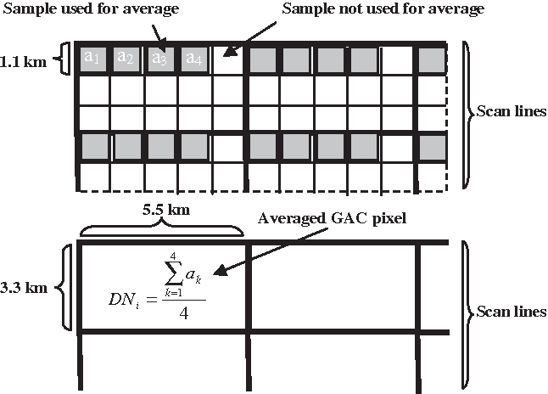
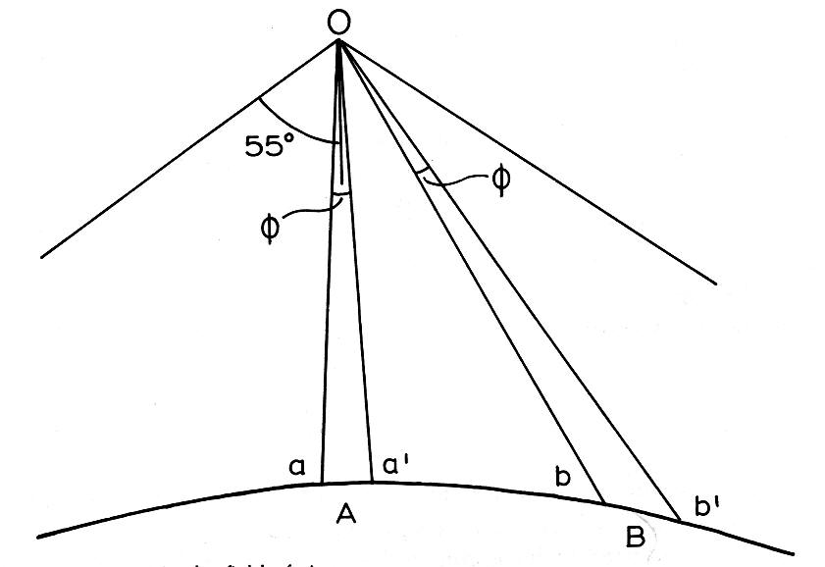
AVHRR scan geometry & GAC sampling
Nadir 1.1km → swath edge 4 x 6 km
blurring of information due to enlarged footprint at swath edges
GAC data is often gridded to 4 km x 4 km, in our case 0.05° x 0.05°
Cracknell, 1997
Pinheiro et al. 2006
Notes:
Some challenges with AVHRR GAC data
Blurring at swath edges -> pixel up to 12 x 18 km -> exclusion of data at swath edges
GAC sampling very special due to on-board storage space restrictions

Slide 6
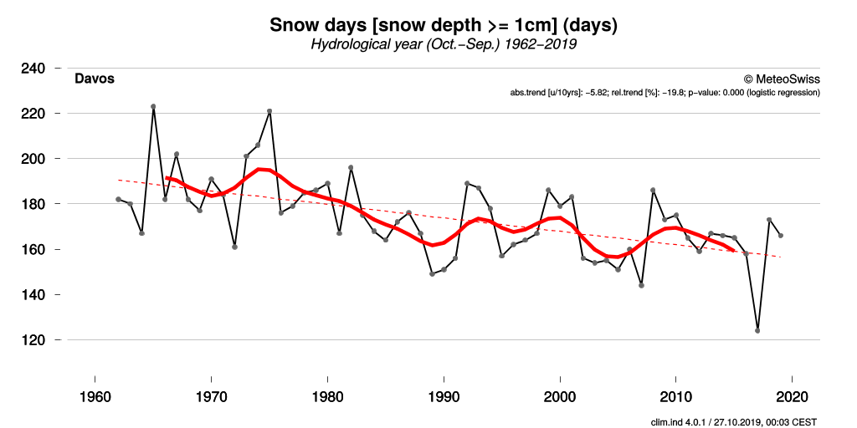
Why AVHRR?
WMO requirement for climate period: 30 years
AVHRR
MODIS
Sentinel-2
Sentinel-3
NOAA-20
Notes:
But then WHY AVHRR?
It is admittlingly not the most attractive sensor, right, however
Unique chance of consistent sensors over more than 30 years -> WMO requirement for climate studies

Slide 7
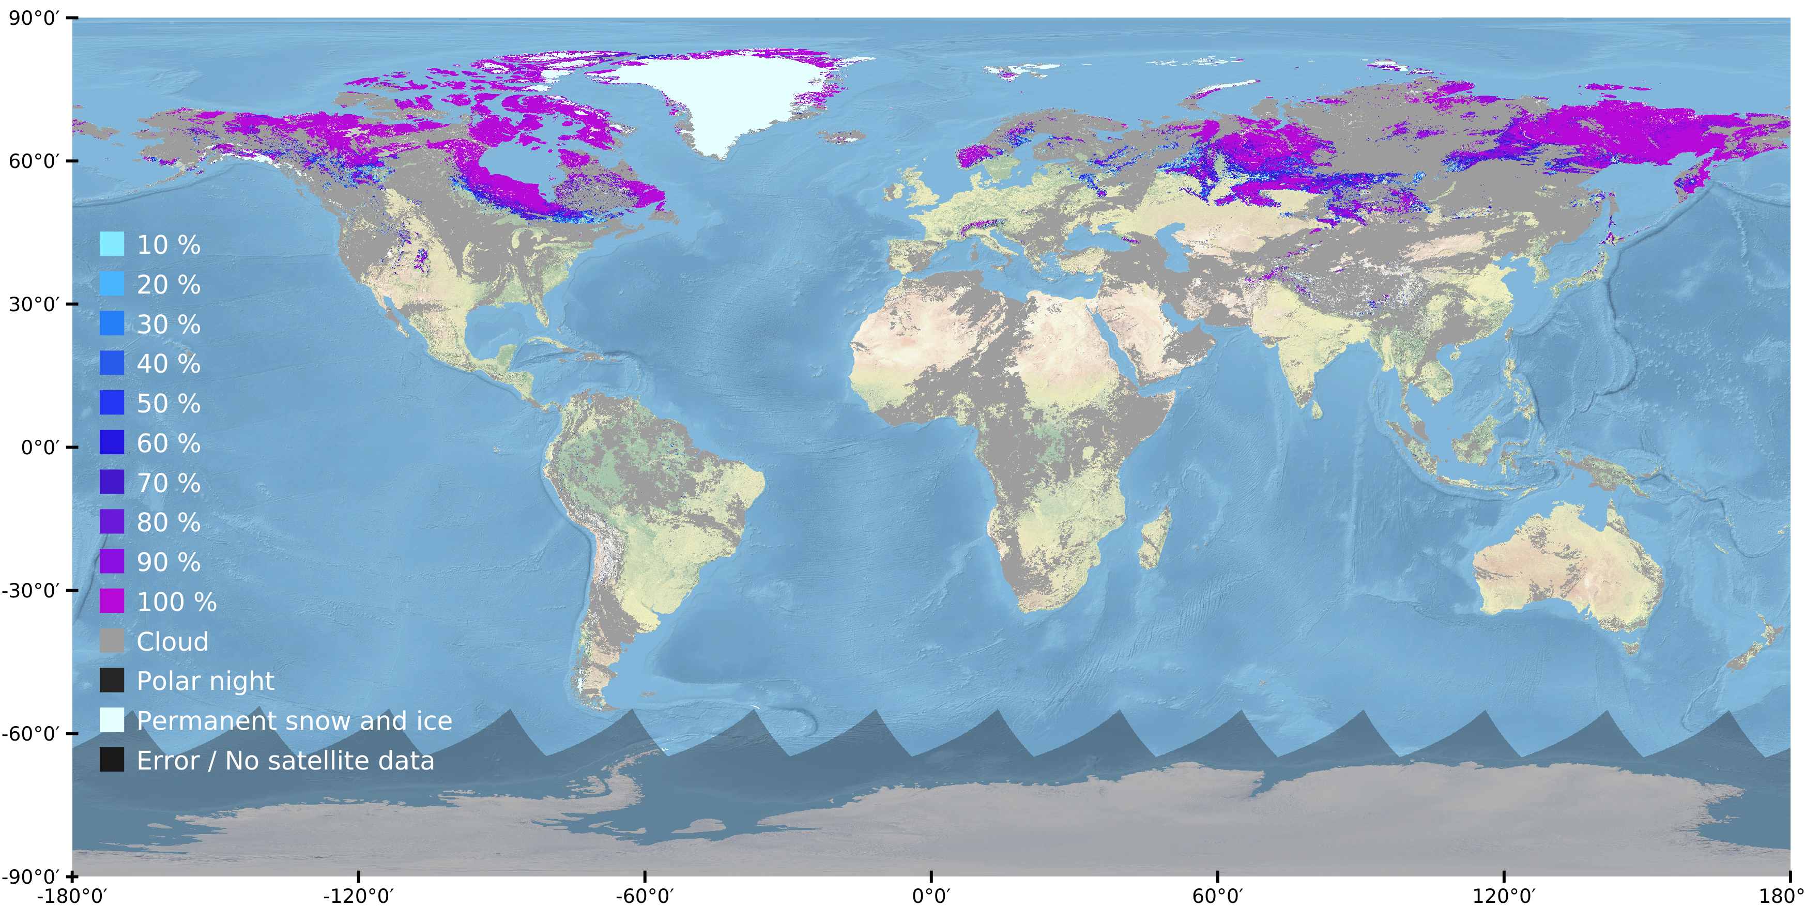
First results
Example of AVHRR GAC fractional snow cover map: NOAA 16 – 20030416
Notes:
Right into results
Fractional Snow Cover product
Daily
global

Slide 8
Global fractional snow cover extent
Challenges
Polar night
Clouds
Missing data
Notes:
3 years of data – 2002-2004
Focus on:
Polar night
Occurence of clouds
Snow extent in total
Amount of fractional snow cover

Slide 9
Snow cover area (SCA) percentage
global, from 1982 to 2018
Notes:
SCA = ratio of snow covered pixels in the reference area to all pixels in the reference area at a specific point in time
Weekly-means
Consistency of time series eventhough change of sensor type, i.e. AVHRR-2 to AVHRR-3 (remember slides from before)
Attention: compared to the IPCC graph, this graph does not show anomalies and thus trends can not be detected
However, we see clear inter-annual variability,
with years that show a great total amount of SCA -> high peak, e.g. 1986, 2011
and years with a long snow cover duration -> broad peak, e.g. 1995, 2003

Slide 10
Snow cover area (SCA) percentage
global, from 1982 to 2018
seasonal snow cover on southern hemisphere
Notes:
How can we see this a global time series and not only NH as all the previous snow cover products?

Slide 11
Seasonal snow cover

Slide 12
Snow cover area (SCA) percentage
global, from 2016 to 2018
polar-night influence
seasonal snow cover on southern hemisphere
Notes:
Southern peak between October and December

Slide 13
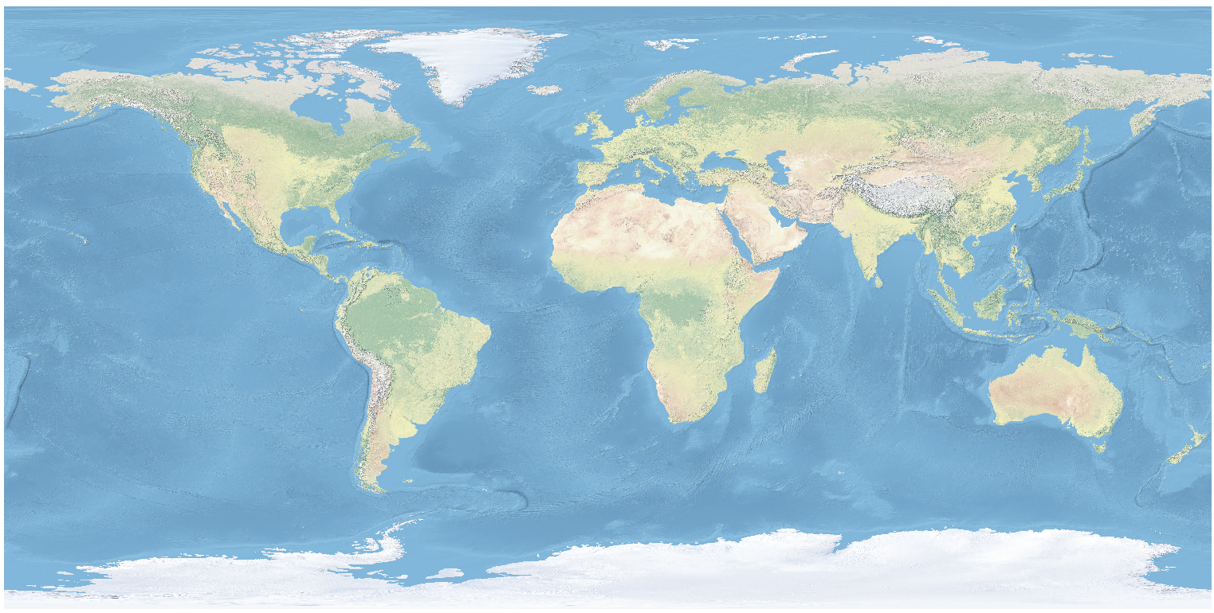
Regional influence on global SCA
Svalbard
Iceland
North Asia
Europe
Central Asia
North America
North Africa
South Asia
Australia/NZ
South America
South Africa

Slide 14
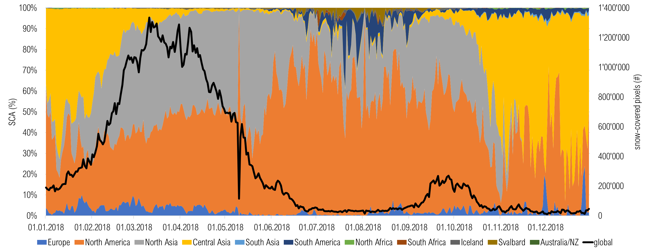
Regional influence on global SCA

Slide 15
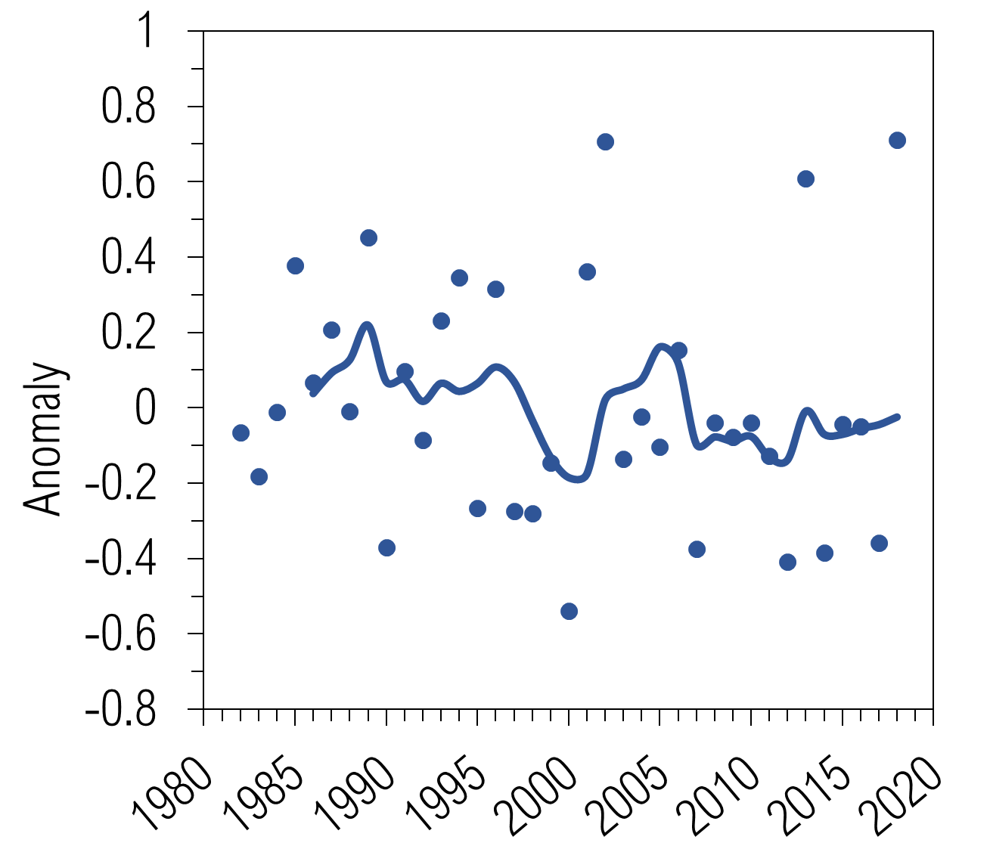
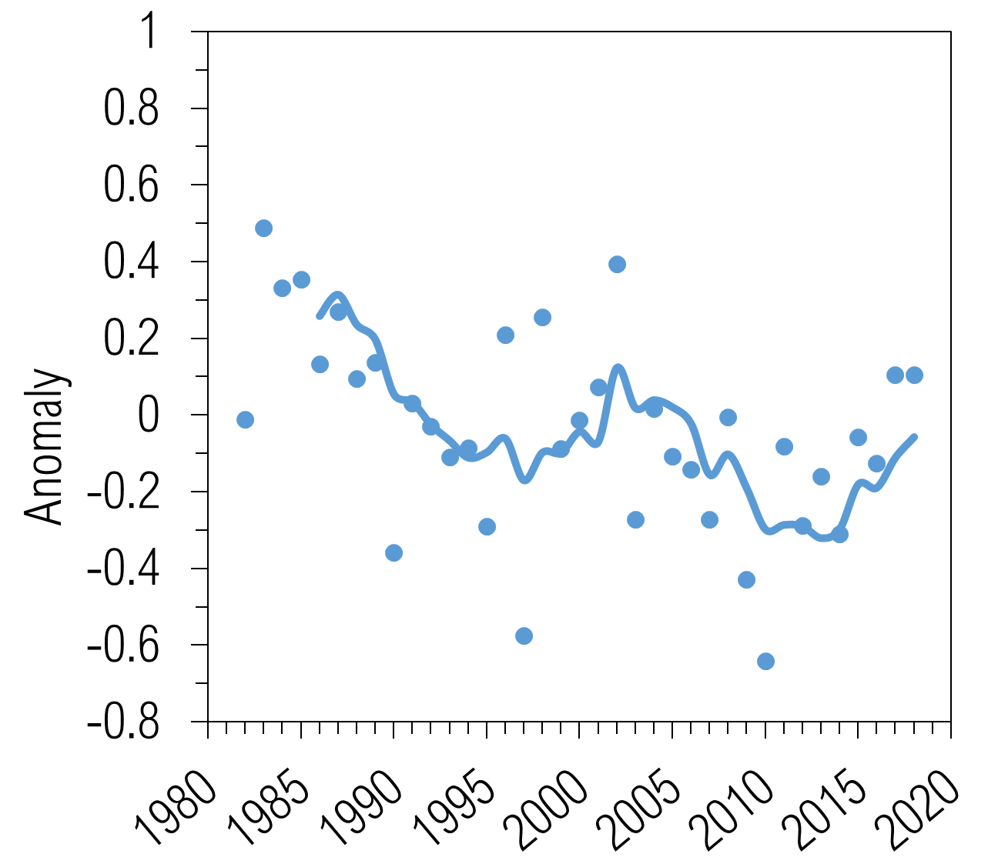
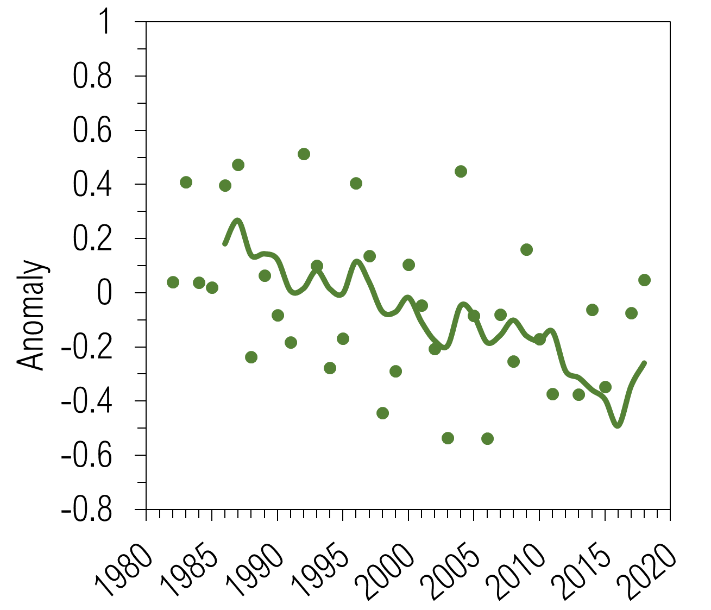
Snow cover dynamics – Northern Hemisphere
Monthly spring anomalies with respect to long-term mean 1982-2010
April
May
June
Notes:
Dots = monthly mean per year
Line = 5 year running mean
April – slight decrasing trend, but still rather large variability
May – clear decreasing trend with intersection of increase in years 1995 to beginning of 2000ends
June- clear decreasing trend over entire time period with small interanual variability
INTERESTING: increasing trend in all three month after about 2015…

Slide 16
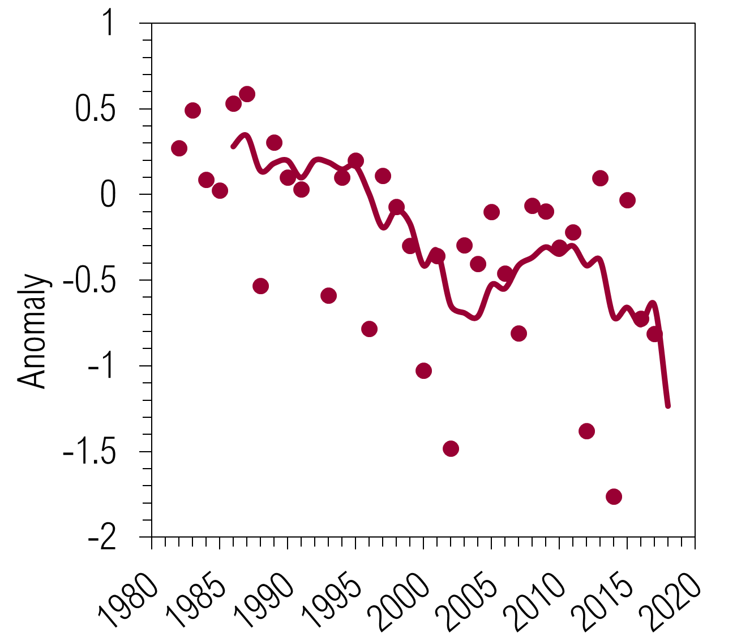
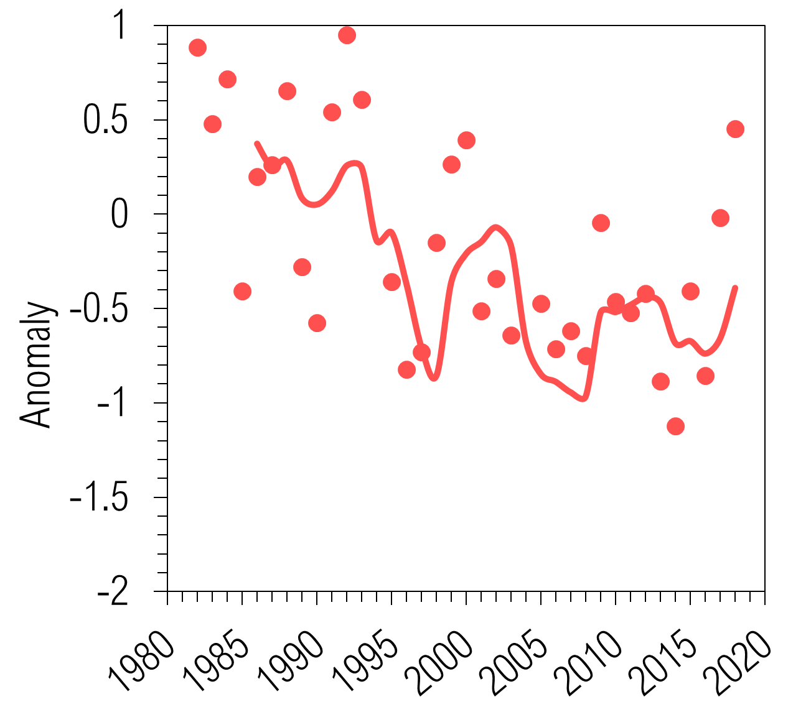
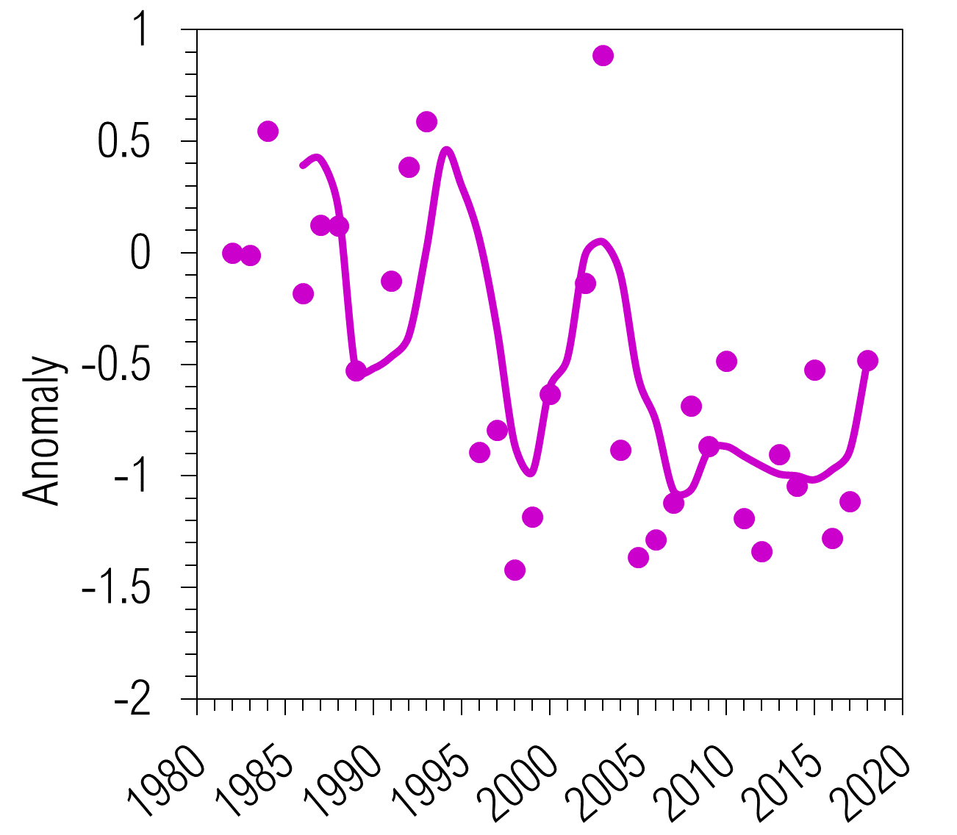
Snow cover dynamics – Southern Hemisphere
Monthly spring anomalies with respect to long-term mean 1982-2010
September
October
November
Notes:
Dots = monthly mean per year
Line = 5 year running mean
September = clear decreasing trend with intersection of increasing anomalies for the years 2004 – 2010
October = generally decreasing trend but strong interannual variability
November = generally decreasing trend but even stronger interannual variability
-> interannual variability might be explained by the fact that the southern hemisphere snow cover consists of different smaller areas of snow cover, thus local extreme situations are much more relevant and better seen in the overall picture

Slide 17
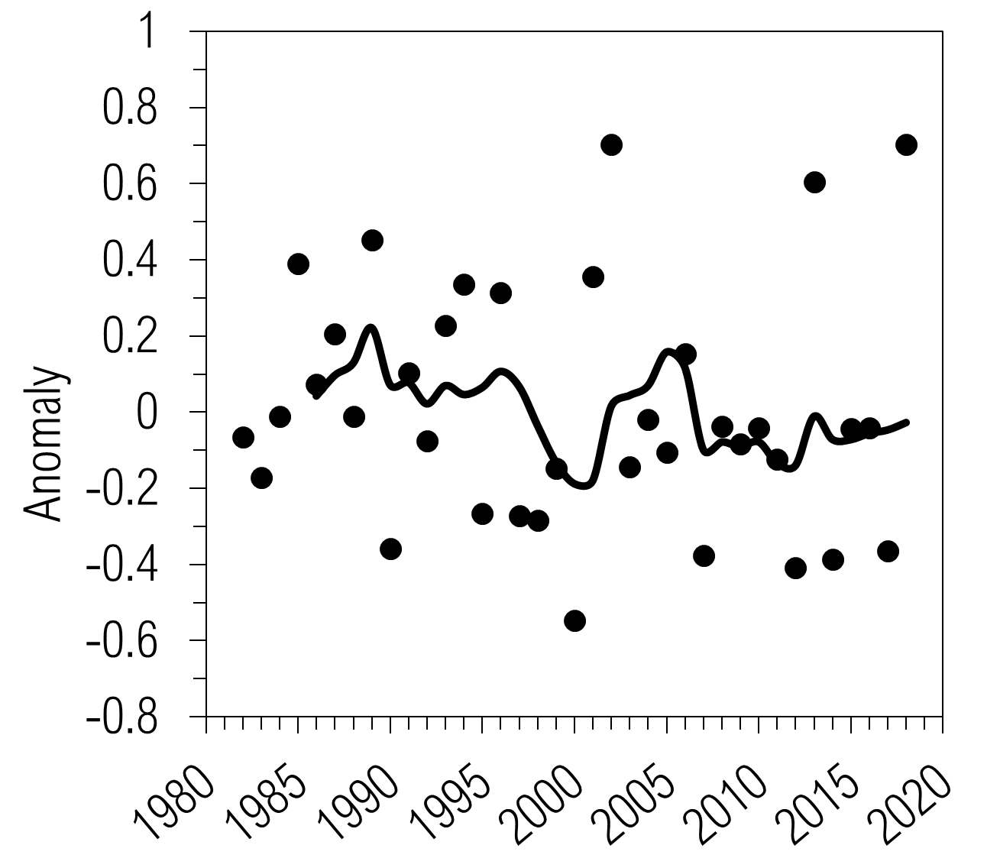
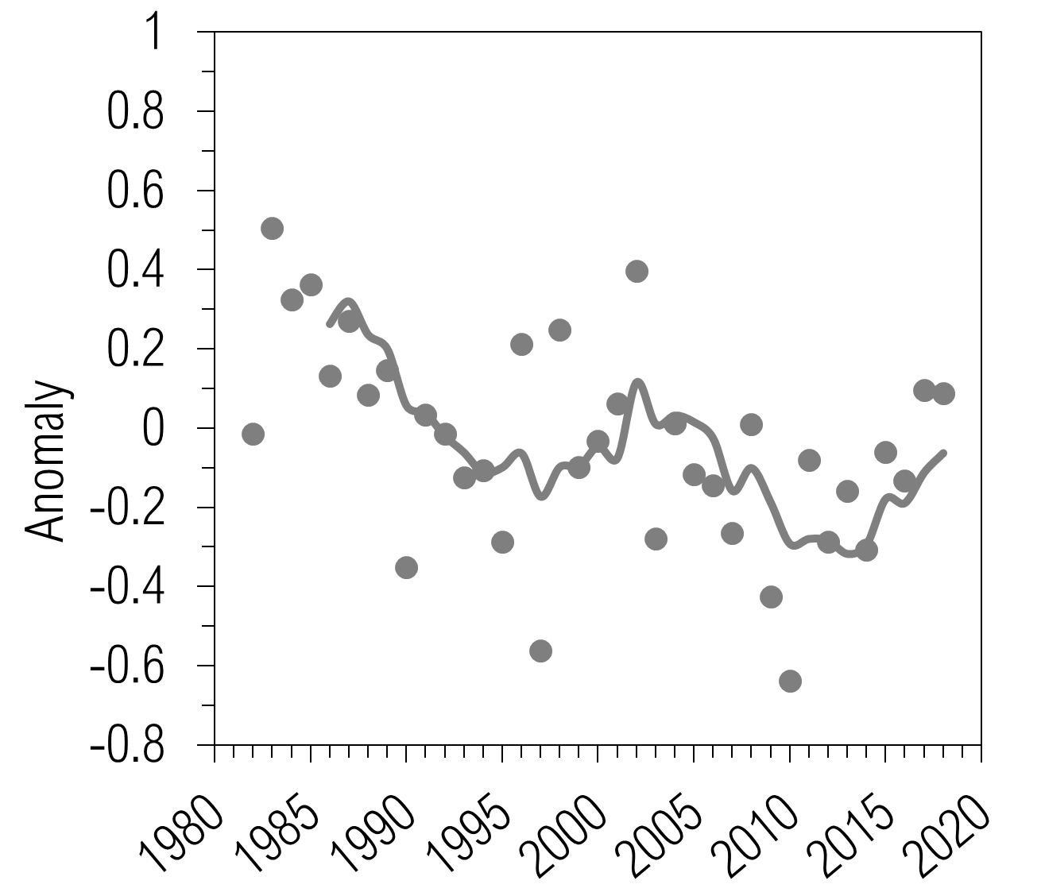
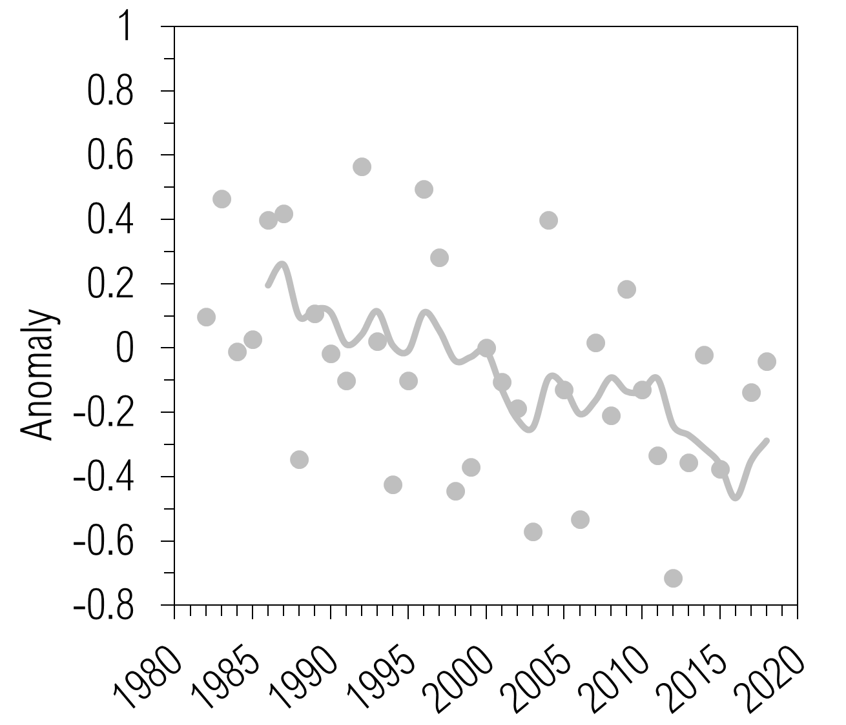
Snow cover dynamics – Global
Monthly spring anomalies with respect to long-term mean 1982-2010
April
May
June
Notes:
Dots = monthly mean per year
Line = 5 year running mean
Very similar picture as for the Northern Hemisphere only as expected due to the domination of snow cover present in the Northern Hemisphere compared to the global distribution

Slide 18
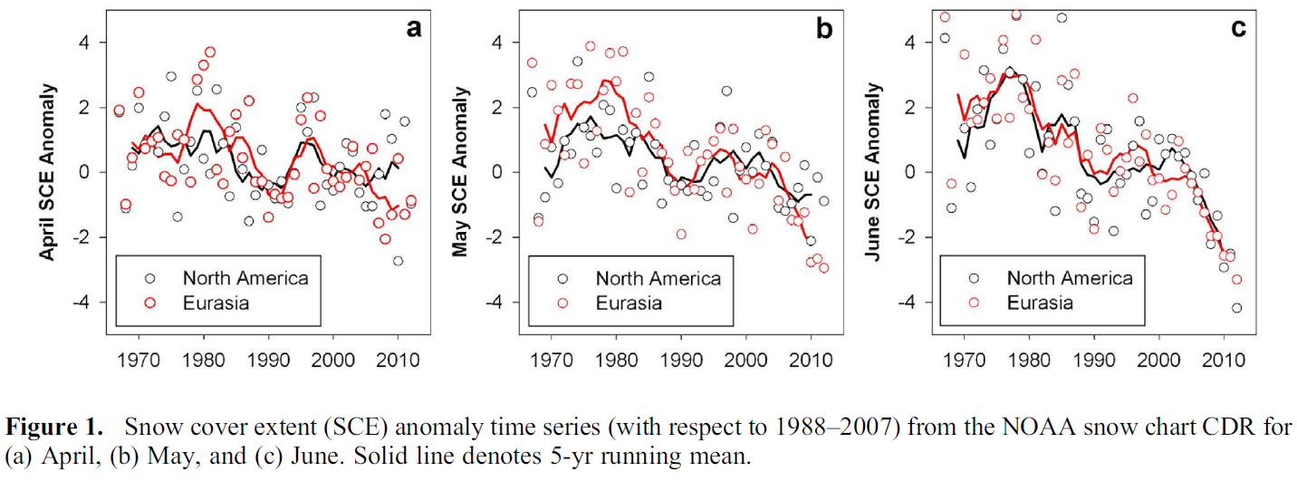
Snow cover dynamics
Monthly spring anomalies with respect to long-term mean 1982-2010
April
May
June
Derksen and Brown 2012
Notes:
Comparison to a study by Derksen and Brown 2012, who focused on Northern Hemisphere only -> red = Eurasia / black = North America
Their time series is based on the NOAA snow chart Climate Data Record for the time period 1967 to 2012
Very similar picture between this study and our data
EXCEPT for newest years, where we detect a slightly positive anomalies

Slide 19
Snow cover dynamics
Monthly spring anomalies with respect to long-term mean 1982-2010
April
May
June
Mudryk et al. 2020
Notes:
Most recent study by Mudryk et al., currently under discussion in The Cryosphere, is based on six independent datasets covering the time period 1981-2018.
Datasets: some satellite based e.g. GlobSnow, NOAA Snow Charts, JAXA
some model based e.g. CROCUS, Merra-2
Actually show similar neutral or slightly positive anomalies for the latest about 3 years

Slide 20
Outlook
Analysis of snow cover dynamics
> snow cover area percentage - anomalies
> snow cover duration
> snow cover on-set / melt-out day
> timing of maximum snow cover
Regional assessments
…
snow cover duration
on-set day
melt-out day
maximum day

Slide 21
Outlook
Gap-filling
> (Spatial) & temporal
Testing of pre-conditions
Noise in channel 3
> apply to AVHRR-2
Snow on ground > canopy correction
Outlier-filtering
> Thresholding / low-pass filter
Regional assessments
> Hindu Kush Himalaya (Poster Wu et al.)

Slide 22
Summary – what we did the last year …
> 18’487 daily composites processed
> prototype time series of 37 years of global snow cover extent
> first results of global snow cover area percentage and spring anomalies
> in-sights to up-coming analysis challenges (e.g. polar night, outliers)
Challenging, but highly valuable data set to investigate global seasonal snow cover and to assess changes thereof

Slide 23
Thank you for your attention

Slide 25
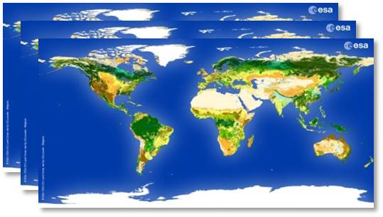
Cloud mask & auxilliary data
Cloud mask: ESA CCI Cloud Version 3
Daily composites based on AVHRR GAC PM data
Only AVHRR-PM satellite overpasses from prime satellites
Community Cloud retrieval for Climate (CC4CL; Sus et al., 2018; McGarragh et al., 2018)
Cloud detection uncertainty at pixel level in %
Auxilliary
ESA CCI Landcover data from year 2000
Digital Elevation Model (DEM) based on TanDEM-X void-filled with SRTMV41
Notes:
Cloud detection uncertainty:
Cloud detection uncertainty on pixel level (Level-2, Level-3U) originates from quantifying the agreement to CALIOP cloud mask as a function of used threshold. The uncertainty values provided on Level-2 are to be interpreted as probability (in %) that the given cloud mask information is not correct (e.g. higher value -> higher uncertainty). (PUG Cloud CCI)

Slide 26
Protoype processing 2019
Definitions
Polar night if solar zenith angle > 80°
Cloudy if cloud mask == 1 AND cloud detection uncertainty < 20%
Water if % per pixel > 50
Permanent ice/snow if % per pixel > 50
Pre-classification
Certainly snow-free if avh1 < 0.12 OR avh4 > 280° K
currently under evaluation

Slide 27
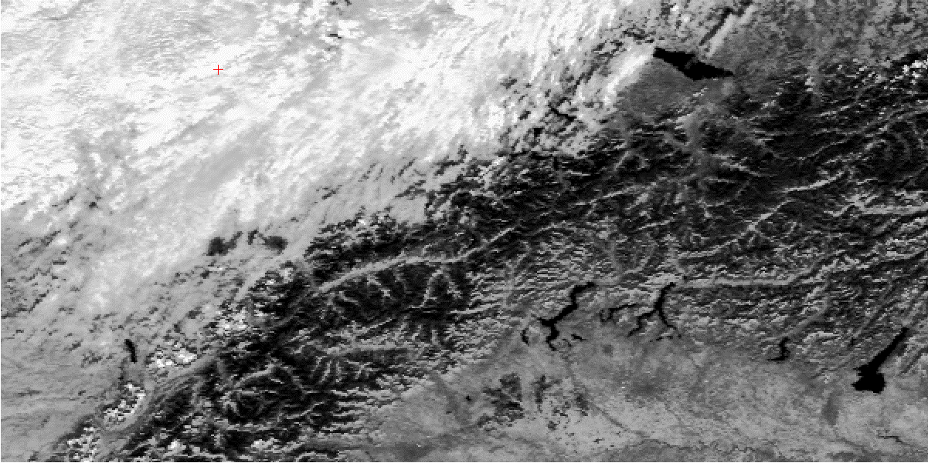
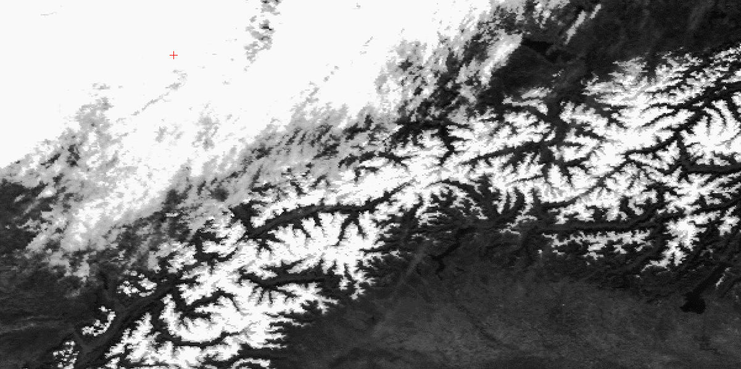
Methodology
NDSI = Normalised Difference Snow Index
$$NDSI= \frac{visGREEN −NIR}{visGREEN +NIR}$$
AVHRR
channel 1
(visGREEN)
AVHRR
channel 3a
(NIR)
Hüsler 2012

Slide 28
Fractional Snow Cover (FSC)
Daily, global, visible fractional snow cover extent
(after Salomonson and Appel 2004, 2006)
$FSC=−0.01+1.45∗NDSI$
NDSI for AVHRR
$NDSI= \frac{avh1 − avh3a}{avh1 + avh3a}$ or $NDSI= \frac{avh1 − ref3b}{avh1 + ref3b}$
where, $ref3b= \frac{I_{3}(measured) − I_{3}\left(BT_{4}\right)}{\frac{1}{π}\left(F_{3}μ_{0}\right) − I_{3}(BT_{4})}$
Notes:
Channels properties are changing over time – long time series needs to be consistent!! > Consistency test
Reflective part of the middle infrared
Channel 3B contains an equal amount of reflected and emitted energy. A separate correction is foreseen to retrieve this reflectance. channel 3b

Slide 29
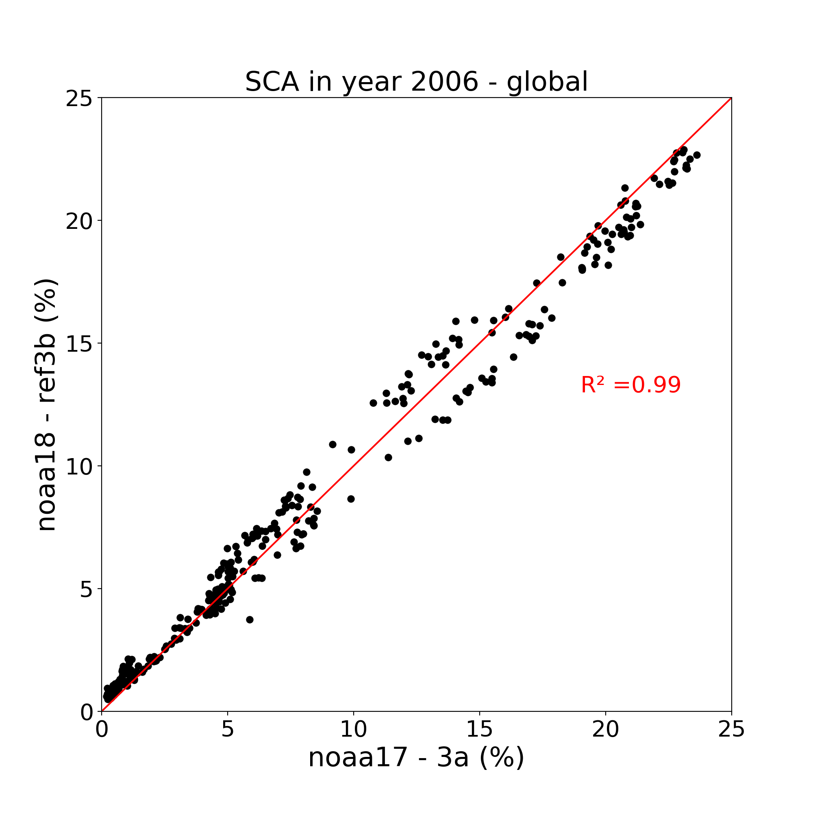
NDSI consistency - global
Notes:
Slightly different picture.
Above 10% SCA, slight underestimation of fractional snow cover extent when using ref3b, for year 2003
Year 2006: high agreement up to 10% SCA, diverse picture between 10-20% and again slight underestimation above 20% SCA when ref3b is used

Slide 30
NDSI consistency - global
Notes:
Spring: overestimation with ref3b
Fall: underestimation with ref3b

Slide 31
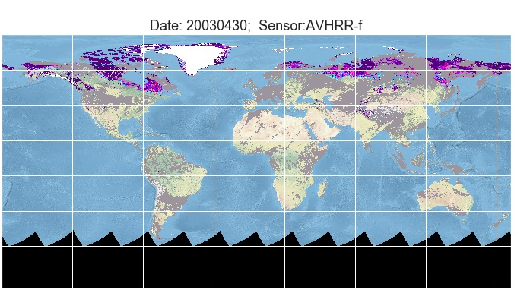
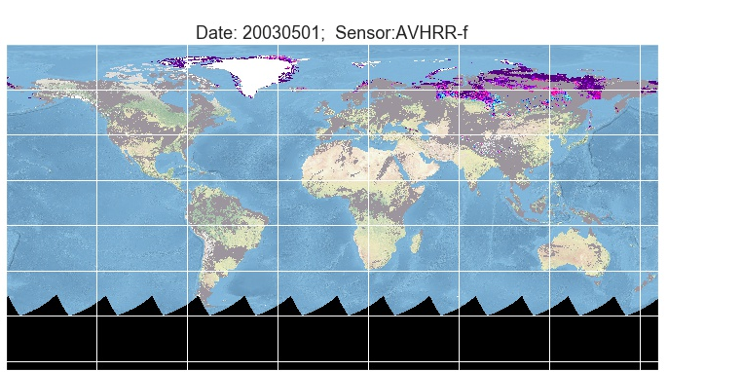
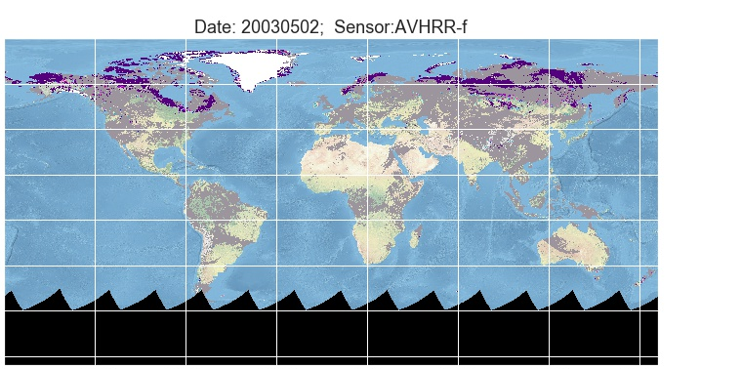
NDSI consistency - global

Slide 32
NDSI consistency - global
Notes:
Spring: overestimation with ref3b
Fall: underestimation with ref3b

