Slide 1
Validation of ESA CCI+ Snow Products
Carlo Marin, Claudia Notarnicola, Sari Metsämäki, Valentina Premier, Kathrin Nägeli, Arnt-Børre Salberg, Gabriele Schwaizer, Rune Solberg, Andreas Wiesmann, Stefan Wunderle, Thomas Nagler, Anna Marie Trofaier
9th EARSeL Workshop, Bern

Slide 2
Validation objectives
The objectives of the validation activities are:
Quantify the error of the snow_cci products;
Characterize the performance against:
Seasonality;
Forest presence;
Local topography.
Quantify the error of the provided snow_cci uncertainty.
Independent from algorithm development.

Slide 3
Validation Workflow
Landsat/Sentinel-2
In-situ measurements
Other SCF/SWE products
Ancillary data
DEM
Water masks
Land cover
Climate zones
Data Preparation
Collect representative HR images
Collect representative in-situ measurements
Collect representative SCF/SWE maps
Generate HR SCE
Format the in-situ data in the ESA snow CCI format
Preparation of the data
Preparation of the data
snow_cci SCF products validation
snow_cci reference dataset
snow_cci SWE products validation
snow_cci validation activities
SCF high resolution intercomparision
In-situ validation of SCF and SWE
Other SCF/SWE products intercomparison
Uncertainty validation
snow_cci SCF products
snow_cci SWE products
Documentation of the results

Slide 4
SCF Validation Protocol

Slide 5
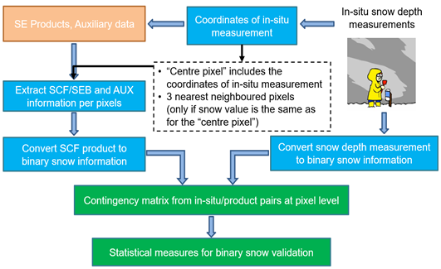
SCF Validation: in-situ validation
All products and in-situ data are treated as binary (snow/no-snow) using the following snow depth binary conversion thresholds:
SD=0cm;
SD=2cm;
SD=15cm.
SCF binary conversion thresholds:
SCF=25%;
SCF=50%.
Inhomogeneous neighborhood is rejected from validation.
Results are divided according to:
different land-cover classes (forest, non-forest, mountain, plain)
four three-month periods: October-December, January-March, April- June, July-September
Metrics: True/False positive, recall, precision, false alarm rate, accuracy, critical success index, f-score.
Snow_cci SCF products
Pre-processing
Workflow for the in-situ comparison.

Slide 6
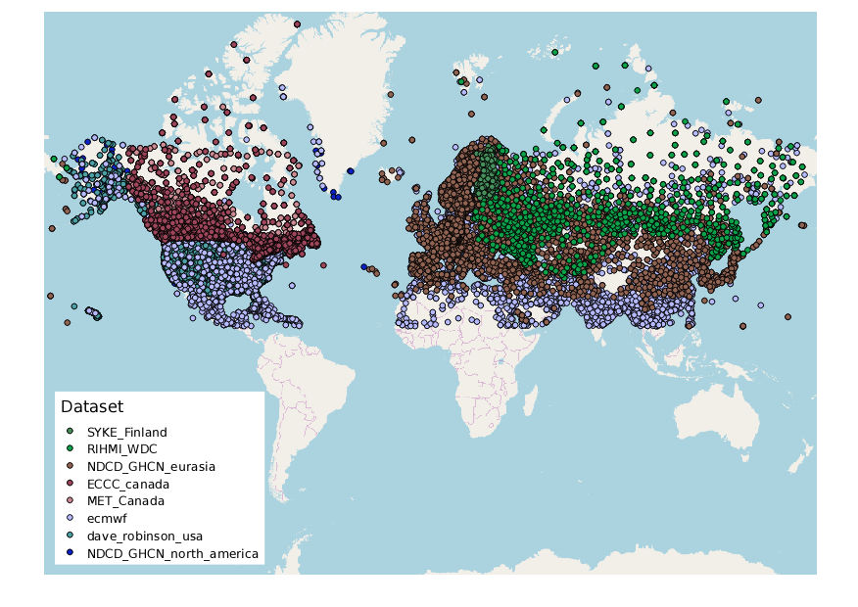
SCF Validation: in-situ validation
In-situ data snow depth observations

Slide 7
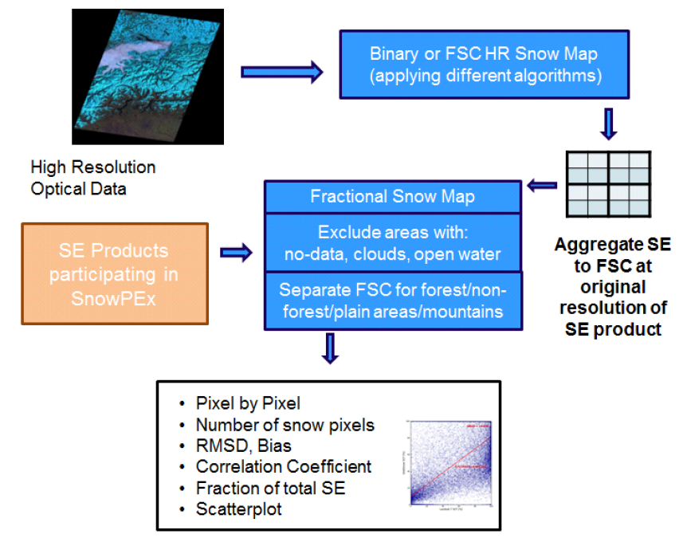
SCF Validation: HR validation
HR snow cover maps derived according to State-of-the-art snow algorithms:
Dozier and Painter (2004): binary snow on ground;
Klein et al. (1998): binary snow on ground;
Salomonson and Appel (2006): viewable fractional snow cover.
The HR intercomparison is carried out at the lowest resolution between the snow_cci SE maps and the intercompared maps.
The following steps are required for the intercomparison:
Pixel aggregation;
Identification of valid pixels;
Masking considering the ancillary data;
Intercomparison.
Pixel-by-pixel intercomparison metrics: bias, RMSE, unbiased RMSE, CorrCoef, True/False positive, True/False negative.
Analysis of different land surface classes (forest, non-forest, mountain, plain) in the intercomparison process.
Snow_cci SCF products
Workflow for the HR inter-comparison.

Slide 8
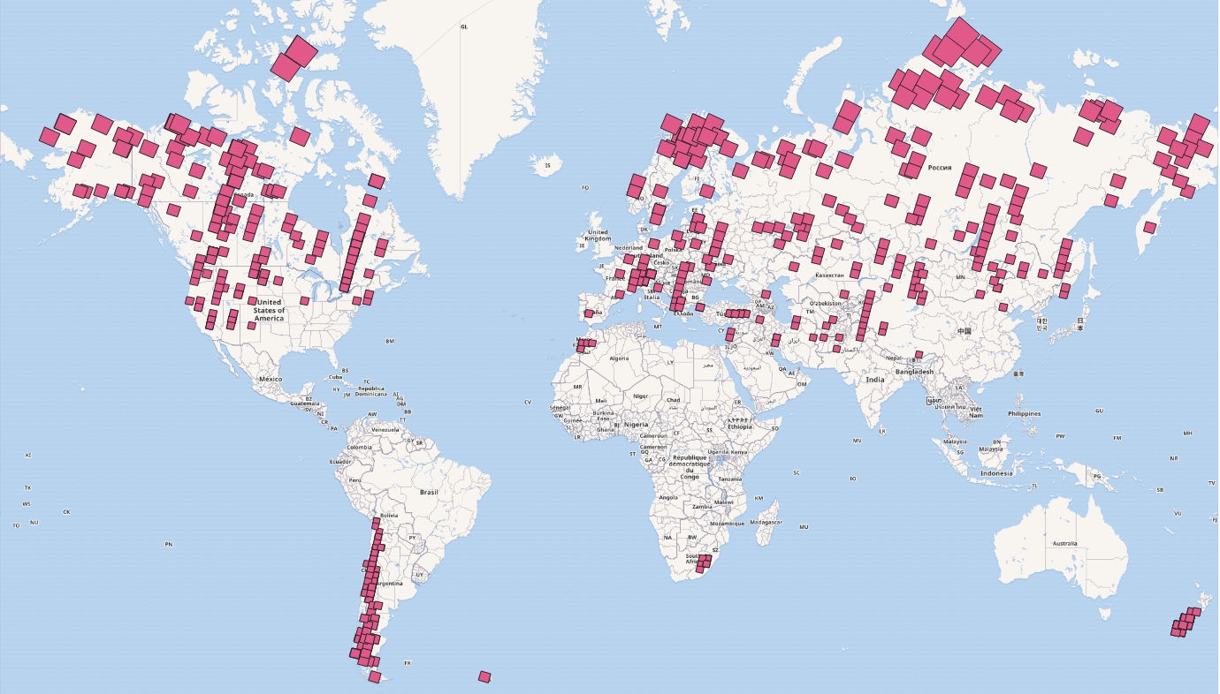
SCF Validation: HR intercomparison
~800 scenes spanning 1986-2018
Landsat images selected for the validation

Slide 9
SCF Validation: Intercomparison
Inter-comparison between different SCF and snow binary products (CP1).
All the comparisons are done at the lowest resolution.
Pixel-by-pixel intercomparison metrics: bias, RMSE, unbiased RMSE, CorrCoef, True/False positive, True/False negative
Analysis of different land surface classes (forest, non-forest, mountain, plain) in the intercomparison process.
Workflow for the SE inter-comparison.

Slide 10
SWE Validation Protocol

Slide 11
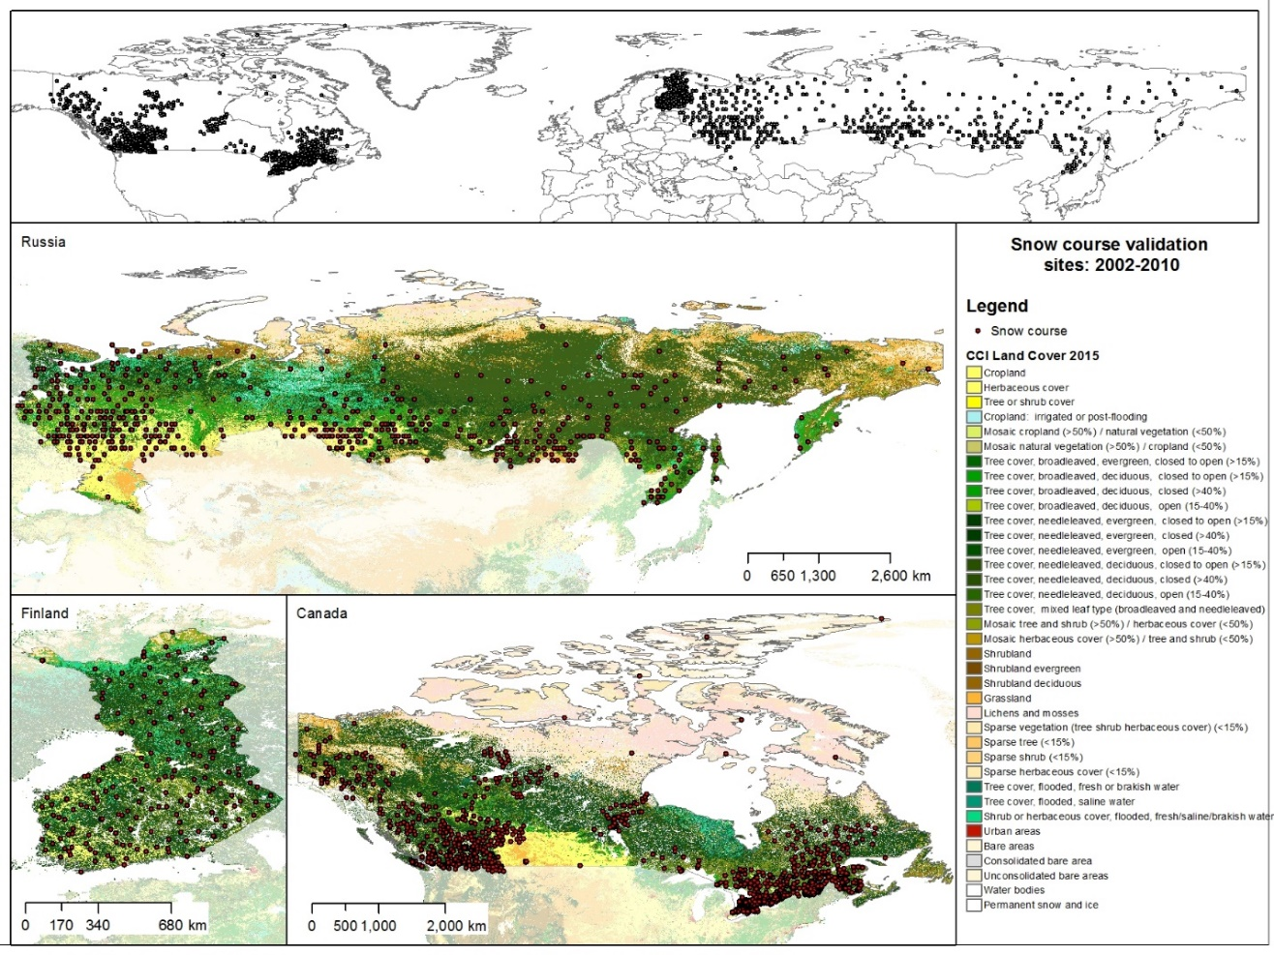
SWE Validation: in-situ validation

Slide 12
SWE Validation: intercomparison
Product Name | Meteorology | Time Period | Data Source
Crocus v8 | ERA-Interim | 1979-2018 | ECCC
Brown | ERA-Interim | 1979-2018 | ECCC
MERRA2 | MERRA2 | 1980-- | GMAO, 2015
ERA5 | ERA5 | 1979-- | C3S, 2017
GLDAS-2.1 | GDAS/GPCP | 2010-- | Beaudoing, 2016
Agreement between the snow_cci products and LSM products is assessed using metrics of bias, RMSE and correlation.
Notes:
The results are not yet available.

Slide 13
SCF Validation Results

Slide 14
SCF Validation Results: in-situ
Statistics obtained by considering 419 MODIS available and 2M of in-situ measurements for the different combination of thresholds.
binary metrics.
SD threshold [m] | 0 | 0 | 0.02 | 0.02 | 0.15 | 0.15
SCF threshold [%] | 25 | 50 | 25 | 50 | 25 | 50
Recall | 0.85 | 0.76 | 0.87 | 0.80 | 0.94 | 0.90
Precision | 0.94 | 0.96 | 0.90 | 0.93 | 0.62 | 0.67
False Alarm Rate | 0.00 | 0.00 | 0.01 | 0.00 | 0.03 | 0.02
Hit Rate (Accuracy) | 0.98 | 0.98 | 0.98 | 0.98 | 0.97 | 0.98
Critical Success Index | 0.80 | 0.74 | 0.80 | 0.75 | 0.60 | 0.62
F-score | 0.89 | 0.85 | 0.89 | 0.86 | 0.75 | 0.76
contingency matrix
TSD | 0 |  | 0 |  | 0.02 |  | 0.02 |  | 0.15 |  | 0.15
TSCF | 25 |  | 50 |  | 25 |  | 50 |  | 25 |  | 50
 | Snow | No-Snow | Snow | No-Snow | Snow | No-Snow | Snow | No-Snow | Snow | No-Snow | Snow | No-Snow
Snow | 84.60 | 15.40 | 76.50 | 23.50 | 87.50 | 12.50 | 79.96 | 20.04 | 94.17 | 5.83 | 89.78 | 10.22
No-Snow | 0.46 | 99.54 | 0.28 | 99.72 | 0.74 | 99.26 | 0.46 | 99.54 | 2.75 | 97.25 | 2.07 | 97.93
Notes:
The best accuracy is 98%. As expected by increasing the threshold on SCF from 25% to 50% we are losing in sensitivity i.e., the recall decreases. Whereas, by increasing the threshold on the SD the recall increases at the expenses of the other metrics. This means that the snow_cci products are able to identify shallow snowpack or patchy situations well.

Slide 15
SCF Validation Results: in-situ
Statistics obtained by considering 810 AVHRR available and 3.8M of in-situ measurements for the different combination of thresholds.
binary metrics.
SD threshold [m] | 0 | 0 | 0.02 | 0.02 | 0.15 | 0.15
SCF threshold [%] | 25 | 50 | 25 | 50 | 25 | 50
Recall | 0.89 | 0.84 | 0.90 | 0.85 | 0.93 | 0.91
Precision | 0.89 | 0.92 | 0.85 | 0.88 | 0.49 | 0.52
False Alarm Rate | 0.01 | 0.01 | 0.02 | 0.01 | 0.05 | 0.04
Hit Rate (Accuracy) | 0.98 | 0.98 | 0.98 | 0.98 | 0.95 | 0.96
Critical Success Index | 0.80 | 0.78 | 0.77 | 0.76 | 0.47 | 0.49
F-score | 0.89 | 0.88 | 0.87 | 0.87 | 0.64 | 0.66
contingency matrix
TSD | 0 |  | 0 |  | 0.02 |  | 0.02 |  | 0.15 |  | 0.15
TSCF | 25 |  | 50 |  | 25 |  | 50 |  | 25 |  | 50
 | Snow | No-Snow | Snow | No-Snow | Snow | No-Snow | Snow | No-Snow | Snow | No-Snow | Snow | No-Snow
Snow | 88.63 | 11.37 | 83.96 | 16.04 | 89.65 | 10.35 | 85.36 | 14.64 | 93.16 | 6.84 | 90.62 | 9.38
No-Snow | 1.18 | 98.82 | 0.74 | 99.26 | 1.63 | 98.37 | 1.08 | 98.92 | 5.19 | 94.81 | 4.17 | 95.83
Notes:
The best accuracy is 98%. As expected by increasing the threshold on SCF from 25% to 50% we are losing in sensitivity i.e., the recall decreases. Whereas, by increasing the threshold on the SD the recall increases at the expenses of the other metrics. This means that the snow_cci products are able to identify shallow snowpack or patchy situations well.

Slide 16
SCF Validation Results: in-situ
Statistics obtained by considering 419 MODIS available and 2M of in-situ measurements for the different combination of thresholds in forest and unforested areas.
forest
SD threshold [m] | 0 | 0 | 0.02 | 0.02 | 0.15 | 0.15
SCF threshold [%] | 25 | 50 | 25 | 50 | 25 | 50
Recall | 0.82 | 0.71 | 0.83 | 0.73 | 0.90 | 0.83
Precision | 0.94 | 0.96 | 0.92 | 0.94 | 0.73 | 0.78
False Alarm Rate | 0.01 | 0.00 | 0.01 | 0.01 | 0.03 | 0.02
Hit Rate (Accuracy) | 0.97 | 0.97 | 0.97 | 0.97 | 0.97 | 0.97
Critical Success Index | 0.78 | 0.69 | 0.77 | 0.69 | 0.67 | 0.67
F-score | 0.87 | 0.81 | 0.87 | 0.82 | 0.81 | 0.80
Open field
SD threshold [m] | 0 | 0 | 0.02 | 0.02 | 0.15 | 0.15
SCF threshold [%] | 25 | 50 | 25 | 50 | 25 | 50
Recall | 0.86 | 0.79 | 0.89 | 0.83 | 0.96 | 0.93
Precision | 0.94 | 0.95 | 0.89 | 0.92 | 0.57 | 0.61
False Alarm Rate | 0.00 | 0.00 | 0.01 | 0.00 | 0.03 | 0.02
Hit Rate (Accuracy) | 0.99 | 0.98 | 0.99 | 0.99 | 0.97 | 0.98
Critical Success Index | 0.81 | 0.76 | 0.81 | 0.77 | 0.55 | 0.59
F-score | 0.89 | 0.86 | 0.89 | 0.87 | 0.71 | 0.74
Notes:
the accuracy in forested areas decrease of about 2% in terms of hit rate and F-score for both the sensors. This is an expected result given the well-known issues of identifying snow in forested areas using optical remote sensing data.

Slide 17
SCF Validation Results: in-situ
Statistics obtained by considering 810 AVHRR available and 3.8M of in-situ measurements for the different combination of thresholds in forest and unforested areas.
forest
SD threshold [m] | 0 | 0 | 0.02 | 0.02 | 0.15 | 0.15
SCF threshold [%] | 25 | 50 | 25 | 50 | 25 | 50
Recall | 0.74 | 0.68 | 0.75 | 0.69 | 0.83 | 0.79
Precision | 0.94 | 0.95 | 0.93 | 0.94 | 0.76 | 0.78
False Alarm Rate | 0.01 | 0.00 | 0.01 | 0.01 | 0.02 | 0.02
Hit Rate (Accuracy) | 0.96 | 0.96 | 0.96 | 0.96 | 0.96 | 0.97
Critical Success Index | 0.71 | 0.65 | 0.71 | 0.66 | 0.66 | 0.65
F-score | 0.83 | 0.79 | 0.83 | 0.79 | 0.80 | 0.79
Open field
SD threshold [m] | 0 | 0 | 0.02 | 0.02 | 0.15 | 0.15
SCF threshold [%] | 25 | 50 | 25 | 50 | 25 | 50
Recall | 0.91 | 0.87 | 0.92 | 0.88 | 0.96 | 0.94
Precision | 0.88 | 0.91 | 0.84 | 0.87 | 0.46 | 0.48
False Alarm Rate | 0.01 | 0.01 | 0.02 | 0.01 | 0.06 | 0.04
Hit Rate (Accuracy) | 0.98 | 0.98 | 0.98 | 0.98 | 0.95 | 0.95
Critical Success Index | 0.81 | 0.80 | 0.78 | 0.78 | 0.45 | 0.47
F-score | 0.90 | 0.89 | 0.88 | 0.88 | 0.62 | 0.64

Slide 18
SCF Validation Results: HR validation
Overall results of the validation of the snow_cci products:
MODIS-derived
 | Salomonson | Klein | Dozier
RMSE | 13.995 | 19.415 | 15.474
Unbiased RMSE | 13.629 | 18.265 | 15.038
Bias | -3.180 | -6.585 | -3.648
Correlation Coefficient | 0.952 | 0.917 | 0.943
AVHRR-derived
 | Salomonson | Klein | Dozier
RMSE | 20.536 | 21.634 | 21.307
Unbiased RMSE | 20.535 | 21.253 | 21.257
Bias | 0.247 | -4.042 | -1.450
Correlation Coefficient | 0.890 | 0.883 | 0.884
User requirements:
Unbiased RMSE < 20%

Slide 19
SCF Validation Results: HR validation
Overall results of the validation of the snow_cci products in forested and unforested areas:
User requirements:
Unbiased RMSE < 20%
MODIS-derived
 | Salomonson forested | Salomonson open areas
RMSE | 18.882 | 12.495
Unbiased RMSE | 17.228 | 12.325
Bias | -7.728 | -2.055
Correlation Coefficient | 0.909 | 0.962
AVHRR-derived
 | Salomonson forested | Salomonson open areas
RMSE | 24.801 | 19.473
Unbiased RMSE | 24.790 | 19.468
Bias | -0.730 | 0.462
Correlation Coefficient | 0.799 | 0.905

Slide 20
SWE Validation Results

Slide 21
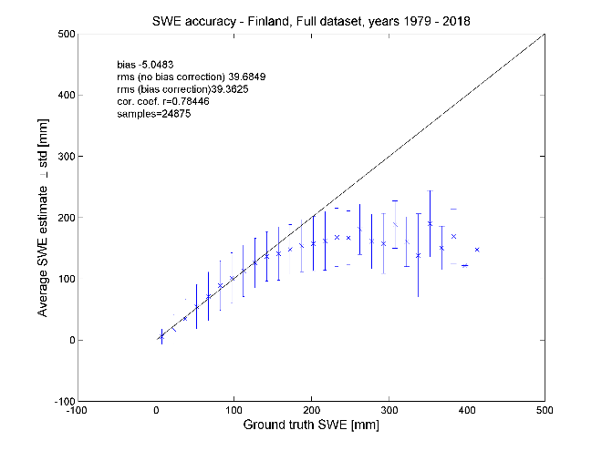
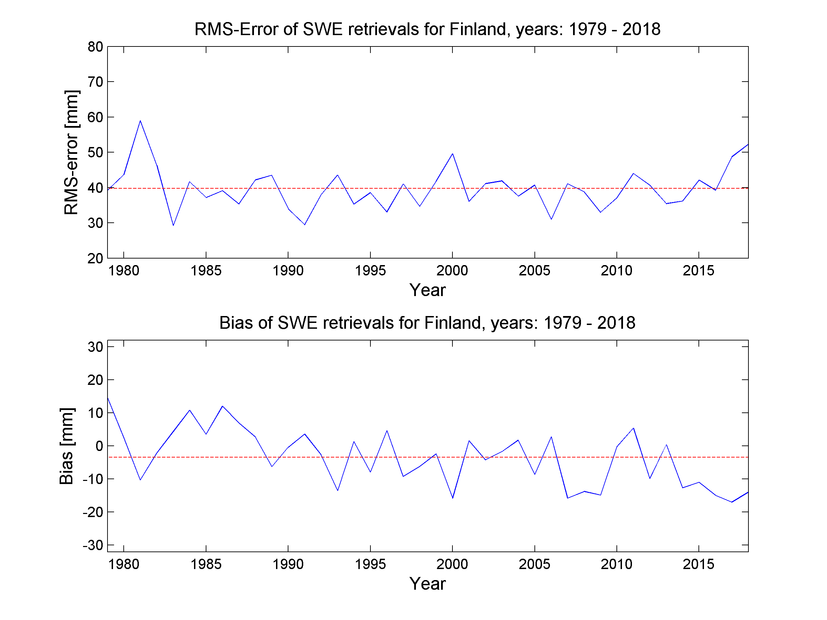
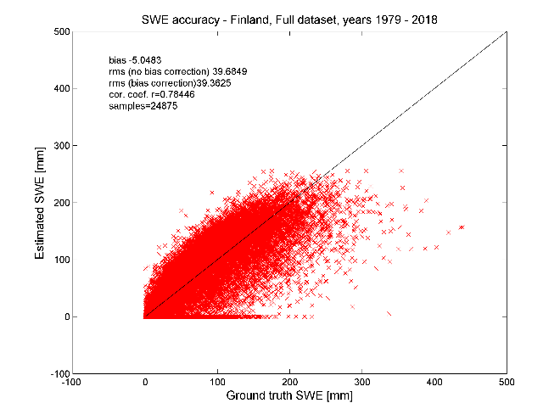
SWE Validation Results: in-situ
Finnish snow course results
Bias: -5 mm
RMSE: 40 mm
Notes:
While RMSE is higher under deep snow conditions (SWE>200 mm), these only represent approximately 4% of the validation dataset. The slight fluctuations are generally due to the characteristics of the seasonal snowpack (i.e., wet or dry seasons). Nonetheless, for the time span considered the performance of the algorithm is stable.

Slide 22
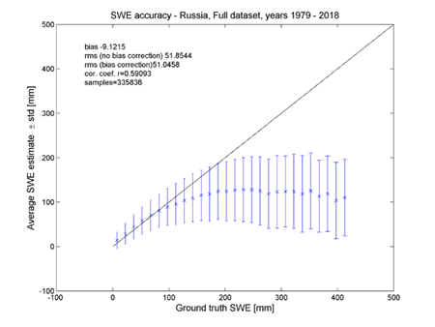
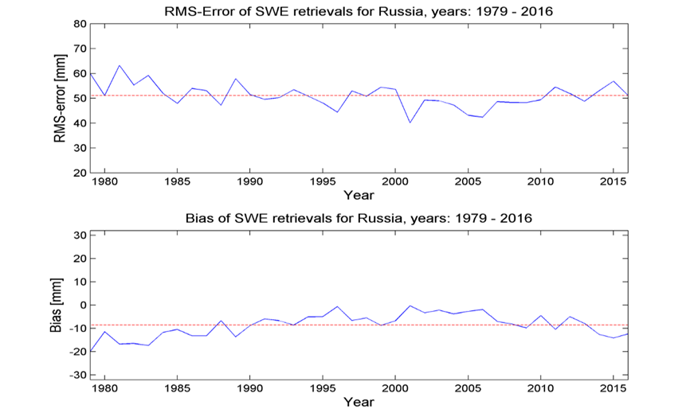
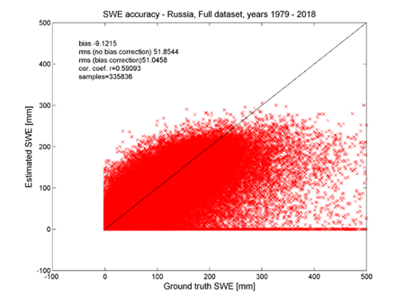
SWE Validation Results: in-situ
Russian snow course results
Bias: -9 mm
RMSE: 52 mm
Notes:
While RMSE is higher under deep snow conditions (SWE>200 mm), these only represent approximately 4% of the validation dataset. The slight fluctuations are generally due to the characteristics of the seasonal snowpack (i.e., wet or dry seasons). Nonetheless, for the time span considered the performance of the algorithm is stable.

Slide 23
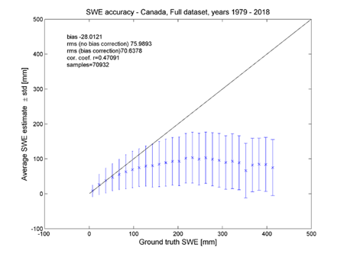
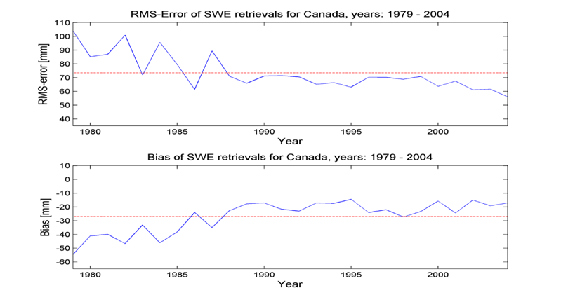
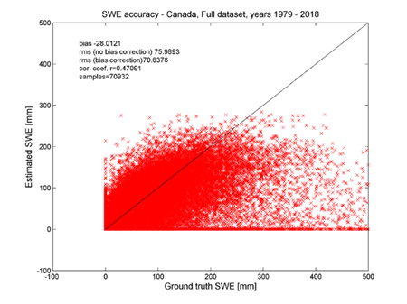
SWE Validation Results: in-situ
Canadian snow course results
Bias: -28 mm
RMSE: 71 mm
Notes:
While RMSE is higher under deep snow conditions (SWE>200 mm), these only represent approximately 4% of the validation dataset. The slight fluctuations are generally due to the characteristics of the seasonal snowpack (i.e., wet or dry seasons). Differently from the previous assessments, at the beginning of the time series the performance is slightly worse than after the late eighties. This can be due to characteristics of the Scanning Multichannel Microwave Radiometer (SMMR) which operated between 1978 and 1987

Slide 24
Conclusions
A validation protocol based on the well-established protocol developed in the Satellite Snow Product Intercomparison and Evaluation Exercise (SnowPEx) has been defined for snow_cci.
SNOW COVER FRACTION:
Reference data set consisting of >3.8 million and >2 million in-situ measurements & 833 and 410 high resolution SCE maps for AVHRR and MODIS used for validation activities in the first year.
Product performance was assessed considering also different surface and topography conditions
High accuracy for SCF products from both the sensors from validation with in-situ data:
Hit Rate > 95% for all the thresholds combinations
F-score > 87% for SCF ≥ 25% and SD ≥ 0 m and SD ≥ 0.02 m
For validation with high resolution snow maps:
Overall unbiased RMSE < 19% and < 21% for MODIS and AVHRR → compliant with the user requirements.
Overall bias < 4% and < 6% for AVHRR and MODIS, respectively
Correlation coefficient > 0.91 for MODIS and > 0.88 for AVHRR.

Slide 25
Conclusions and future work
SNOW WATER EQUIVALENT
In order to assess the quality of the snow_cci SWE product v1.0, we compared it with an extensive and a diverse ground-based reference dataset from Russia, Finland and Canada, spanning the years 1979-2018.
The overall retrieval accuracy for the SWE product, for all investigated samples was around 50 – 70 mm. The overall bias was around 10 – 20mm. The range of these values depend on the reference data and the region.
For most snowpacks (all but the 5% of the deepest snowpacks), the SWE retrieval fulfils the user requirements with an RMS error of 42.5 mm.
Validation results reflect a good overall performance of the snow_cci SCF products
Accuracies of snow_cci products generated in the first year fulfil the user requirements
Reference data set will be extended in the second year, and each future product version will be evaluated and quality checked.

Slide 26
SCF Validation Results: HR validation
Overall results of the validation of the snow_cci products in mountains and plains:
User requirements:
Unbiased RMSE < 20%
MODIS-derived
mountains
plains
 | Salomonson | Klein | Dozier
RMSE | 13.259 | 16.393 | 14.136
Unbiased RMSE | 13.015 | 15.841 | 13.937
Bias | -2.533 | -4.216 | -2.361
Correlation Coefficient | 0.958 | 0.940 | 0.953
 | Salomonson | Klein | Dozier
RMSE | 14.391 | 20.921 | 16.177
Unbiased RMSE | 13.948 | 19.366 | 15.575
Bias | -3.542 | -7.915 | -4.371
Correlation Coefficient | 0.945 | 0.895 | 0.933
AVHRR-derived
mountains
plains
 | Salomonson | Klein | Dozier
RMSE | 20.961 | 22.182 | 21.086
Unbiased RMSE | 20.799 | 21.591 | 20.809
Bias | -2.602 | -5.087 | -3.405
Correlation Coefficient | 0.899 | 0.894 | 0.901
 | Salomonson | Klein | Dozier
RMSE | 20.361 | 21.408 | 21.396
Unbiased RMSE | 20.313 | 21.100 | 21.386
Bias | 1.402 | -3.618 | -0.656
Correlation Coefficient | 0.861 | 0.851 | 0.848

Slide 27
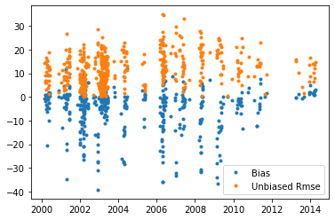
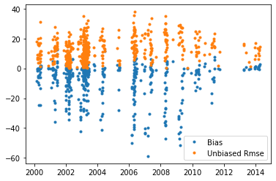
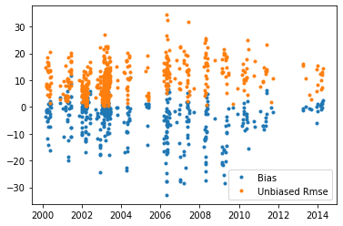
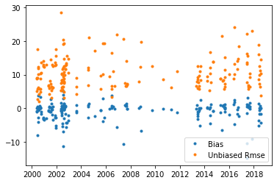
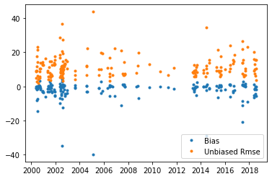
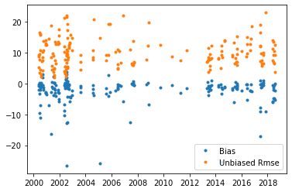
SCF Validation Results: HR validation
Dozier
Klein
Salomonson
User requirements:
Unbiased RMSE < 20%
MODIS-derived

Slide 28
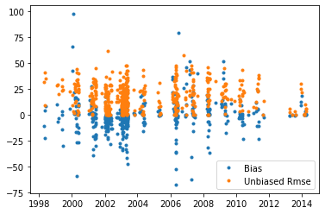
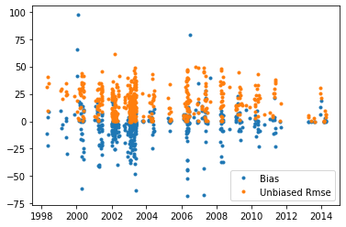
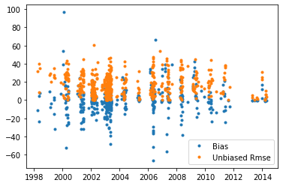
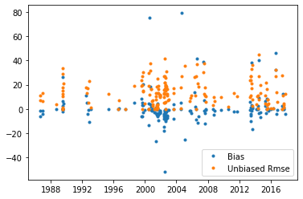
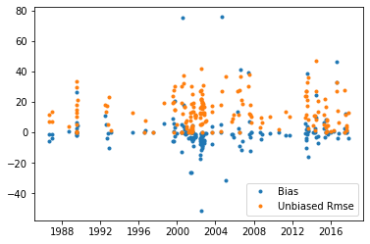
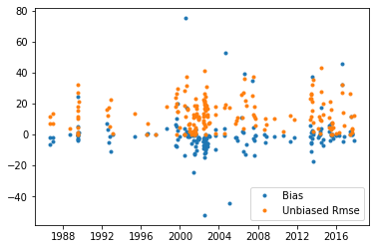
SCF Validation Results: HR validation
Dozier
Klein
Salomonson
User requirements:
Unbiased RMSE < 20%
AVHRR-derived

