Slide 1



Quantifying Snow Water Equivalent by
Integration of UAS and GPR Surveys
PhD Student Semih YILDIZ¹, METU, TURKEY
Prof. Dr. Zuhal AKYUREK² , METU, TURKEY
Prof. Dr. Andrew BINLEY³ , Lancaster Univ., UK
ODTU
03 - 05 February 2020, Bern, Switzerland

Slide 2






Snow Review: What are the snow parameters?
HN
_{HS}n+1
Snow Water Equivalent
(SWE)
HS^{n}
SWE
Snow depth (HS)
24 h new snow depth (HN)
https://www.slideshare.net/pelacia/mysnowmaps-snow-maps-display-and-snow-data-crowdsourcing
-
2/51

Slide 3
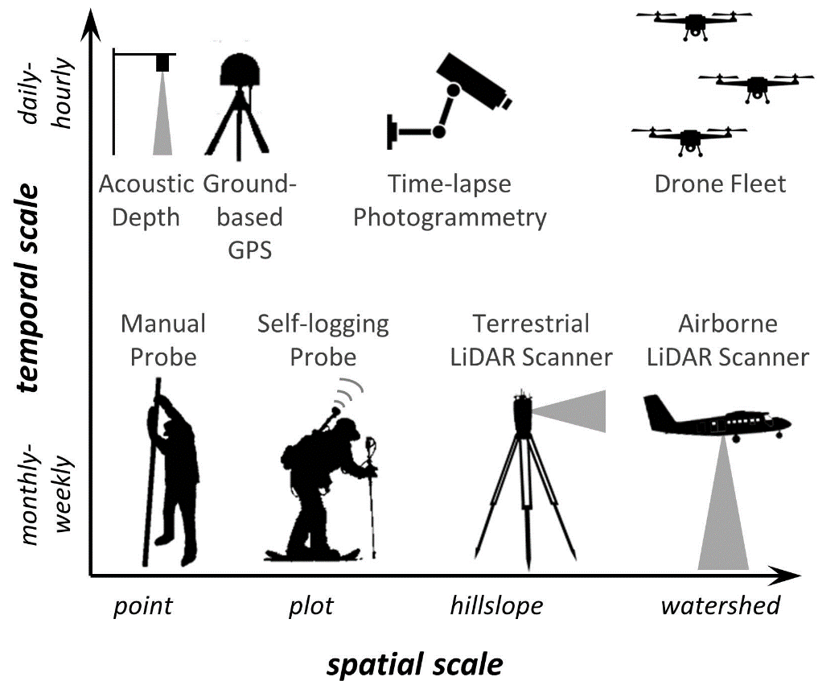
Snow Review: How are the snow parameters measured?

Slide 4
Snow Review: UAS-Photogrammetry in Snow Survey
UAS-Photogrammetry are emerging as a potential low-cost technique to yield spatially continuous snow depth measurements (Avanzi et al. 2018; Bühler et al., 2016).
UAS are flexible platforms in terms of acquisition time and region of interest (Whitehead et al., 2014)
UAS is used to acquire images of the study area with optical cameras having cm scale ground resolution (Avanzi et al. 2018).
The output is a very high-resolution digital surface model (DSM) of the survey area.
Spatially continuous snow depths of the study area are obtained by simply subtracting a non-snow DSM from a snow covered DSM.
But.................
What about snow density snd SWE?

Slide 5
Snow Review: GPR in Snow Survey
GPR surveys can be effectively used to determine snow properties (Holbrook, Miller, & Provart, 2016).
GPR surveys provide two-way travel times of radar reflections (e.g. at the base of snow pack), typically along a transect.
Converting travel times to depth requires measurement or estimates of the radar velocity.
GPR has been shown to be an effective tool for measuring snow density because of the close relationship between dry snow density and radar velocity. (St. Clair and Holbrook, 2017).
But......
Velocity estimations from radar reflections are limited to number of reflective objects.

Slide 6
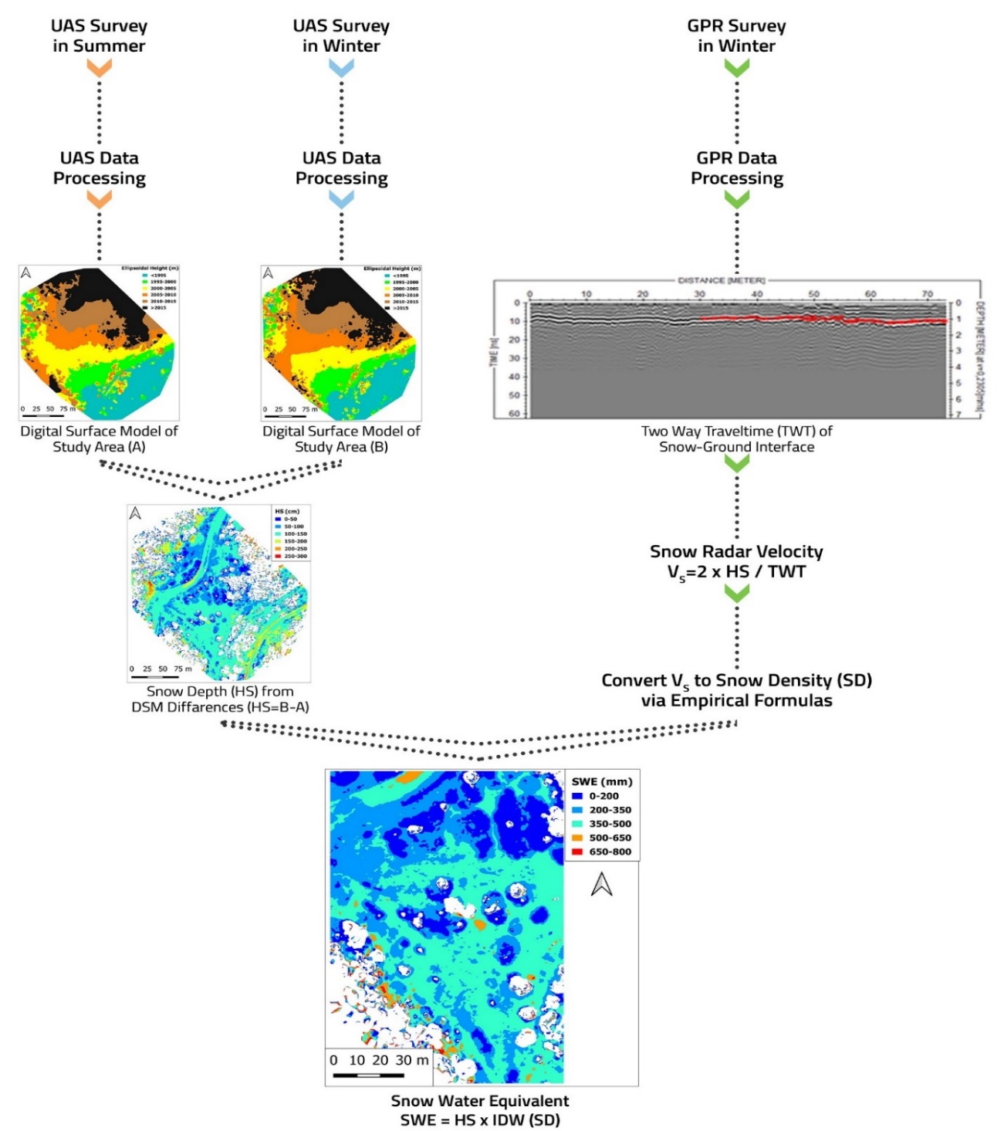
A New Approach: UAS-Photogrammetry and GPR Cooperation

Slide 7
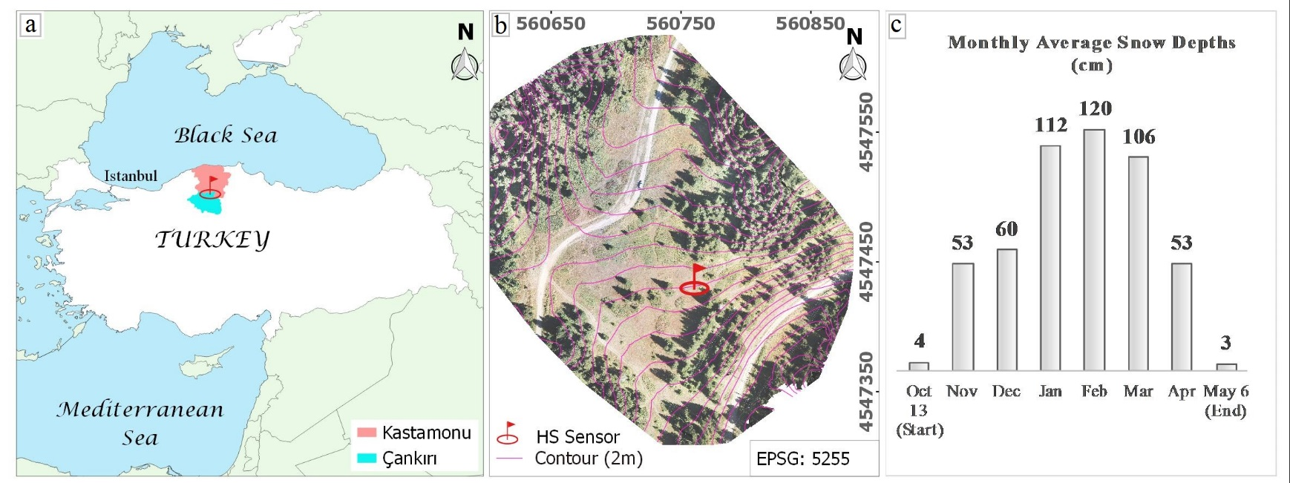
Study Area
The study area (7 ha) is the Ilgaz Mountains National Park catchment located in the northwest of Turkey
The catchment has a surface area of approximately 45 km2, with a mean elevation of about 1800 m. The annual mean air temperature is 5.7 °C.
-
7/51

Slide 8
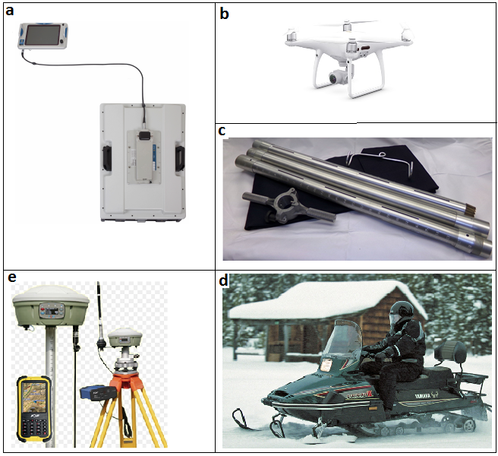
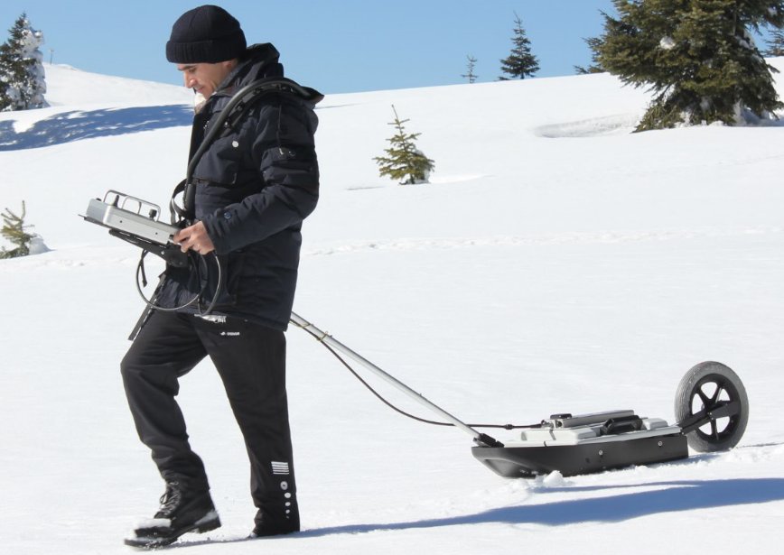
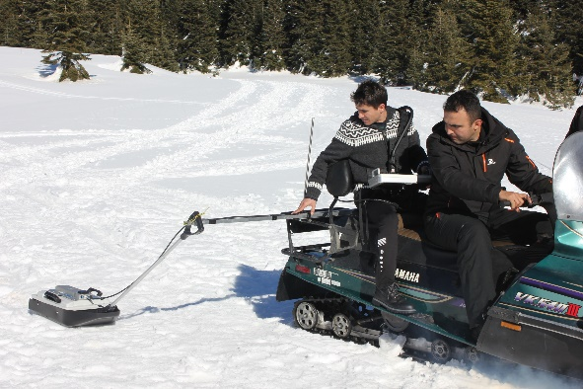
Equipments
GPR
UAS
Snow Sampler Tube
GNNS
Snow Mobile
-
8/51

Slide 9
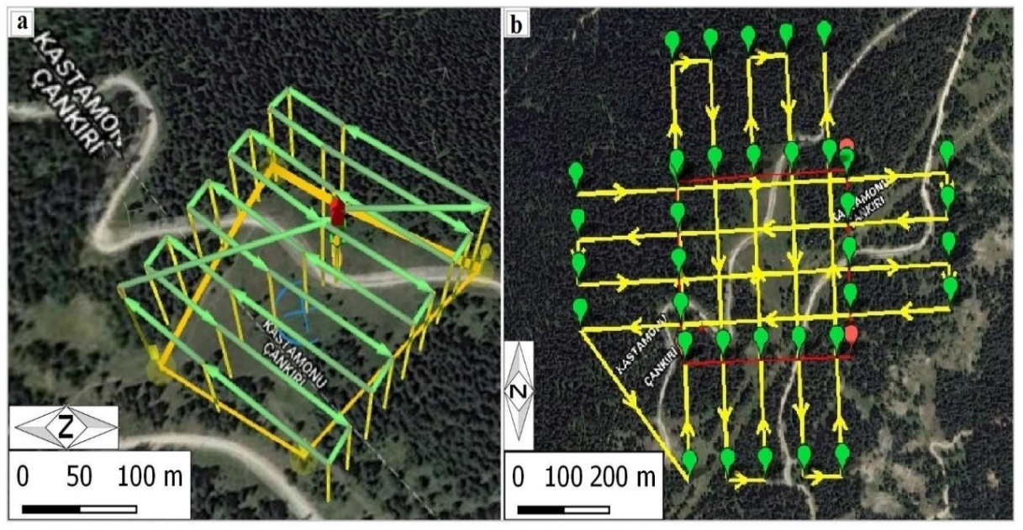
Fieldwork:UAS Surveys
Flight Plan (Summer)
Flight Plan (Winter)
Forward overlap : 75%
Side overlap: 75%
Area:7.4 ha
Flight height:80 m.
GSD:2.5 cm
Forward overlap : 80%
Side overlap: 60%
Area:26.4 ha
Flight height:150 m.
GSD: 5.9 cm
Flight speed: 6 m/s
Image acquisition time: 09:42-09:48
118 images were acquired.
Flight speed: 12 m/s
Image acquisition time: 14:08-14:17
120 images were acquired.
-
9/51

Slide 10
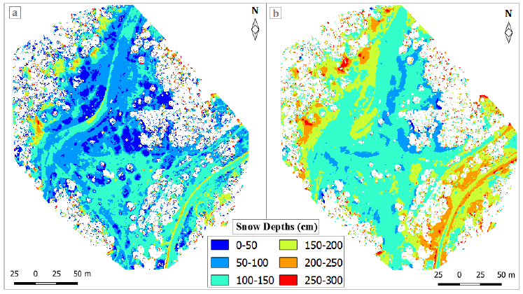
UAS based Snow Depth
(a) HS from DSM-DSM Differences (6 cm/pixel)
(b) HS from DSM-DTM
Differences(6 cm/pixel)
-
10/51

Slide 11
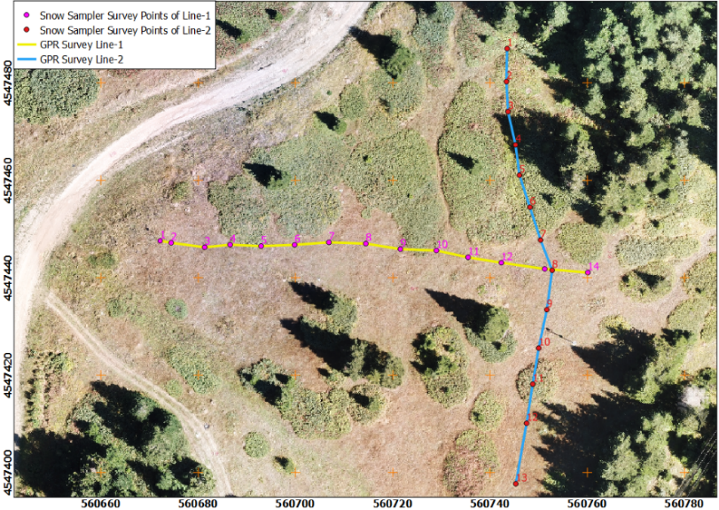
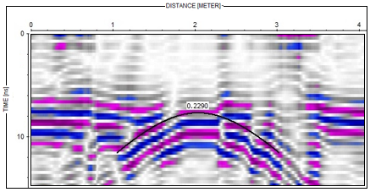
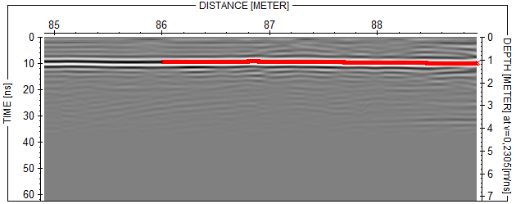
GPR based Snow Depth
GPR data processing steps
(Reflexw Software):
resetting the traces to the time zero
DC shift Removal
Dewow
time gain function
background removal
median filter to remove antenna ringing.
Pick velocity from Hyperbolic Reflection
Pick snow depths
-
11/51

Slide 12

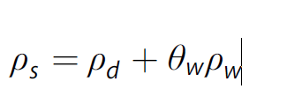

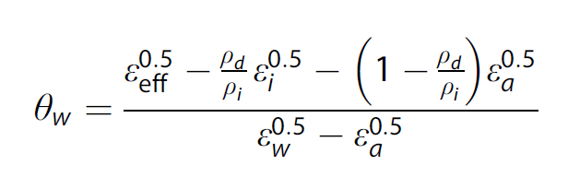

GPR based Snow Depth
is radar velocity in snow layer
is real part of the dielectric constant
c is speed of light in vacuum (~0.3 m/ns)
ρ is snow density (kg/m3)
ρ _{max}=362 kg/m³ v _{max}=0.230 m/ns
Bradford, J., Harper, J., & Brown, J. (2009). Water Resources Research, 45, W08403. https://doi.org/10.1029/2008WR007341
 | Relative Permittivity | EM Velocity (m / ns)
snow | 1.4 - 3.2 | 0.168 - 0.254
Sea Ice | 4 - 8 | 0.106 - 0.150
Dry Soil | 3 - 8 | 0.110 - 0.170
-
12/51

Slide 13
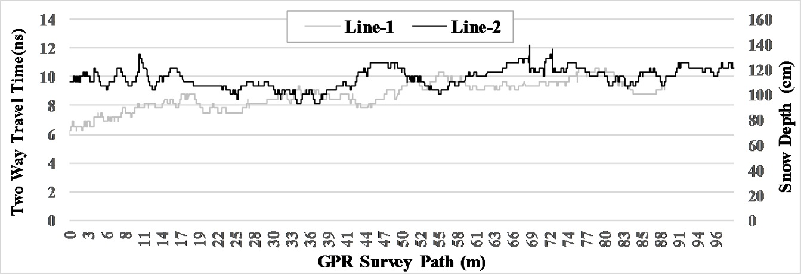
GPR based Snow Depth
The two-way travel time (TWT) of GPR signals and snow depths obtained for Line-
1 and Line-2. Velocity was obtained from buried plate reflection.
-
13/51

Slide 14
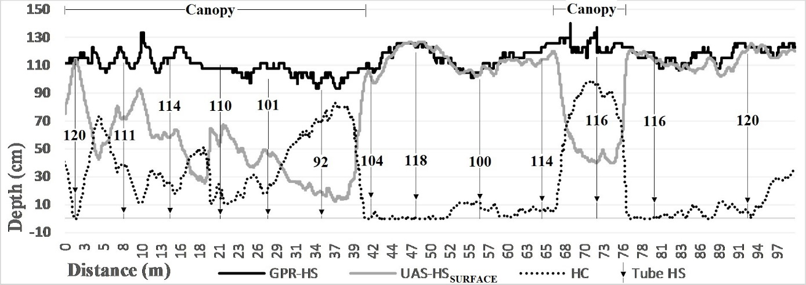
Effects on Canopy on UAS based HS
Illustrations of snow depths obtained from GPR, UAS and Snow Tube observations and the canopy heights (HC) along Line 2.
-
14/51

Slide 15
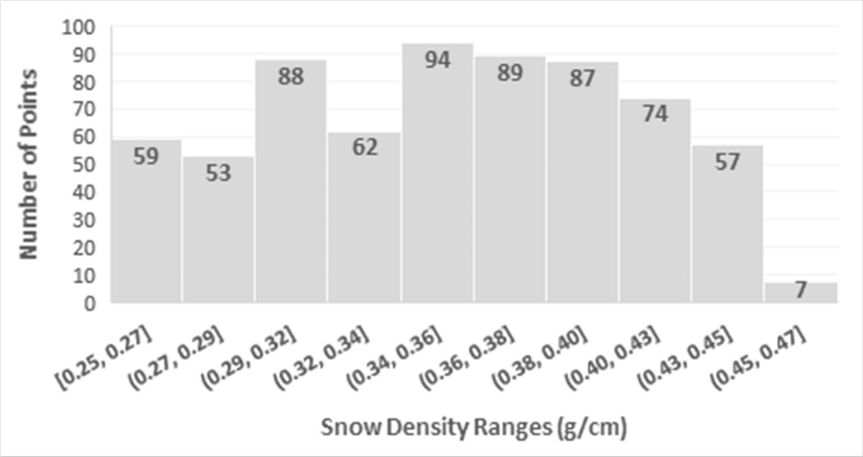
UAS and GPR based Snow Densities
Histogram of snow densities determined from snowmobile GPR measurements (total of 670 points). The mean density is 0.353 g/cm3.
-
15/51

Slide 16
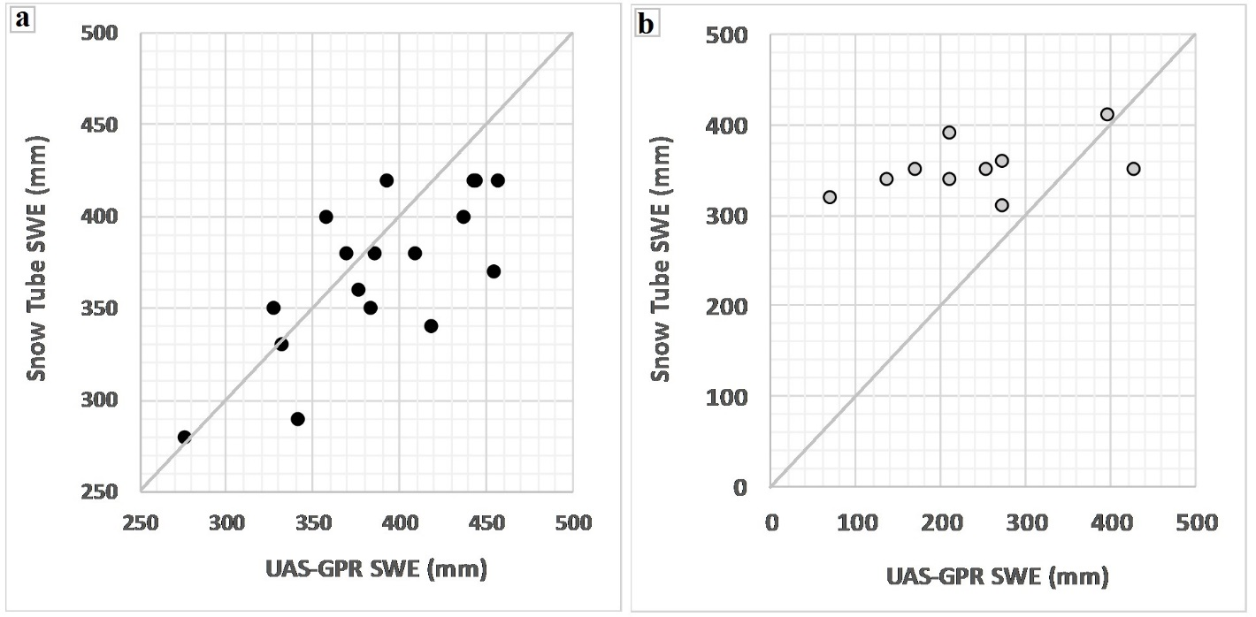
Effects of Canopies on UAS - GPR based SWE
SWEs measured via Snow Tube vs SWEs estimated from DSM-DSM differences multiplied by IDW based snow density derived from GPR TWT and UAV HS.
(a) SWEs of points located on canopy-free areas
(b) SWEs of points located on canopy covered areas
-
16/51

Slide 17
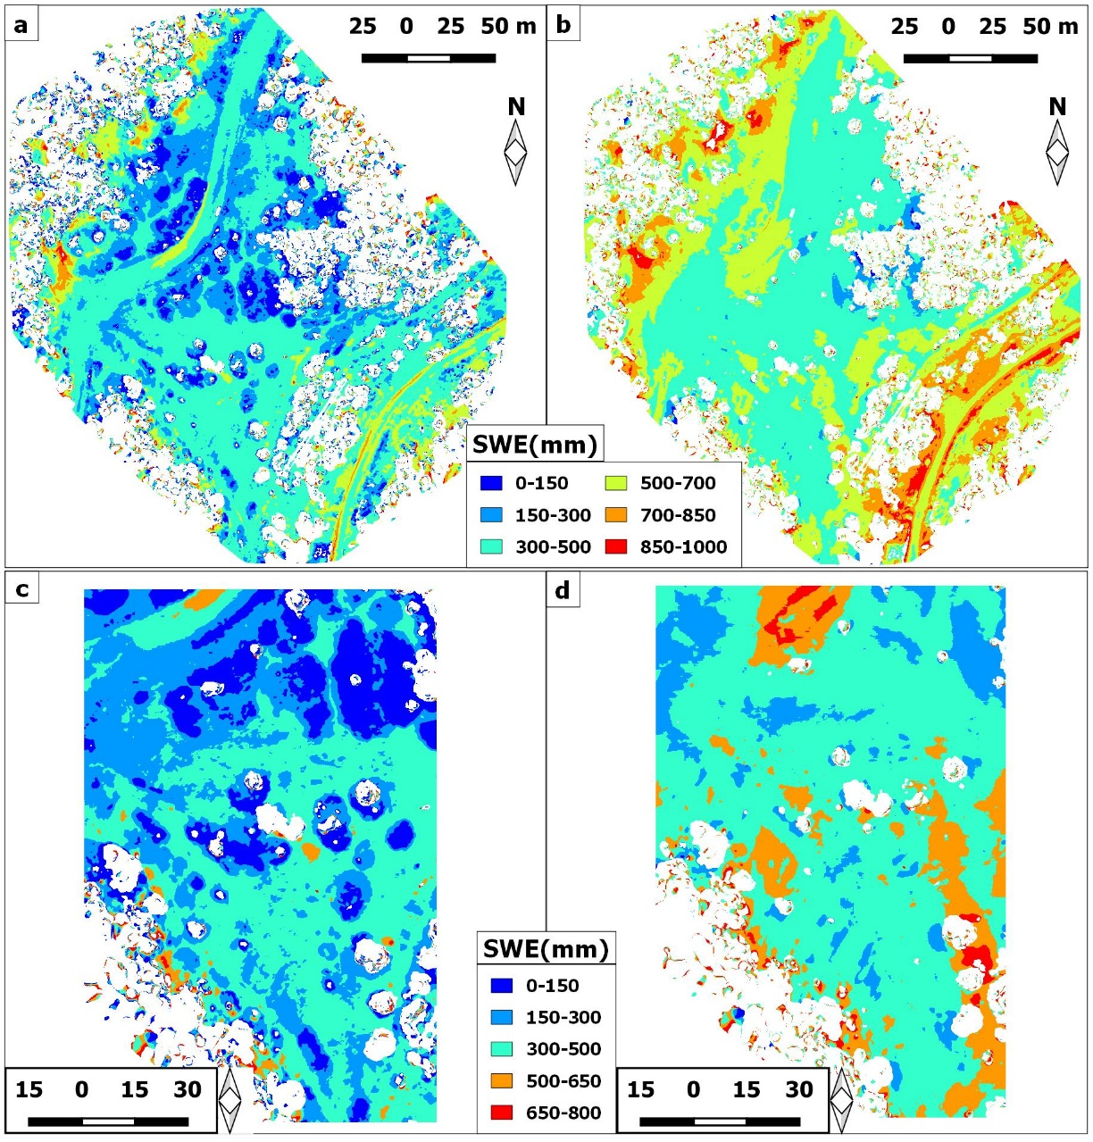
UAS-GPR based SWE
SWE from DSM-DTM Differences multiplied by GPR derived density
SWE from DSM-DSM Differences multiplied by GPR derived density
SWE from DSM-DTM Differences multiplied by IDW based density derived from GPR TWT and UAS HS
SWE from DSM-DSM Differences multiplied by IDW based density derived from GPR TWT and UAS HS
-
17/51

Slide 18
Results:
Table 1. Snow depths accuracies were evaluated based on manual snow measurements. Tube refers to the manual measurement.
-
18/51

Slide 19
Results:
Table 2. Snow density estimation accuracies were assessed in reference to manual snow tube measurements.
-
19/51

Slide 20
Results:
Table 3. Snow water equivalent (SWE) accuracies were evaluated based on manual snow measurements
SWE (mm) | Snow Tube | GPR_{MOBILE} HS_{SURFACE} HS_{TERRAIN} |  | GPR_{PLATE} HS_{SURFACE} HS_{TERRAIN}
 | Mean | Mean RMSE | Mean RMSE | Mean RMSE | Mean RMSE
Canopy-Free (17 Points) | 370 | 389 ±39 | 407 ±63 | 384 ±33 | 407 ±58
Canopy-Covered (10 Points) | 352 | 241 ±146 | 352 ±86 | 246 ±143 | 356 ±75
Total Samples (27Points) | 363 | 334 ±94 | 387 ±72 | 333 ±91 | 388 ±65
-
20/51

Slide 21
Conclusions
Snow depths and Snow Water Equivalents can be obtained in less time with a UAS-GPR cooperation than manual methods, although significant data processing is needed.
Spatially continuous model of SWEs provides opportunity to observe the effects of environmental parameters such as canopy cover, slope, and topography.
Although we have focused efforts on a relatively small study area, the approach can be adopted at a much larger spatial scale, thus offering immense value for basin-scale hydrology.
-
21/51

