Slide 1
Operational daily snow extent products from EUMETSAT weather satellites
Niilo Siljamo and Otto Hyvärinen

Slide 2
Contents
Snow (satellite vs surface)
H SAF meteorological snow extent products
Validation
H SAF = EUMETSAT Satellite Application Facility on Support to Operational Hydrology and Water Management

Slide 3
Snow

Slide 4
Chaos

Slide 5
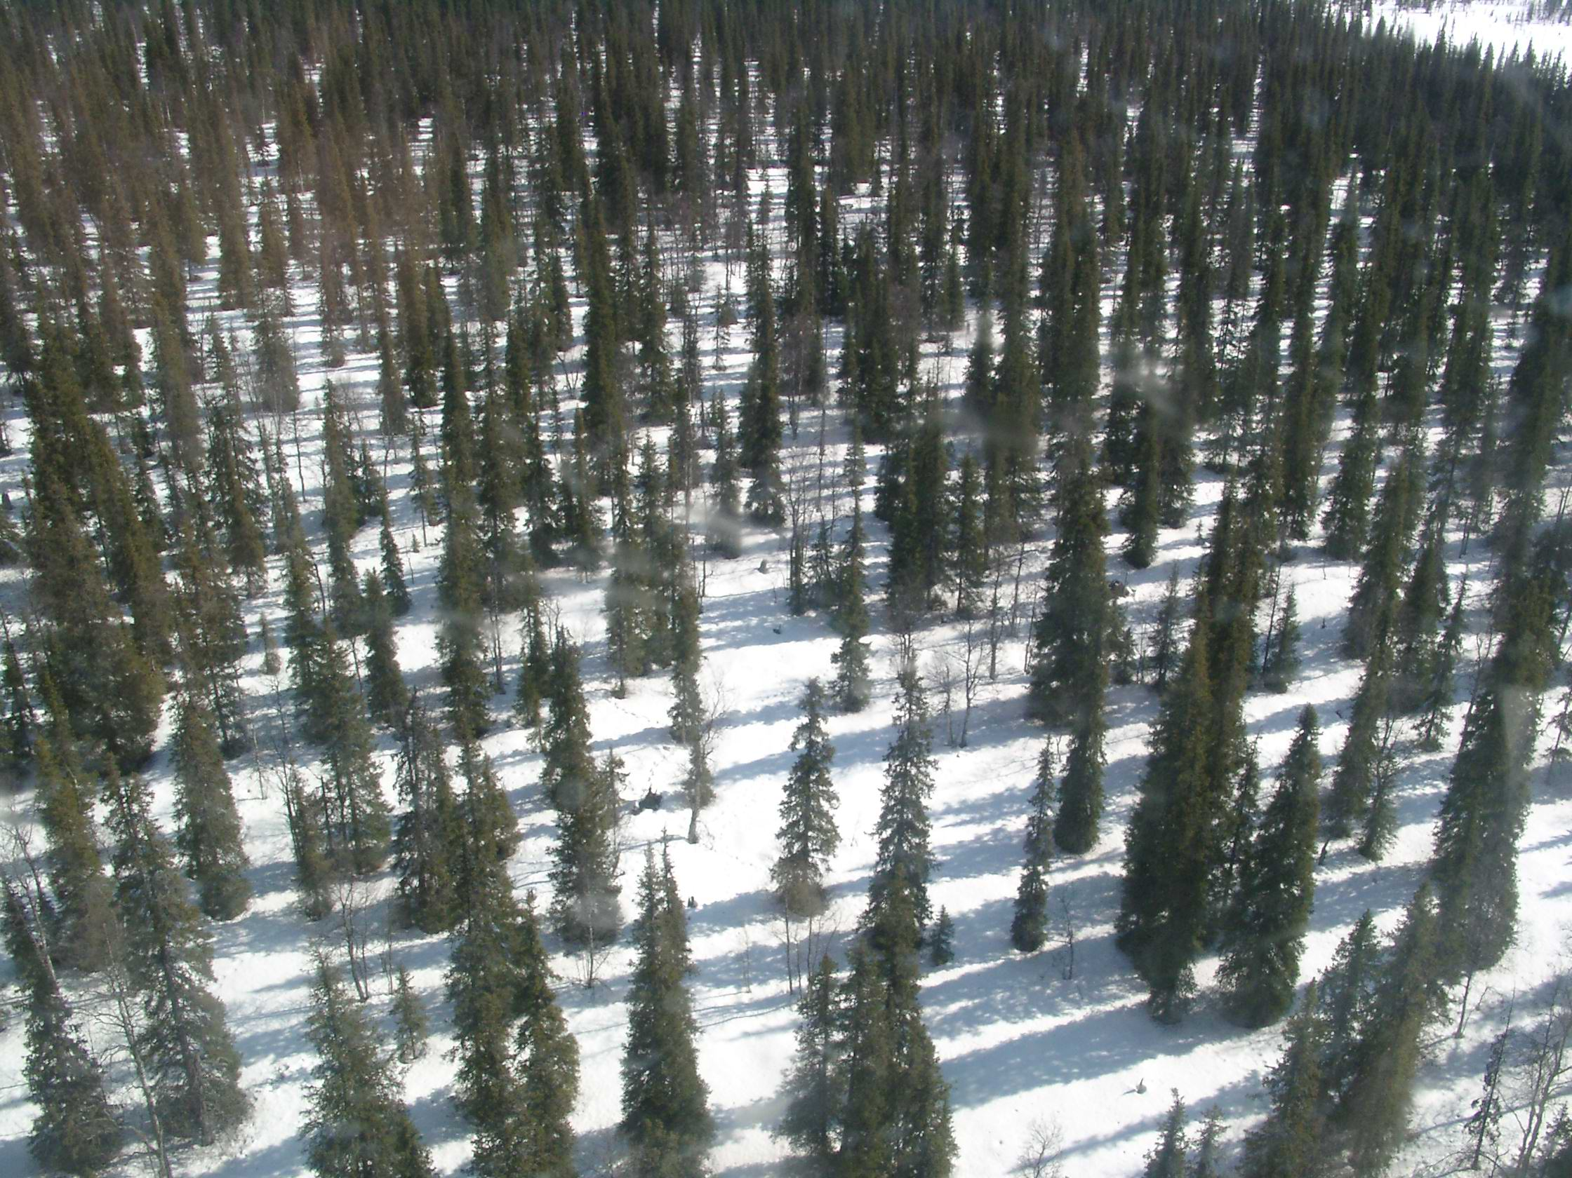
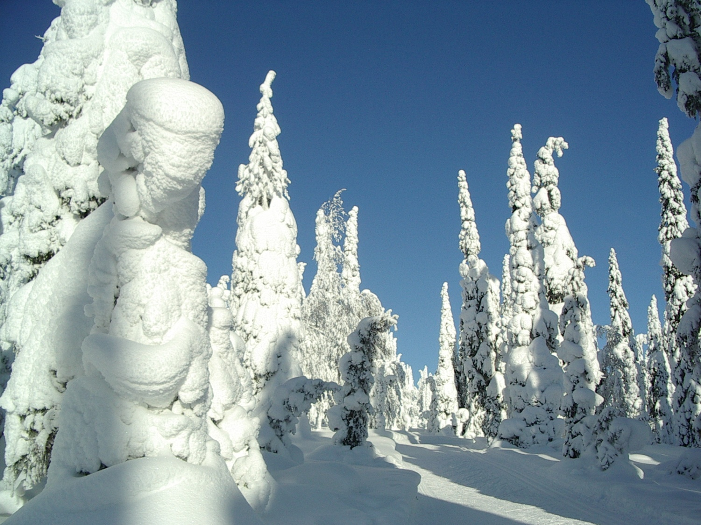
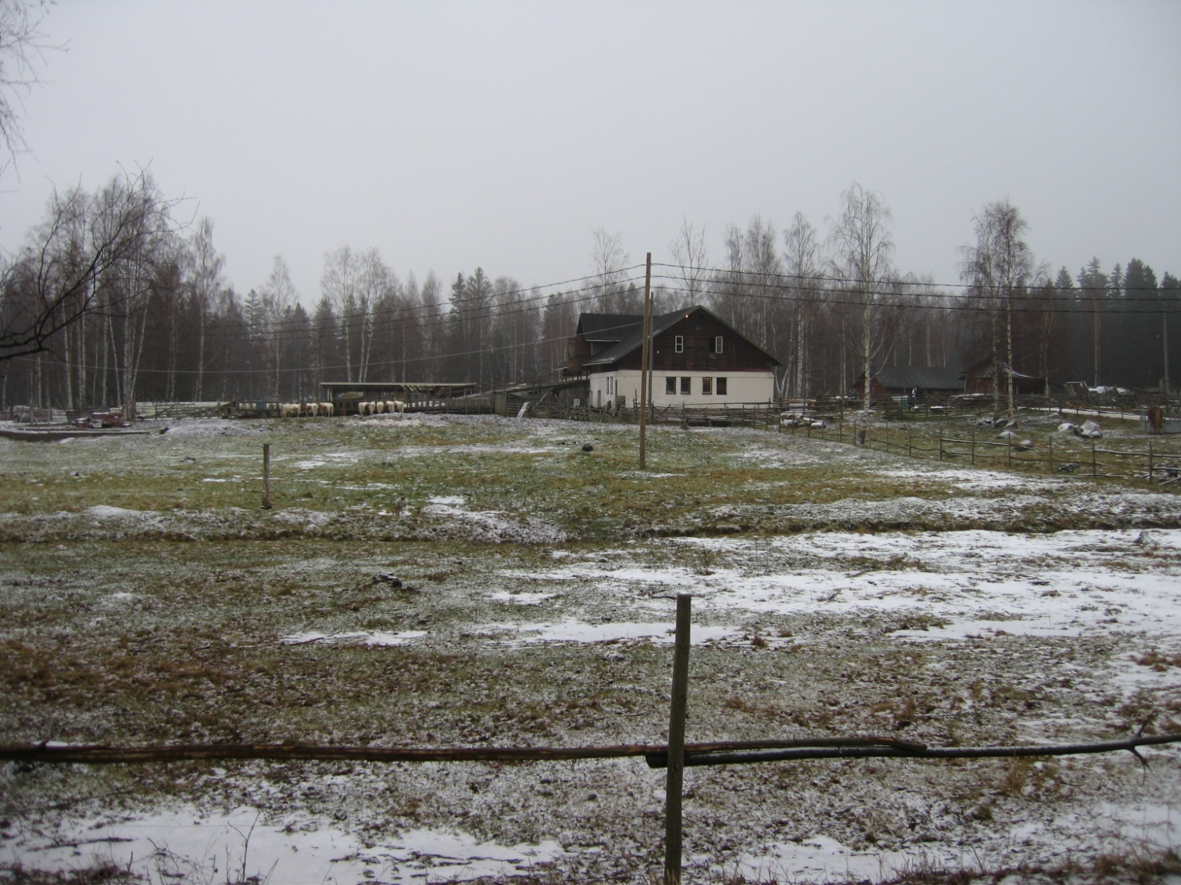
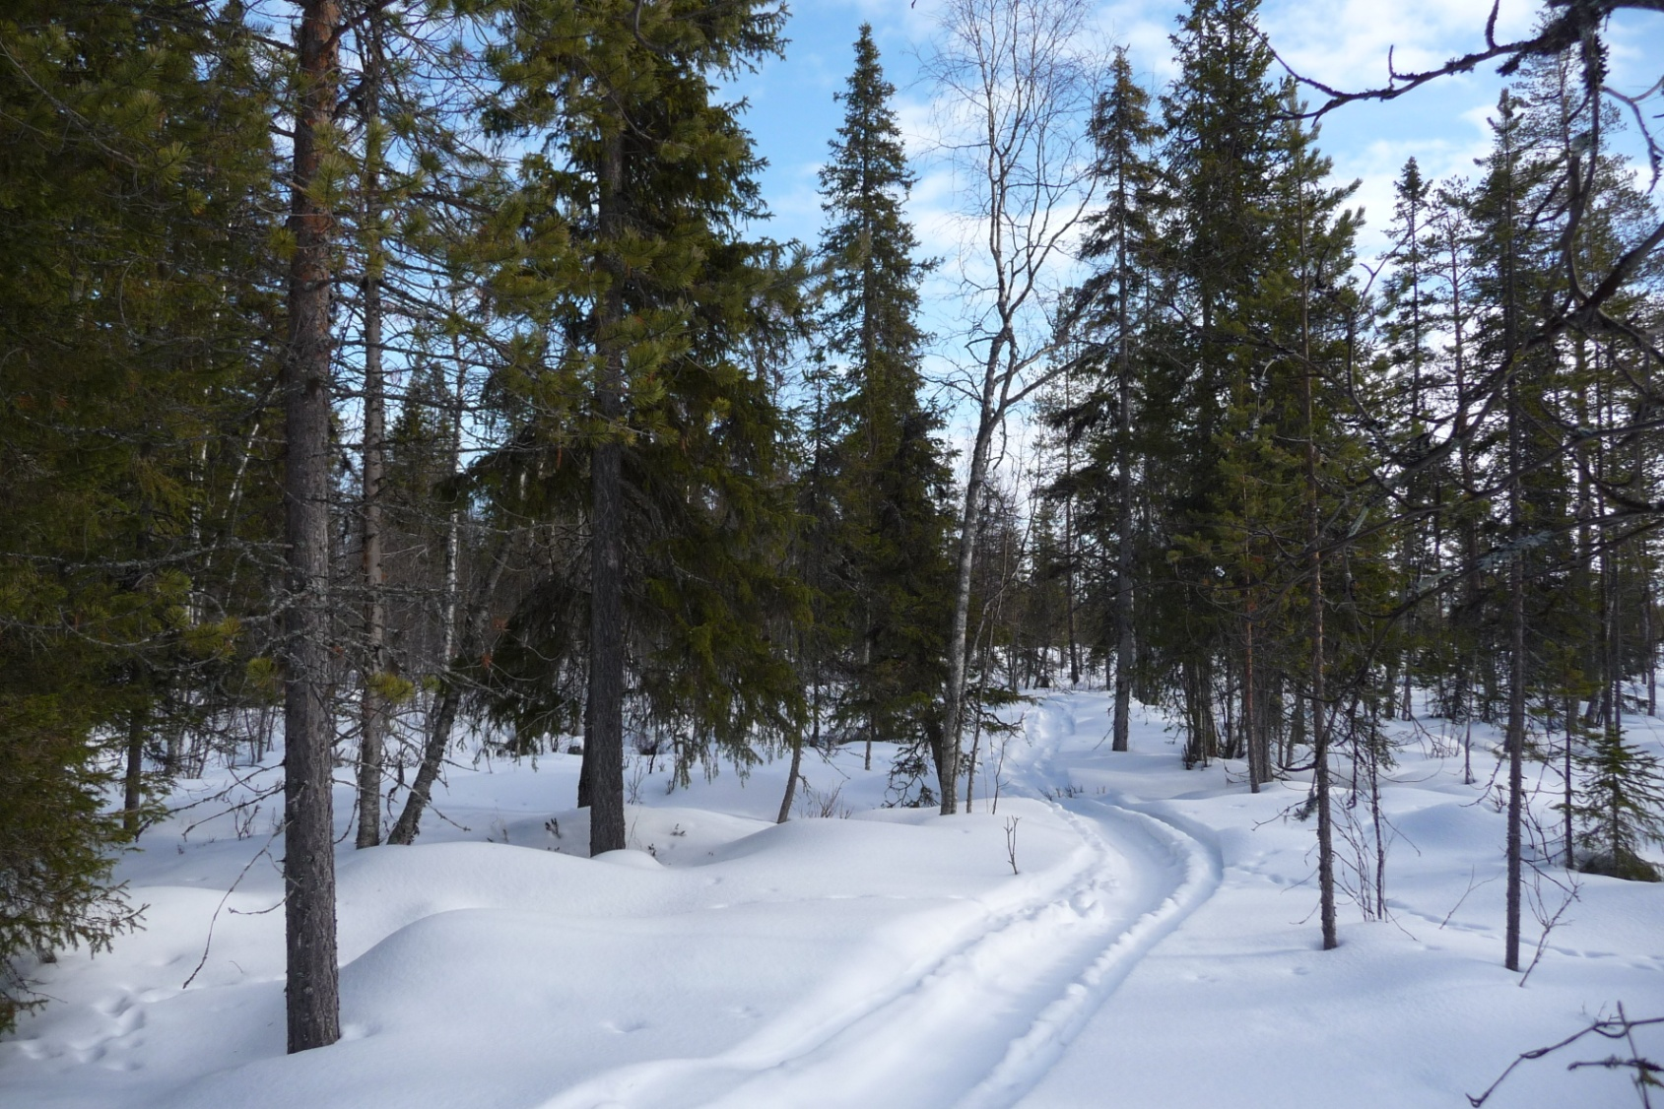
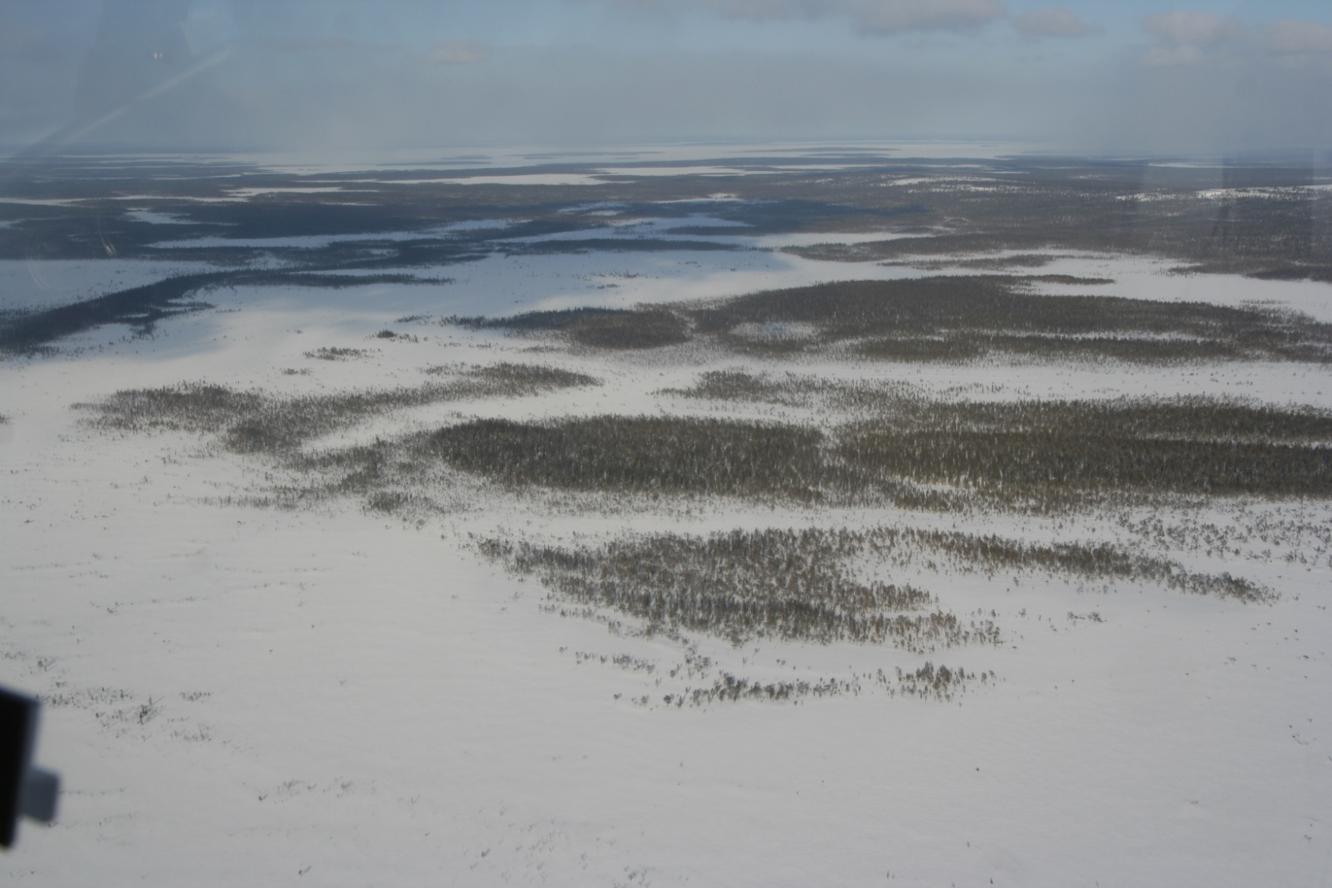
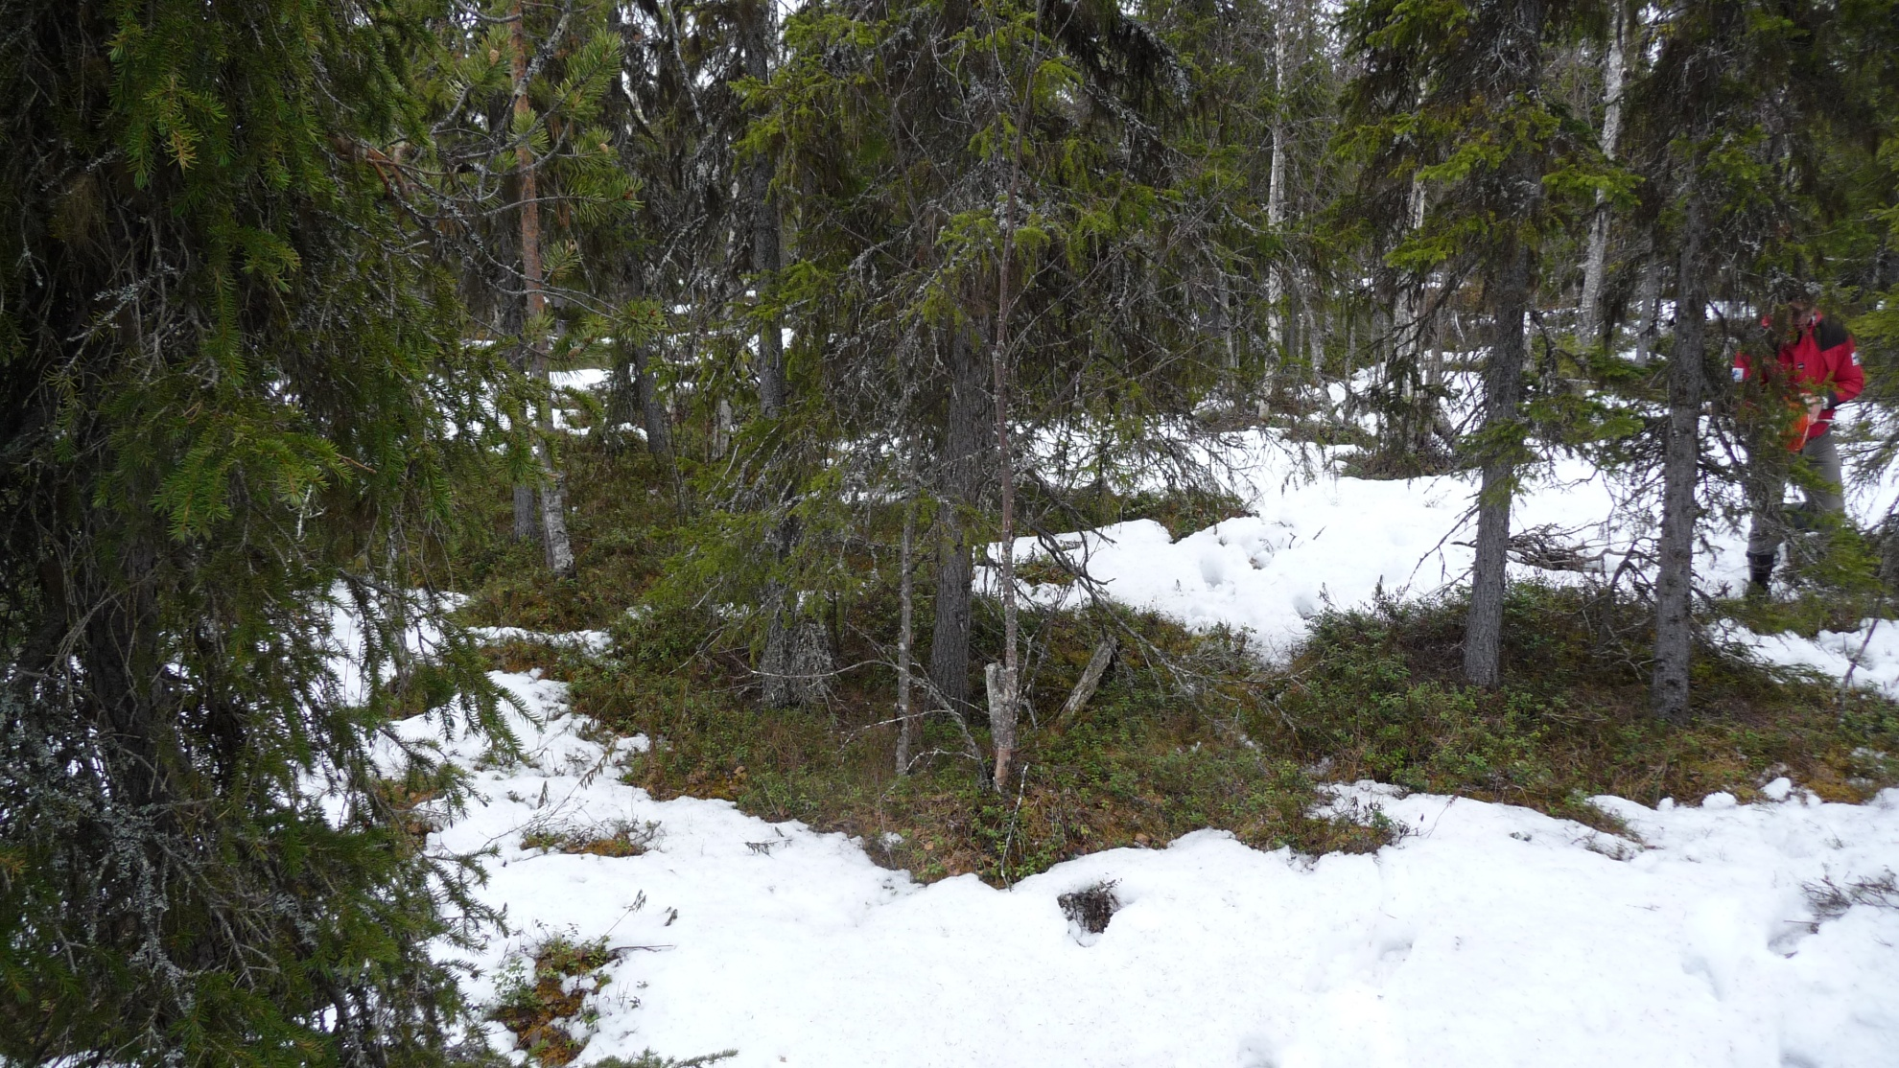
Snow

Slide 6
Snow

Slide 7
Geostationary and polar satellites
Geostationary orbit
Good temporal resolution
Limitations near the edge of the disk (e.g. Northern Europe)
EUMETSAT: MSG/SEVIRI
Polar orbit
Good spatial resolution in polar regions
Limited temporal resolution (quite often only 1-2 images/day)
EUMETSAT: Metop/AVHRR

Slide 8
Product development
Users: NWP, Meteorological applications
Reliable data (do not classify everything if it mean more misclassifications)
Data gaps (missing data) not a problem
Prefer single instrument data
Recent data (last 3/6/12/24 hours, daily product ok)
Prefer operational products
EUMETSAT satellites, optical instruments: VIS and IR bands
Do not use cloud mask
Search snow and snow free surface directly, no need for cloud masking
Everything else: unclassified (or water from water mask/land cover data)

Slide 9
Product development
Lots of variability
Vegetation, snow coverage, snow properties, sun angles, shadows, water (lakes and rivers), etc
Empirical approach
Algorithm development based on manually classified data sets
MSG/SEVIRI over 500000 pixels, Metop/AVHRR over 600000 pixels
More details about algorithms in the product documentation

Slide 10
H SAF meteorological snow products
H31 (MSG/SEVIRI, geostationary)
Operational
Daily
MSG Disk
Available since 2008
Data assimilation trials at Met Office, expected to go operational later this year
H32 (Metop/AVHRR, polar)
Operational
Daily
Global (0.01x0.01° lat-lon)
Available since 2015

Slide 11
MSG/SEVIRI snow extent (H31)

Slide 12
Metop/AVHRR snow extent (H32)

Slide 13
Example: Europe Feb 5, 2019
MODIS RGB
© NASA Worldview
MSG/SEVIRI (H31)
Metop/AVHRR (H32)

Slide 14
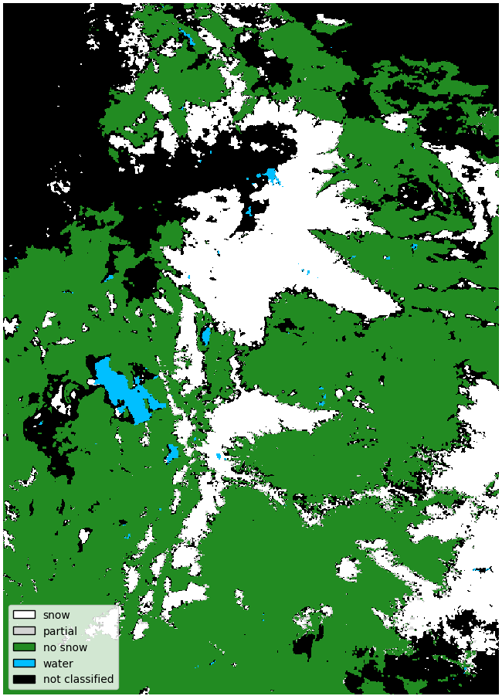
Example: North America, Nov 20, 2018
MODIS RGB
© NASA Worldview
Metop/AVHRR (H32)

Slide 15
Validation
All products are worthless
Unless
they are validated and
can be used for something (e.g. as inputs in NWP)

Slide 16
Validation data
Best option: Surface observations of snow coverage
No operational large scale daily snow coverage data available
Available option: Weather stations
Snow depth
Convert to snow/no snow (point measurement, but better than nothing)
Missing snow and missing measurements not reported
State of the ground
low quality snow coverage, convert to snow/no snow
Manual observation, not available from all stations
Observations taken from FMI observations database
Good global coverage, although no observations from many countries
About 4000 stations, which make these observations at least sometimes

Slide 17
Snow product validation
Compare weather station observation and satellite classification
Create daily contingency tables
$a, b, c, d$ are number of cases in each group
2 year time series
Very little snow during northern summers → small number of misclassifications dominate in some validation measures
Obs Sat | Snow | No snow
Snow | $a$: correct snow | $b$: false alarm
No snow | $c$: missed snow | $d$: correct no snow

Slide 18
Validation results Metop/AVHRR
Very good/excellent results
Dark green marks the days when $d≤20(a+b+c)$ i.e. snow season in the northern hemisphere

Slide 19
Validation results Metop/AVHRR
Snow season in dark green
Symmetric Extremal Dependence Index (SEDI)

Slide 20
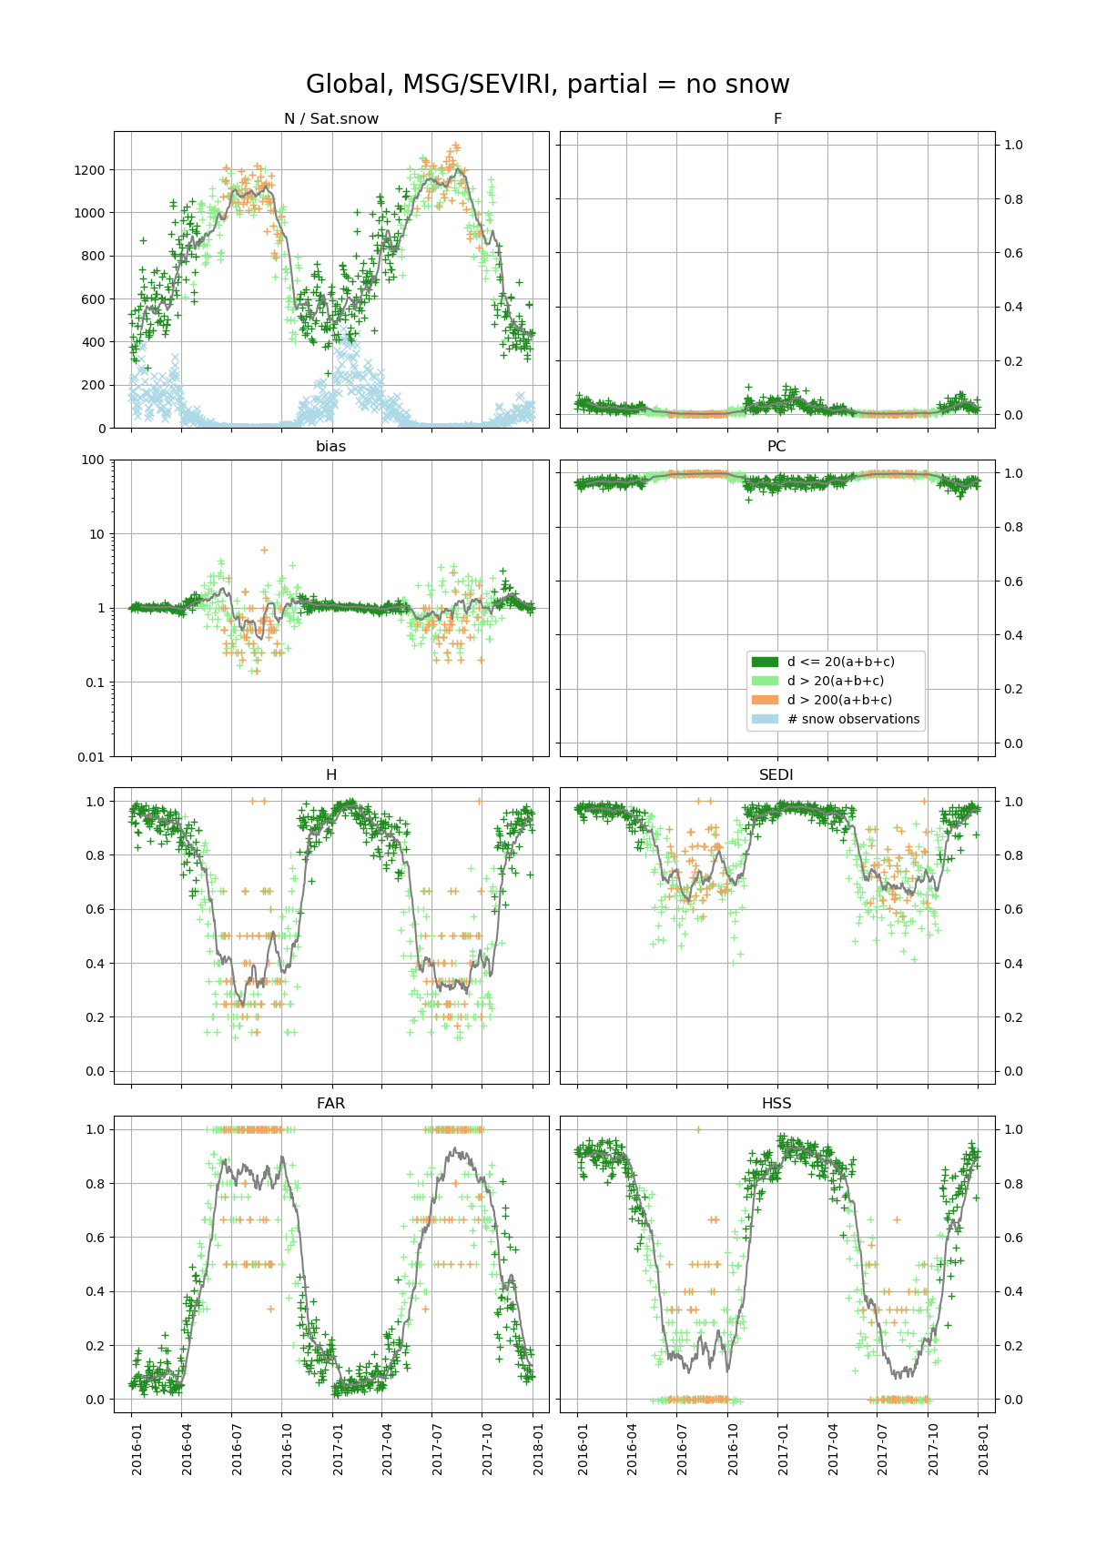
Validation results MSG/SEVIRI
Excellent results
Snow season as dark green

Slide 21
Validation results MSG/SEVIRI
Snow season as dark green
Symmetric Extremal Dependence Index (SEDI)

Slide 22
Future
New EUMETSAT weather satellites and instruments
MTG/FCI and Metop-SG/METimage
Similar snow extent products planned
New ideas
Polar satellite “snow barrels”
~equal area classification distributions based on satellite grid snow product
Suitable for NWP
Data assimilation trials at FMI
Maybe similar algorithms for other satellites/instruments

Slide 23
Conclusions
Two operational daily snow extent products for meteorological applications
MSG/SEVIRI (H SAF H31)
Metop/AVHRR (H SAF H32)
Very good validation results
Similar products planned for future satellites

Slide 24
Thank you!

